Slide 1




April 3 Meeting
Luke Bell + Steve Girvin

Slide 2
Topics to Discuss
1. Spectrum of VTA
2. Recursive application of VTA to initial state

Slide 3
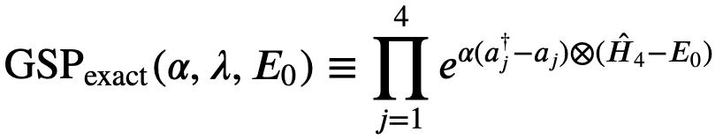
Clarification of Notation

Slide 4
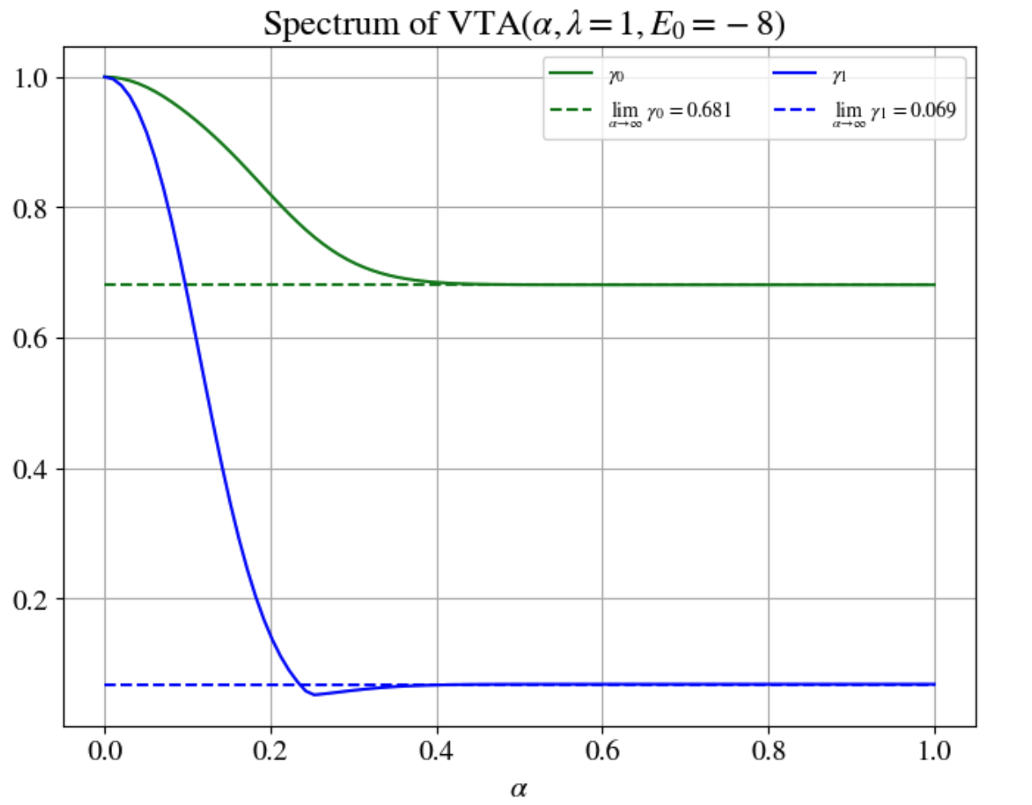
Eigenvalues 0-1

Slide 5
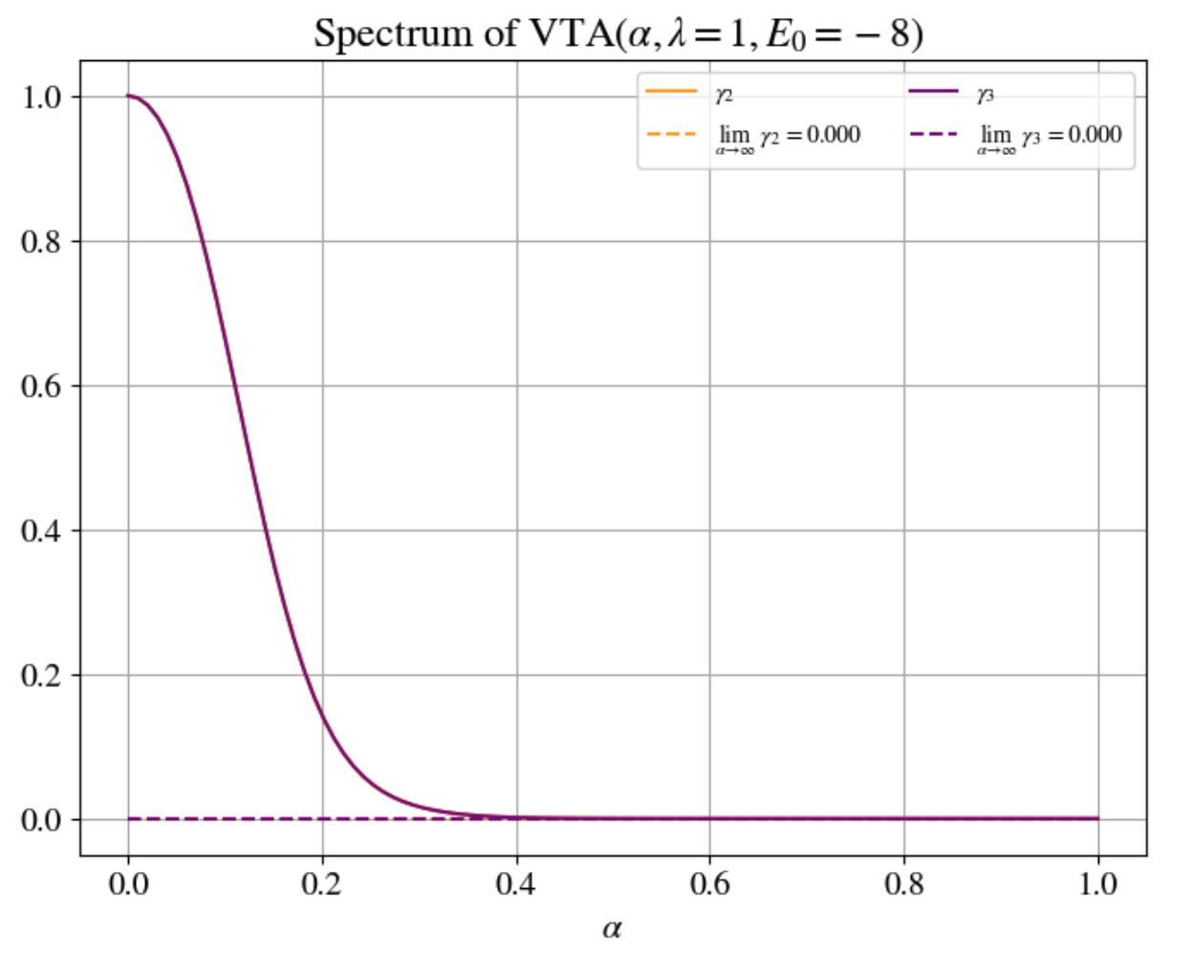
Eigenvalues 2-3

Slide 6
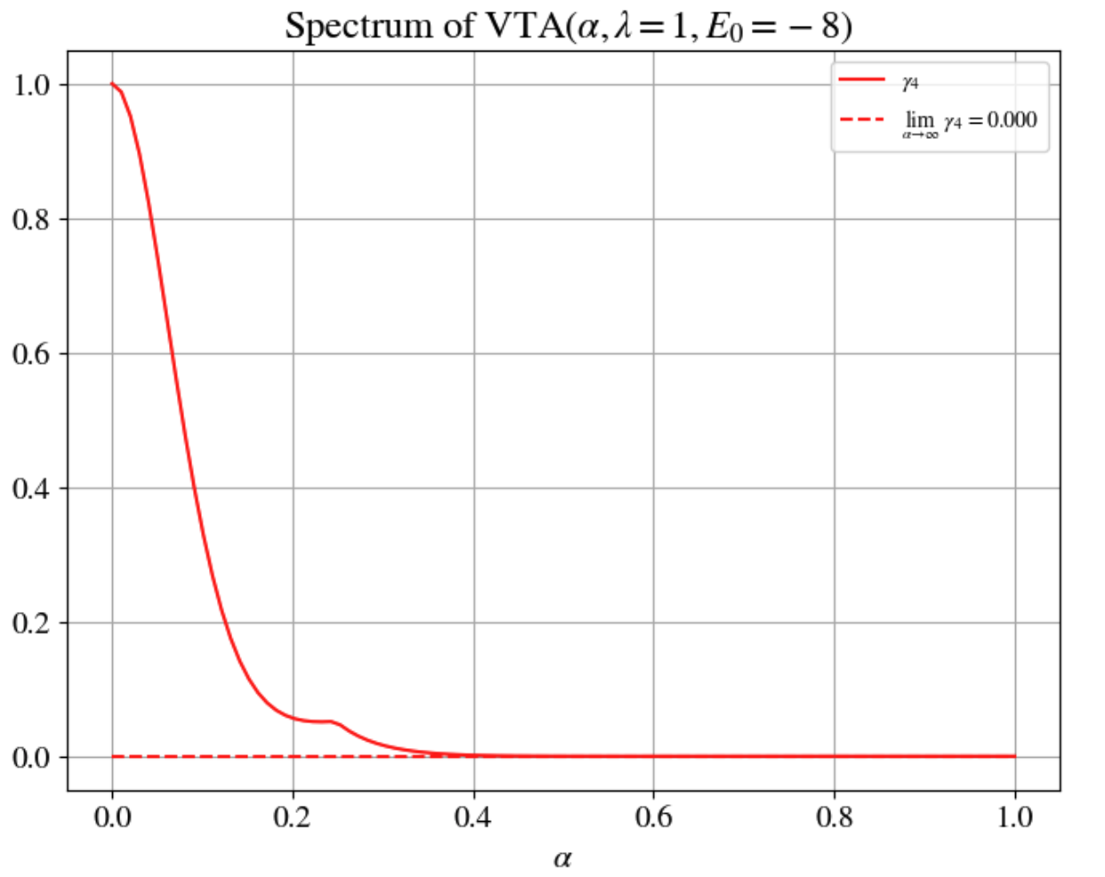
Eigenvalues 4

Slide 7
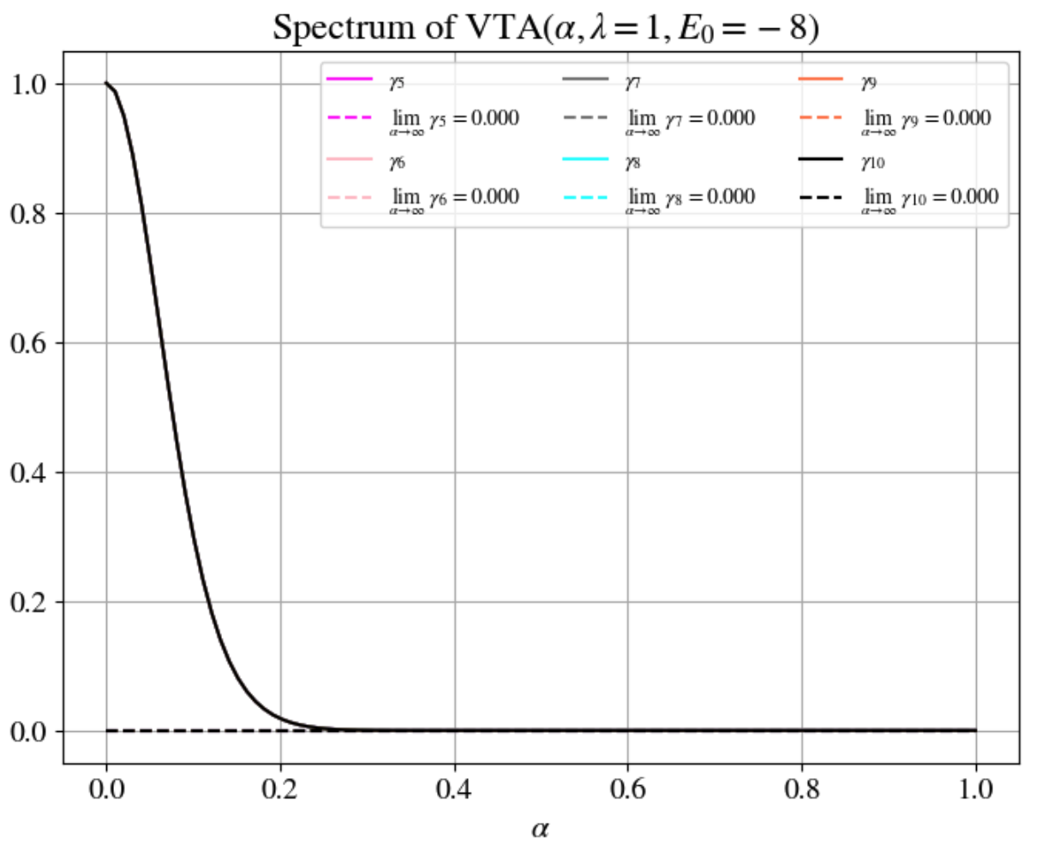
Eigenvalues 5-10

Slide 8
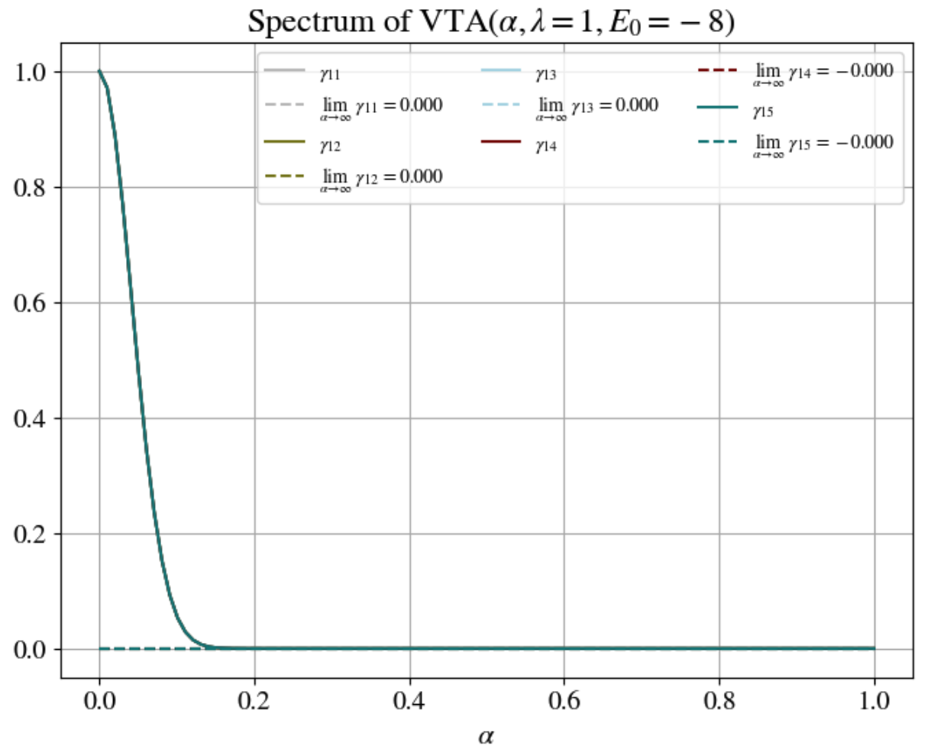
Eigenvalues 11-15

Slide 9
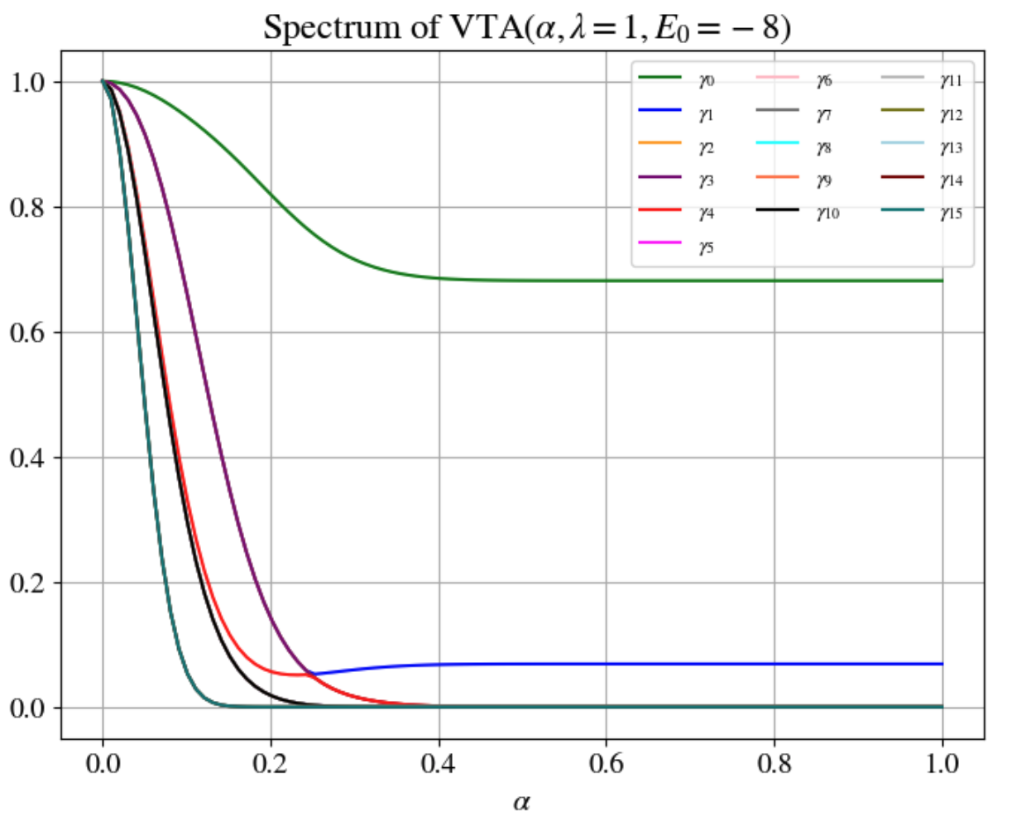
Eigenvalues 0-15

Slide 10
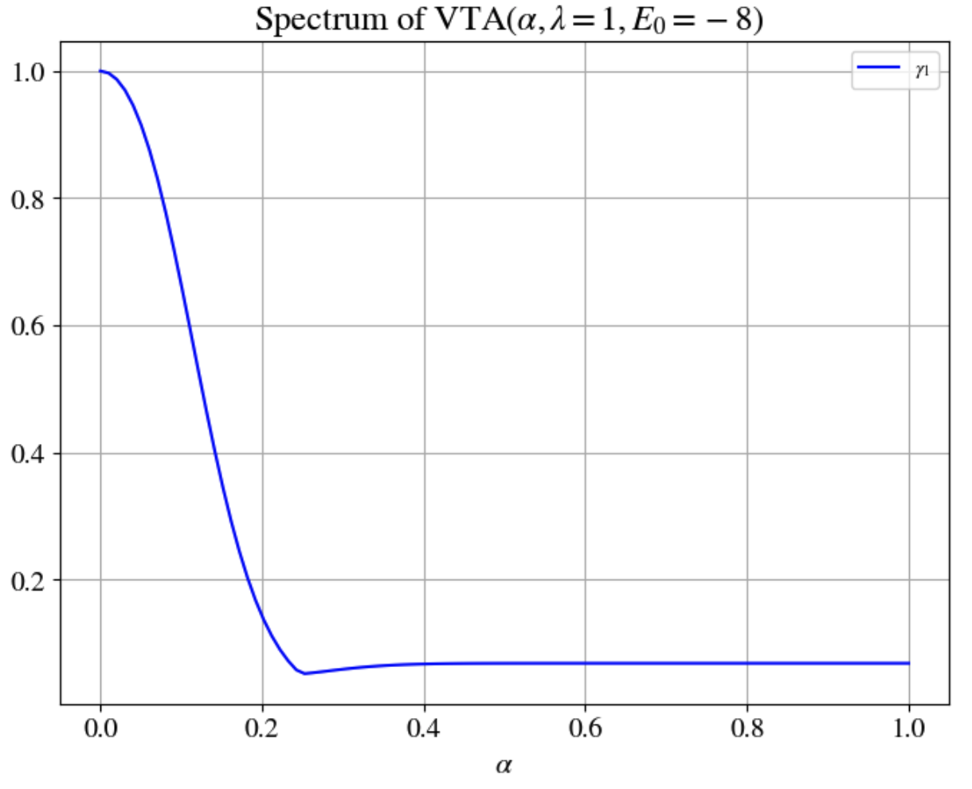
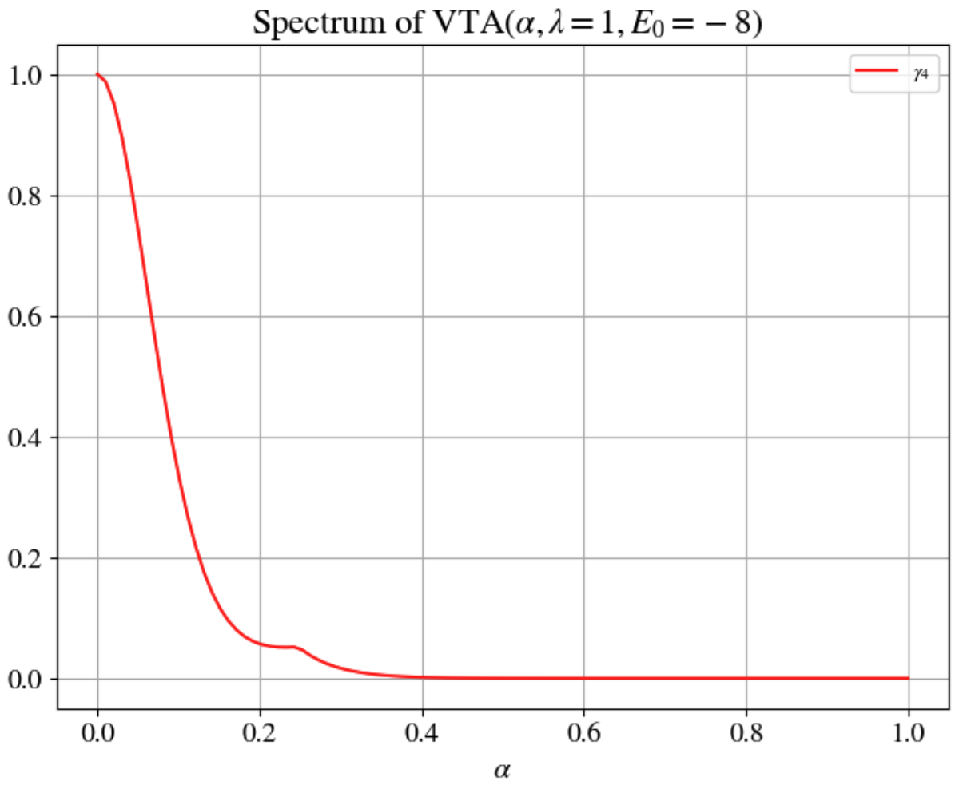
Eigenvalues 1 & 4

Slide 11
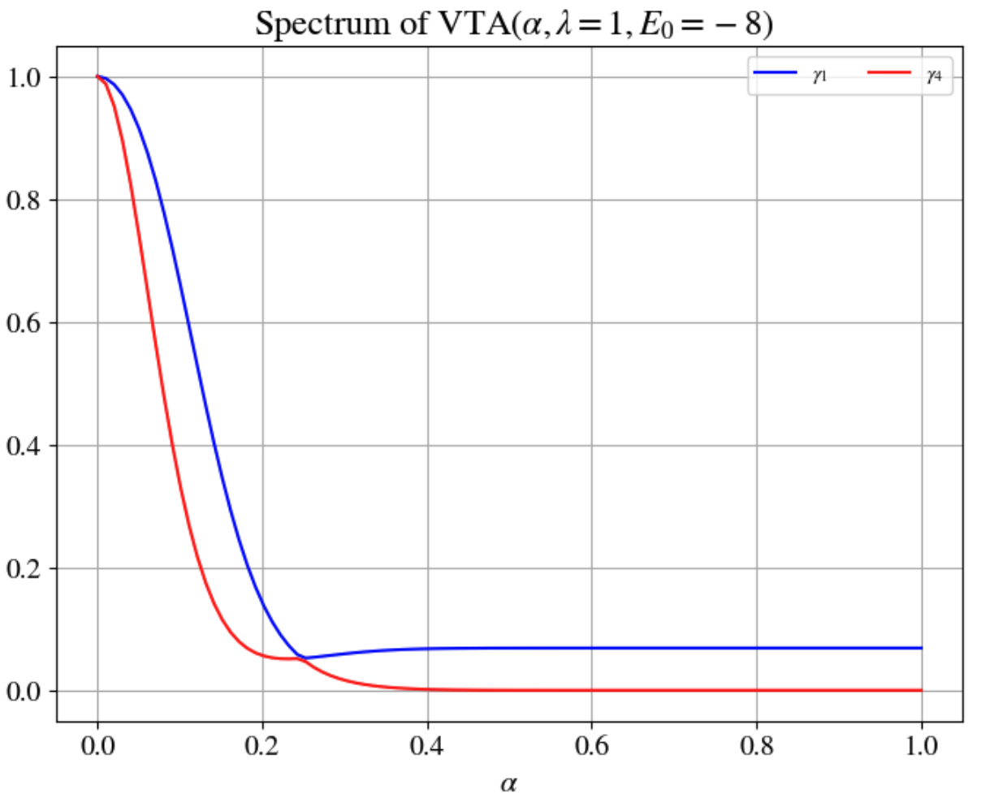
Eigenvalues 1 & 4

Slide 12
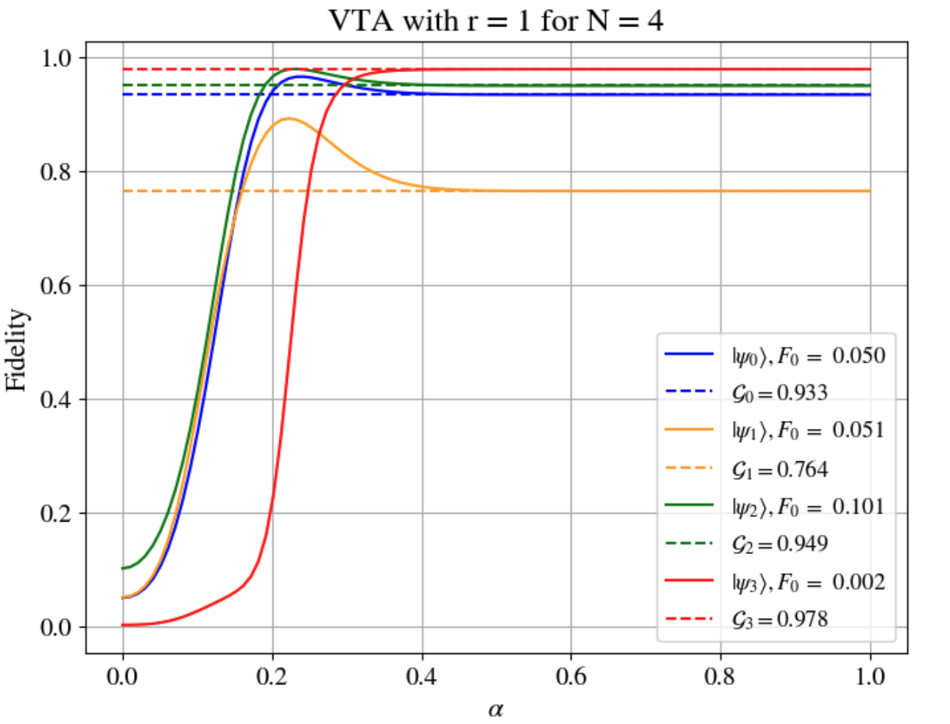
Higher-order Trotterization

Slide 13
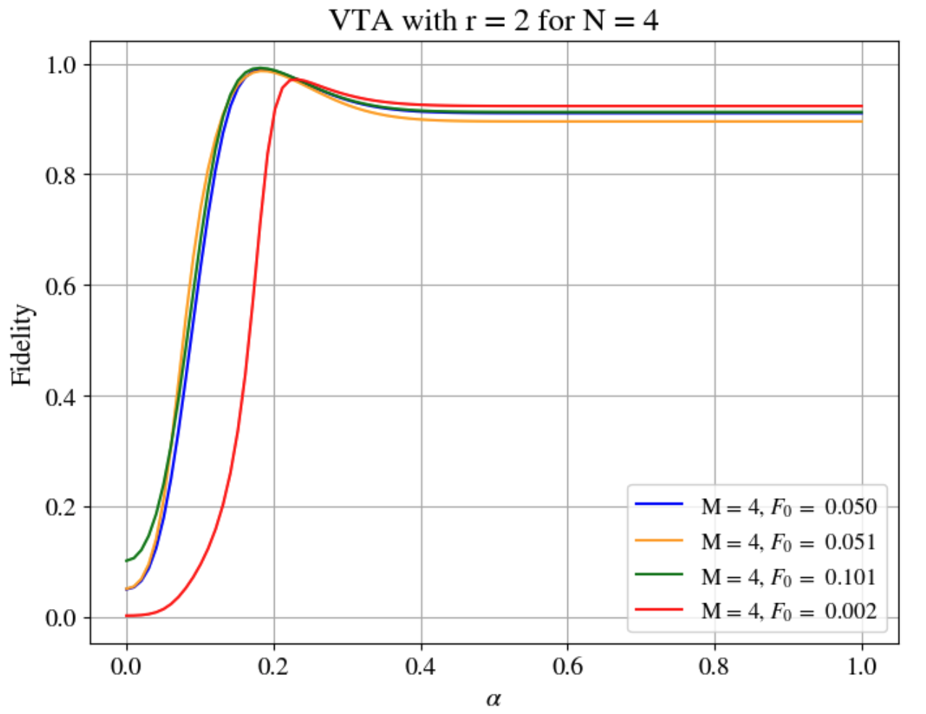
Higher-order Trotterization

Slide 14
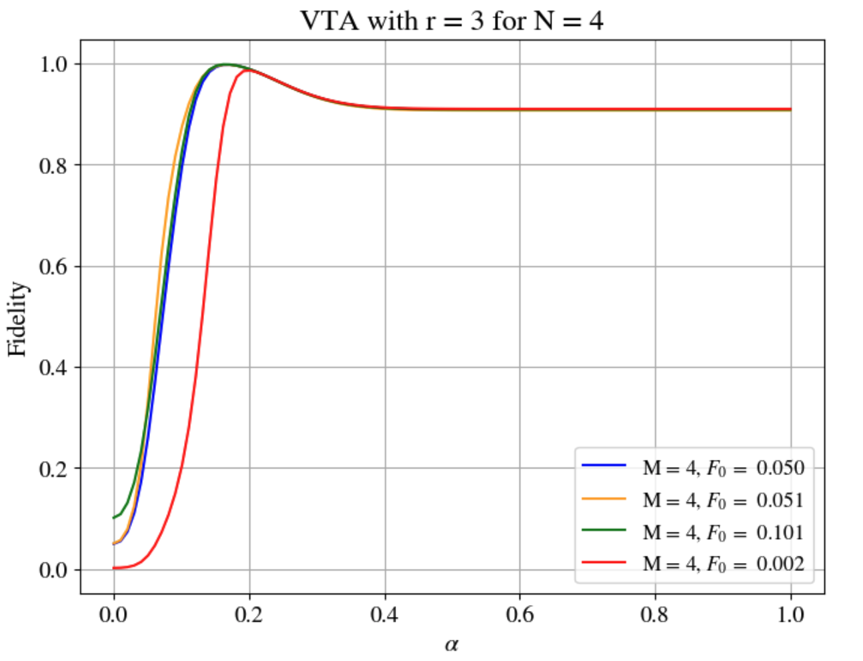
Higher-order Trotterization

