Slide 1




May Boson Gang Meeting
Luke Bell, Yan Wang, Eugene Dumitrescu,
Kevin Smith, Yuan Liu, Steven Girvin

Slide 2
Outline

Slide 3
Outline
1. Recap of features in VTA fidelity plots

Slide 4
Outline
1. Recap of features in VTA fidelity plots
2. (Quasi) diagonalization of VTA_{exact} and VTA

Slide 5
Outline
1. Recap of features in VTA fidelity plots
2. (Quasi) diagonalization of VTA_{exact} and VTA
3. Spectrum of VTA and log(VTA) spectrum

Slide 6
Outline
1. Recap of features in VTA fidelity plots
2. (Quasi) diagonalization of VTA_{exact} and VTA
3. Spectrum of VTA and log(VTA) spectrum
4. Optimal α that maximizes VTA projection fidelity

Slide 7
Outline
1. Recap of features in VTA fidelity plots
2. (Quasi) diagonalization of VTA_{exact} and VTA
3. Spectrum of VTA and log(VTA) spectrum
4. Optimal α that maximizes VTA projection fidelity
5. Generalized transition amplitudes (Yuan)

Slide 8
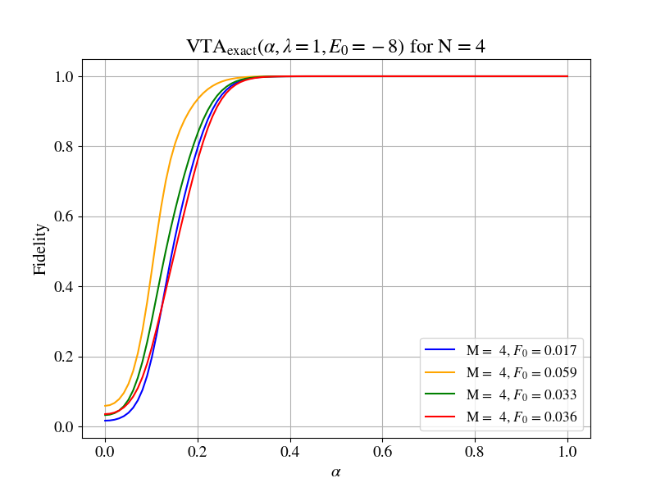
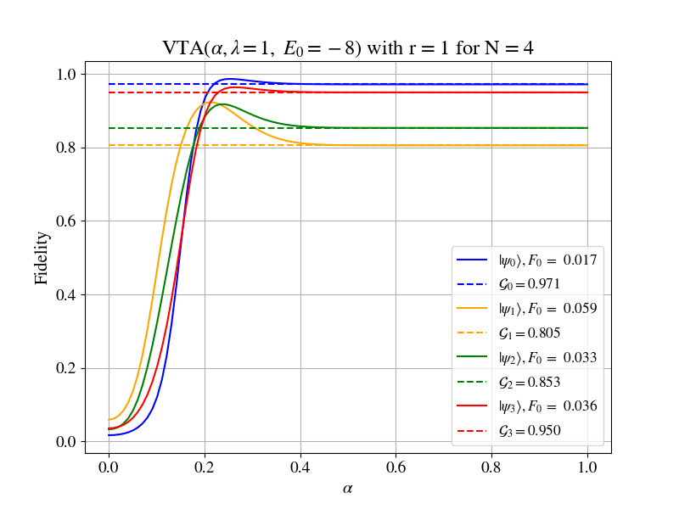

Slide 9
Non-monotonicities?

Slide 10
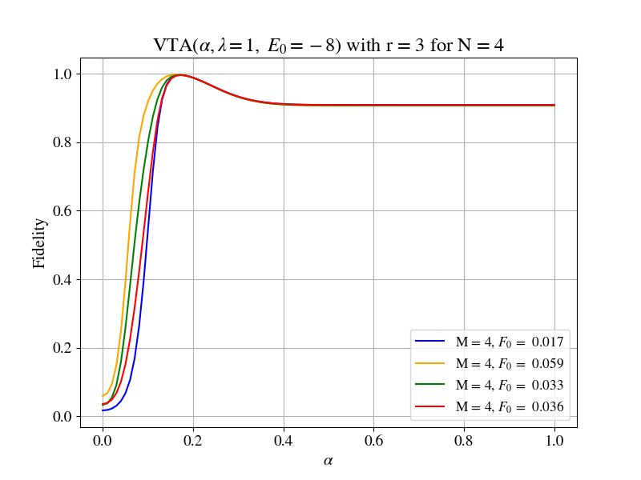
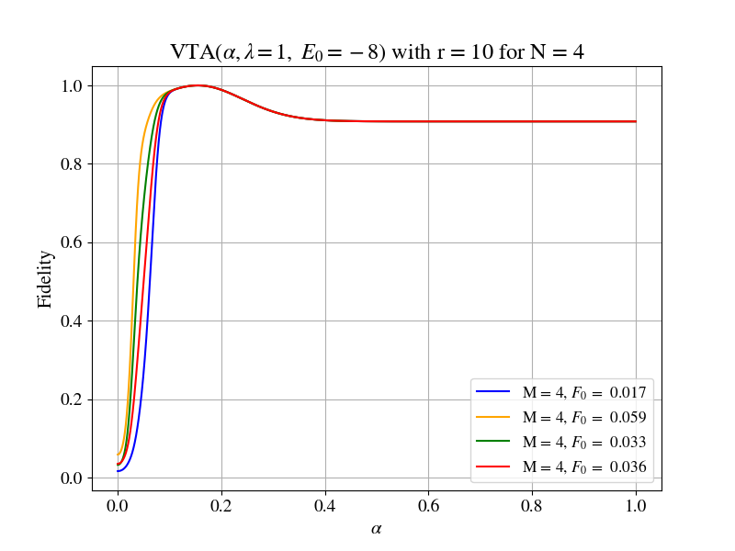
Non-monotonicities?

Slide 11
Non-monotonicities?
Optimal α = 0.1546 that maximizes fidelity for
each curve?

Slide 12


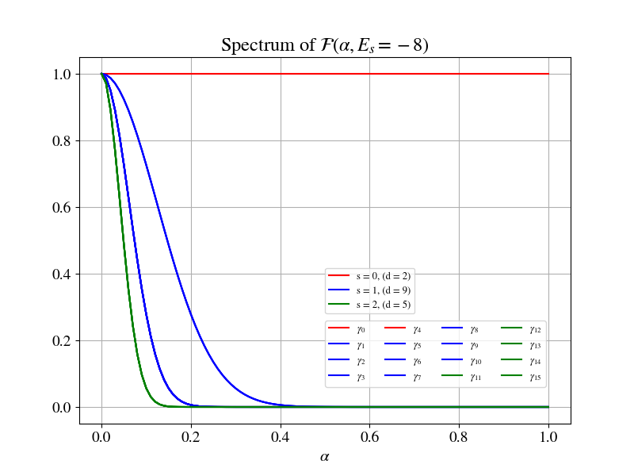
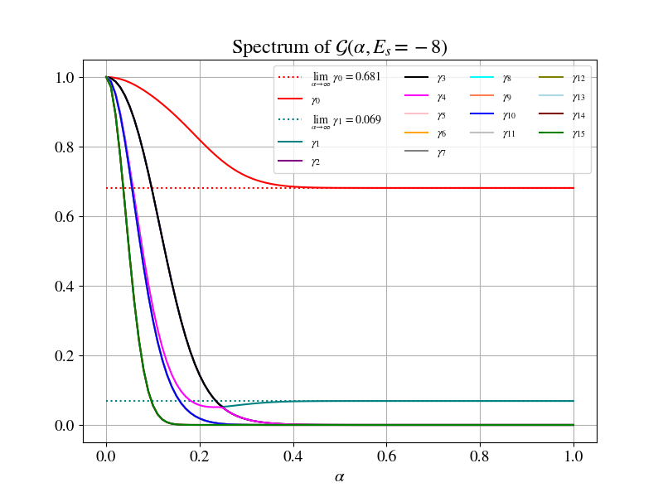

Slide 13
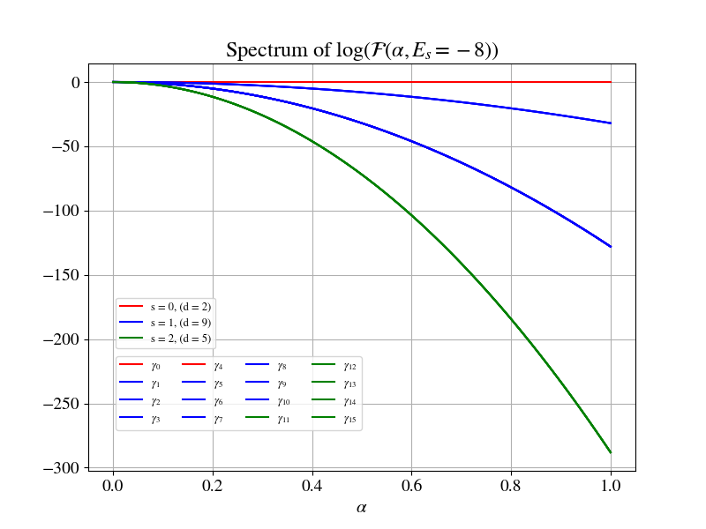
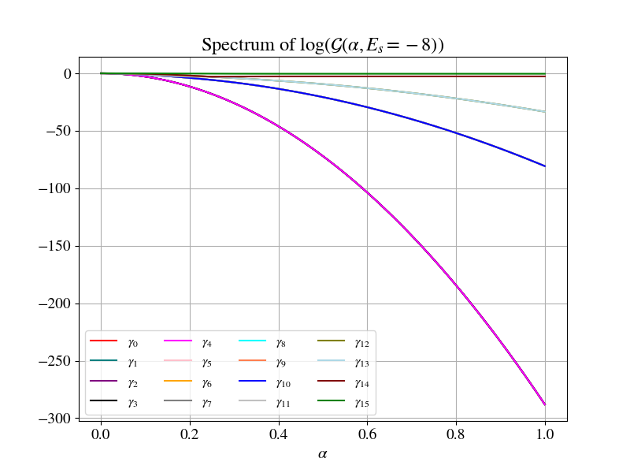

Slide 14
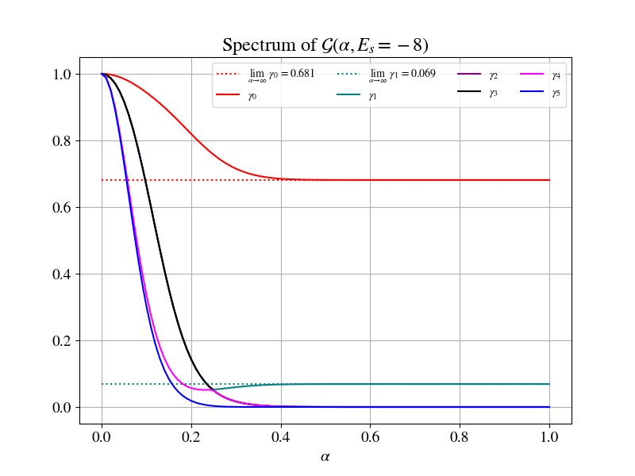
Neat Features

Slide 15
Neat Features
Desire to understand level crossings and asymptotes!

Slide 16
(Quasi) Diagonalization of VTA_{exact} and VTA

Slide 17
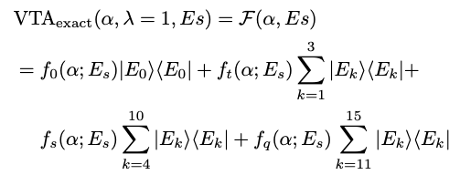
(Quasi) Diagonalization of VTA_{exact} and VTA

Slide 18
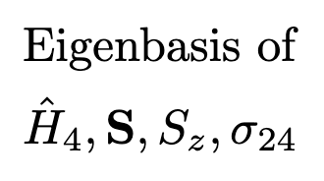
(Quasi) Diagonalization of VTA_{exact} and VTA

Slide 19
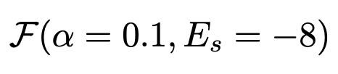
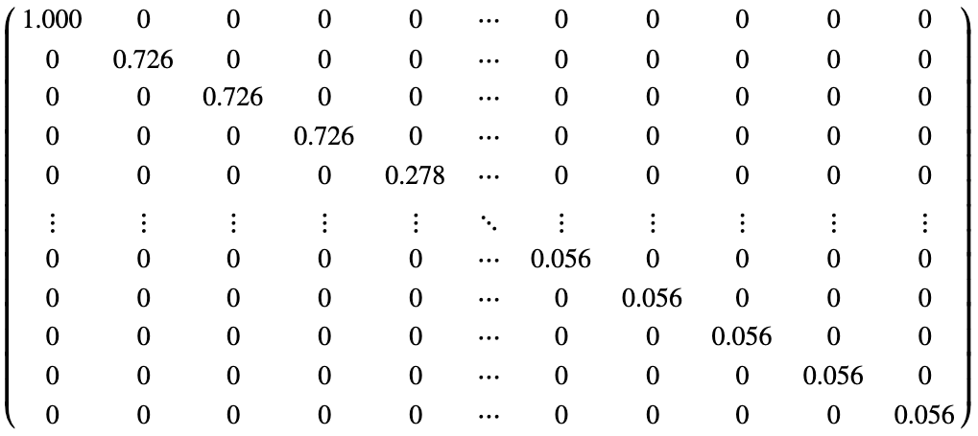
(Quasi) Diagonalization of VTA_{exact} and VTA

Slide 20
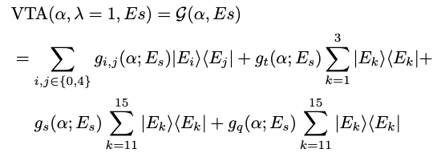
(Quasi) Diagonalization of VTA_{exact} and VTA

Slide 21
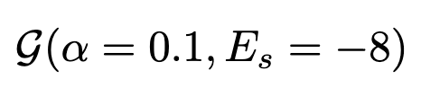
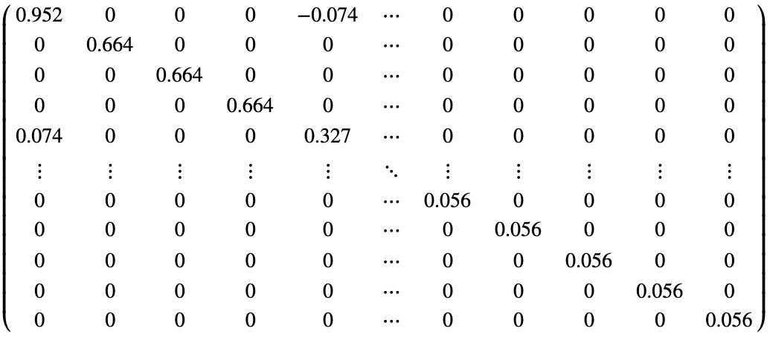
(Quasi) Diagonalization of VTA_{exact} and VTA

Slide 22
(Quasi) Diagonalization of VTA_{exact} and VTA

Slide 23
Analysis of s = 0 sector

Slide 24

Analysis of s = 0 sector
Operator for Logical Subspace

Slide 25
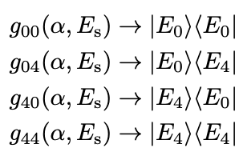
Analysis of s = 0 sector
Operator for Logical Subspace
Intuition for Entries

Slide 26
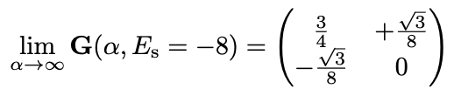

Analysis of s = 0 sector
Operator for Logical Subspace
Intuition for Entries
Limits

Slide 27
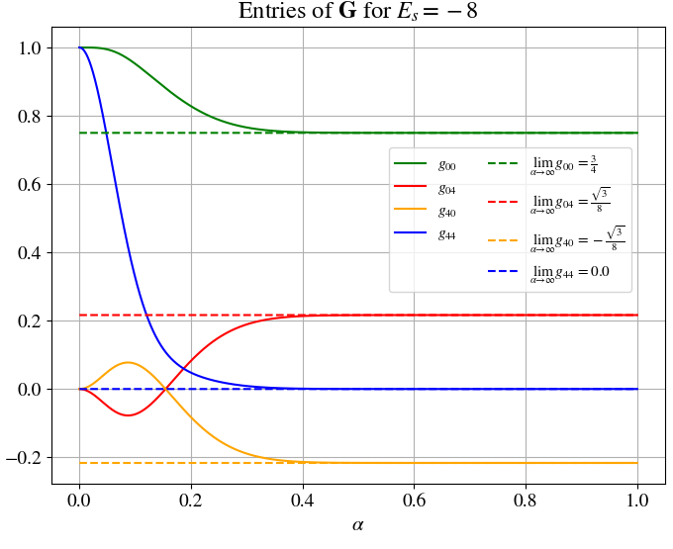
Analysis of s = 0 sector
Operator for Logical Subspace
Intuition for Entries
Limits

Slide 28

Analysis of s = 0 sector
Operator for Logical Subspace
Intuition for Entries
Limits

Slide 29

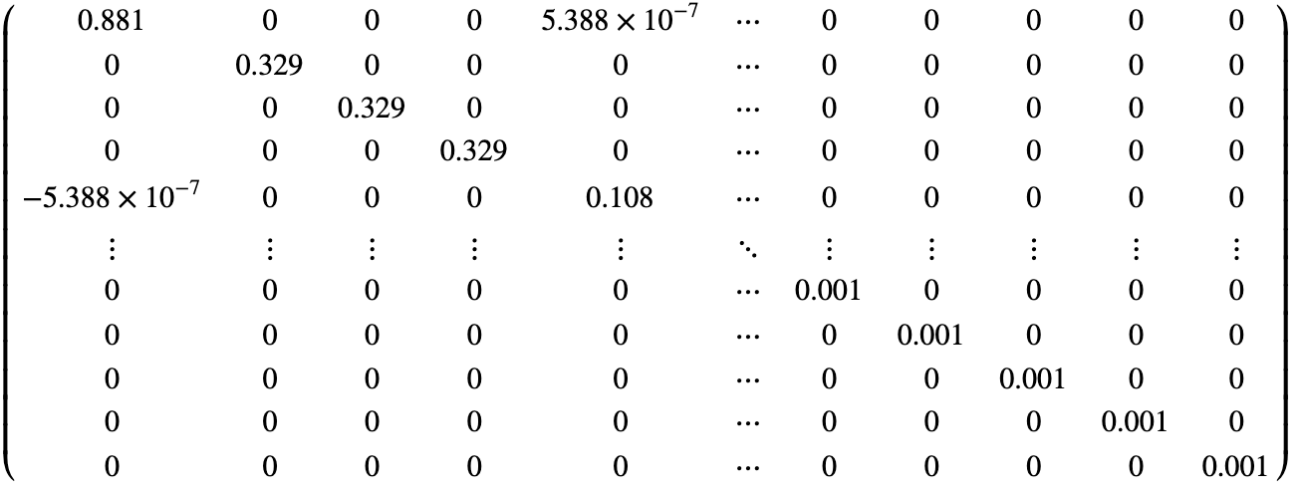
Analysis of s = 0 sector
Operator for Logical Subspace
Intuition for Entries
Limits

