Slide 1
Error Scalings of Product Factorizations For Imaginary Time evolution
Eugene Dumitrescu
DOEAnd collaborators
Funded By ASCR

Slide 2
Scaling of Errors
Whether the exponential contain real, imaginary, or complex-time, the factorization error goes as the commutator error.
This can be expressed in terms of (at least) two critical variables:
The size of the exponentiated Hamiltonian regions and their overlaps:
We basically mean that the application of larger Hamiltonians (from the 2-local case to the multi-local case, to the entire Hamiltonian) will reduce the error systematically.
This error is the same at each step, the question is how many steps does one need to apply (to achieve a given result).
This interplays with the factorization error in a rich way.
The magnitude of the projections
Weak vs strong debate
This reminds me of the fastest equilibrium which comes from overdriving.
(Other scaling variables?)

Slide 3
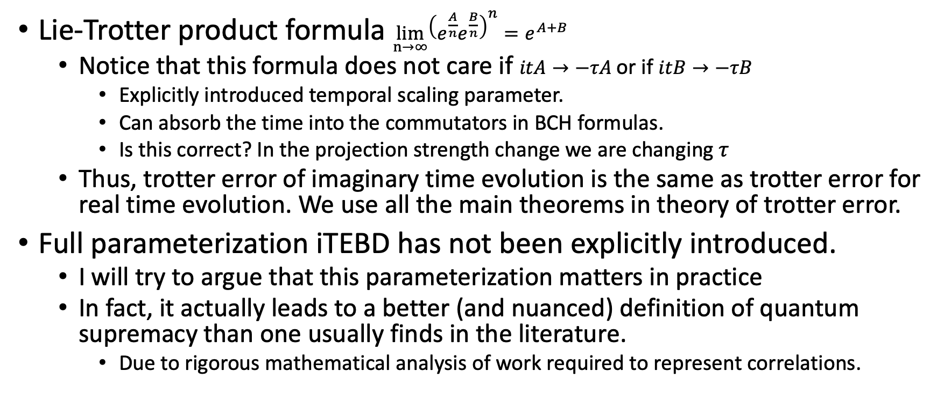
Scaling of Error w.r.t. Projector size/complexity
Lie-Trotter product formula $\lim_{n→∞}{{\left(e^{\frac{A}{n}}e^{\frac{B}{n}}\right)}^{n}}=e^{A+B}$
Notice that this formula does not care if $itA→−τA$or if $itB→−τB$
Explicitly introduced temporal scaling parameter.
Can absorb the time into the commutators in BCH formulas.
Is this correct? In the projection strength change we are changing $τ$
Thus, trotter error of imaginary time evolution is the same as trotter error for real time evolution. We use all the main theorems in theory of trotter error.
Full parameterization iTEBD has not been explicitly introduced.
I will try to argue that this parameterization matters in practice
In fact, it actually leads to a better (and nuanced) definition of quantum supremacy than one usually finds in the literature.
Due to rigorous mathematical analysis of work required to represent correlations.

Slide 4
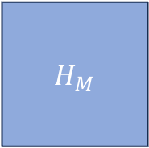

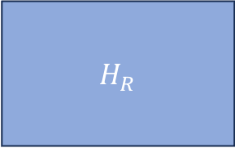
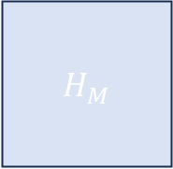
Region interpolation
$$H_{L}$$
$H_{M}$
Left step
E.g. even bonds
Right step
E.g. odd bonds
Each of the steps consists of regions
Overlapping with neighboring regions.
This leads to commutator error
Regions which are non-overlapping.
This part does not contribute to error
$H_{M}$
$H_{R}$

Slide 5

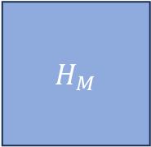

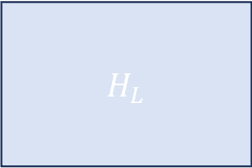


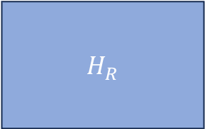

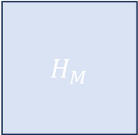

Slide explaining Luke’s case.
$$H_{L}$$
$S_{1}⋅S_{2}$
$H_{M}$
$⋯$
$S_{3}⋅S_{4}$
$H_{M}$
$H_{R}$
$S_{2}⋅S_{3}$
$⋯$
$S_{N−1}⋅S_{N}$

Slide 6






Slide Explaining Next Step.
$S_{1}⋅S_{2}$
$$+$$
$S_{2}⋅S_{3}$
$$H_{L}$$
$H_{M}$
$⋯$
$S_{3}⋅S_{4}$
$$+$$
$H_{M}$
$H_{R}$
$S_{2}⋅S_{3}$
$$+$$
$S_{3}⋅S_{4}$
$⋯$
$$+$$
$S_{N−1}⋅S_{N}$

Slide 7





Still going
$S_{1}⋅S_{2}$
$$H_{L}$$
$H_{M}$
$S_{3}⋅S_{4}$
$$+$$
$S_{3}⋅S_{4}$
$⋯$
$$+$$
$$+$$
$S_{2}⋅S_{3}$
$H_{M}$
$H_{R}$
$S_{2}⋅S_{3}$
$$+$$
$⋯$
$$+$$
$S_{N−1}⋅S_{N}$

Slide 8



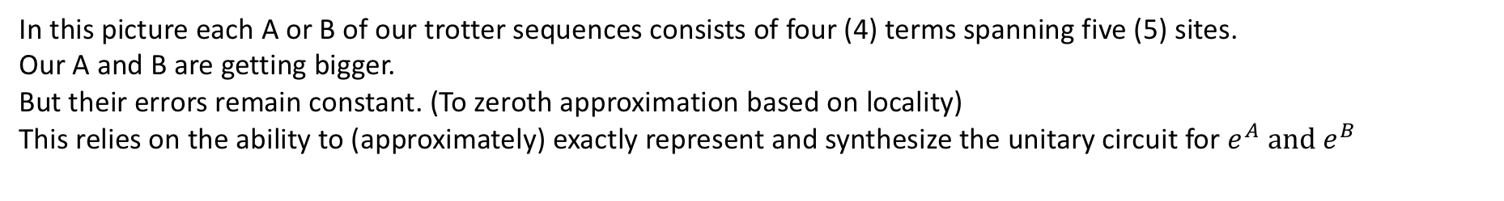

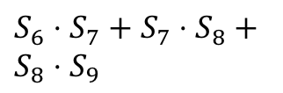
Another one
$S_{1}⋅S_{2},+S_{2}⋅S_{3}+S_{3}⋅S_{4}$
$$H_{L}$$
$H_{M}$
$⋯$
$$+$$
$+ S_{4}⋅S_{5}$
$H_{M}$
$S_{5}⋅S_{6}+$
$H_{R}$
$⋯$
$$+$$
$S_{N−1}⋅S_{N}$
$S_{6}⋅S_{7}+S_{7}⋅S_{8}+S_{8}⋅S_{9}$
In this picture each A or B of our trotter sequences consists of four (4) terms spanning five (5) sites.
Our A and B are getting bigger.
But their errors remain constant. (To zeroth approximation based on locality)
This relies on the ability to (approximately) exactly represent and synthesize the unitary circuit for $e^{A} and e^{B}$

Slide 9
Last Limit
When A = H - one site’s interactions, and B = H – another site’s we still get the same commutator error 1x times. But we also only need to apply one A and one B (there are no longer smaller A’s or B’s in parallel) in series.
When A = H and B=H then we can just evolve by the full dynamics. Lie-Trotter factorization ceases to make sense as we are no longer factorizing. Full dynamics.
Global optimum work geodesic:
It’s probably too much work to really synthesize the perfect cases of the last two bullets. (Which involve many fewer in-series trotter steps to get to a target imaginary or real time)
In the worst case the work required to synthesize this may scale exponentially
Instead, a multi-layer series application of some moderate sized gates may actually land one in the “Goldilocks” optimum zone.
This is the original trotter idea.
But we are exploring a nuanced and important point.
Classical and quantum computers will excel at the different aspects of this generalized Trotterization.

Slide 10
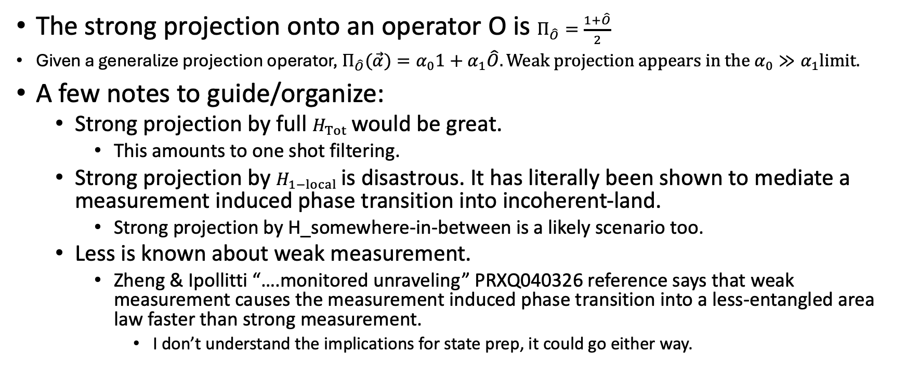
Projection Strength
The strong projection onto an operator O is $Π_{\hat{O}}=\frac{1+\hat{O}}{2}$
Given a generalize projection operator, $Π_{\hat{O}}(\vec{α})=α_{0}1+α_{1}\hat{O}. Weak projection appears in the α_{0}≫α_{1}limit.$
A few notes to guide/organize:
Strong projection by full $H_{Tot}$would be great.
This amounts to one shot filtering.
Strong projection by $H_{1−local}$is disastrous. It has literally been shown to mediate a measurement induced phase transition into incoherent-land.
Strong projection by H_somewhere-in-between is a likely scenario too.
Less is known about weak measurement.
Zheng & Ipollitti “….monitored unraveling” PRXQ040326 reference says that weak measurement causes the measurement induced phase transition into a less-entangled area law faster than strong measurement.
I don’t understand the implications for state prep, it could go either way.

Slide 11
Need 10 more slides to investigate projection strength
There is a lot going on with

