Slide 1




2/29 Boson Gang Meeting
Luke, Kevin, Yuan, Yan, Eugene, Steve

Slide 2
2/29 Boson Gang Meeting Leap Day Edition
Luke, Kevin, Yuan, Yan, Eugene, Steve

Slide 3
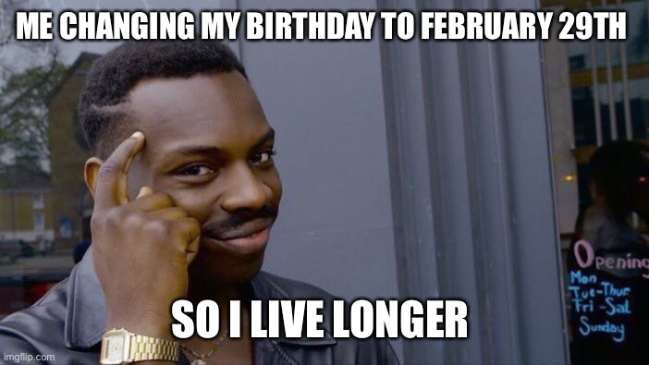
2/29 Boson Gang Meeting Leap Day Edition
Luke, Kevin, Yuan, Yan, Eugene, Steve

Slide 4
Schema for VTA when N = 4

Slide 5
Schema for VTA when N = 4
Ingredients

Slide 6
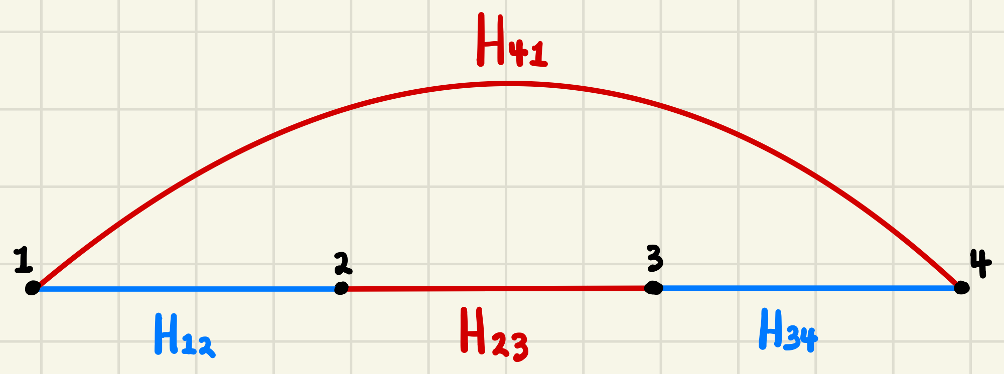
Schema for VTA when N = 4
Ingredients
4-site Spin Chain

Slide 7
Schema for VTA when N = 4
Ingredients
4-site Spin Chain
Local Hamiltonians

Slide 8

Schema for VTA when N = 4
Ingredients
4-site Spin Chain
Local Hamiltonians

Slide 9

Schema for VTA when N = 4
Ingredients
4-site Spin Chain
Local Hamiltonians

Slide 10

Schema for VTA when N = 4
Ingredients
4-site Spin Chain
Local Hamiltonians

Slide 11

Schema for VTA when N = 4
Ingredients
4-site Spin Chain
Local Hamiltonians

Slide 12

Schema for VTA when N = 4
Ingredients
4-site Spin Chain
Local Hamiltonians
Shared Eigenkets

Slide 13

Schema for VTA when N = 4
Ingredients
4-site Spin Chain
Local Hamiltonians
Shared Eigenkets
Shared Eigenkets

Slide 14
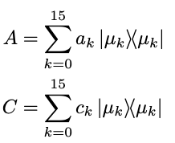
Schema for VTA when N = 4
Ingredients
4-site Spin Chain
Local Hamiltonians
Spectral Resolutions
Shared Eigenkets
Shared Eigenkets

Slide 15
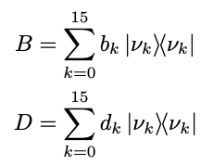
Schema for VTA when N = 4
Ingredients
4-site Spin Chain
Local Hamiltonians
Spectral Resolutions
Shared Eigenkets
Shared Eigenkets

Slide 16
Schema for VTA when N = 4
Ingredients
4-site Spin Chain
Local Hamiltonians
Spectral Resolutions
Shared Eigenkets
Shared Eigenkets
Time Ordering

Slide 17
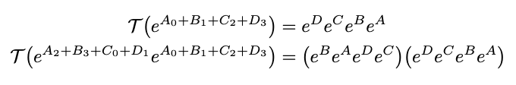
Schema for VTA when N = 4
Ingredients
4-site Spin Chain
Local Hamiltonians
Spectral Resolutions
Shared Eigenkets
Shared Eigenkets
Time Ordering

Slide 18
Schema for VTA when N = 4
Ingredients
4-site Spin Chain
Local Hamiltonians
Spectral Resolutions
Shared Eigenkets
Shared Eigenkets
Time Ordering

Slide 19
Schema for VTA when N = 4
Ingredients
4-site Spin Chain
Local Hamiltonians
Spectral Resolutions
Shared Eigenkets
Shared Eigenkets
Time Ordering

Slide 20
Schema for VTA when N = 4
Ingredients
4-site Spin Chain
Local Hamiltonians
Spectral Resolutions
Shared Eigenkets
Shared Eigenkets
Time Ordering

Slide 21
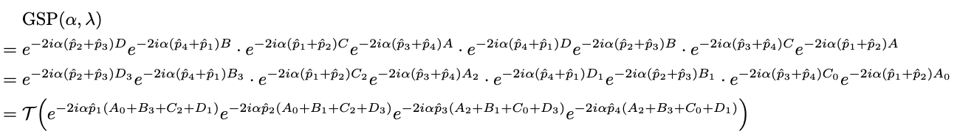
Schema for VTA when N = 4
Ingredients
Synthesized GSP Operator
4-site Spin Chain
Local Hamiltonians
Spectral Resolutions
Shared Eigenkets
Shared Eigenkets
Time Ordering

Slide 22
Schema for VTA when N = 4
Ingredients
Synthesized GSP Operator
4-site Spin Chain
Local Hamiltonians
Spectral Resolutions
Shared Eigenkets
Shared Eigenkets
Time Ordering

Slide 23
Schema for VTA when N = 4
Ingredients
Synthesized GSP Operator
4-site Spin Chain
Local Hamiltonians
Spectral Resolutions
Shared Eigenkets
Shared Eigenkets
Time Ordering

Slide 24
Schema for VTA when N = 4
Ingredients
Synthesized GSP Operator
4-site Spin Chain
Local Hamiltonians
Spectral Resolutions
Shared Eigenkets
Shared Eigenkets
Time Ordering

Slide 25
Schema for VTA when N = 4
Ingredients
Synthesized GSP Operator
4-site Spin Chain
Local Hamiltonians
Spectral Resolutions
Shared Eigenkets
Shared Eigenkets
Time Ordering

Slide 26
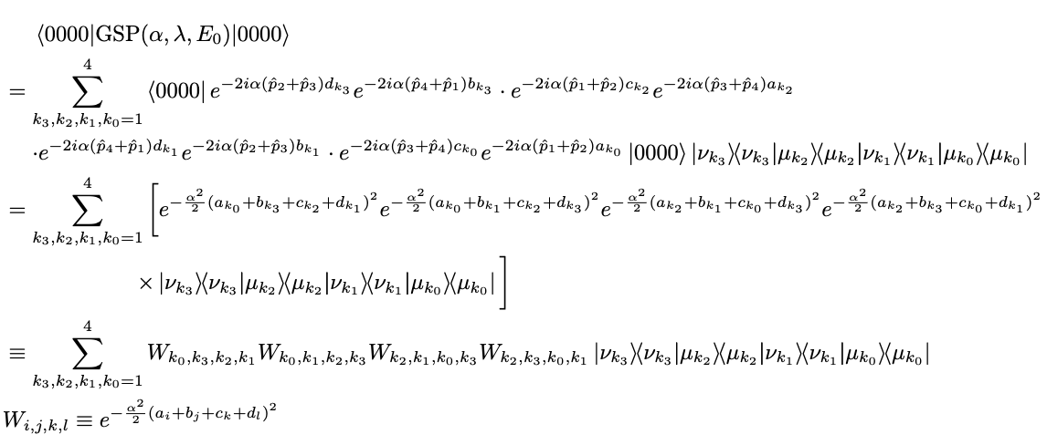
Schema for VTA when N = 4
Ingredients
Synthesized GSP Operator
4-site Spin Chain
Local Hamiltonians
Spectral Resolutions
Transition Amplitude of GSP
Shared Eigenkets
Shared Eigenkets
Time Ordering

Slide 27
Schema for VTA when N = 4
Ingredients
Synthesized GSP Operator
4-site Spin Chain
Local Hamiltonians
Spectral Resolutions
Transition Amplitude of GSP
Shared Eigenkets
Shared Eigenkets
Time Ordering

Slide 28
Schema for VTA when N = 4
Ingredients
Synthesized GSP Operator
4-site Spin Chain
Local Hamiltonians
Spectral Resolutions
Transition Amplitude of GSP
Shared Eigenkets
Shared Eigenkets
Time Ordering

Slide 29
Schema for VTA when N = 4
Ingredients
Synthesized GSP Operator
4-site Spin Chain
Local Hamiltonians
Spectral Resolutions
Transition Amplitude of GSP
Shared Eigenkets
Shared Eigenkets
Time Ordering

Slide 30
Schema for VTA when N = 4
Ingredients
Synthesized GSP Operator
4-site Spin Chain
Local Hamiltonians
Spectral Resolutions
Transition Amplitude of GSP
Shared Eigenkets
Shared Eigenkets
Time Ordering

Slide 31
Schema for VTA when N = 4
Ingredients
Synthesized GSP Operator
4-site Spin Chain
Local Hamiltonians
Spectral Resolutions
Transition Amplitude of GSP
Shared Eigenkets
Shared Eigenkets
Time Ordering

Slide 32

Gaussian Weight Tensor

Slide 33
Gaussian Weight Tensor
Exploit multiplicities of eigenvalues

Slide 34
Gaussian Weight Tensor
Exploit multiplicities of eigenvalues
Bethe Ansatz

Slide 35
Gaussian Weight Tensor
Exploit multiplicities of eigenvalues
Bethe Ansatz
DMRG

Slide 36
Gaussian Weight Tensor
Exploit multiplicities of eigenvalues
Bethe Ansatz
DMRG
Tensor Trains

Slide 37
Gaussian Weight Tensor
Exploit multiplicities of eigenvalues
Bethe Ansatz
Using global eigenkets to find local correlations
DMRG
Tensor Trains

