Slide 1
Data for Boson Gang
Luke Bell

Slide 2
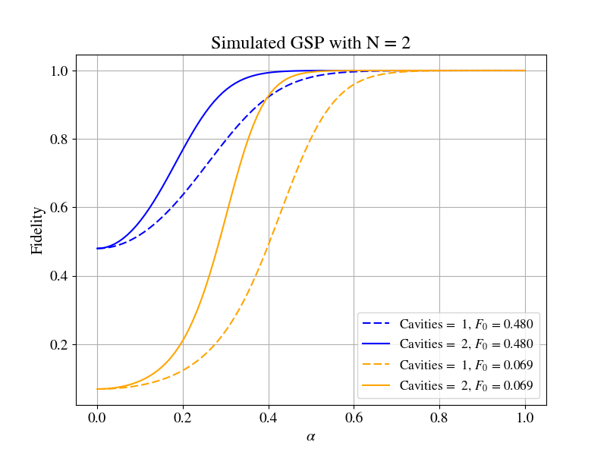
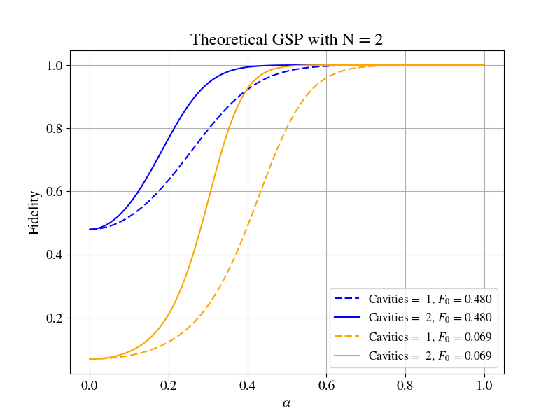
Two Sites, Two States

Slide 3
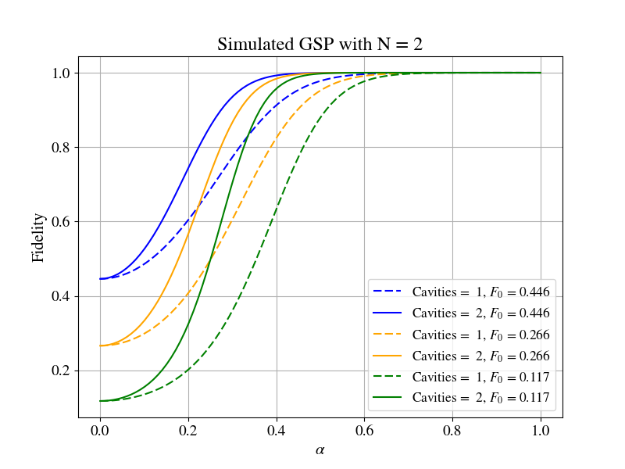

Two Sites, 3 States

Slide 4
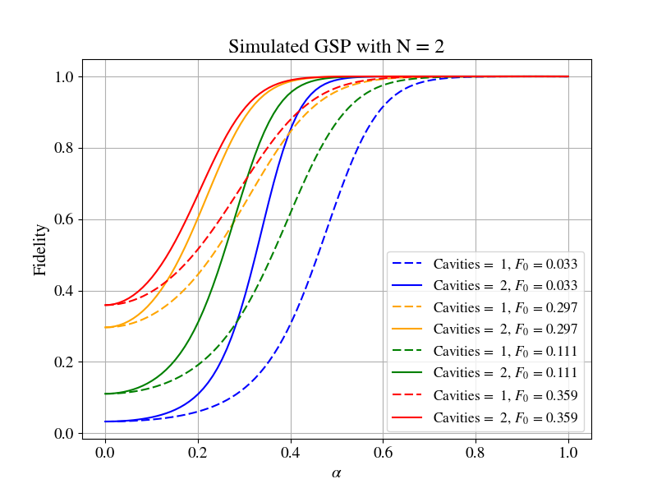

Two Sites, Four States

