Slide 1




1/31 Boson Gang Meeting
Luke, Kevin, Yuan, Yan, Eugene, Steve

Slide 2
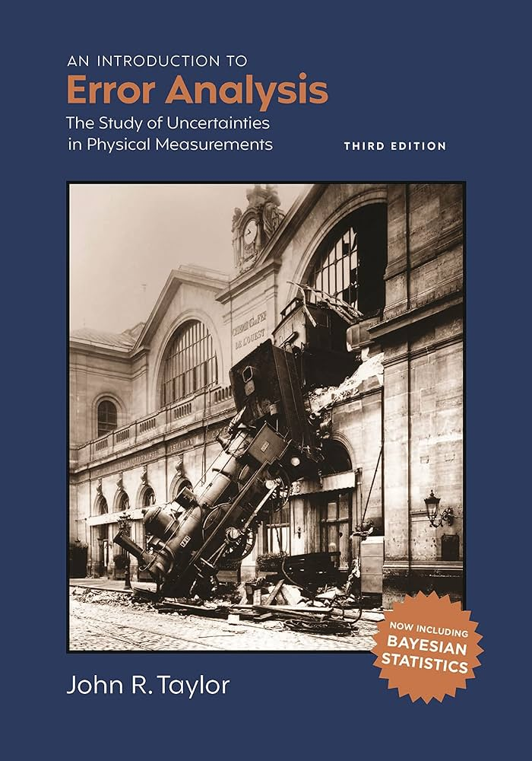
1/31 Boson Gang Meeting Error Analysis Edition
Luke, Kevin, Yuan, Yan, Eugene, Steve

Slide 3
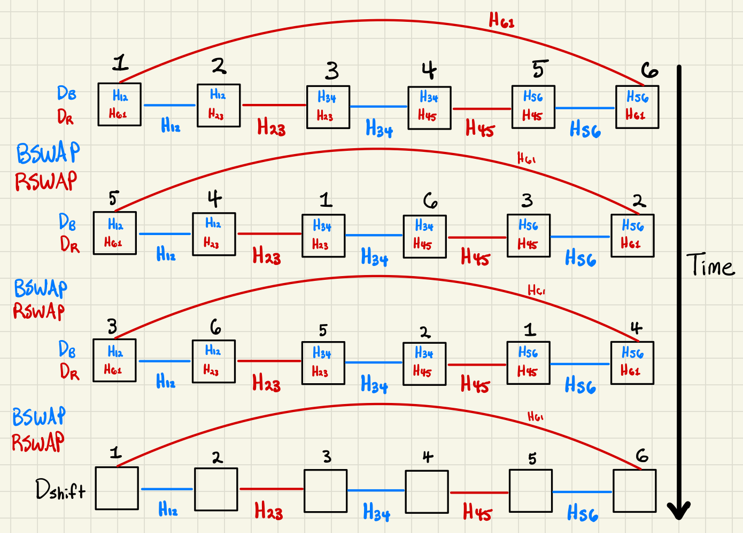
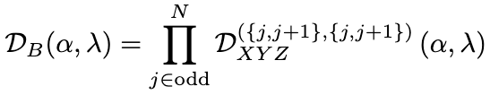
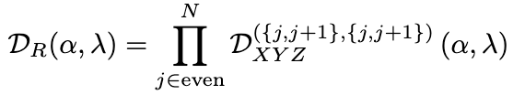

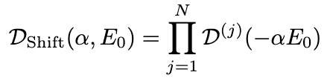
Refresher on GSP Algorithm
Ingredients

Slide 4
Refresher on GSP Algorithm
Ingredients

Slide 5
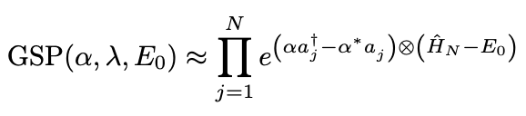

Trotter Error vs Vacuum Transition Amplitude
Algorithm

Slide 6
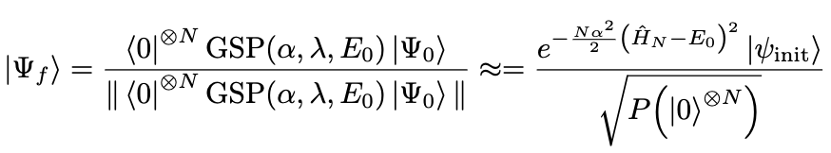
Trotter Error vs Vacuum Transition Amplitude
Algorithm

Slide 7

Trotter Error vs Vacuum Transition Amplitude
Algorithm

Slide 8
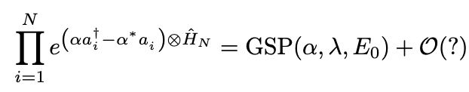
Trotter Error vs Vacuum Transition Amplitude
Algorithm
Trotter Error

Slide 9

Trotter Error vs Vacuum Transition Amplitude
Algorithm
Trotter Error

Slide 10
Trotter Error vs Vacuum Transition Amplitude
Algorithm
Trotter Error

Slide 11
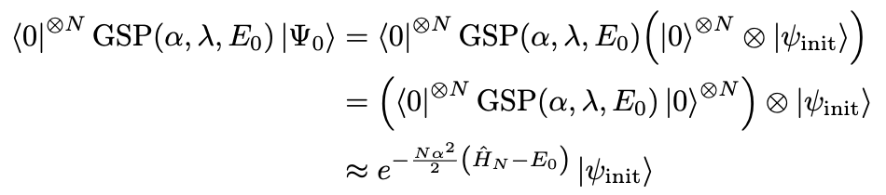
Trotter Error vs Vacuum Transition Amplitude
Algorithm
Trotter Error
Vacuum Transition Amplitude

Slide 12
Trotter Error vs Vacuum Transition Amplitude
Algorithm
Trotter Error
Vacuum Transition Amplitude

Slide 13
Trotter Error vs Vacuum Transition Amplitude
Algorithm
Trotter Error
Vacuum Transition Amplitude

Slide 14

Trotter Error vs Vacuum Transition Amplitude
Algorithm
Trotter Error
Vacuum Transition Amplitude

Slide 15
Trotter Error vs Vacuum Transition Amplitude
Algorithm
Trotter Error
Vacuum Transition Amplitude

Slide 16

Trotter Error vs Vacuum Transition Amplitude
Algorithm
Trotter Error
Vacuum Transition Amplitude

Slide 17

Trotter Error vs Vacuum Transition Amplitude
Algorithm
Trotter Error
Vacuum Transition Amplitude

Slide 18


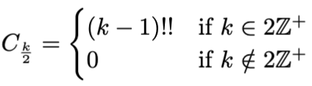
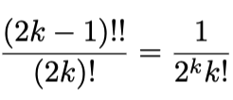
VTA for Displacement Operators
Recall the following:

Slide 19
VTA for Displacement Operators
Recall the following:

Slide 20
VTA for Displacement Operators
Recall the following:

Slide 21
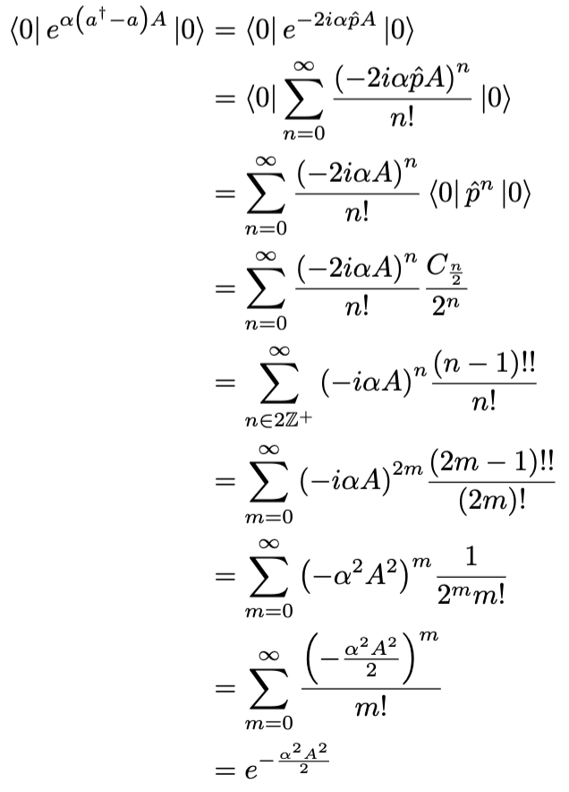
VTA for Displacement Operators
Recall the following:

Slide 22

VTA for Displacement Operators
Recall the following:
VTA for one Hamiltonian-weighted displacement operator

Slide 23
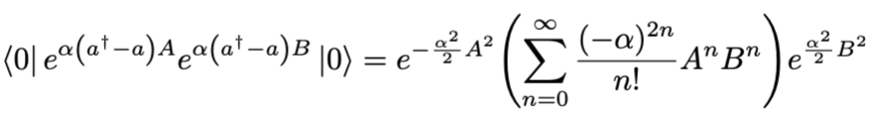
VTA for Displacement Operators
Recall the following:
VTA for one Hamiltonian-weighted displacement operator
VTA for two Hamiltonian-weighted displacement operators

Slide 24
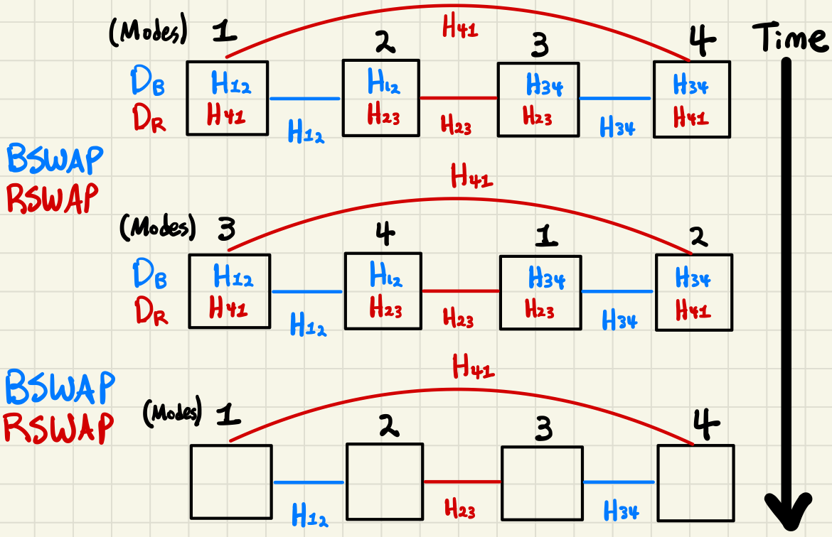
Applications of VTA Approach when N = 4
GSP and VTA for 4-site spin chain

Slide 25
Applications of VTA Approach when N = 4
GSP and VTA for 4-site spin chain

Slide 26
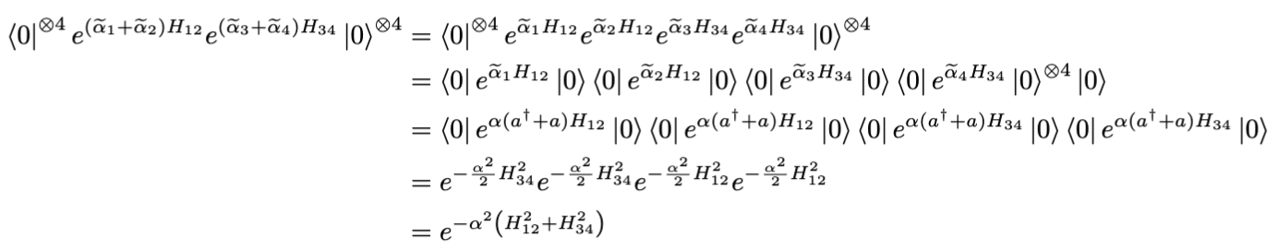
Applications of VTA Approach when N = 4
GSP and VTA for 4-site spin chain
VTA of first blue displacements

Slide 27
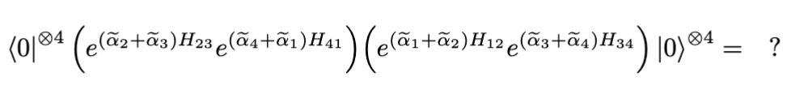
Applications of VTA Approach when N = 4
GSP and VTA for 4-site spin chain
VTA of first blue displacements
VTA of first blue and red displacements

