Slide 1




Ground State Preparation Schemes using Bosonic Algorithms
Luke Bell, Kevin Smith, Yuan Liu, Yan Wang, Eugene Dumitrescu, Steven Girvin

Slide 2
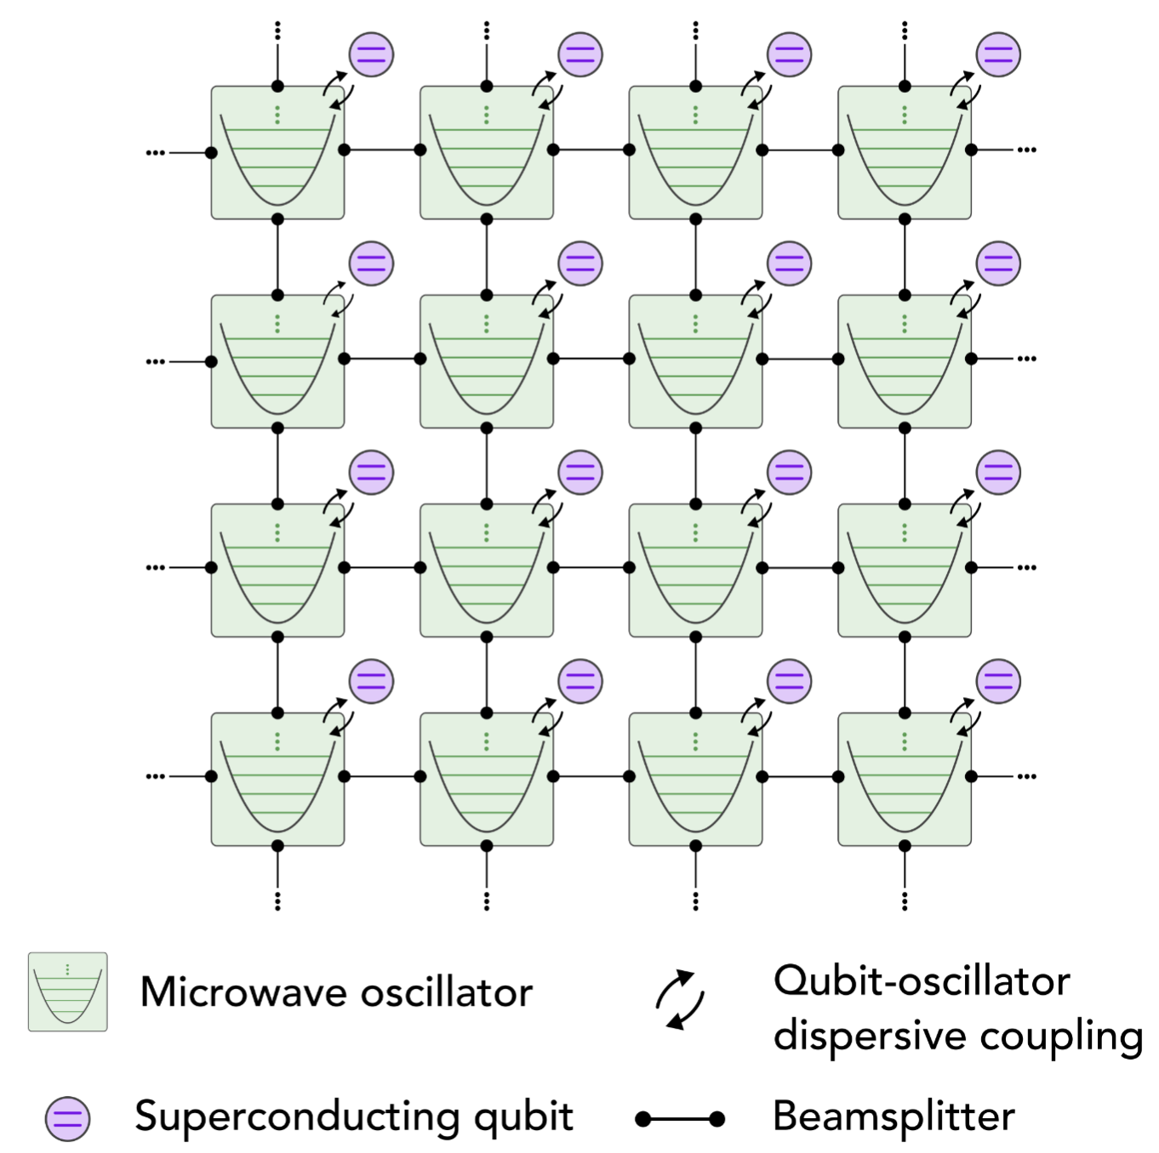
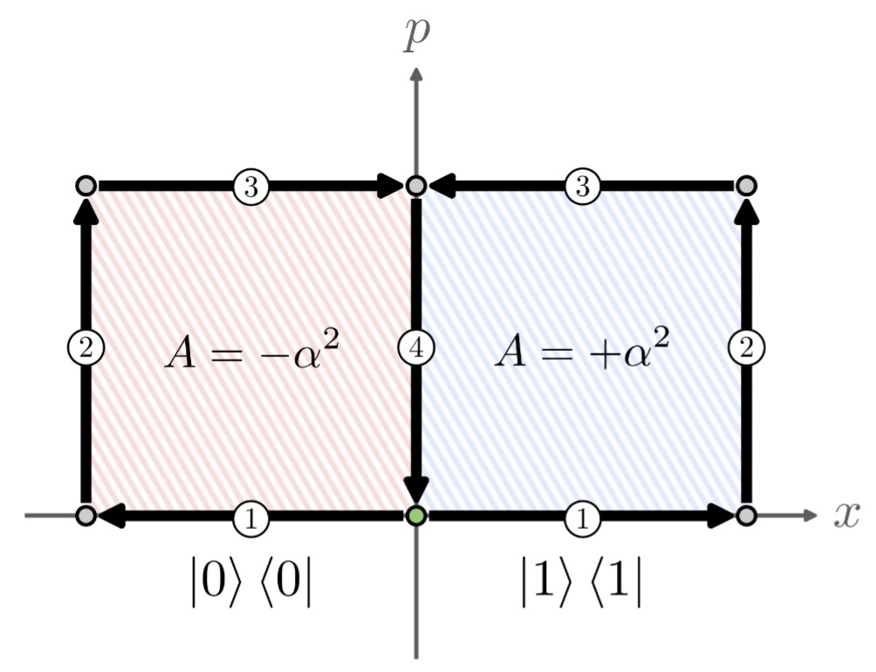
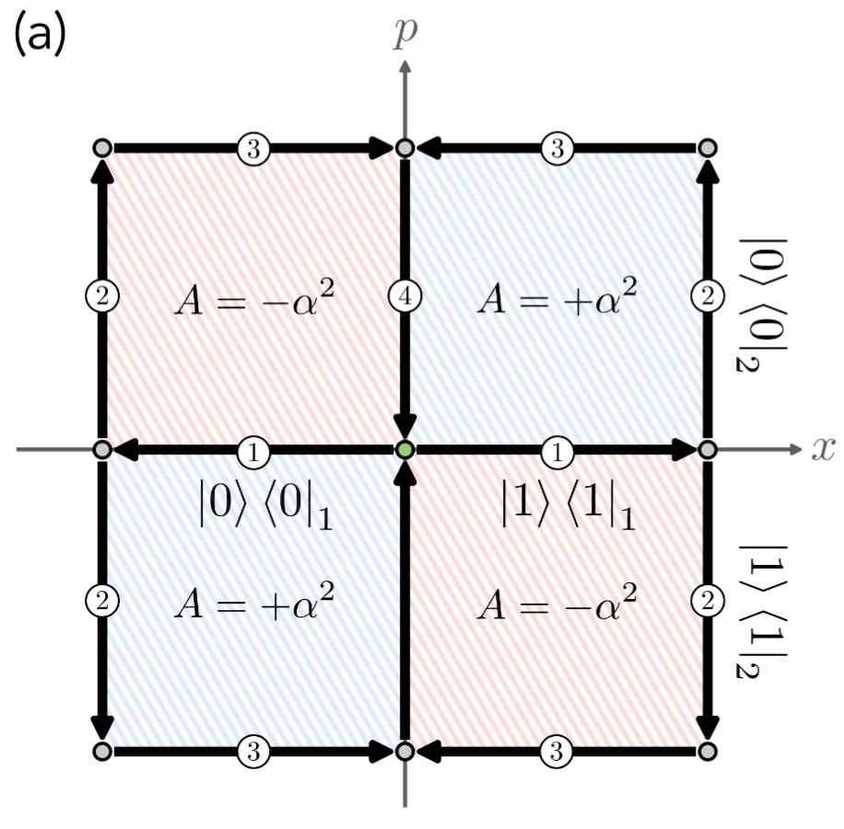



The Big Idea
Hybrid CV-DV quantum processor
Single Qubit Gate
Two Qubit Gate

Slide 3
The Big Idea
Can we extend these ideas to synthesize a ground state preparation algorithm for an antiferromagnetic XXZ Heisenberg spin chain?
Hybrid CV-DV quantum processor
Single Qubit Gate
Two Qubit Gate

Slide 4
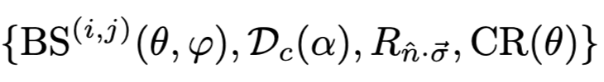
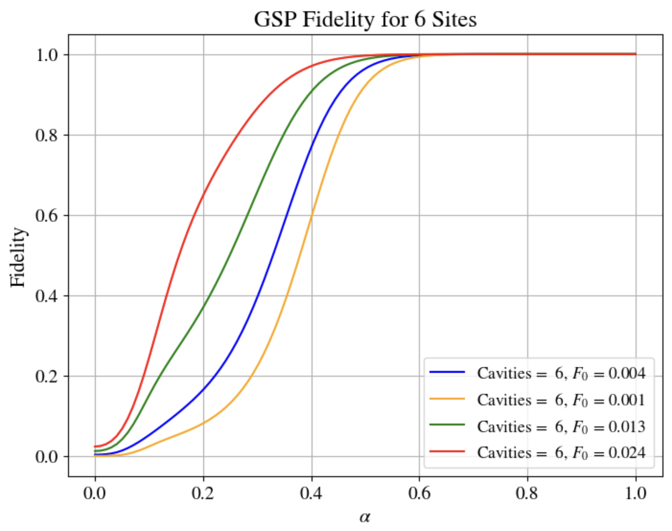

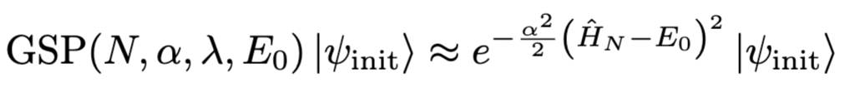
Overview of Algorithm

Slide 5
Talk about total number of natively available gates
Talk about how to compile Dxx, Dyy, Dzz using rules of controlled parities and beamsplitters and single subit rotations
Talk about two site
Then talk about three site and four site with trotter error
Talk about ideal, how this is an approximation to many of these things

