Slide 1


Week 2: Algorithmic complexity
Algorithmic Data Science
2025-26

Slide 2
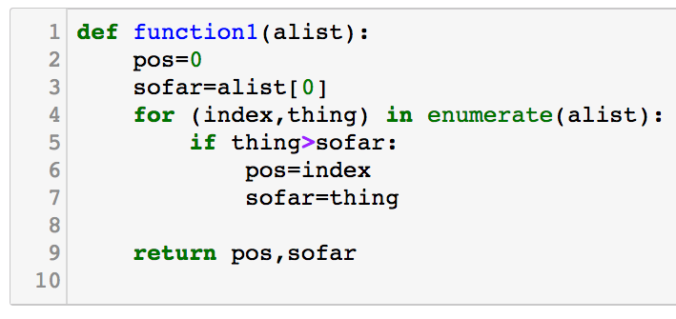
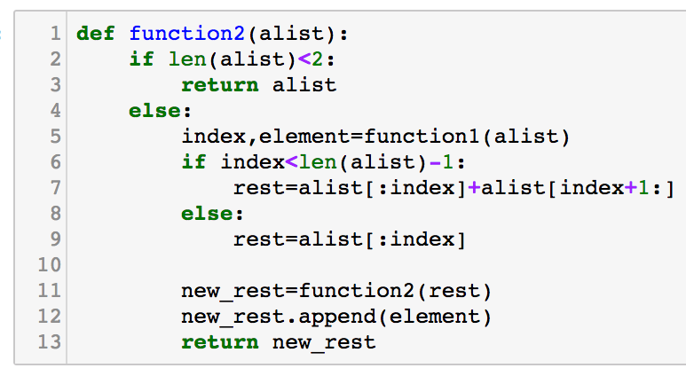
Warm-up:
Look at the code for function1() and function2()
What would be the result of running each of them on the list [5,3,7]?
What problem is each of them trying to solve?
Do you think each of them uses the best algorithm to solve the problem they are trying to solve?
Notes:
Top one for beginners, Both for those who are experienced.

Slide 3
Main topics per week
Week | Topic
1 | Data structures and data formats
2 | Algorithmic complexity. Sorting.
3 | Matrices: Manipulation and computation
4 | Similarity analysis
5 | Processes and concurrency
6 | Distributed computation
7 | Map/reduce
8 | Graphs/networks
9 | Graphs/networks, PageRank algorithm
10 | Databases
11 | independent study
Notes:
Similarity, Clustering, Graphs/networks, PageRank.

Slide 4
Today: 1. Finishing up Topic 1: Data Structures and Data formats 2. Algorithmic Complexity. Sorting algorithms.

Slide 5
1. Finishing up Topic 1: Data Structures and Data formats

Slide 6
Binary Search Trees
height | nodes | capacity
0 | 1 | 1
1 | 2 | 3
2 | 4 | 7
3 | 8 | 15
h | 2^{h} | 2^{h+1}-1
occupations = { }
key | value
sue | lecturer
julie | lecturer
tom | student
bob | porter
tam | student
alice | student
sue
…
julie
…
tom
…
bob
…
tam
…
alice
…
Notes:
Better for accessing in alphabetical order

Slide 7
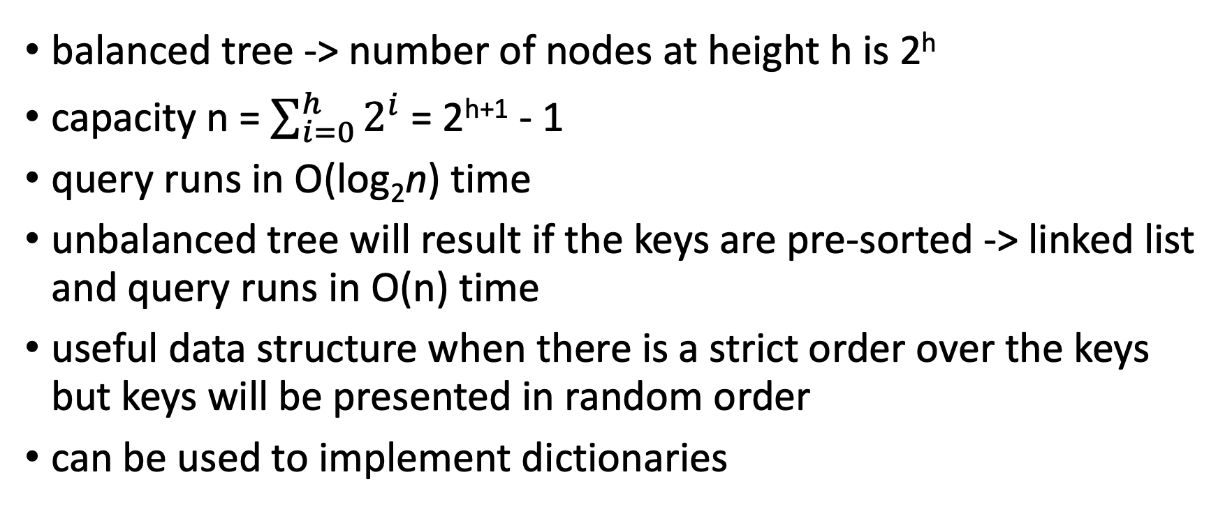
Binary Search Trees
balanced tree -> number of nodes at height h is 2^{h}
capacity n = $\sum_{i=0}^{h}{2^{i}}$ = 2^{h+1} - 1
query runs in O(log₂n) time
unbalanced tree will result if the keys are pre-sorted -> linked list and query runs in O(n) time
useful data structure when there is a strict order over the keys but keys will be presented in random order
can be used to implement dictionaries
Notes:
Talk about what happens in example if names had been presented in alphabetical order
Hash table hard to sort data, and can get collisions, and slow down if no idea what size data you have. O(log n) vs O(1)
Hash table has prescribed size
Anyone know database management example?

Slide 8
Example
Suppose a librarian wants to know how many books in their library have an author that starts with A.
Would it be quicker if the dictionary were stored in a hash table or a binary search tree?

Slide 9
Topic 2: Algorithmic complexity. Sorting.

Slide 10
Recap: algorithms vs problems
An algorithm is a well-defined procedure that takes a value or set of values as input and produces some value or set of values as output.
We distinguish algorithms from problems (or functions), because intuitively we know that sometimes very different algorithms do the same thing i.e., solve the same problem

Slide 11
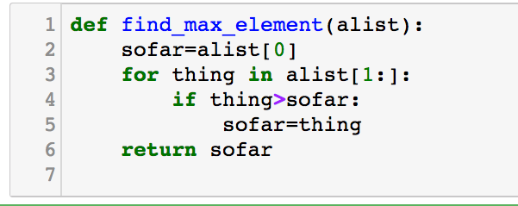
Aside: algorithms vs programs
We use the term algorithm interchangabley with program (e.g., in Python). The emphasis is different though:
An algorithm
A program
Finding biggest element in a list:
Set biggest_sofar to be first element of list.
Then, check each element in list in turn
If It is bigger than biggest_sofar,
update biggest_sofar
Algorithms focus on ideas, not syntax
Programs should be syntactically correct

Slide 12

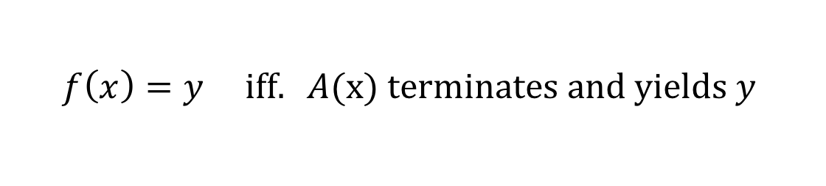
Problems
More formally, a problem is a mapping or a relation from inputs to outputs.
Many problems are also functions. For functions, the mapping is many-to-one or one-to-one. In other words there is only a single correct output for a given input.
$$f:X→Y$$
We say that an algorithm A implements a function problem f, if $∀x∈X,∀y∈Y:$
$$f\left(x\right)=y \text{iff}. A(\text{x}\text{) }\text{terminates} \text{and} \text{yields} y$$

Slide 13
Rate my algorithm ….
Its not enough to write down an algorithm and say ‘Behold. Look at this marvellous algorithm I have written.’
We need to convince ourselves that:
The algorithm terminates (for every possible input)
The algorithm is correct (for every possible input)
The algorithm is better than other possible algorithms.

Slide 14
Comparing algorithms
What does it mean for algorithm A to be better than algorithm B?
TIME COMPLEXITY
SPACE COMPLEXITY
How long will my program take to run?
Is algorithm A faster than algorithm B?
How much memory will my program need?
Does algorithm A use less memory than algorithm B?
COMMUNICATION COMPLEXITY
How many packets of data will my program send over the network?
Does algorithm A send less packets over the network than algorithm B?

Slide 15
What does A is faster than B mean?
A runs faster than B on some inputs
A runs faster than B on all inputs
A runs faster than B on the best case
A runs faster than B on the worst case
A runs faster than B on average
A runs faster than B on average relative to some probability distribution over the inputs
A runs faster than B on typical inputs

Slide 16
Time Complexity
How does the run-time of an algorithm depend on the size of the problem instance / input?

Slide 17
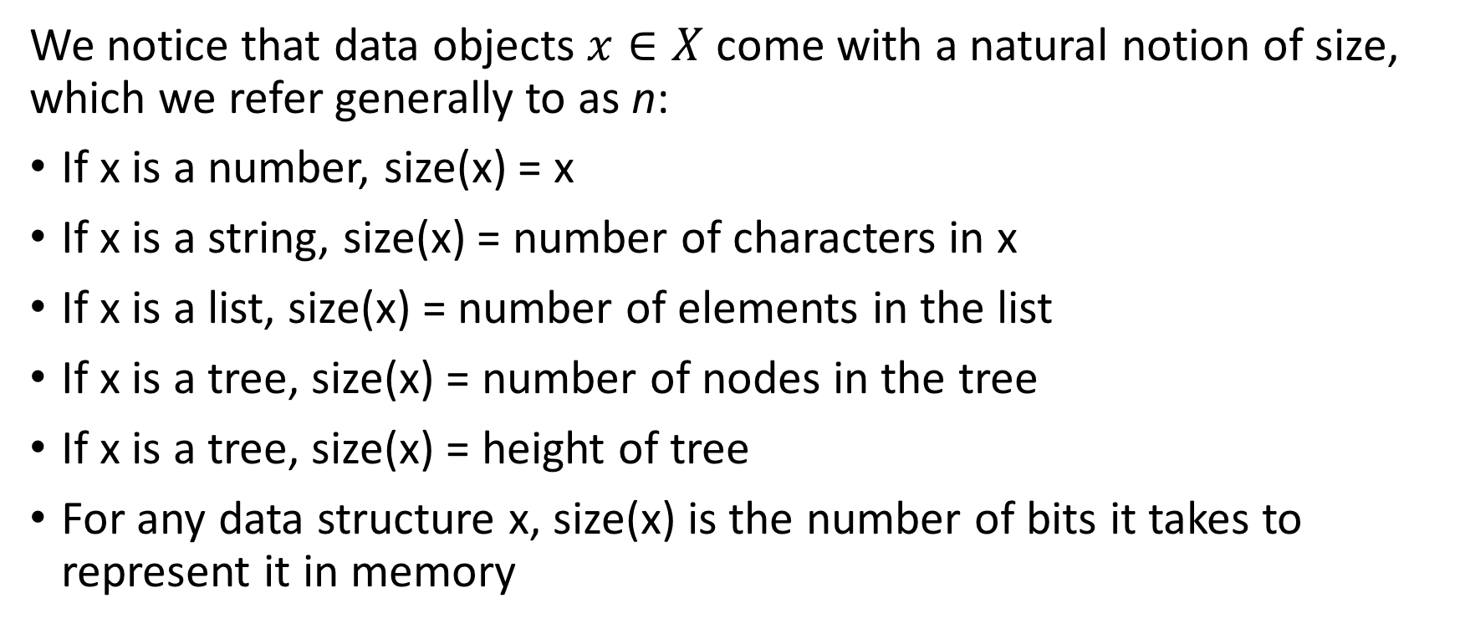
Size of the problem instance : n
We notice that data objects $x∈X$ come with a natural notion of size, which we refer generally to as n:
If x is a number, size(x) = x
If x is a string, size(x) = number of characters in x
If x is a list, size(x) = number of elements in the list
If x is a tree, size(x) = number of nodes in the tree
If x is a tree, size(x) = height of tree
For any data structure x, size(x) is the number of bits it takes to represent it in memory

Slide 18
Constant-time Operations
Clearly, taking more information into account yields more accurate predictions. But, it also makes the analysis much more complicated.
An important insight is that addition, subtraction, if-then-else, …, are (to a good approximation) constant-time operations.
That means there are constants c_{add}, c_{subtract}, c_{if-then-else}, … such that
Executing an addition always takes c_{add} seconds
Executing a subtraction always takes c_{subtract} seconds
Executing a conditional always takes c_{if-then-else} seconds
These constants rely heavily on the chosen programming language, CPU, compiler, clockspeed etc

Slide 19
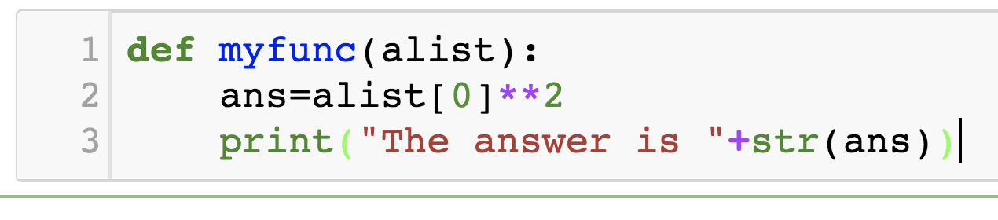
Constant-time
Problem size n = len(alist)
3 operations which are all constant-time: access to list component, exponentiation and assignment
The length of time to complete does NOT depend on the size of the input. This is a constant-time function. The run-time is of the order of 1: O(1)
3 constant-time operations: conversion to string, string concatenation, printing

Slide 20
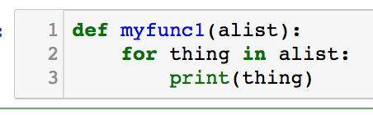
Iterations: Linear-time
Problem size n = len(alist)
A constant time operation (print) is carried out n times
The length of time to complete depends linearly on the size of the input. If the length of the list is doubled, the run-time will be doubled. The run time is some function of n i.e., it is of the order of n. We call this O(n)

Slide 21
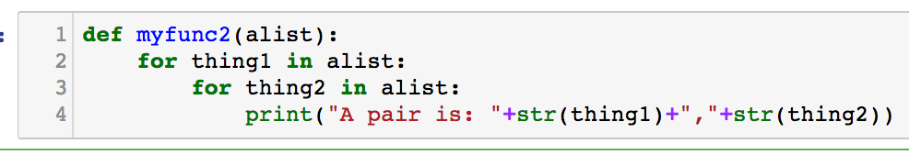
Nested iterations: quadratic time
Problem size n = len(alist)
This internal loop is carried out n times
This instruction is carried out n * n times.
The run-time is quadratic in the size of the input. If the length of the list doubles, the run-time will quadruple. We call this O(n²)

Slide 22
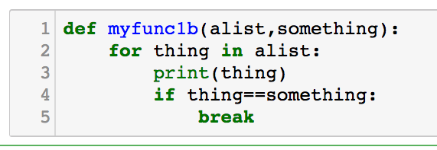
Broken Iterations: Linear-time
Problem size n = len(alist)
3 constant time operations (print, == and if) is carried out up to n times
The UPPER BOUND on the length of time to complete depends linearly on the size of the input. If the length of the list is doubled, the run-time will be potentially doubled. The upper-bound on run time is some linear function of n i.e., it is of the order of n. This is O(n)

Slide 23
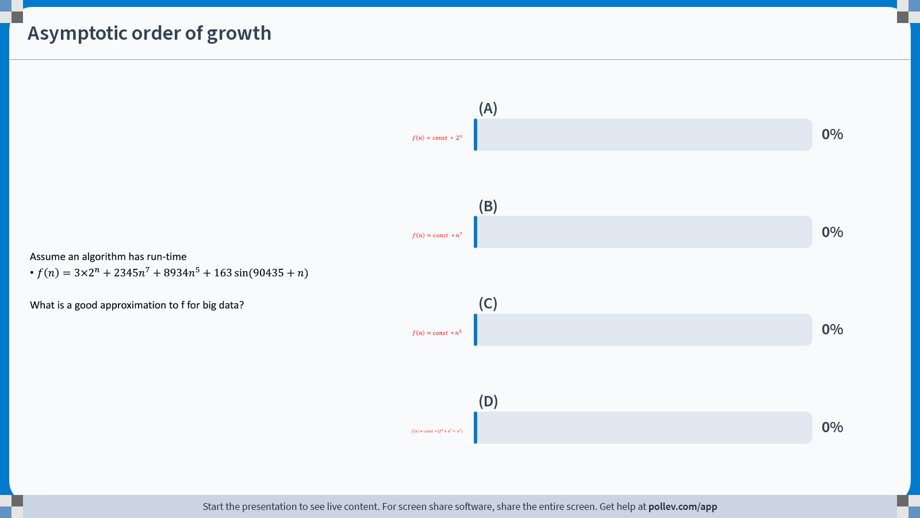
Notes:
Do not modify the notes in this section to avoid tampering with the Poll Everywhere activity. More info at polleverywhere.com/support Asymptotic order of growth
https://www.polleverywhere.com/multiple_choice_polls/0yIrz5GHvV3SAOhX8kOIx?state=opened&flow=Default&onscreen=persist

Slide 24
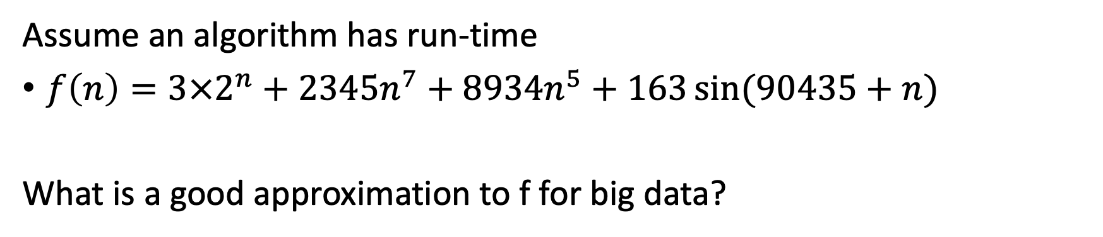
Asymptotic order of growth
Assume an algorithm has run-time
$f\left(n\right)=3×2^{n}+2345n^{7}+8934n^{5}+163\sin{(90435+n)}$
What is a good approximation to f for big data?

Slide 25
Do constants matter?
Assume 1,000,000 operations per second
 | n | nlogn | n² | n³ | 1.5^{n} | 2^{n} | n!
n=10 | <1s | <1s | <1s | <1s | <1s | <1s | 4s
n=30 | <1s | <1s | <1s | <1s | <1s | 18m | 10²⁵y
n=50 | <1s | <1 | <1s | <1s | 11m | 36y | long
n=10² | <1s | <1s | <1s | 1s | 12892y | long | long
n=10³ | <1s | <1s | 1s | 18m | long | long | long
n=10⁴ | <1s | <1s | 2m | 12d | long | long | long
n=10⁵ | <1s | 2s | 3h | 32y | long | long | long
n=10⁶ | 1s | 20s | 12d | 31710y | long | long | long
s=seconds
m=minutes
h=hours
d=days
y=years
long> 10²⁵ years
For large enough n, the specific constants often fade into insignificance in comparison to the number of operations.
In practice, you can find the constant by running algorithm on a subset of data, and then extrapolate to estimate the time needed for the big data task you want to do.

Slide 26
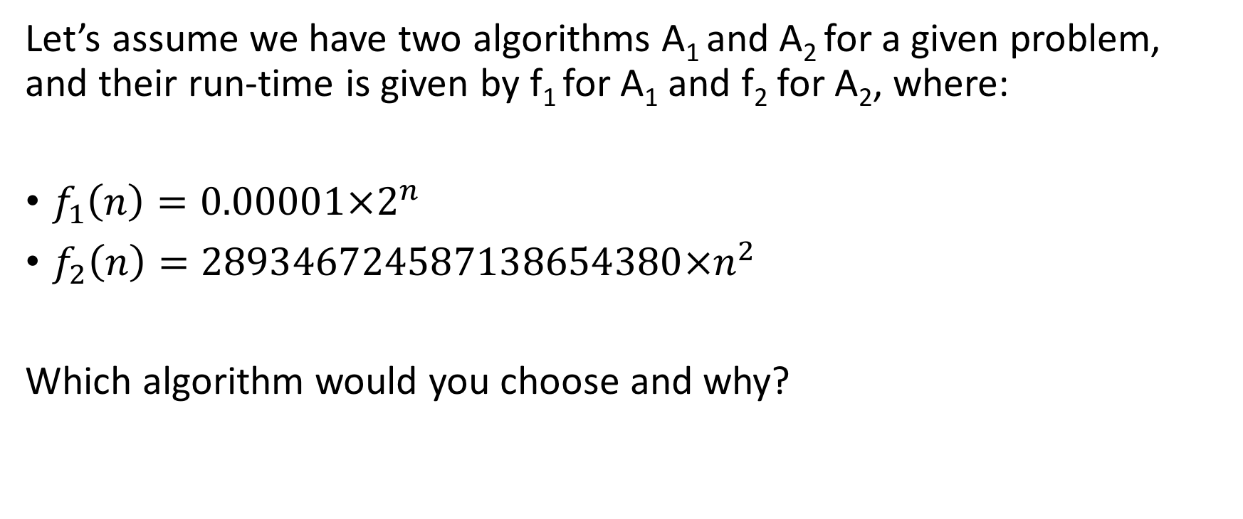
Asymptotic order of growth
Let’s assume we have two algorithms A₁ and A₂ for a given problem, and their run-time is given by f₁ for A₁ and f₂ for A₂, where:
$f_{1}\left(n\right)=0.00001×2^{n}$
$f_{2}\left(n\right)=289346724587138654380×n^{2}$
Which algorithm would you choose and why?

Slide 27
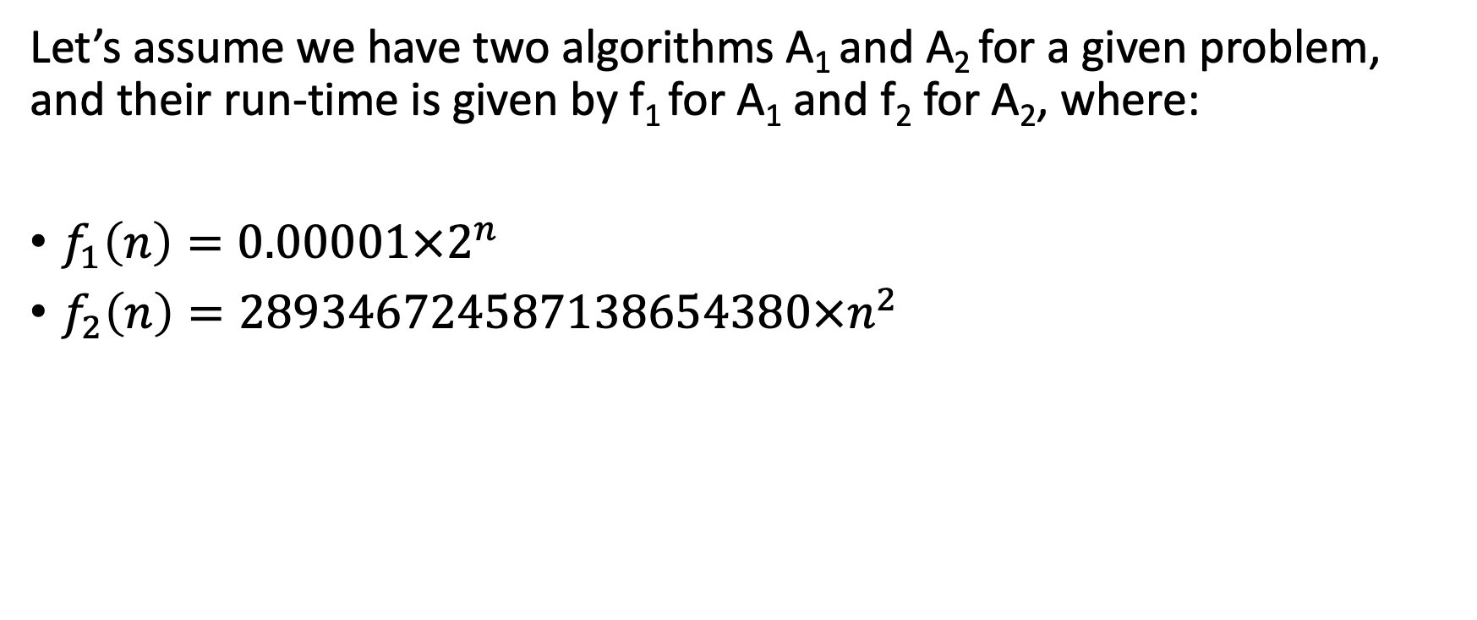
Asymptotic order of growth
Let’s assume we have two algorithms A₁ and A₂ for a given problem, and their run-time is given by f₁ for A₁ and f₂ for A₂, where:
$f_{1}\left(n\right)=0.00001×2^{n}$
$f_{2}\left(n\right)=289346724587138654380×n^{2}$

Slide 28
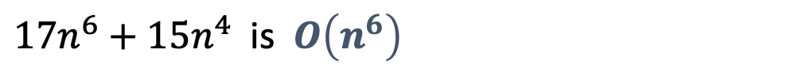
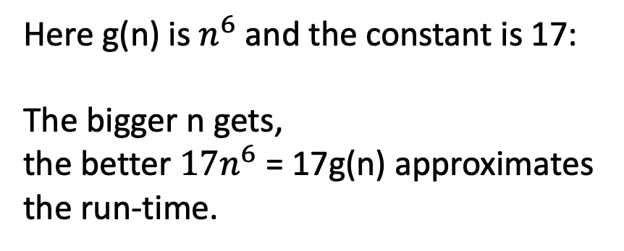
Time complexity O Notation: Loose definition.
A run-time is O(g(n)) if:
For sufficiently large data, const x g(n) approximates the run-time well,
and the approximation generally gets better and better the bigger the data.
Here g(n) is $n^{6}$ and the constant is 17:
The bigger n gets,
the better $17n^{6}$ = 17g(n) approximates the run-time.
Example:
$17n^{6}+15n^{4}$ is $O\left(n^{6}\right)$
Notes:
Common abuse: f(n) = O(g(n)) rather than f(n)∈O(g(n))

Slide 29
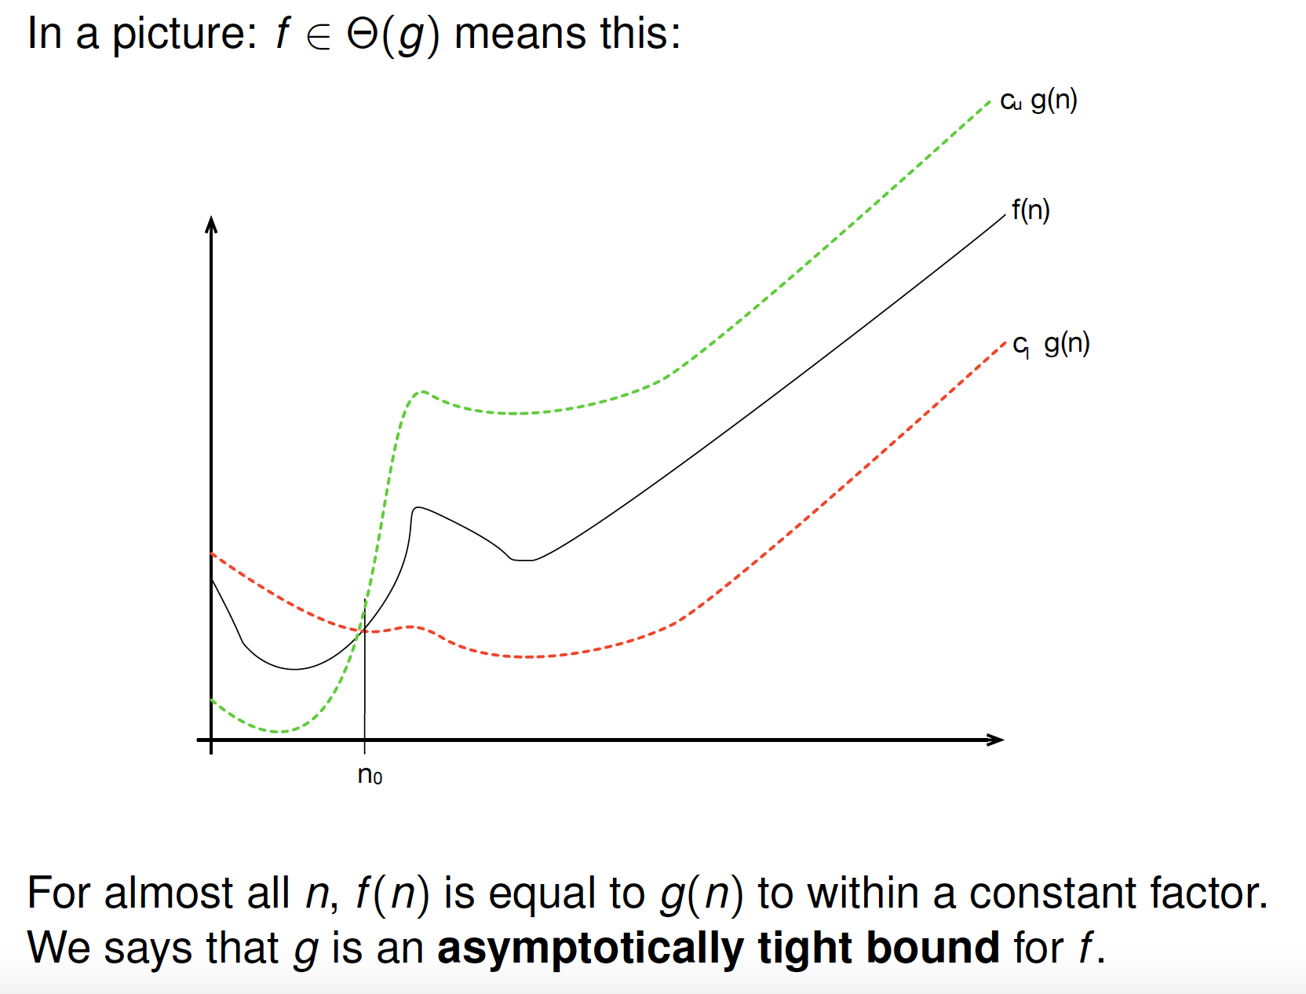

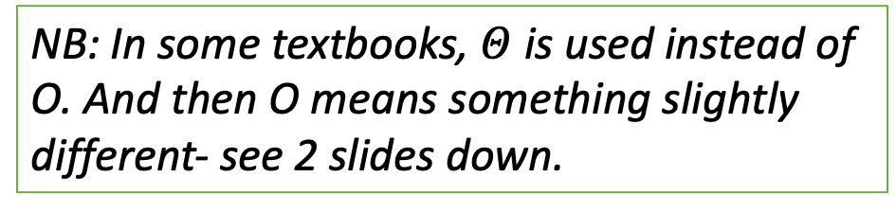
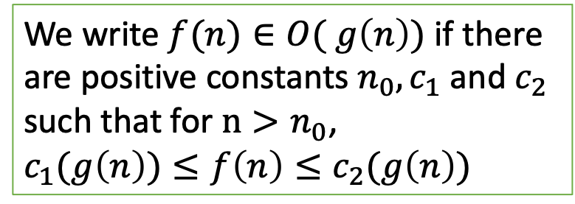
O Notation
O notation asymptotically bounds a function from above and below.
In a picture: $f∈O( g)$ means this:
We write $f(n)∈O( g\left(n\right))$ if there are positive constants $n_{0}, c_{1}$ and $c_{2}$ such that for $n>n_{0}$,
$c_{1}(g\left(n\right))≤f\left(n\right)≤c_{2}(g\left(n\right))$
For almost all n, f(n) is equal to g(n), to within a constant factor. We say that g is an asymptotically tight bound for f.
NB: In some textbooks, $Θ$ is used instead of O. And then O means something slightly different- see 2 slides down.
Notes:
Common abuse: f(n) = O(g(n)) rather than f(n)∈O(g(n))

Slide 30
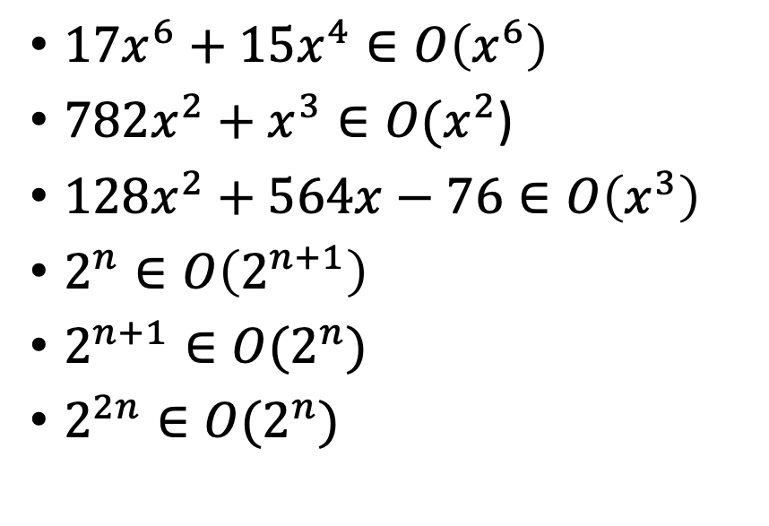
O Notation Examples: True or False?
$17x^{6}+15x^{4}∈O\left(x^{6}\right)$
$782x^{2}+x^{3}∈O(x^{2}$)
$128x^{2}+564x−76∈O\left(x^{3}\right)$
$2^{n}∈O\left(2^{n+1}\right)$
$2^{n+1}∈O(2^{n})$
$2^{2n}∈O(2^{n})$

Slide 31
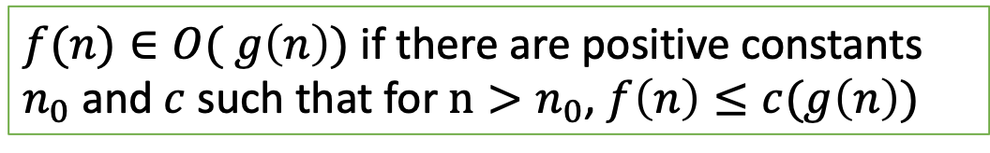

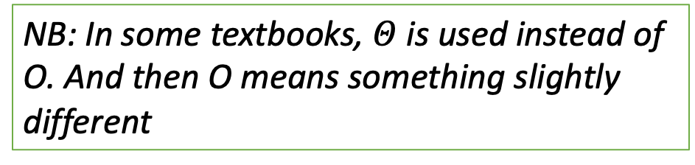
A sometimes encountered alternative definition of O:
NB: In some textbooks, $Θ$ is used instead of O. And then O means something slightly different
This alternative O, that you might encounter elsewhere, provides an asymptotic upper bound on a function.
$f(n)∈O( g\left(n\right))$ if there are positive constants $n_{0}$ and $c$ such that for $n>n_{0}$, $f\left(n\right)≤c(g\left(n\right))$
With this alternative definition,
$$128x^{2}+564x−76∈O\left(x^{3}\right)$$
becomes true.
DO NOT use this definition in any of your work in this module!
Notes:
All the others remain the same.

Slide 32
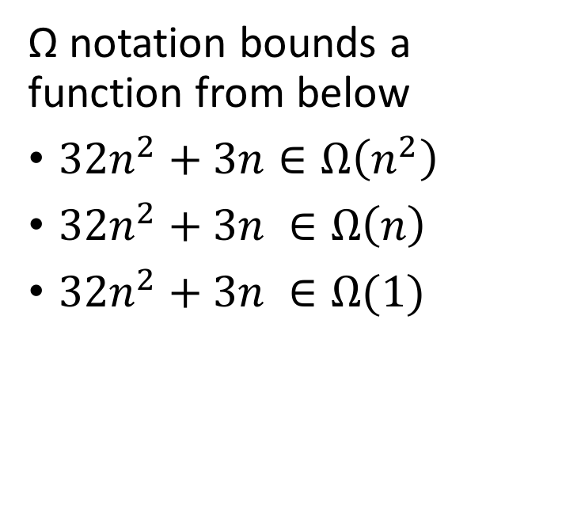
Ω Notation
Ω notation bounds a function from below
$32n^{2}+3n∈Ω\left(n^{2}\right)$
$32n^{2}+3n ∈Ω\left(n\right)$
$32n^{2}+3n ∈Ω(1)$

Slide 33
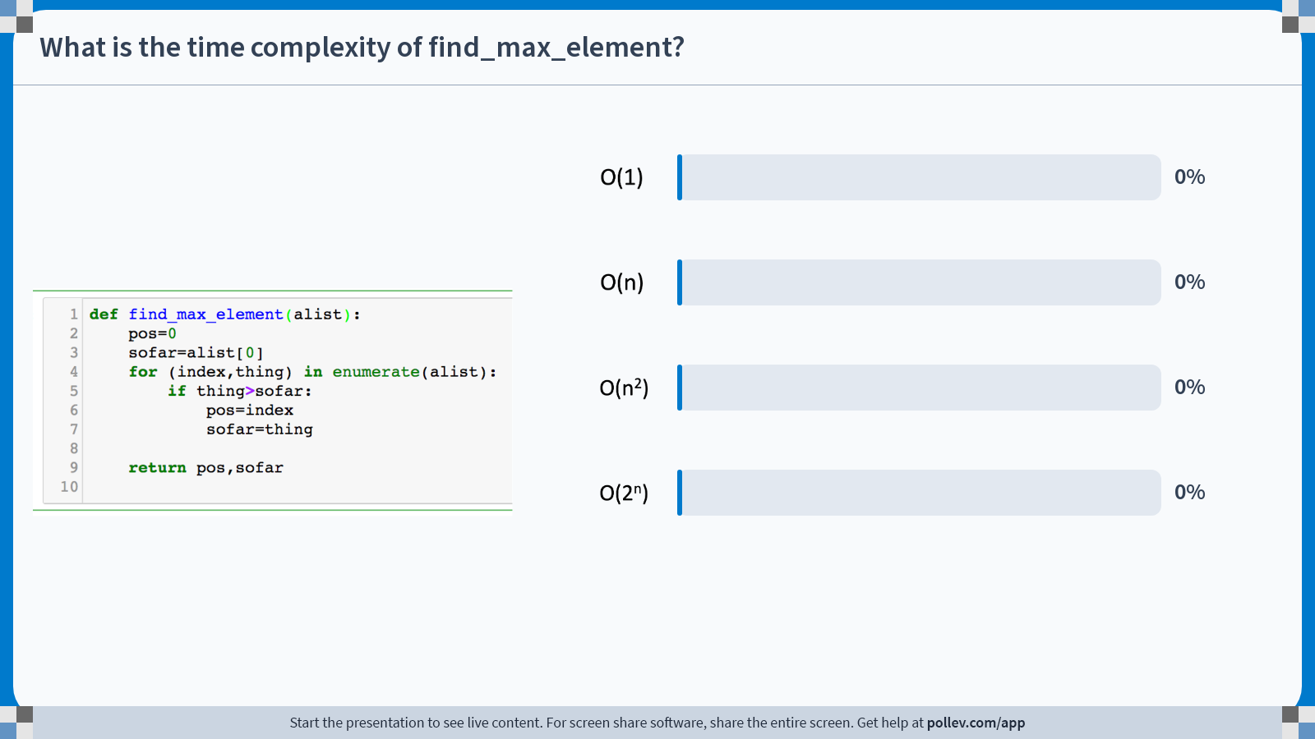
Notes:
Do not modify the notes in this section to avoid tampering with the Poll Everywhere activity. More info at polleverywhere.com/support What is the time complexity of find_max_element?
https://www.polleverywhere.com/multiple_choice_polls/4v6YydO1gsXTcL6ScWpq4?state=opened&flow=Default&onscreen=persist

Slide 34
The Sorting Problem
We saw this algorithm for sorting a list at the beginning of the lecture.
Function: max-sort(alist)
If the length of alist < 2, it is sorted so return alist
Else,
2.1 search alist from beginning to end and find the maximum element and its position (call these element and i).
2.2 Remove element from alist
2.3 sortedlist = max-sort(alist with max element removed)
2.4 sortedlist.append(element)
2.5 return sortedlist
Exercise: Go back to the beginning of the lecture notes and understand the Python code that implements this pseudo code.
What’s the upper bound on its run time?
Can we do better?

Slide 35
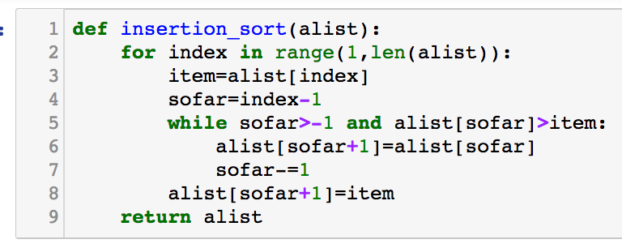
Insertion-sort
For each element in the list, find its correct place in the already sorted list to the left. Insert it (by shifting everything up) and proceed to next element.
alist =
index=1
5, 2, 1, 6
2, 5, 1, 6
1, 2, 5, 6
1, 2, 5, 6
What’s the upper bound on running time for this algorithm?
index=2
index=3

Slide 36
Divide-and-Conquer
Many useful algorithms are recursive in nature. They use the divide-and-conquer paradigm
Divide the problem into a number of subproblems which are similar to the original problem but smaller in size
Conquer the subproblems by solving them recursively. If the subproblems are small enough, solve them in an obvious way (the base case!)
Combine the solutions to the subproblems into the solution for the original problem

Slide 37
Merge-sort
What’s the time complexity of this?
T(n) = 2T(n/2) + T(MERGE(n))
If the length of the list < 2, it is sorted so return
Else, divide the list into 2 halves
Sort each list use merge-sort
MERGE the two sorted lists

Slide 38
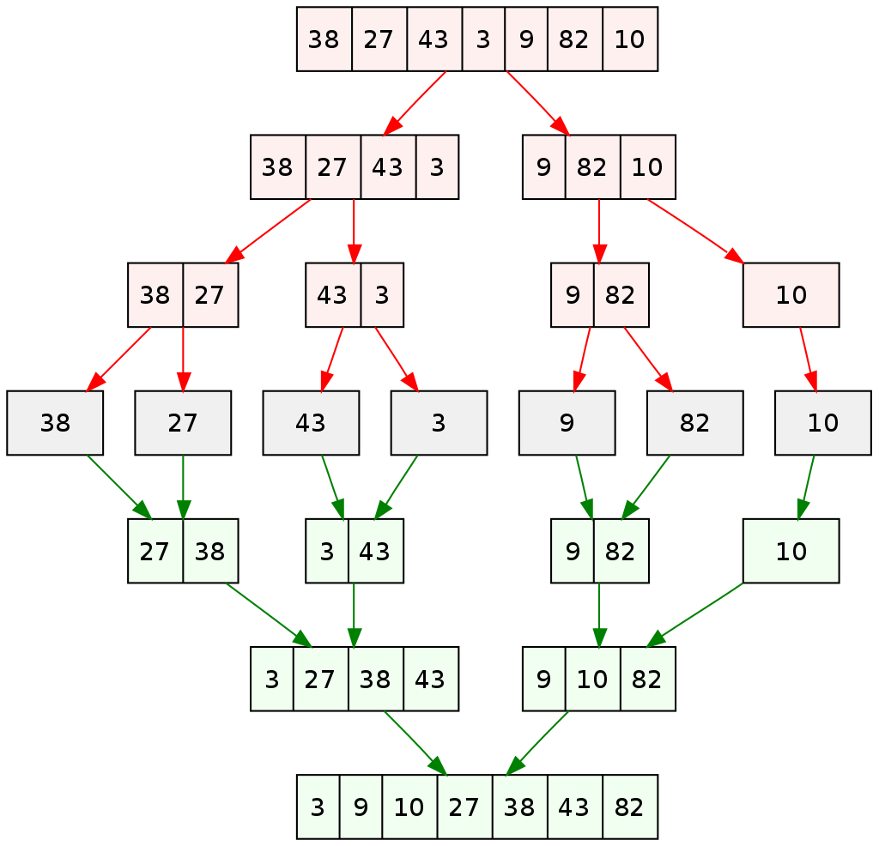
Example (from Wikipedia page on mergsort)
By Vineet Kumar at English Wikipedia - Transferred from en.wikipedia to Commons by Eric Bauman using CommonsHelper.

Slide 39
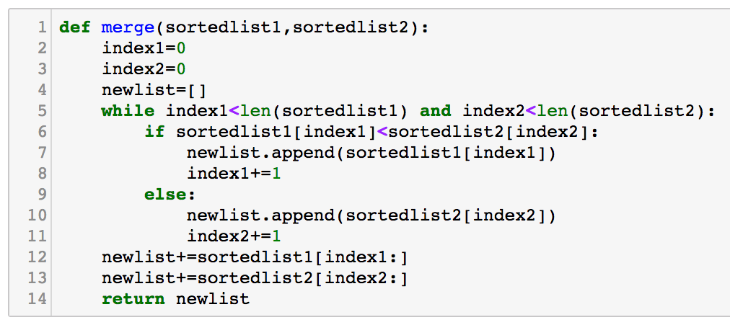
Merging 2 sorted lists
newlist=[]
counter1=0
counter2=0
While counter1 < length(list1) and counter2 < length(list2)
Compare list1[counter1] and list2[counter2]
Append the smaller of these to newlist.
Add 1 to the corresponding counter.
One list will have some stuff left over - append this to newlist.
At most, we check and append each element in each list once. So merging 2 sorted lists is O(n)
Exercise: Go through this Python code and understand it.

Slide 40
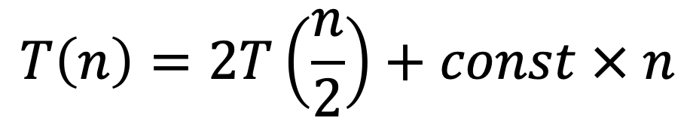
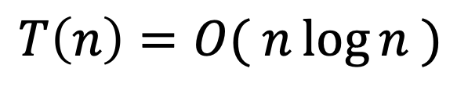
Analysis of merge-sort
Worst case running time for n elements (if n=2^{k} and k>1):
$$T\left(n\right)=2T\left(\frac{n}{2}\right)+const × n$$
Using mathematical induction we can show:
$$T\left(n\right)=O( n\log{n} )$$
[ Get log n copies of const x n term, and other term is $2^{\log_{2}n}T\left(1\right)=O\left(n\right)$ ]
Notes:
Get log n copies of n

Slide 41
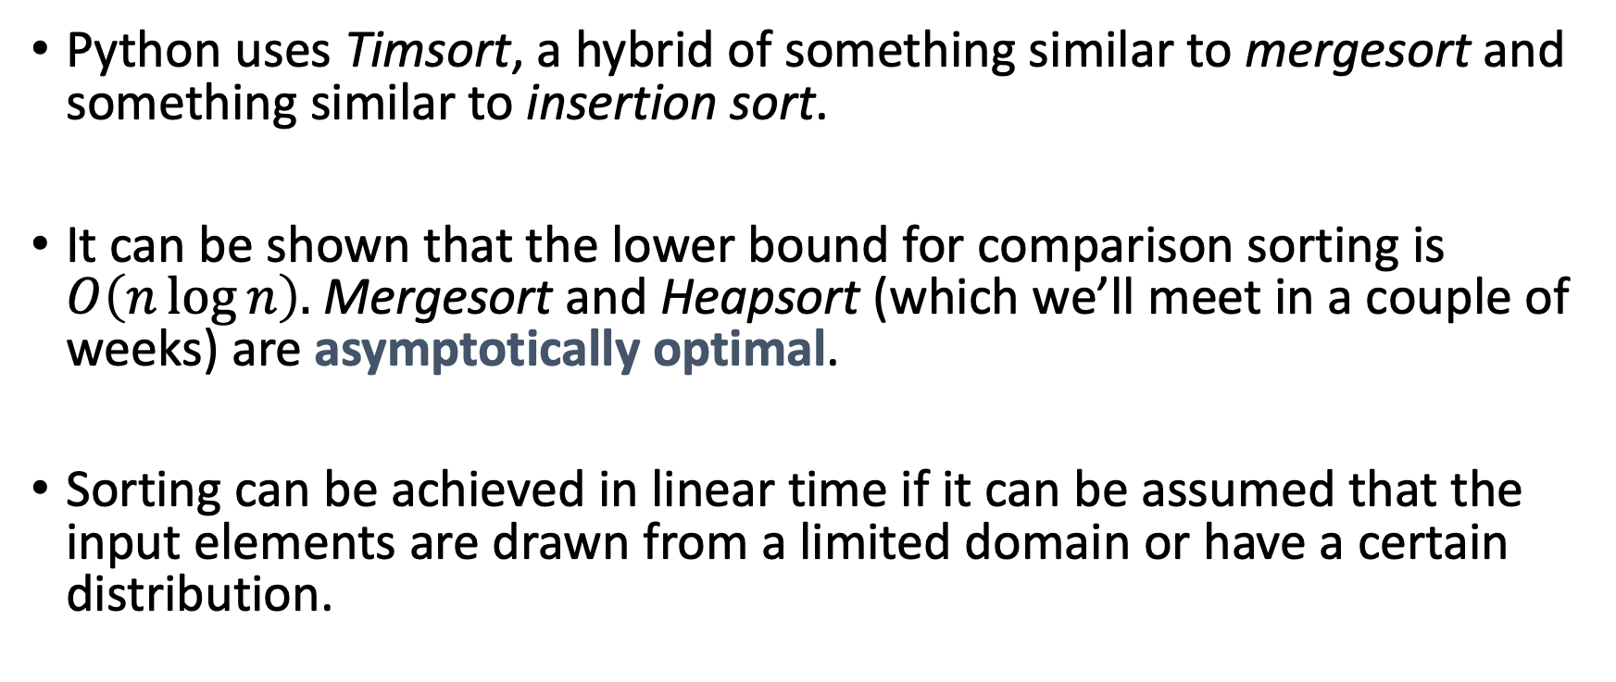
Other sorting algorithms
Python uses Timsort, a hybrid of something similar to mergesort and something similar to insertion sort.
It can be shown that the lower bound for comparison sorting is $O\left(n\log{n}\right).$Mergesort and Heapsort (which we’ll meet in a couple of weeks) are asymptotically optimal.
Sorting can be achieved in linear time if it can be assumed that the input elements are drawn from a limited domain or have a certain distribution.
Notes:
Limited domain: between 1 and 10, 1000 elements.

Slide 42
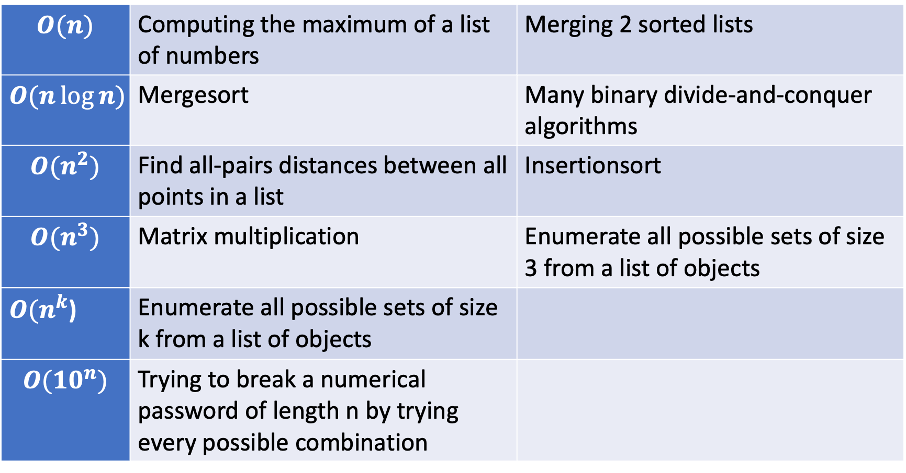
Common Run-times
$$O(n)$$ | Computing the maximum of a list of numbers | Merging 2 sorted lists
$$O(n\log{n})$$ | Mergesort | Many binary divide-and-conquer algorithms
$$O(n^{2})$$ | Find all-pairs distances between all points in a list | Insertionsort
$$O(n^{3})$$ | Matrix multiplication | Enumerate all possible sets of size 3 from a list of objects
$O(n^{k}$) | Enumerate all possible sets of size k from a list of objects
$$O({10}^{n})$$ | Trying to break a numerical password of length n by trying every possible combination

Slide 43
Summary
What have you learnt today?
Time complexity and O notation
Analysed sorting algorithms, recursion as a tool.
Insertion sort
Mergesort
Heapsort

