Slide 1
IMS Project
By Luke brazil

Slide 2
Introduction
My name is Luke Brazil
Aspiring Software Developer
Hobbies: Disc Golf, Reading, Scuba Diving

Slide 3
Technologies Used
Maven
Java
Junit
MySql

Slide 4
Testing
Testing was Conducted Using Junit
Testing conducted to test functionality of methods

Slide 5
Sprint Review
Epics List
Create Maven Project
Build Basic Classes
Build Sql Connection
Build Tests
Create Presentation

Slide 6
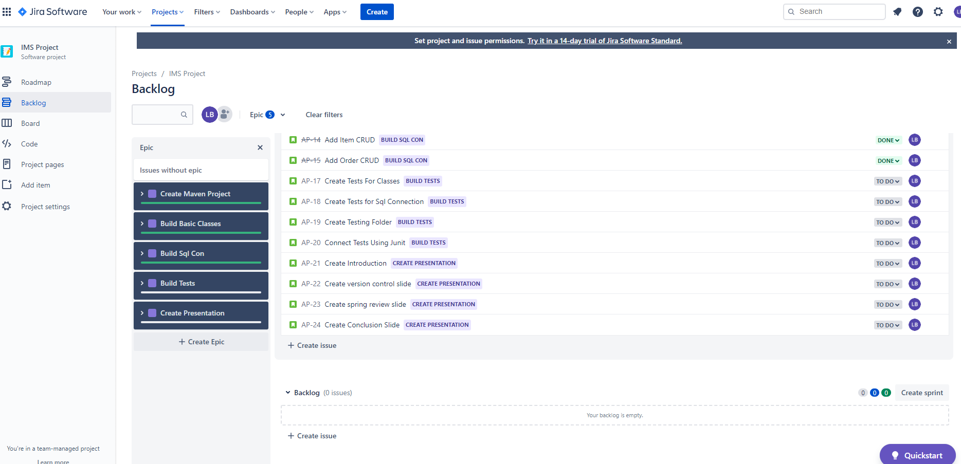

Slide 7
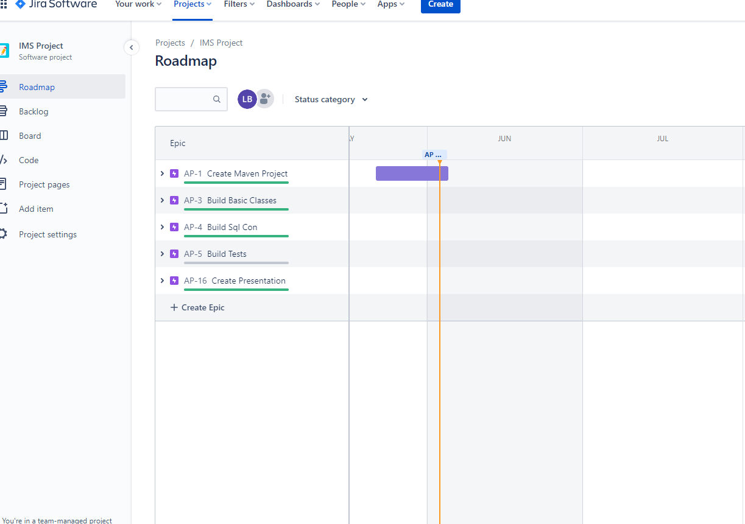

Slide 8
Sprint Retrospective
Sprint started well
Personal reasons made the sprint hard
Building classes sprint and sql connection sprint
  Built basic classes and connected to sql using a runner class
  Runner class runs a switch statement based on input
Presentation sprint went well with creating the presentation

Slide 9
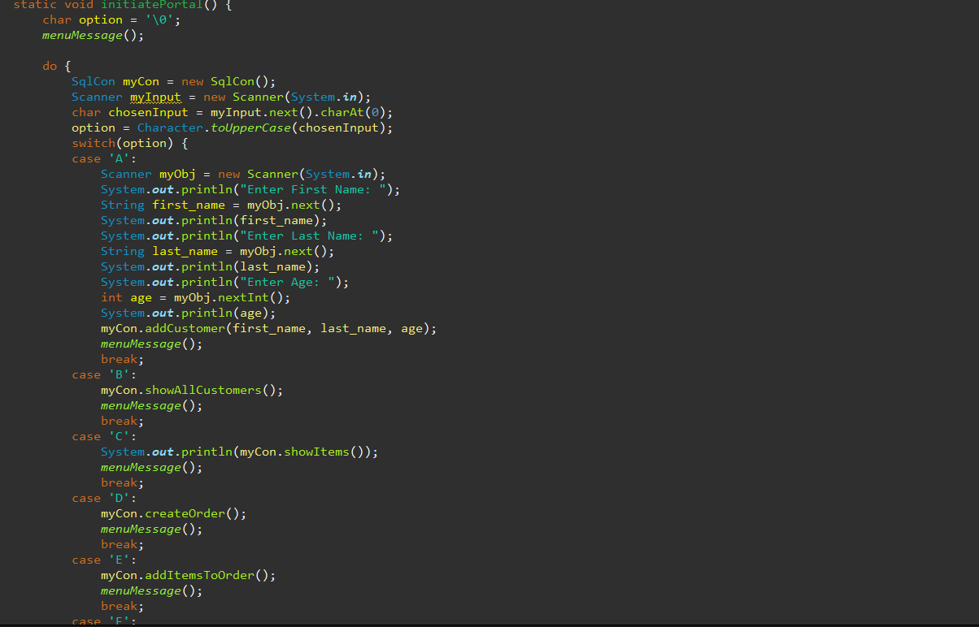

Slide 10
Thank you!!
Thanks for looking at my project I hope it finds you well.
  Luke Brazil

