Slide 1
Average UK Temperatures Analysed between 1957 and 1975
Laura J. Phillips

Slide 2
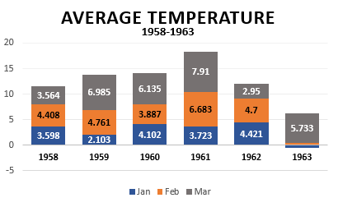
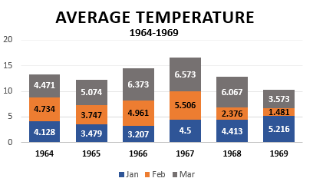
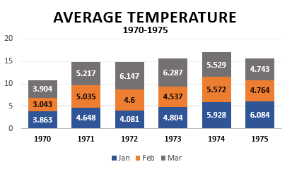
1963 was an outlier,
not a good year for the UK weather as temperatures were considerably colder during these time.
271 records analysed between 1958 and 1975
We can see the change in the quarterly, average temperature change each year and it is quite significant for January!

