Slide 1
Average UK Temperatures (Jan – March) Analysed between 1957 and 1975
Laura J. Phillips

Slide 2
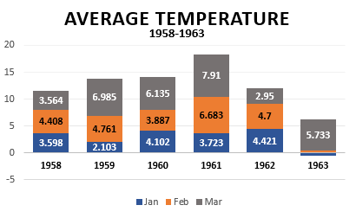
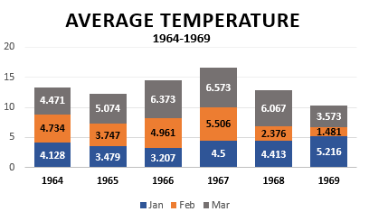
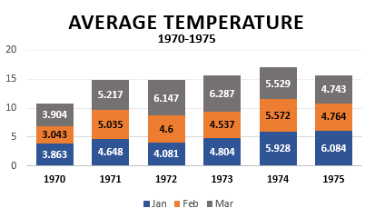
January and February 1963 was not a good year for the UK weather temperatures as these were considerably colder during this time.
Between 1958 and 1975, 271 weather temperature records were recorded. This analysis is investigating the trends of the first three months across this time period.
We can see the change in the UK’s quarterly, average temperature for each year

