Slide 1

Guild Planner
By Jay Forbes, Luke Cormier and Cameron Watson

Slide 2
Our Idea..
No more google sheets
No more discord
No in game schedule

Slide 3


Communication
We used discord as the main way to communicate.
We transferred files through discord and google drive.

Slide 4

Adonis Framework
AdonisJS is a Node.js web framework.
AdonisJS is a lot like Laravel framework.
Supports a large variety of modules.

Slide 5
Adonis Framework
Create URLs using routes
Handle requests using controllers
Database interaction
Render HTML using templates
Authenticate users
Validation

Slide 6

Hurdles we had..
Difficult to run off of a local database
Moving website to a server

Slide 7
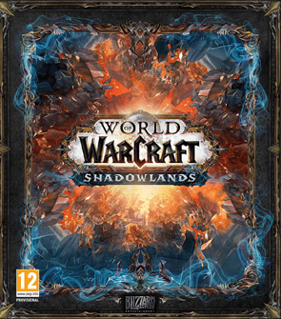
Guild Planner 2.0
Import your character
Display character stats
Authenticate users with their battle.net tag using blizzard API.

Slide 8
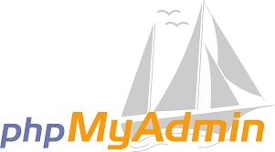
Database
Uses phpmyadmin to store events.
Can be accessed by those with admin privileges.
Can dynamically change events.

Slide 9

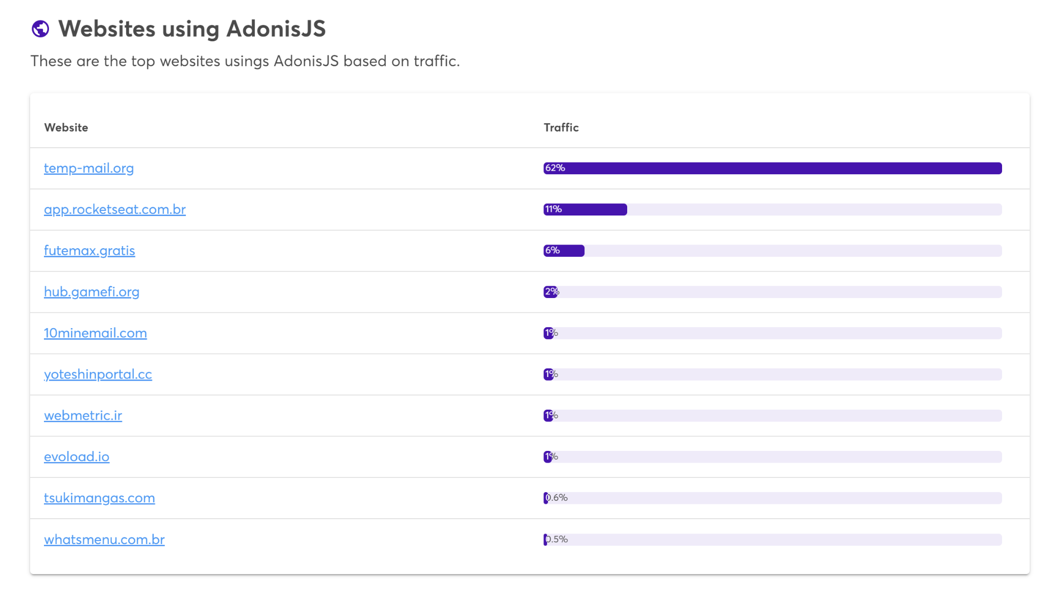
Other Websites
There are other websites that also use AdonisJS
Temp-mail.org
Keeps email anonymous when in public.

Slide 10
Functionality
Operates only on creating account.
Users can access events once logged in.

Slide 11
Uses
Planning events and raids.
Cooperate with guild members on time and place.
Change plans on the fly.

Slide 12


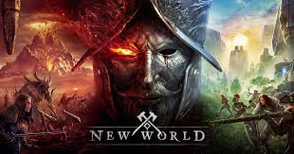
Games
World of Warcraft
New World
Elder Scrolls Online
The Old Republic

Slide 13
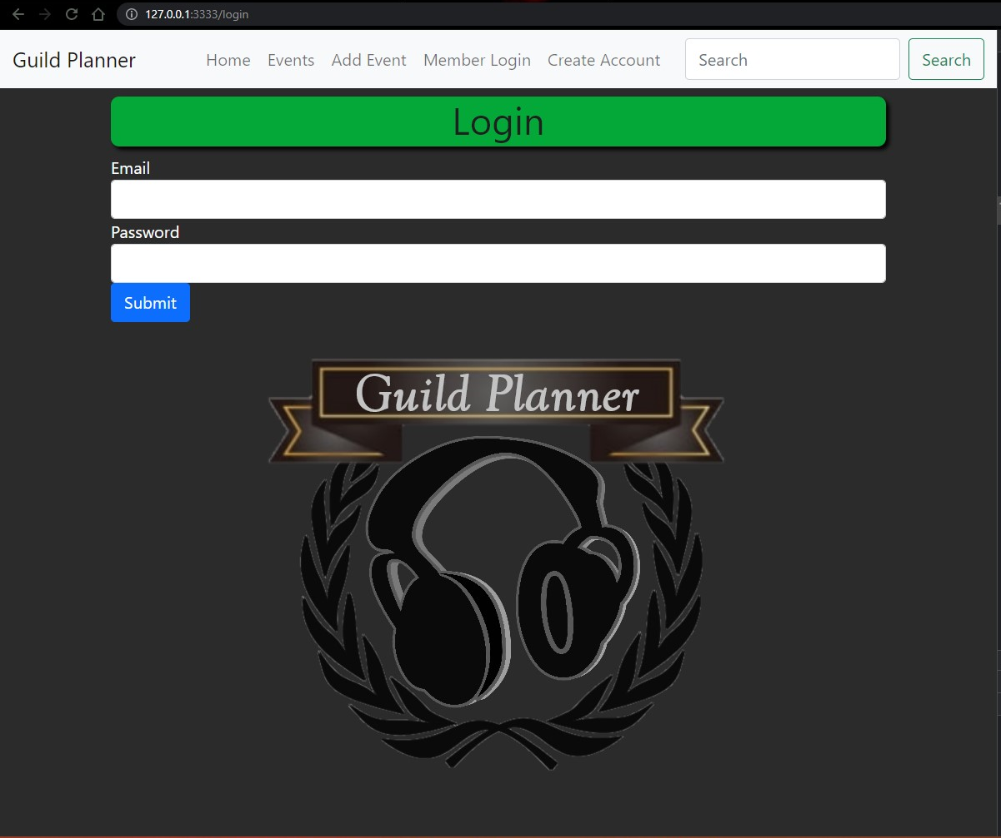
Showcase

Slide 14
Questions?

