Slide 1
D214 Capstone Presentation
By Luke Dorsett

Slide 2

About Me!
B.S. in Geographic Information Systems (GIS) from the University of Washington
Pursuing a M.S. in Data Analytics from Washington Governors University
Passionate about learning new applications for data science/analytics

Slide 3
Problem Statement and Hypothesis
Dataset for this study: 300,152 observed flight prices in India on EaseMyTrip.com. Observed from February-March 2022 (source)
Problem statement: Can a Random Forest Regressor (RFR) model be made on the research dataset?
Null hypothesis: A RFR model cannot be made from the research dataset
Alternate hypothesis: A RFR model can be made on the research dataset at <15% MAPE

Slide 4
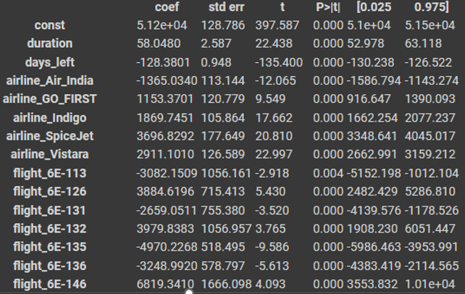
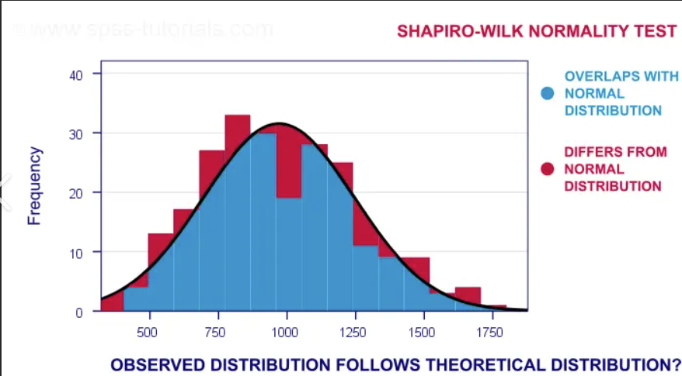
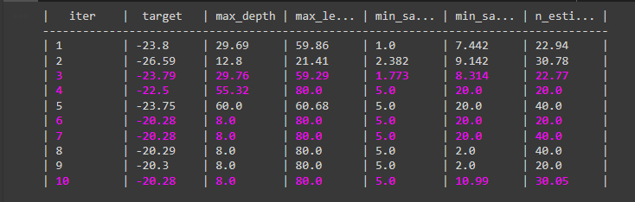
Data Analysis Process
Step 1: Clean Data | Step 2: Explore Data | Step 3: Analyze Data
Check for missing values | Evaluate normality of data | Create model for analysis
Convert categorical variables to numeric | Perform linear regression | Use hyperparameter tuning to find best models
Fig 2
Fig 3
Fig 1

Slide 5
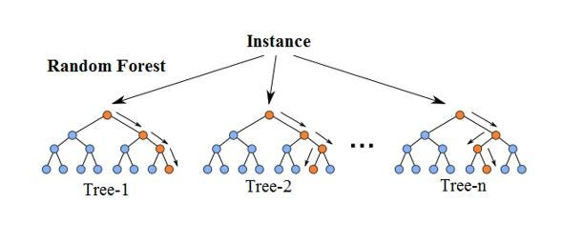
Findings
Model No. | N_estimators (purple) | Max_depth (green) | Max_leaf_nodes (orange) | MAPE
1 | 10 | 4 | 4 | 30.9%
2 | 20 | 8 | 8 | 24.56%
3 | 34 | 8 | 8 | 18.24%
4 | 40 | 8 | 80 | 12.72%
MAPE <15%: Null hypothesis is rejected

Slide 6
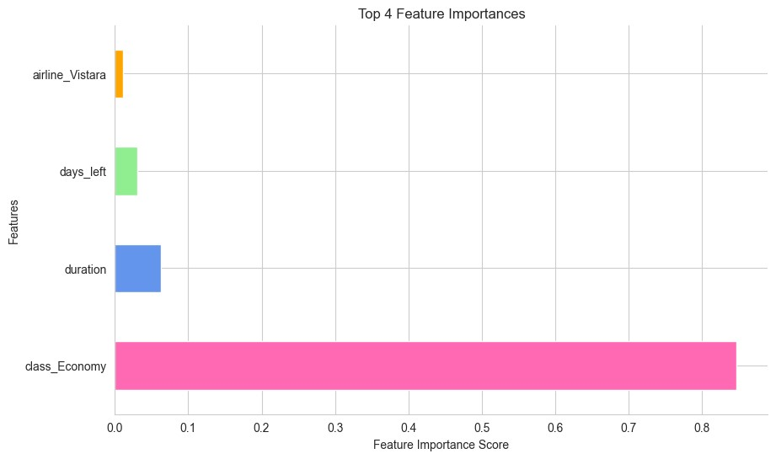
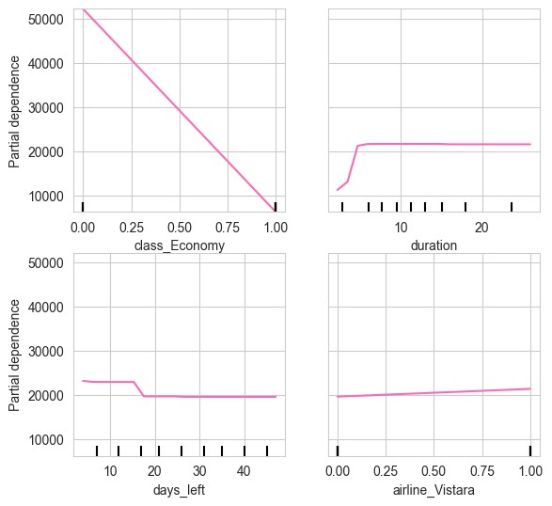
Findings (cont.)
Most Important Features
Analysis of Most Important Features

Slide 7
Limitations of Tools and Techniques
Primary limitations: hardware and time
Machine used for the study did not have optimal CPU for the task
More CPU cores = faster training
Python is the slowest data science language (R and SAS are faster)
Random Forest Model

Slide 8
Proposed Actions
Refine the model from this study – with more time, the MAPE value can likely get much lower than from this study
Use more advanced hardware for faster training – multiple machines with better CPUs can train several models at once at faster rates
Use data from around the year for better generalization – events such as holidays not represented, so model likely will not work for these times

Slide 9
Benefits of this Study
Better understanding of the nuances of airline pricing – insight into how airline companies price different types of flights (What actually increases flight price?)
Useful for planning for companies and the average person – companies can plan better when many tickets must be purchased, individuals can plan travel with less uncertainty
Competitive insight into airlines – airline companies can evaluate how competitors price their tickets for different flight types

