Slide 1
Samuli Launiainen (google: https://goo.gl/zTQA2D)
Academy Research Fellow (- 8/2021)
PhD meteorology (2011, Univ. Helsinki)
Univ. Helsinki: 2006 – 2010
Metla / Luke: 8/2010 -
Strengths:
Generalist, excellent in seeing connections and breaking the big picture into pieces (and sometimes putting it back together)
Some mathematical & programing skills
Motivation & motivating(?)
Research interests: numerous
Mechanistic modeling, dynamic modeling
Soil-vegetation-atmosphere exchange, coupling biogeochemical and hydrologic cycles
Environmental impacts of forestry
Forest trafficability

Slide 2
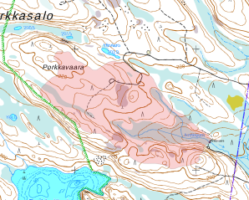
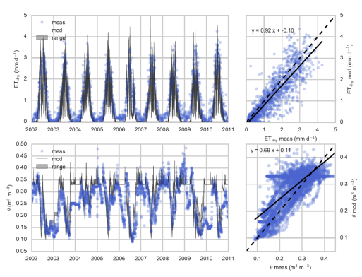
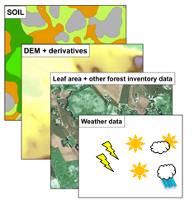
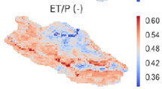
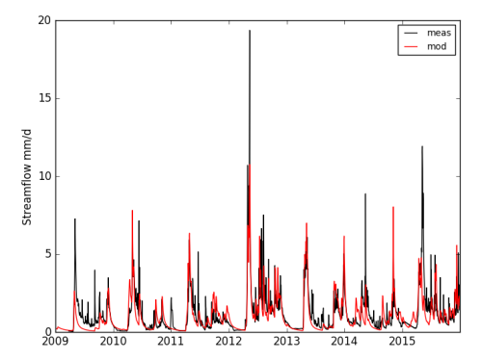
Can we upscale processes and mass balances from point to stand and landscape?
?
Theories, small-scale models
Open GIS-data
meteorologic data
Distributed ET,
snow & soil water
predictions,
streamflow
ICOS
Small-scale data
Large-scale data

Slide 3
Contacts
Luke:
Antti-Jussi, Kersti Haahti, Mingfu Guan, Aura Salmivaara, Leena Finer, Mika Nieminen, forest technologists, Hiha-people
Climate impacts of boreal bryophytes – from functional traits to global models (AKA 2016-2018)
Gaby Katul (Duke Univ.); Seven Rice (Union College); Sebastian Luyssaert (VU Amsterdam); Hotaek Park (Japan), Eeva-Stiina Tuittila (UEF); Annalea Lohila, Mika Aurela (FMI); Univ. Hel. / INAR / ICOS
Ecophysiology and ecohydrology
Gaby Katul; Timo Vesala, Annikki Mäkelä (Univ. Hel); Hjalmar Laudon, Niles Hasselquist (SLU Umeå); Giulia Vico (SLU Uppsala)
Hydrologic & biogeocemical modeling
Ari Lauren (UEF/Luke); Gaby Katul; Stefano Manzoni (Univ. Stockholm), Harri Koivusalo (Aalto)

