Slide 1
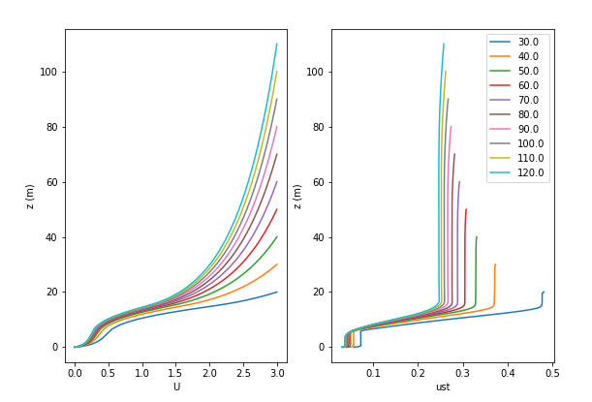
1st order closure, growing
ASL. Constant Utop = 3ms-1

