Slide 1
Infinite Impulse Response Filters

Slide 2
Outline
Many roles for filters
Two IIR filter structures
  Biquad structure
  Direct form implementations
Stability
Z and Laplace transforms
Cascade of biquads
  Analog and digital IIR filters
  Quality factors
Conclusion
6 - <number>

Slide 3
Many Roles for Filters
Noise removal
  Signal and noise spectrally separated
  Example: bandpass filtering to suppress out-of-band noise
Analysis, synthesis, and compression
  Spectral analysis
  Examples: calculating power spectra (slides 14-10 and 14-11) and polyphase filter banks for pulse shaping (lecture 13)
Spectral shaping
  Data conversion (lectures 10 and 11)
  Channel equalization (slides 16-8 to 16-10)
  Symbol timing recovery (slides 13-17 to 13-20 and slide 16-7)
  Carrier frequency and phase recovery
6 - <number>

Slide 4
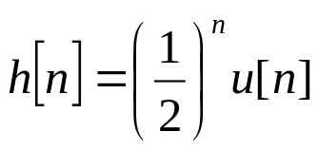
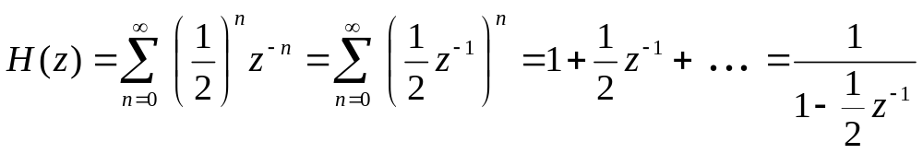
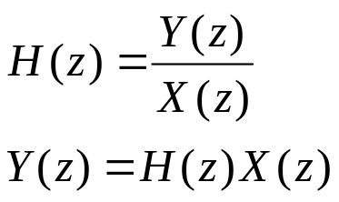
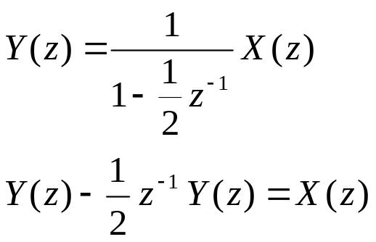
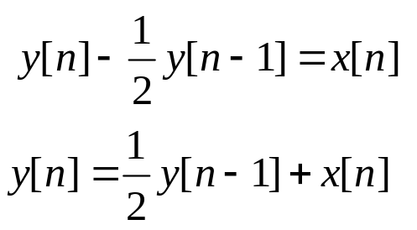
Digital IIR Filters
Infinite Impulse Response (IIR) filter has impulse response of infinite duration, e.g.
How to implement the IIR filter by computer?
  Let x[k] be the input signal and y[k] the output signal,
Z
Recursively compute output y[n], n ≥ 0, given y[-1] and x[n]
6 - <number>

Slide 5
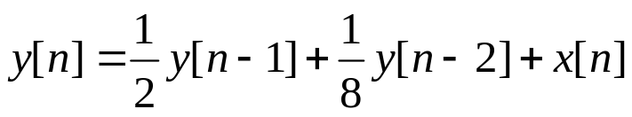
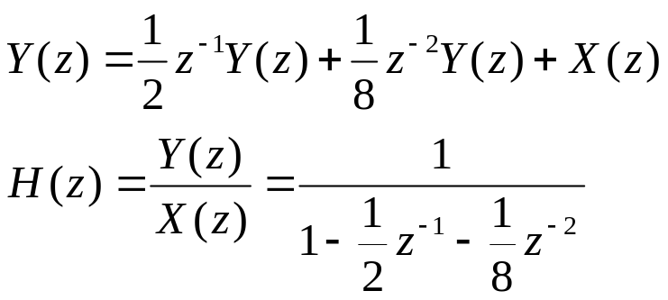
Different Filter Representations
Difference equation
  Recursive computation needs y[-1] and y[-2]
  For the filter to be LTI,
  y[-1] = 0 and y[-2] = 0
Transfer function
  Assumes LTI system
Block diagram representation
  Second-order filter section (a.k.a. biquad) with 2 poles and 0 zeros
x[n]
Σ
y[n]
Unit
Delay
1/2
y[n-1]
Unit
Delay
1/8
y[n-2]
Poles at –0.183 and +0.683
6 - <number>

Slide 6
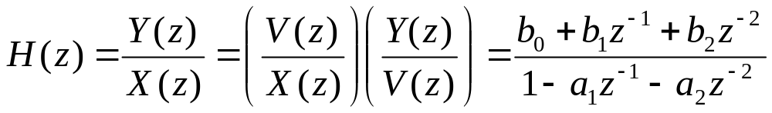
Discrete-Time IIR Biquad
Two poles, and zero, one, or two zeros
Overall transfer function
  Real a₁, a₂ : poles are conjugate symmetric (α ± jβ ) or real
  Real b₀, b₁, b₂ : zeros are conjugate symmetric or real
v[n]
x[n]
Σ
b₀
Σ
y[n]
Unit
Delay
a₁
b₁
v[n-1]
Biquad is short for biquadratic− transfer function is ratio of two quadratic polynomials
Unit
Delay
v[n-2]
a₂
b₂
6 - <number>

Slide 7
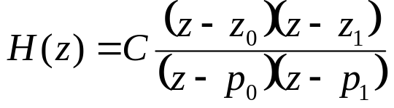
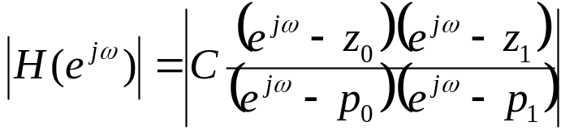
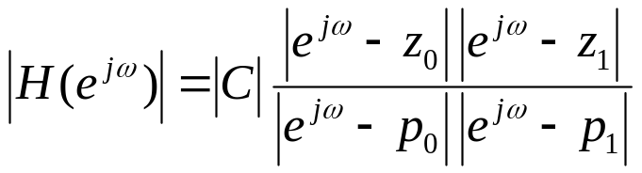
Discrete-Time IIR Filter Design
Biquad w/ zeros z₀ and z₁
and poles p₀ and p₁
  Magnitude response
  |a – b| is distance between
  complex numbers a and b
  |e^{jω} – p₀| is distance from point
  on unit circle e^{jω} and pole location p₀
When poles and zeros are separated in angle
  Poles near unit circle indicate filter’s passband(s)
  Zeros on/near unit circle indicate stopband(s)
6 - <number>

Slide 8
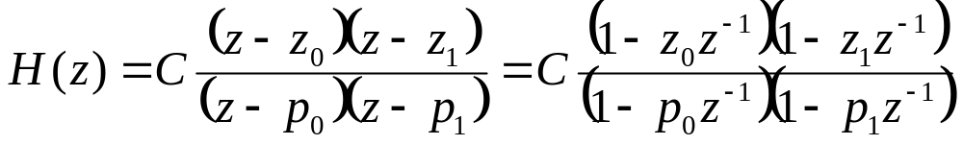
Discrete-Time IIR Biquad Examples
Transfer function
When transfer function coefficients are real-valued
  Poles (X) are conjugate symmetric or real-valued
  Zeros (O) are conjugate symmetric or real-valued
Filters below have what magnitude responses?
Im(z)
Im(z)
Im(z)
lowpass
highpass bandpass bandstop allpass notch?
O
O
X
X
O
X
Re(z)
Re(z)
Re(z)
O
X
X
X
O
O
Zeros are on the unit circle
Poles have radius r Zeros have radius 1/r
6 - <number>

Slide 9
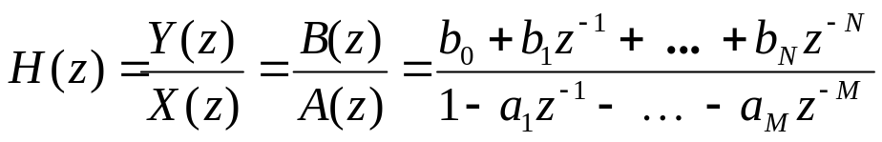
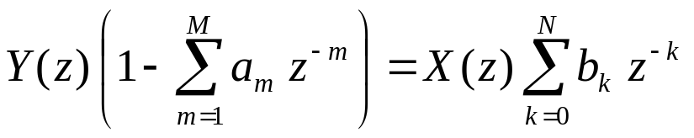
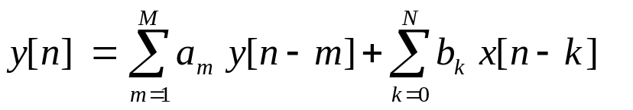
A Direct Form IIR Realization
IIR filters having rational transfer functions
Direct form realization
  Dot product of vector of N +1
  coefficients and vector of current
  input and previous N inputs (FIR section)
  Dot product of vector of M coefficients and vector of previous M outputs (“FIR” filtering of previous output values)
  Computation: M + N + 1 multiply-accumulates (MACs)
  Memory: M + N words for previous inputs/outputs and
  M + N + 1 words for coefficients
6 - <number>

Slide 10
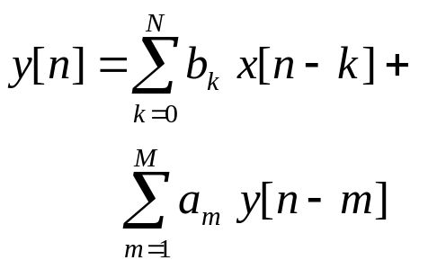
Filter Structure As a Block Diagram
x[n]
y[n]
b₀
Σ
Unit
Delay
Unit
Delay
x[n-1]
b₁
a₁
y[n-1]
Unit
Delay
Unit
Delay
Full Precision Wordlength of y[0] is 2 words. Wordlength of y[n] increases with n for n > 0.
x[n-2]
b₂
a₂
y[n-2]
Feed-forward
Feedback
Unit
Delay
Unit
Delay
x[n-N]
b_{N}
a_{M}
y[n-M]
M and N may be different
6 - <number>

Slide 11
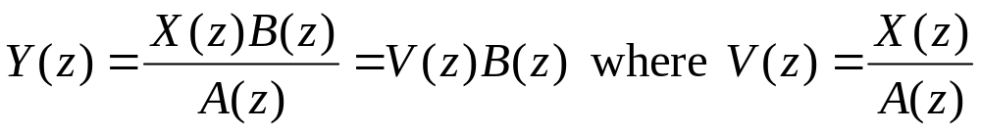
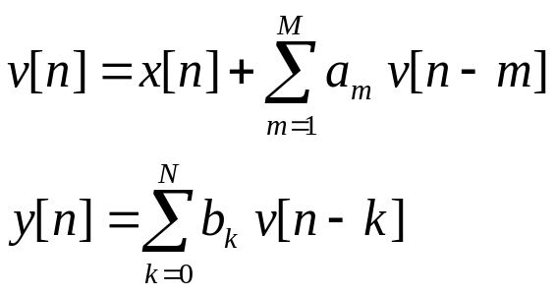
Yet Another Direct Form IIR
Rearrange transfer function to be cascade of an all-pole IIR filter followed by an FIR filter
  Here, v[n] is the output of an all-pole filter applied to x[n]:
Implementation complexity (assuming M ≥ N)
  Computation: M + N + 1 MACs
  Memory: M double words for past values of v[n] and
  M + N + 1 words for coefficients
6 - <number>

Slide 12
Filter Structure As Block Diagram
v[n]
x[n]
Σ
b₀
Σ
y[n]
Unit
Delay
a₁
b₁
v[n-1]
Unit
Delay
v[n-2]
Full Precision Wordlength of y[0] is
2 words and wordlength of v[0] is 1 word. Wordlength of v[n] and y[n] increases with n.
a₂
b₂
Feedback
Feed-forward
Unit
Delay
v[n-M]
M and N may be different
a_{M}
b_{N}
M=2 yields a biquad
6 - <number>

Slide 13
Demonstrations
Signal Processing First, PEZ Pole Zero Plotter (pezdemo)
DSP First demonstrations, Chapter 8
  IIR Filtering Tutorial (Link)
  Connection Betweeen the Z and Frequency Domains (Link)
  Time/Frequency/Z Domain Movies for IIR Filters (Link)
  For username/password help
link
link
link
6 - <number>

Slide 14
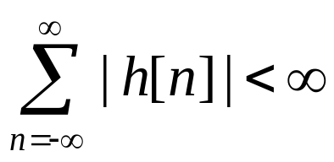
Stability
Review
A discrete-time LTI system is bounded-input bounded-output (BIBO) stable if for any bounded input x[n] such that | x[n] | ≤ B₁ < ∞, then the filter response y[n] is also bounded | y[n] | ≤ B₂ < ∞
Proposition: A discrete-time filter with an impulse response of h[n] is BIBO stable if and only if
  Every finite impulse response LTI system (even after implementation) is BIBO stable
  A causal infinite impulse response LTI system is BIBO stable if and only if its poles lie inside the unit circle
6 - <number>

Slide 15
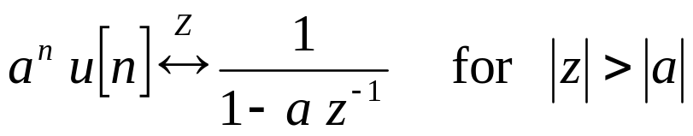
BIBO Stability
Review
Rule #1: For a causal sequence, poles are inside the unit circle (applies to z-transform functions that are ratios of two polynomials) OR
Rule #2: Unit circle is in the region of convergence. (In continuous-time, imaginary axis would be in region of convergence of Laplace transform.)
Example:
  Stable if |a| < 1 by rule #1 or equivalently
  Stable if |a| < 1 by rule #2 because |z|>|a| and |a|<1
pole at z=a
6 - <number>

Slide 16
Z and Laplace Transforms
Transform difference/differential equations into algebraic equations that are easier to solve
Are complex-valued functions of a complex frequency variable
  Laplace: s = σ + j 2 π f
  Z: z = r e ^{j ω}
Transform kernels are complex exponentials: eigenfunctions of linear time-invariant systems
  Laplace: e^{–s t} = e^{–σ t –} ^{j 2 π f t} = e ^{–σ t} e ^{– j 2 π f t}
  Z: z ^{–n} = (r e ^{j ω}) ^{–n} = r ^{– n} e ^{– j ω} ^{n}
dampening factor
oscillation term
6 - <number>

Slide 17
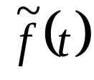


Z and Laplace Transforms
No unique mapping from Z to Laplace domain or from Laplace to Z domain
  Mapping one complex domain to another is not unique
One possible mapping is impulse invariance
  Make impulse response of a discrete-time linear time-invariant (LTI) system be a sampled version of the impulse response for the continuous-time LTI system
Z
Laplace
f[n]
H(z)
y[n]
H(s)
6 - <number>

Slide 18
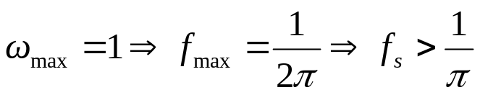

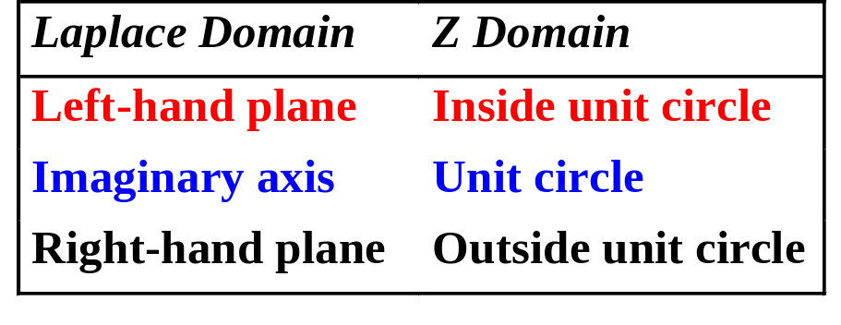
Impulse Invariance Mapping
Mapping is z = e ^{s T} where T is sampling time T_{s}
Im{s}
Im{z}
1
Let f_{s} = 1 Hz
Re{s}
Re{z}
-1
1
1
-1
Poles: s = -1 ± j ⇒ z = 0.198 ± j 0.31 (T = 1 s)
Zeros: s = 1 ± j ⇒ z = 1.469 ± j 2.287 (T = 1 s)
lowpass, highpass bandpass, bandstop allpass or notch?
6 - <number>

Slide 19
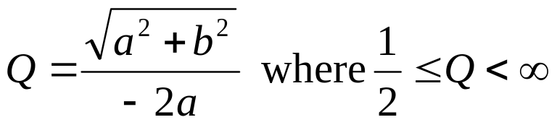
Continuous-Time IIR Biquad
Second-order filter section with 2 poles & 0-2 zeros
  Transfer function is a ratio of two real-valued polynomials
  Poles and zeros occur in conjugate symmetric pairs
Quality factor: technology independent measure of sensitivity of pole locations to perturbations
  For an analog biquad with poles at a ± j b, where a < 0,
  Real poles: b = 0 so Q = ½ (exponential decay response)
  Imaginary poles: a = 0 so Q = ∞ (oscillatory response)
6 - <number>

Slide 20

Continuous-Time IIR Biquad
Impulse response with biquad with poles a ± j b with a < 0 but no zeroes:
  Pure sinusoid when a = 0 and pure decay when b = 0
Breadboard implementation
  Consider a single pole at –1/(R C). With 1% tolerance on breadboard R and C values, tolerance of pole location is 2%
  How many decimal digits correspond to 2% tolerance?
  How many bits correspond to 2% tolerance?
  Maximum quality factor is about 25 for implementation of analog filters using breadboard resistors and capacitors.
  Switched capacitor filters: Q_{max} ≈ 40 (tolerance ≈ 0.2%)
  Integrated circuit implementations can achieve Q_{max} ≈ 80
6 - <number>

Slide 21
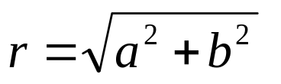
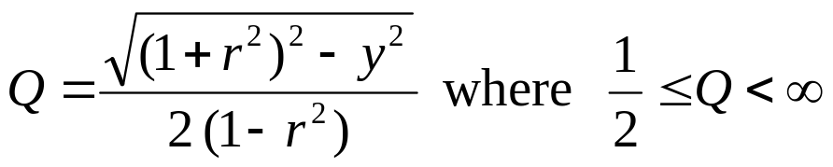
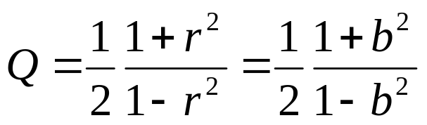
Discrete-Time IIR Biquad
For poles at a ± j b = r e ^{± j θ}, where is the pole radius (r < 1 for stability), with y = –2 a:
  Real poles: b = 0 and −1 < a < 1, so r = |a| and y = ±2 a and Q = ½ (impulse response is C₀ a^{n} u[n] + C₁ n a ^{n} u[n])
  Poles on unit circle: r = 1 so Q = ∞ (oscillatory response)
  Imaginary poles: a = 0 so
  r = |b| and y = 0, and
  16-bit fixed-point digital signal processors with 40-bit accumulators: Q_{max} ≈ 40
Filter design programs often use r as approximation of quality factor
6 - <number>

Slide 22
IIR Filter Implementation
Same approach in discrete and continuous time
Classical IIR filter designs
  Filter of order n will have n/2 conjugate roots if n is even or one real root and (n-1)/2 conjugate roots if n is odd
  Response is very sensitive to perturbations in pole locations
Rule-of-thumb for implementing IIR filter
  Decompose IIR filter into second-order sections (biquads)
  Cascade biquads from input to output in order of ascending quality factors
  For each pair of conjugate symmetric poles in a biquad, conjugate zeroes should be chosen as those closest in Euclidean distance to the conjugate poles
6 - <number>

Slide 23
Classical IIR Filter Design
Classical IIR filter designs differ in the shape of their magnitude responses
  Butterworth: monotonically decreases in passband and stopband (no ripple)
  Chebyshev type I: monotonically decreases in passband but has ripples in the stopband
  Chebyshev type II: has ripples in passband but monotonically decreases in the stopband
  Elliptic: has ripples in passband and stopband
Classical IIR filters have poles and zeros, except
  Continuous-time lowpass Butterworth filters only have poles
Classical filters have biquads with high Q factors
6 - <number>

Slide 24
Analog IIR Filter Optimization
Start with an existing (e.g. classical) filter design
IIR filter optimization packages from UT Austin (in Matlab) simultaneously optimize
  Magnitude response
  Linear phase in passband
  Peak overshoot in step response
  Quality factors
6 - <number>

Slide 25
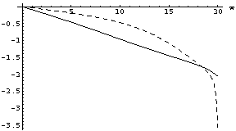
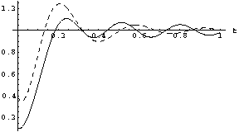
Analog IIR Filter Optimization
Analog lowpass IIR filter design specification
  δ_{pass}= 0.21 at ω_{pass}= 20 rad/s and δ_{stop}= 0.31 at ω_{stop}= 30 rad/s
  Minimized deviation from linear phase in passband
  Minimized peak overshoot in step response
  Maximum quality factor per second-order section is 10
Linearized phase in passband
Minimized peak overshoot
Elliptic
Elliptic
Optimized
Optimized
Q | poles | zeros
1.7 | -5.3533±j16.9547 | 0.0±j20.2479
61.0 | -0.1636±j19.9899 | 0.0±j28.0184
Q | poles | zeros
0.68 | -11.4343±j10.5092 | -3.4232±j28.6856
10.00 | -1.0926±j21.8241 | -1.2725±j35.5476
elliptic
optimized

Slide 26
MATLAB Demos Using fdatool #1
Filter design/analysis
Lowpass filter design specification (all demos)
  fpass = 9600 Hz
  fstop = 12000 Hz
  fsampling = 48000 Hz
  Apass = 1 dB
  Astop = 80 dB
Under analysis menu
  Show magnitude response
FIR filter – equiripple
  Also called Remez Exchange or Parks-McClellan design
  Minimum order is 50
  Change Wstop to 80
  Order 100 gives Astop 100 dB
  Order 200 gives Astop 175 dB
  Order 300 does not converge –how to get higher order filter?
FIR filter – Kaiser window
  Minimum order 101 meets spec

Slide 27
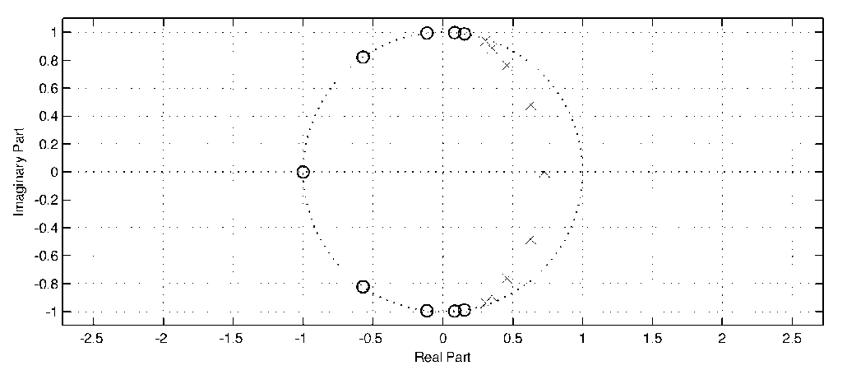
MATLAB Demos Using fdatool #2
IIR filter – elliptic
  Use second-order sections
  Filter order of 8 meets spec
  Achieved Astop of ~80 dB
  Poles/zeros separated in angle
  Zeros on or near unit circle indicate stopband
  Poles near unit circle indicate passband
  Two poles very close to unit circle
IIR filter – elliptic
  Use second-order sections
  Increase filter order to 9
  Eight complex symmetric poles and one real pole:
  Same observations on left
6 - <number>

Slide 28
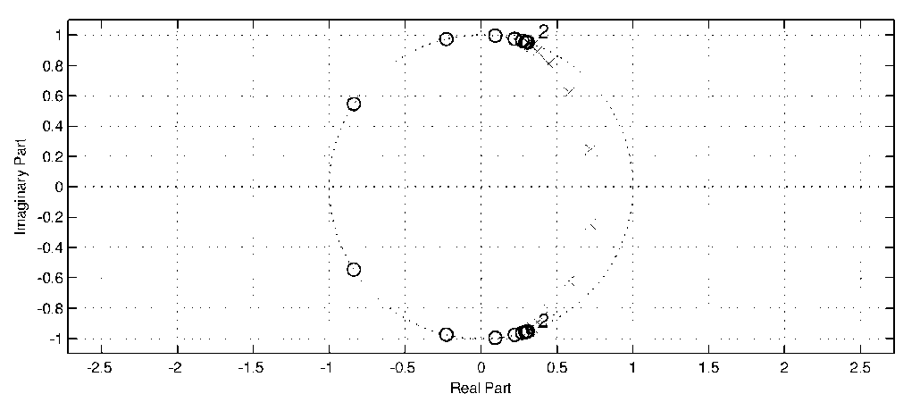
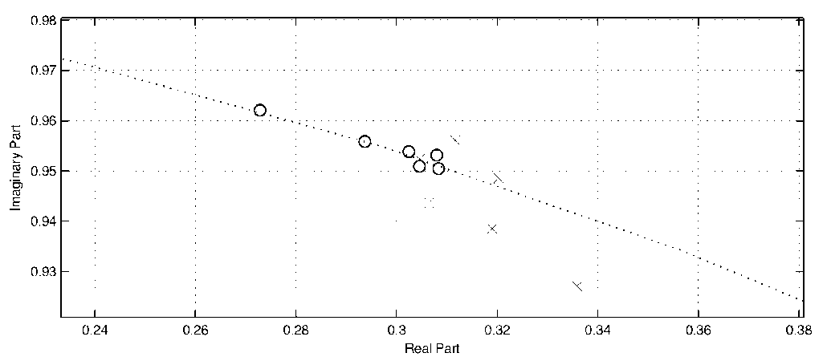
MATLAB Demos Using fdatool #3
IIR filter – elliptic
  Use second-order sections
  Increase filter order to 20
  Two poles very close to unit circle but BIBO stable
  Use single section (Edit menu)
  Oscillation frequency ~9 kHz appears in passband
  BIBO unstable: two pairs of poles outside unit circle
IIR filter design algorithms return poles-zeroes-gain (PZK format):
Impact on response when expanding polynomials in transfer function from factored to unfactored form

Slide 29
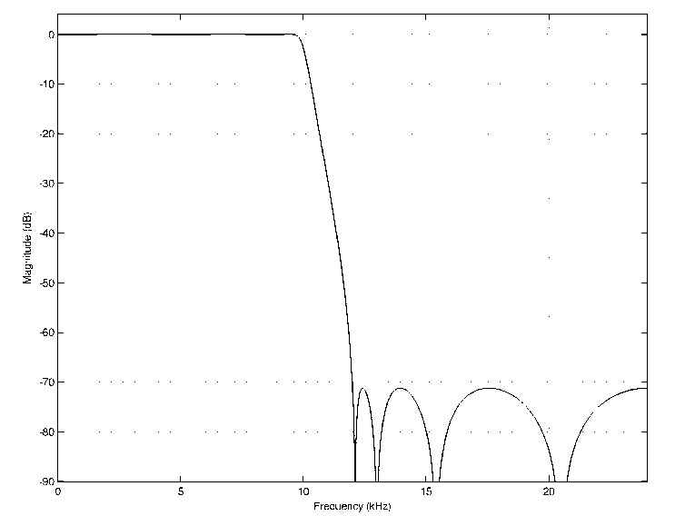
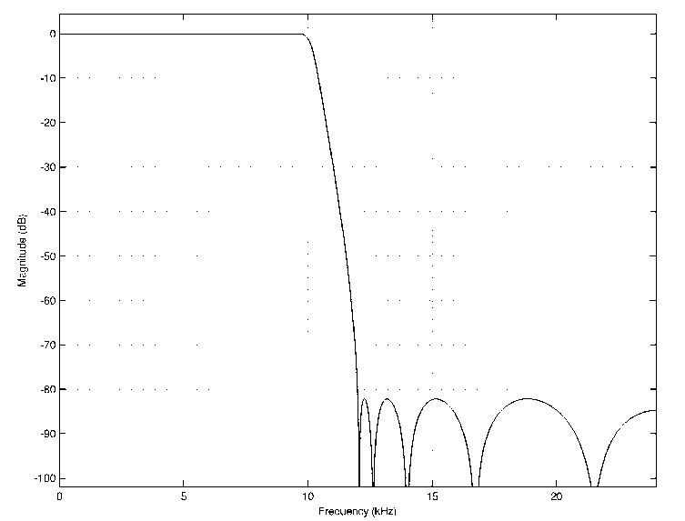
MATLAB Demos Using fdatool #4
IIR filter - constrained least pth-norm design
  Use second-order sections
  Limit pole radii ≤ 0.95
  Increase weighting in stopband (Wstop) to 10
  Filter order 8 does not meet stopband specification
  Filter order 10 does meet stopband specification
Filter order might increase but worth it for more robust implementation
6 - <number>

Slide 30
Conclusion
 | FIR Filters | IIR Filters
Implementation complexity (1) | Higher | Lower (sometimes by factor of four)
Minimum order design | Parks-McClellan (Remez exchange) algorithm (2) | Elliptic design algorithm
Stable? | Always | May become unstable when implemented (3)
Linear phase | If impulse response is symmetric or anti-symmetric about midpoint | No, but phase may made approximately linear over passband (or other band)
(1) For same piecewise constant magnitude specification
(2) Algorithm to estimate minimum order for Parks-McClellan algorithm by
Kaiser may be off by 10%. Search for minimum order is often needed.
(3) Algorithms can tune design to implementation target to minimize risk
6 - <number>

Slide 31
Conclusion
Choice of IIR filter structure matters for both analysis and implementation
Keep roots computed by filter design algorithms
  Polynomial deflation (rooting) reliable in floating-point
  Polynomial inflation (expansion) may degrade roots
More than 20 IIR filter structures in use
  Direct forms and cascade of biquads are very common choices
Direct form IIR structures expand zeros and poles
  May become unstable for large order filters (order > 12) due to degradation in pole locations from polynomial expansion
6 - <number>

Slide 32
Conclusion
Cascade of biquads (second-order sections)
  Only poles and zeros of second-order sections expanded
  Biquads placed in order of ascending quality factors
  Optimal ordering of biquads requires exhaustive search
When filter order is fixed, there exists no solution, one solution or an infinite number of solutions
Minimum order design not always most efficient
  Efficiency depends on target implementation
  Consider power-of-two coefficient design
  Efficient designs may require search of infinite design space
6 - <number>

