Slide 1
Portfolio Question 3
Programming III
Luke Gough/30003918

Slide 2

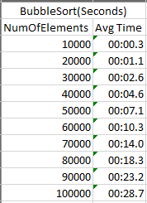
Bubble Sort
Advantages
Well known and easy to implement.
Elements are swapped in space which doesn’t require additional storage.
Disadvantages
Does not preform well when sorting larger data sets.
Has to go over the entire data set every run.

Slide 3
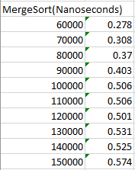
Merge Sort
Advantages
It is faster when sorting larger data sets as it does not go through the whole set several times.
Has more consistent run times as it splits the data sets into smaller data sets and sorts in stages.
Disadvantages
It is slower with smaller data set than other sorting algorithms.
Goes through the whole process even if the data set is already sorted.
Requires more memory space to store the sub data sets it creates.

Slide 4
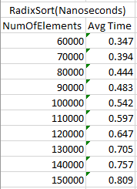
Radix Sort
Advantages
It is fast at sorting small keys of data.
Can be faster than quicksort or heap.
Can sort strings, letters and numbers very quickly.
Disadvantages
If numbers/strings lengths vary the sort can be slower as it needs to test for additional digits that need to be stored.
Can require larger amounts of space compared to other sorting algorithms.
Is much less flexible, if there are different data types the sort would need to be rewritten to meet these requirements.

