Slide 1
Cluster Analysis Tool
Luke Hackett
Notes:
Cluster Analysis Tool Presentation
Luke Hackett (University of Huddersfield)
u0950758@unimail.hud.ac.uk
3rd April 2013

Slide 2
Table of Contents
Clustering Techniques
Cluster Analysis Tool
Integration Strategy

Slide 3
Clustering Techniques
General Introduction, K-Means & DBSCAN

Slide 4
Introduction to Clustering
Clustering is the process of grouping a set of objects into classes of similar objects that are meaningful, useful or both.
A cluster is a collection of objects that are more similar to one another within a cluster and are more dissimilar to other objects within other clusters.
Notes:
Animals Example.
Biological (cancer), business (marketing) examples.
Fraud monitoring systems (opposite).

Slide 5
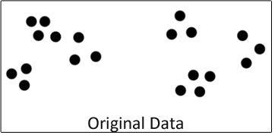
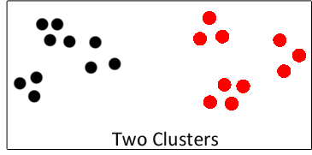
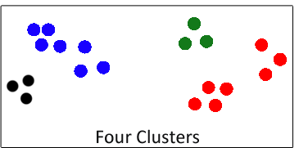
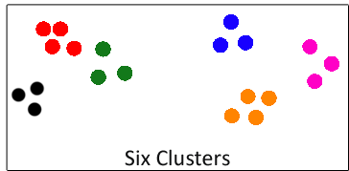
Cluster Definition

Slide 6
K-Means
Aims to partition a set of objects into k clusters
Similarity is measured via the average (mean) value of all objects in a given cluster
The mean object is referred to as the Centroid

Slide 7
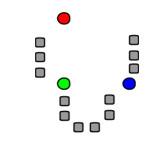
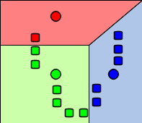
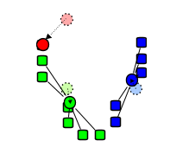
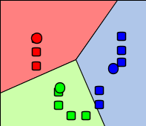
K-Means

Slide 8
Density-Based Spatial Clustering of Applications with Noise
Density-based algorithms will try to locate regions that are of high density and separate these regions from the data space.
“Noise” data is ignored, or removed from the data space completely.
Relies upon the concept of Density rather than Similarity.

Slide 9
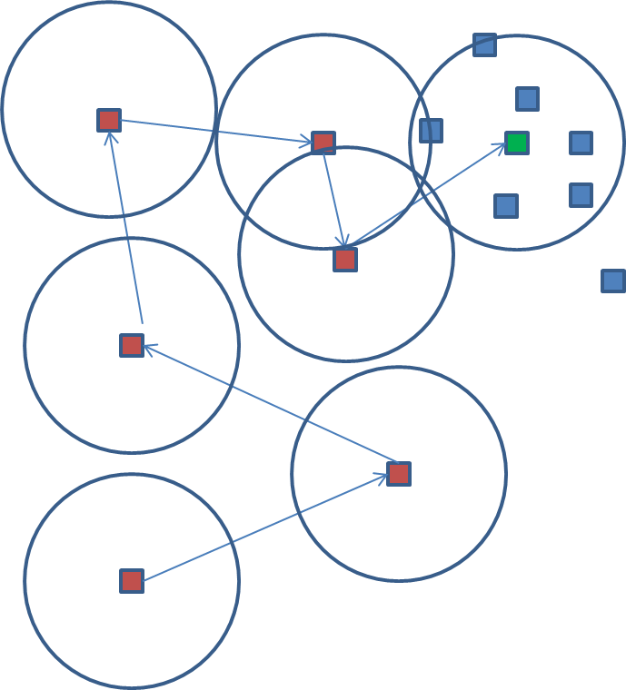
Density-Based Spatial Clustering of Applications with Noise

Slide 10
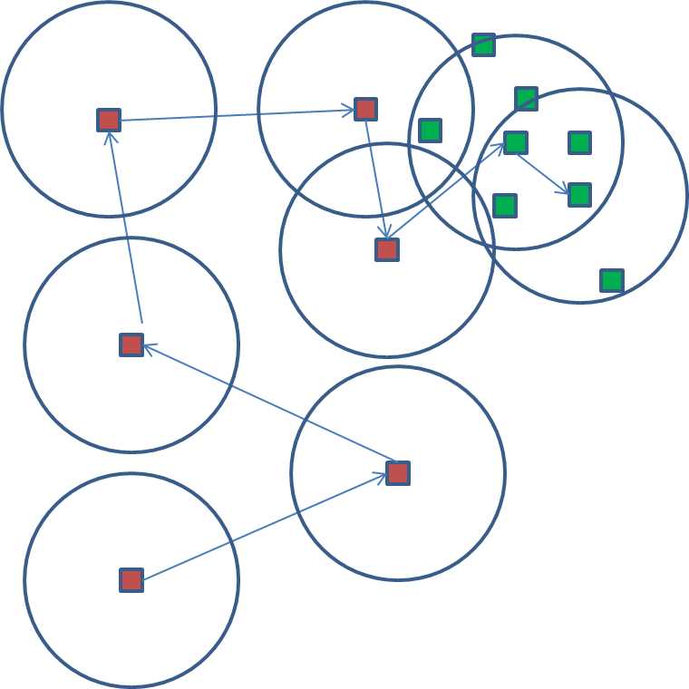
Density-Based Spatial Clustering of Applications with Noise

Slide 11
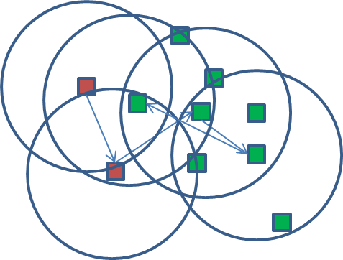
Density-Based Spatial Clustering of Applications with Noise

Slide 12

Density-Based Spatial Clustering of Applications with Noise

Slide 13
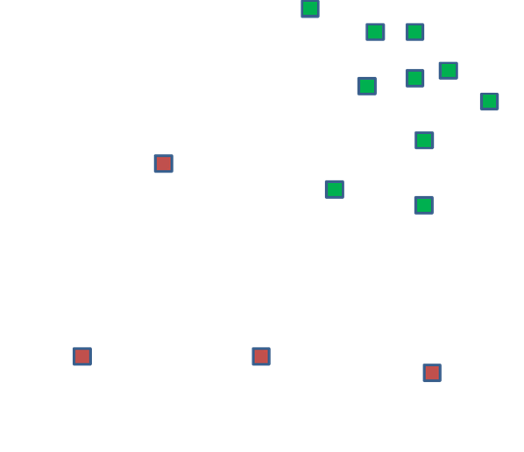
Density-Based Spatial Clustering of Applications with Noise

Slide 14
Cluster Analysis Tool
Data, Design & Extendibility

Slide 15
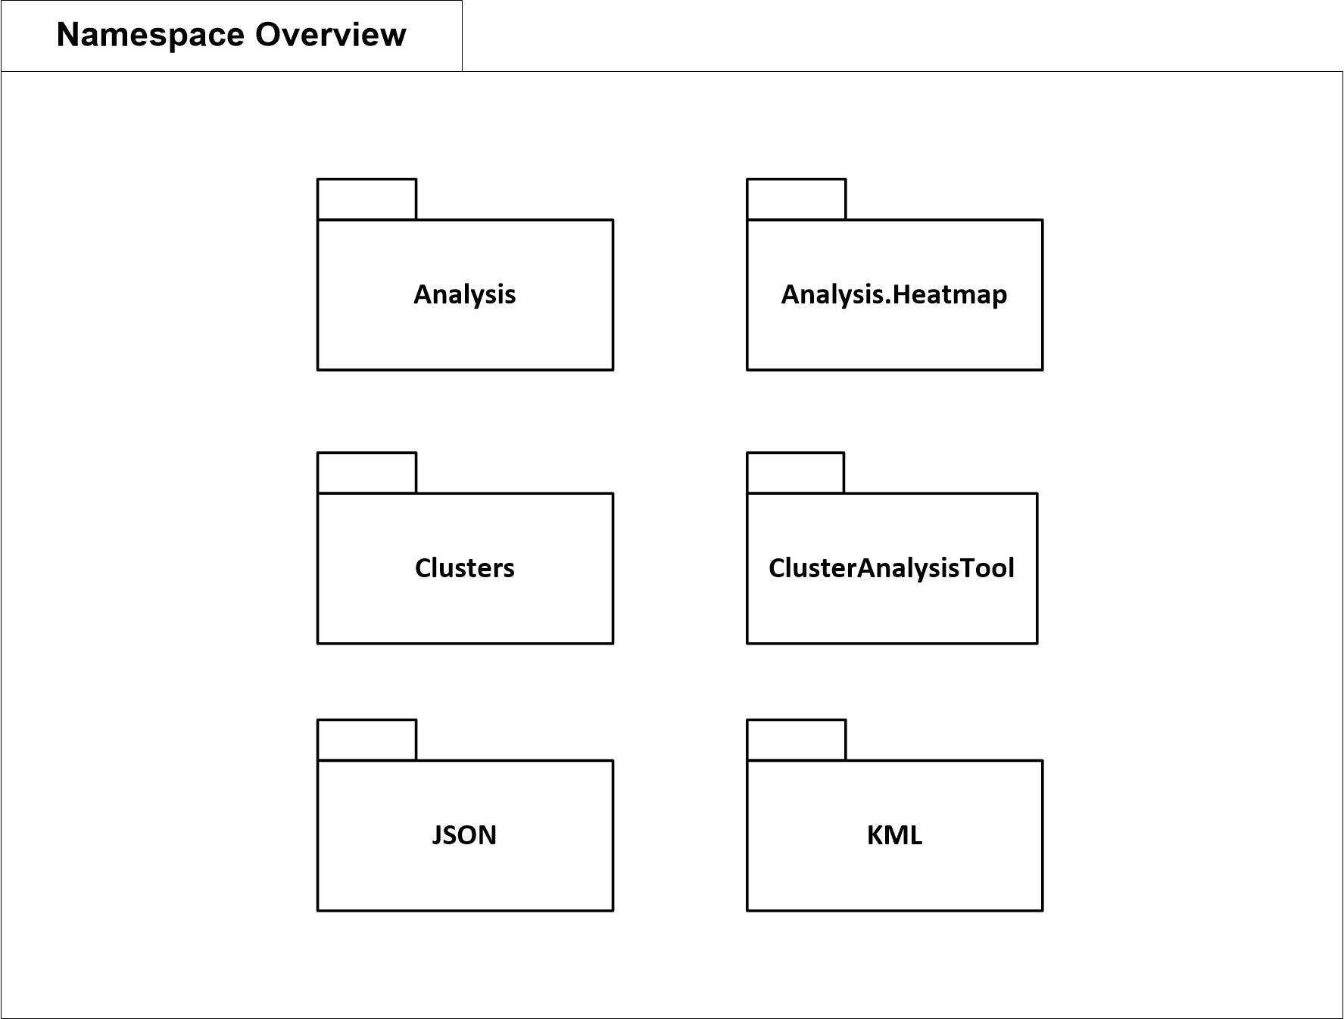
System Design Overview

Slide 16
Analysis Library
Focuses upon providing analysis for clusters on from product and week perspective
Analysis
MultiAnalysis
EventAnalysis
Notes:
Analysis
Provides basic analysis, such as usage figures.
MultiAnalysis
Provides MutliWeek/MultiProduct analysis, as well as JSON and KML files.
EventAnalysis
Provides additional filtering options for a given cluster.

Slide 17
Cluster Library
Focuses upon clustering a given set of data. Basic objects are found within this library.
Coordinate
Event
EventCollection
DBSCAN
KMeans
Notes:
Coordinate
Represents a geographical coordinate.
Event
The main object within the tool, which represents a given “Call Event”.
EventCollection
Extends List<Event> and provides multiple methods for managing a list of events. Usually represents a cluster
DBSCAN & KMeans
An implementation of the each respected algorithm.

Slide 18
Supporting Libraries
JSON provides JSON String output functionality.
JSONWriter
KML Provides KML parsing and writing functionality.
KMLReader
KMLWriter
KMZWriter

Slide 19
Keyhole Markup Language
KML is an XML notation for expressing geographic information
Maintained by Google through a “Open Source” Project
Google Maps and Google Earth fully support the latest KML specification (2.2)
https://developers.google.com/kml/

Slide 20
Keyhole Markup Language
KML is an XML notation for expressing geographic information
Maintained by Google through a “Open Source” Project
Google Earth fully supports the latest KML specification (2.2)
Google Maps has partial support for the latest KML specification (2.2)
https://developers.google.com/kml/

Slide 21
Keyhole Markup Language
<?xml version="1.0" encoding="UTF-8"?> <kml xmlns="http://www.opengis.net/kml/2.2">
<Placemark> <name>Simple placemark</name> <description>Attached to the ground. Intelligently
places itself at the height of the underlying
terrain.</description> <Point> <coordinates>
-122.0822035425683,37.42228990140251,0
</coordinates> </Point> </Placemark>
</kml>

Slide 22
Cluster Analysis Tool
Demo

Slide 23
Integration Strategy
Ideas & Thoughts

Slide 24
Integration Strategy
Simple command line interface
Supports directory input as well as file input
JSON output -> database?
.\ClusterAnalysisTool.exe --source=“C:\kml\input”
--output=“C:\kml\output”
--analysis=“all”
.\ClusterAnalysisTool.exe --source=“C:\kml\input\my_kml.kml”
--output=“C:\kml\output”
--analysis=“all”

Slide 25

Questions

