Slide 1
Ehad/Enu binning & custom neutrino energy binning
NuMu group, Oct. 2016
Luke Vinton, University of Sussex

Slide 2
Version details
Running in S16-09-13
Using FD and ND NuMu decafs found here:

Slide 3
Outline
a

Slide 4
Oscillation parameters
SetL(810);
SetRho(0); // No matter effects
SetDmsq21(7.59e-5);
SetDmsq32(2.6746e-3);
SetTh12(.601);
SetTh13(.1567);
SetdCP(0);
SetTh23(0.68696); // non max (ssqth23 = 0.4022)

Slide 5
4 had frac. bins and vary number neutrino energy bins {20,40,60,80,120,160}
We can use Ehad/Enu to divide our better and worse resolved events
A finer binning would take advantage of the well resolved portion of events

Slide 6
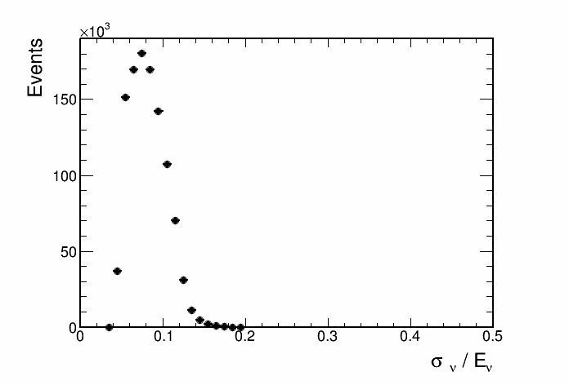
Non-max mixing contours, 4 had frac bins
Bins from 0 - 5 GeV

Slide 7
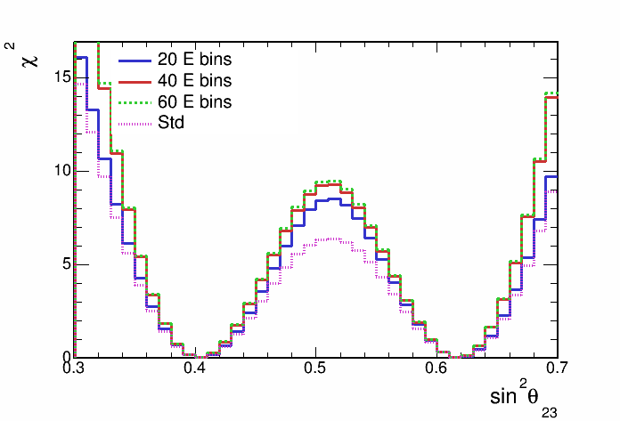
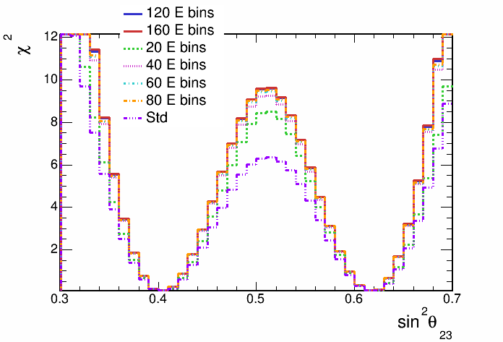
Non-max mixing contours, 4 had frac bins

Slide 8
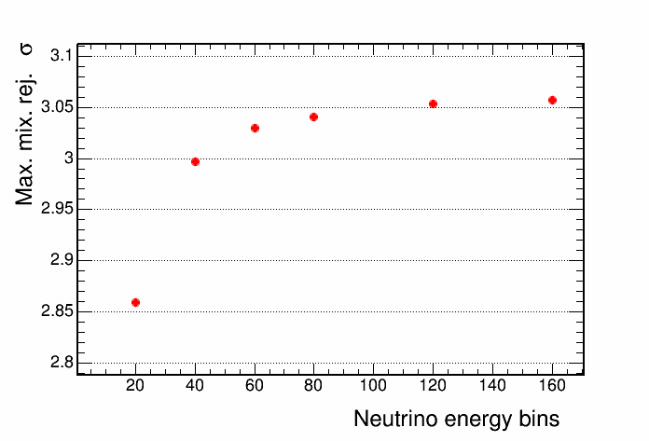
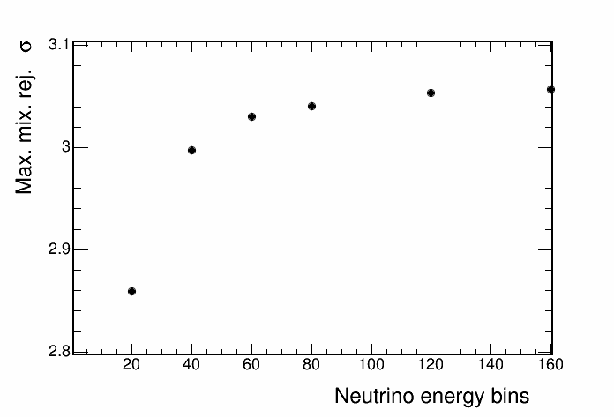
Non-max mixing contours, 4 had frac bins

Slide 9
Chi squared vs. neutrino energy
Comparing
max. and non-max. mixing
minos best fit and non-max mixing
make comparison for each of four Ehad/Enu bins
The relative statistical strength of each bin will guide the choice of the custom bin boundaries

Slide 10
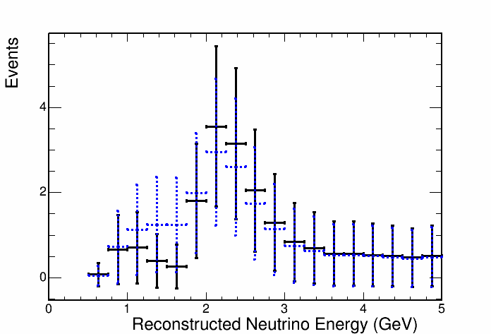
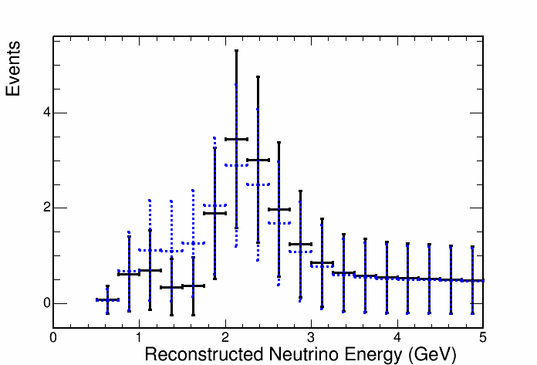
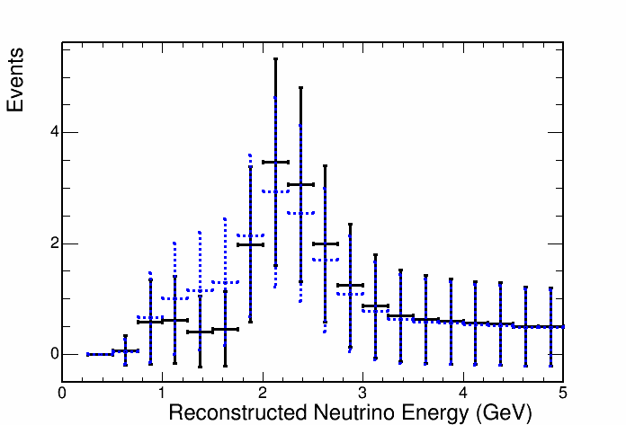
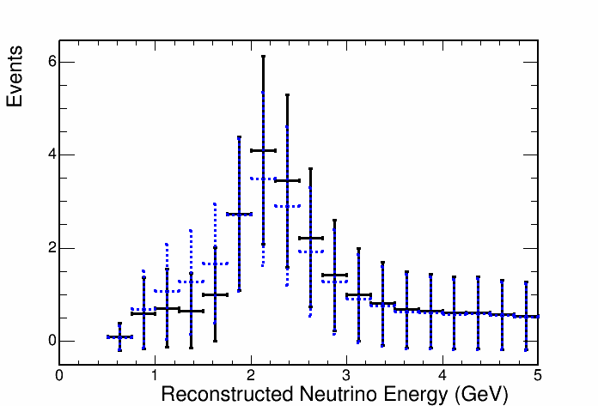
Compare max and non-max mixing distributions
1
2
3
4

Slide 11
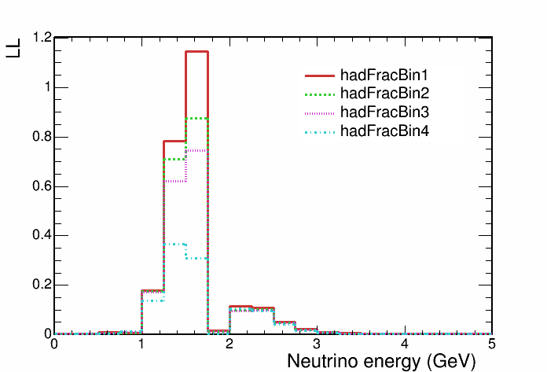
Compare max and non-max mixing distributions

Slide 12
Summary
s
Future plan
s

Slide 13
Backup

Slide 14
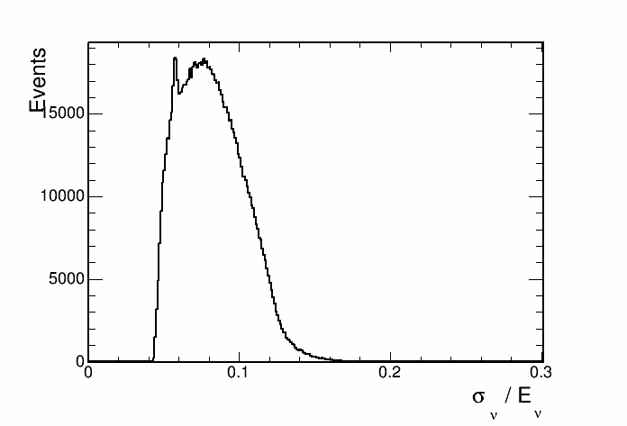
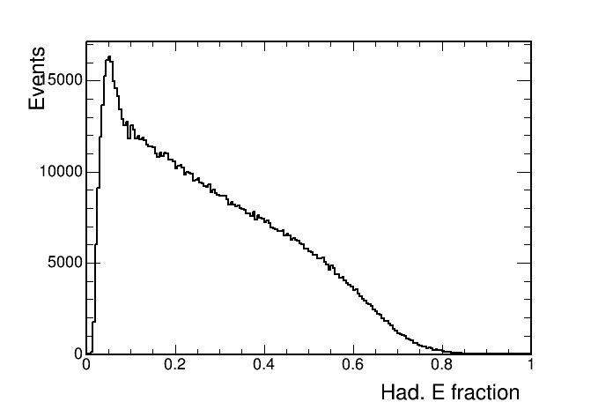
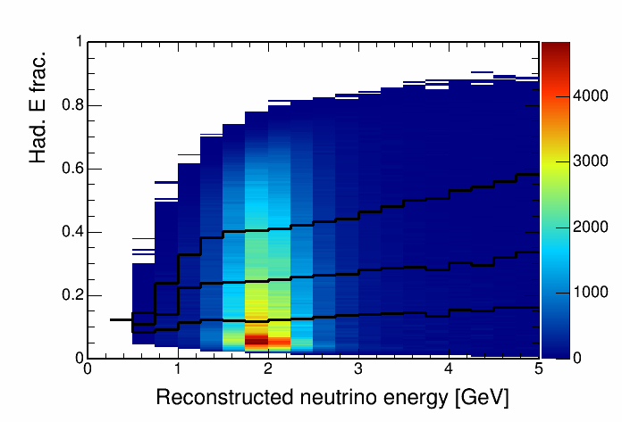
Hadronic energy fraction vs. reco. energy
This histogram is used to separate events into quantiles of energy resolution.

Slide 15
Cosmic background

Slide 16
Contours with and without cosmic bkg

Slide 17
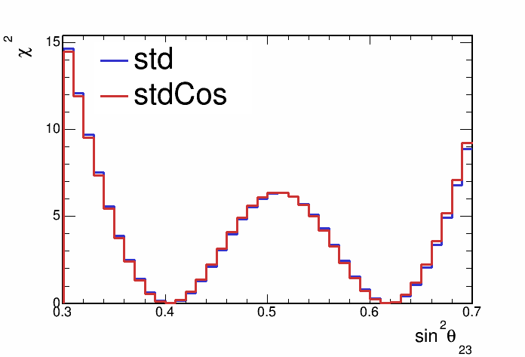
Contours with and without cosmic bkg

Slide 18
Hadronic energy fraction binning
Split events into hadronic energy quantiles
Quantiles made for each bin of reconstructed neutrino energy
Up next, sensitivities with events split into 2,3,4 and 5 hadronic energy fraction quantiles

Slide 19
Sensitivity with hadronic energy fraction binning

Slide 20
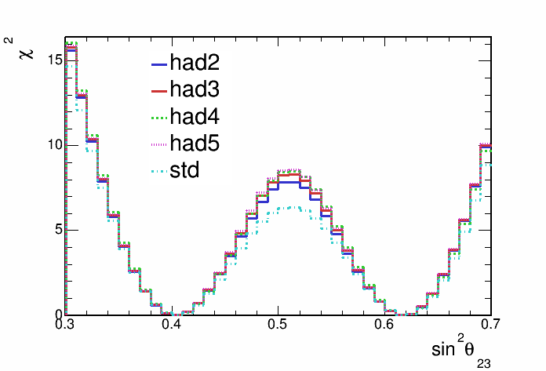
Sensitivity with hadronic energy fraction binning

Slide 21
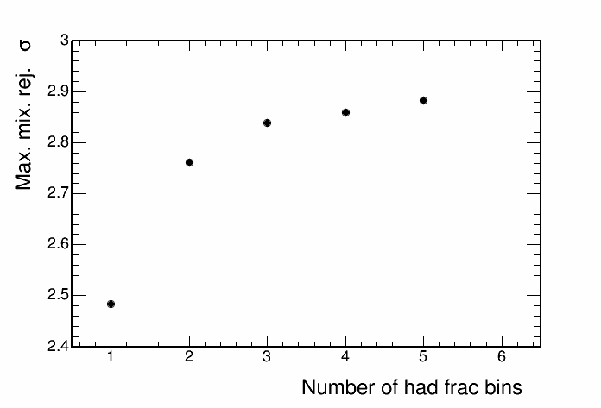
Sensitivity with hadronic energy fraction binning

