Slide 1
Sensitivity with number of hadronic energy fraction bins
Numu group, Sep. 2016
Luke Vinton, University of Sussex

Slide 2
Version details
Running in S16-09-13
Using FD decafs: /pnfs/nova/persistent/production/concat/R16-03-03-prod2reco.d/

Slide 3
Outline
Hadronic energy fraction vs. neutrino energy
Comparison of 1d and 2d binning sensitivity
compare had. frac binning with 2d had frac & remid binning

Slide 4
2D binning scheme
Bin simultaneously in remid and hadronic energy fraction
split hadronic enegy fraction into two quantiles
split remid into two samples
remid >= 0.75
0.4 < remid < 0.75

Slide 5
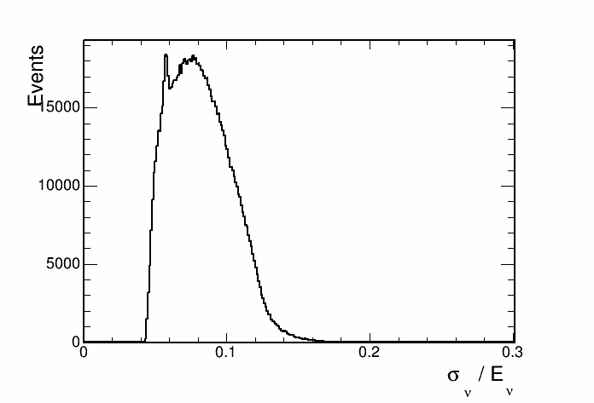
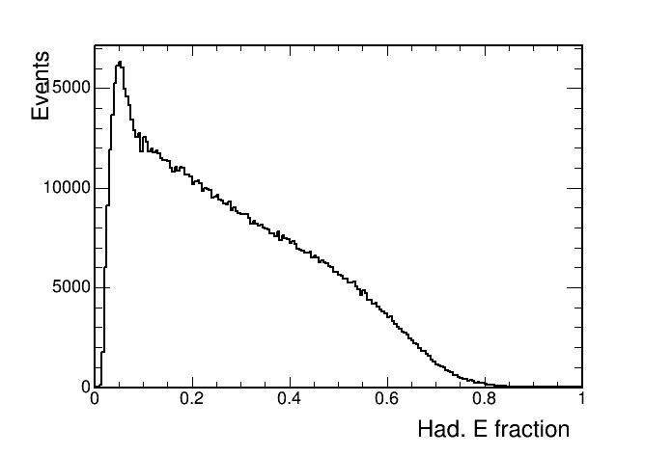
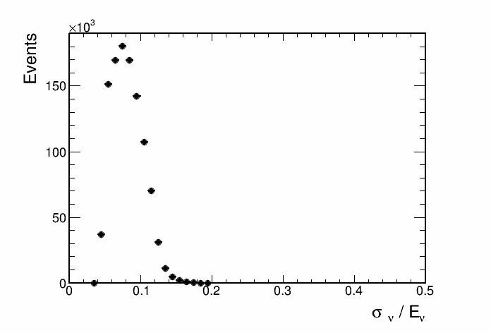
Hadronic energy fraction

Slide 6
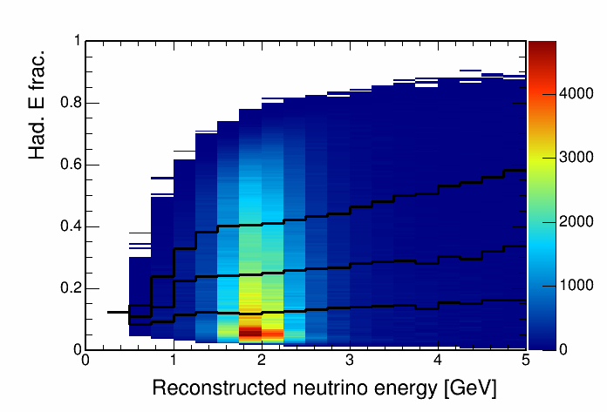
Hadronic energy fraction vs. reco. energy, 4 quantiles
This histogram is used to seperate events into quantiles of energy resolution.

Slide 7
Contours

Slide 8
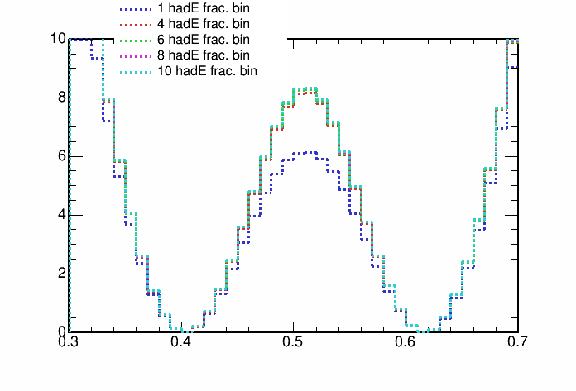
1D marginalised projection

Slide 9
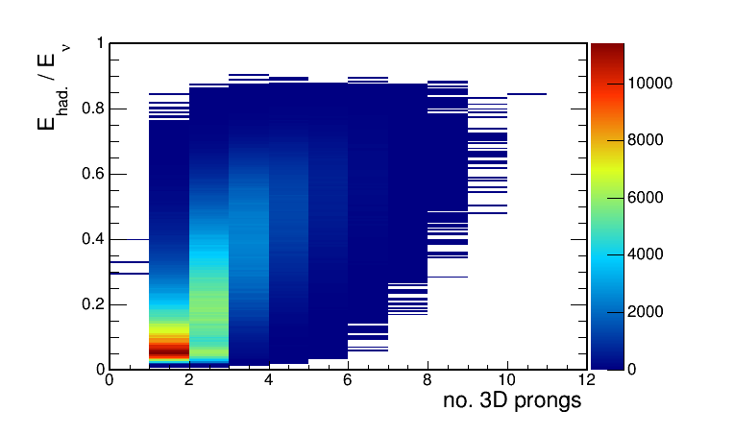
Hadronic energy fraction vs. no. 3D prongs
This histogram is used to seperate events into quantiles of energy resolution.

Slide 10
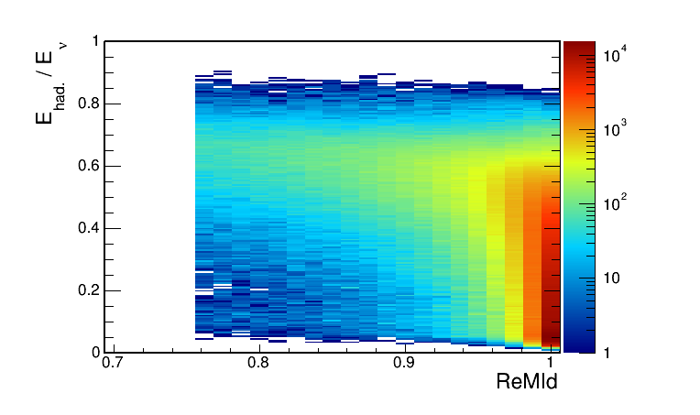
Hadronic energy fraction vs. ReMId
This histogram is used to seperate events into quantiles of energy resolution.

Slide 11
Future plan
Summary
Bin
Re

Slide 12
Backup

