Slide 1
Comparison of sensitivity with resolution and hadronic energy fraction binning
Numu group, Sep. 2016
Luke Vinton, University of Sussex

Slide 2
Version details
Running in development to pick up recent changes
Using FD decafs: /pnfs/nova/persistent/production/concat/R16-03-03-prod2reco.d/

Slide 3
Outline
This is a brief update on work shown last week (see DocDB: 16035)
Plots of hadronic energy fraction and neutrino energy resolution
1D hists
2D hists vs. reco. neutrino energy
Max. and non-max. mixing sensitivity contours

Slide 4
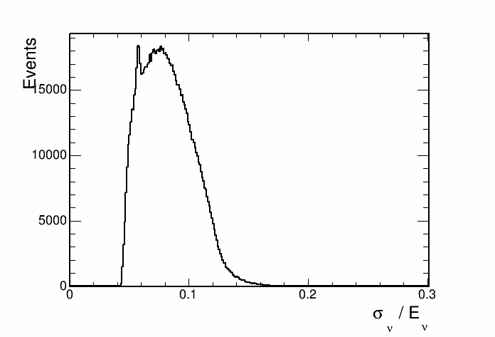
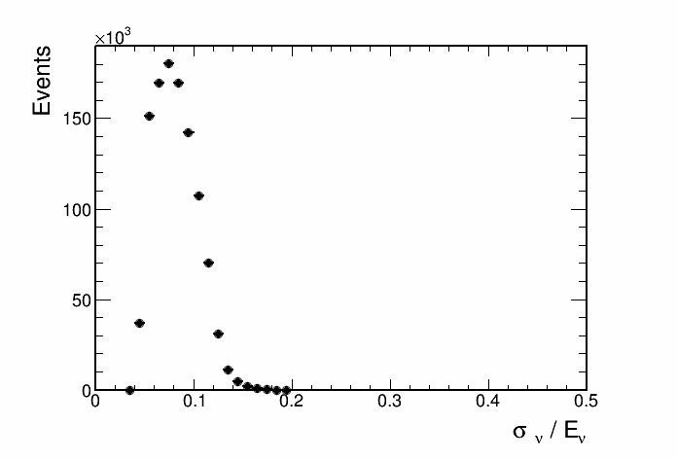
Neutrino energy resolution
This histogram is used to seperate events into quantiles of energy resolution.

Slide 5
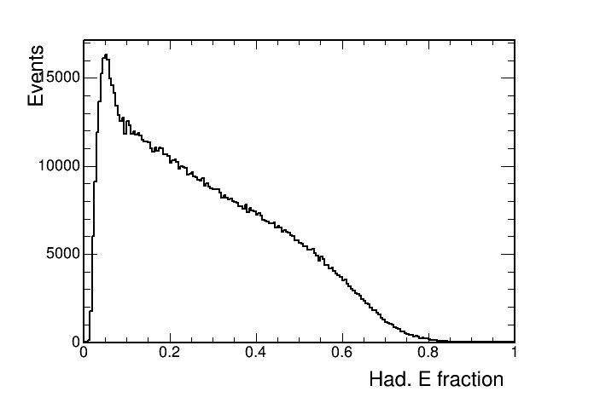
Hadronic energy fraction
This histogram is used to seperate events into quantiles of energy resolution.

Slide 6
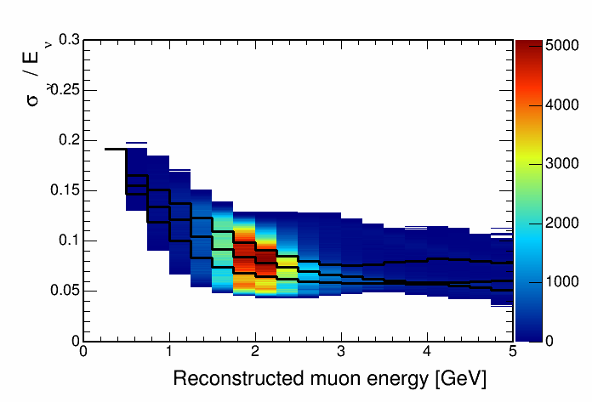
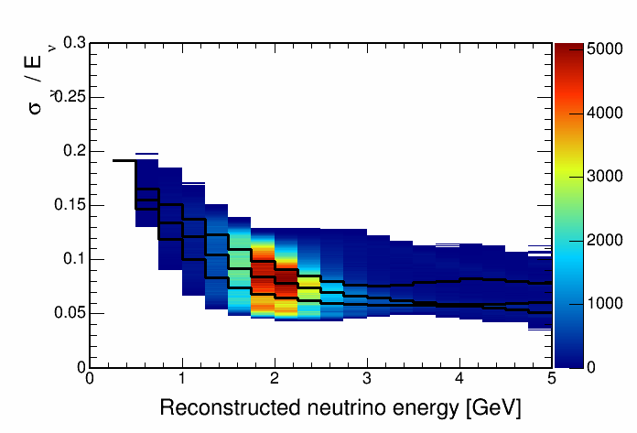
Neutrino energy resolution vs. reco. energy

Slide 7
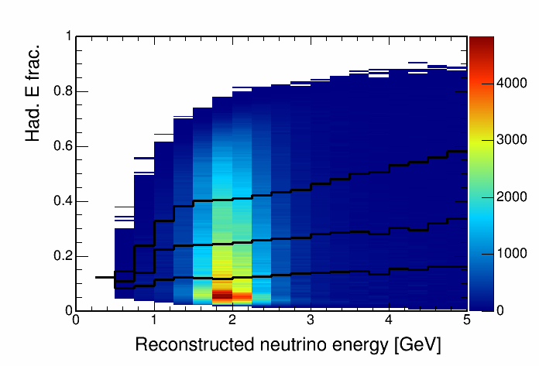
Hadronic energy fraction vs. reco. energy
This histogram is used to seperate events into quantiles of energy resolution.

Slide 8
Max. mixing paremeters sensitivity

Slide 9
SA numu result paramters (ssqth23 = 0.4022) sensitivity

Slide 10
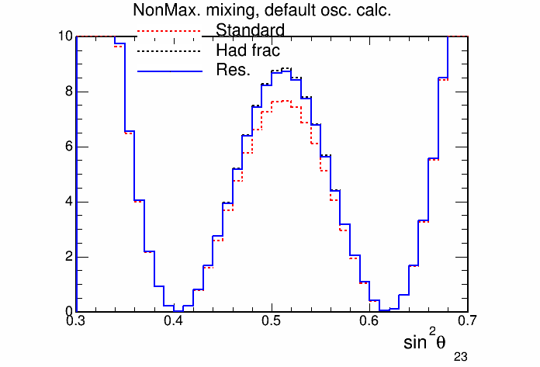
SA numu result paramters (ssqth23 = 0.4022) sensitivity

Slide 11
Future plan
Summary
Binning events by hadronic energy fraction and by energy resolution produces almost the same sensitivity
Hadronic energy fraction binning shows marginally better sensitivity gains
Repeat study including extrapolation and systematics
Optimise number of energy resolution bins for rejection of maximal mixing

Slide 12
Backup

