Slide 1
Sensitivity improvements with hadronic energy fraction binning
Numu group, Oct. 2016
Luke Vinton, University of Sussex

Slide 2
Version details
Running in S16-09-13
Using FD and ND numu decafs found here: /pnfs/nova/persistent/production/concat/R16-03-03-prod2reco.d/

Slide 3
Outline
All Sensitivities shown made with the SA numu (non max mixing) oscillation parameters

Slide 4
Oscillation parameters
SetL(810);
SetRho(0); // No matter effects
SetDmsq21(7.59e-5);
SetDmsq32(2.6746e-3);
SetTh12(.601);
SetTh13(.1567);
SetdCP(0);
SetTh23(0.68696); // non max (ssqth23 = 0.4022)

Slide 5
CVN and ReMId hybrid selection
Kirk introduced a hybrid remid and cvn FD cut designed for efficiency studies in the FD:
const Cut kKirkSATuneFD(
{"sel.cosrej.anglekal", "sel.remid.pid","sel.cvn.numuid", "slc.nhit", "sel.nuecosrej.pngptp”,"sel.cosrej.numucontpid"},
[](const caf::StandardRecord* sr)
{ return (sr->sel.remid.pid > 0.5
&& sr->sel.cvn.numuid > 0.5
&& sr->sel.cosrej.anglekal > 0.4
&& sr->slc.nhit < 400
&& sr->sel.nuecosrej.pngptp < 0.9
&& sr->sel.cosrej.numucontpid > 0.51);
}
);
I created a similar cut for the ND ommitting the cosmic rejection and nhit cuts.

Slide 6
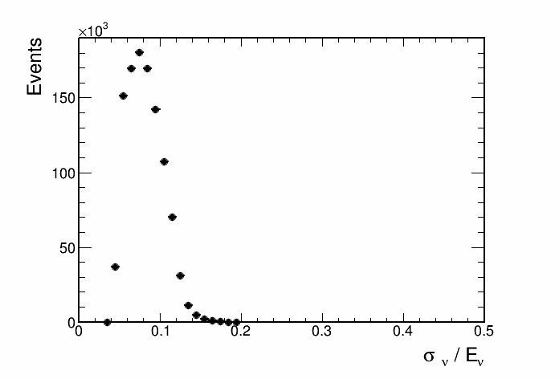
Contours with and without cosmic bkg

Slide 7
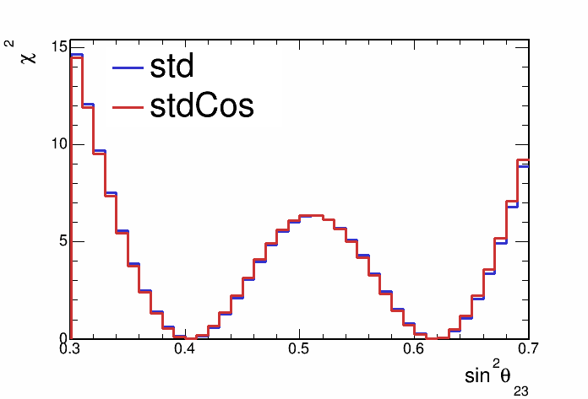
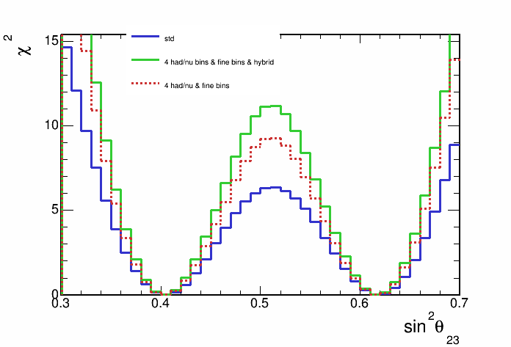
Contours with and without cosmic bkg

Slide 8
Optimising CVN and ReMId hybrid selection
Following plots are the result of making a non-max mixing full-syst. sensitivity contour for each value of the remid and cvn cuts.
First, number of bins within the contour shows a approximation of the contour size.
Second, the rejection of maximal mixing is shown for each value of the remid and cvn cut.

Slide 9
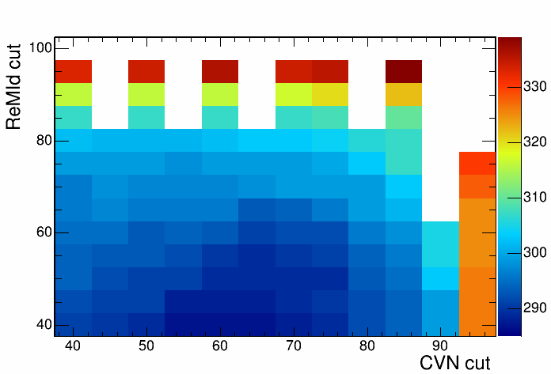
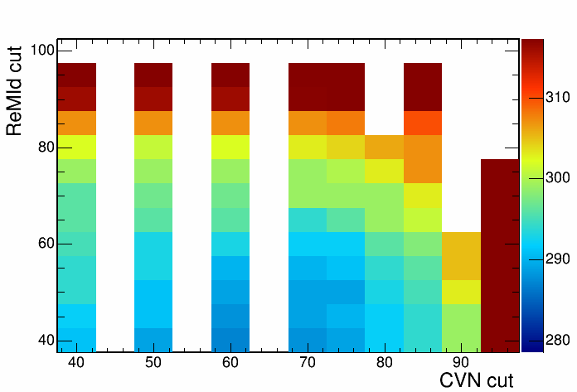
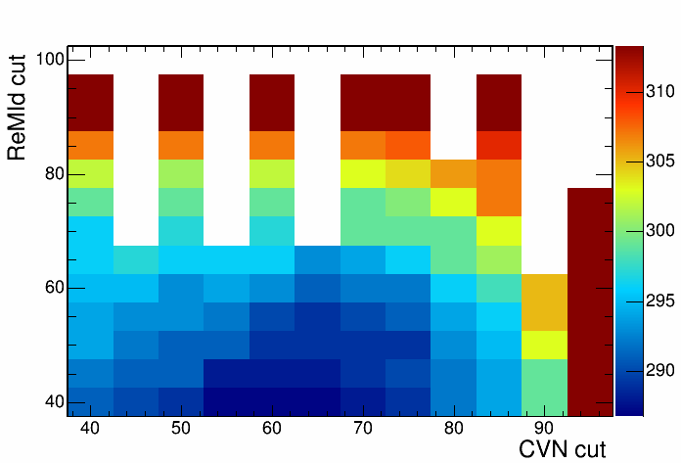
Number of bins within 90% C.L.
Current parameters used in tuned hybrid cut (291 bins)
Least number of bins within contour (287 bins)

Slide 10
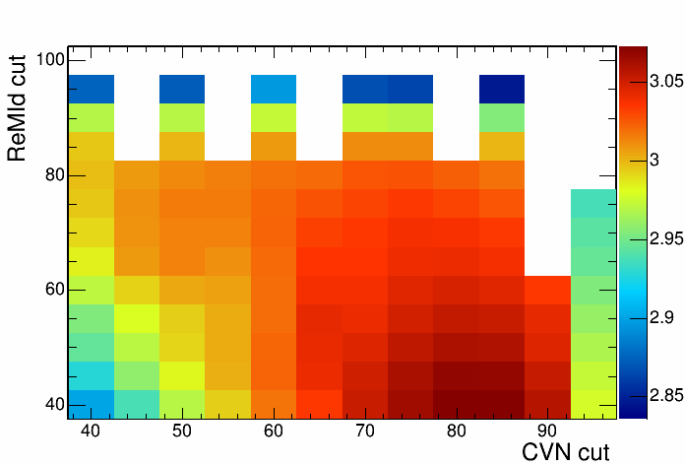

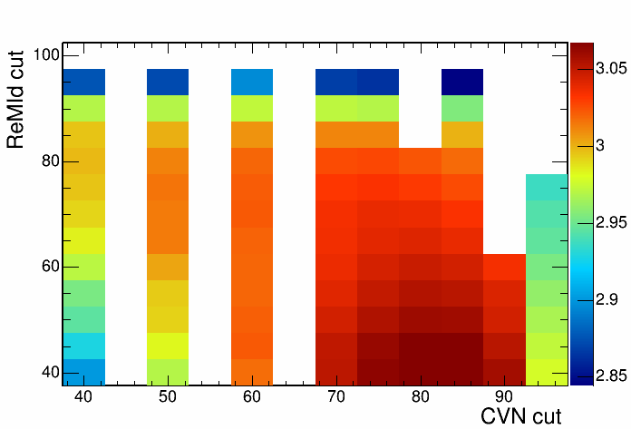
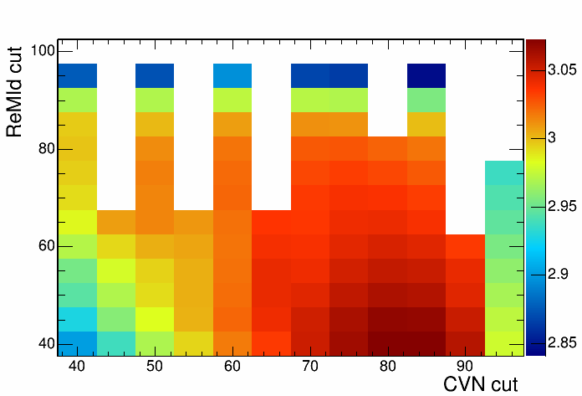
Sensitivity to reject maximal mixing
Current parameters used in tuned hybrid cut (2.992)
Largest maximal mixing rejection sensitivity (3.073 )

Slide 11
4 had frac. bins and vary number neutrino energy bins {20,40,60,80,120,160}

Slide 12
Note: had frac. quantiles formed using 20 neutrino energy bins for the following plots

Slide 13
Non-max mixing contours, 4 had frac bins

Slide 14
Non-max mixing contours, 4 had frac bins

Slide 15
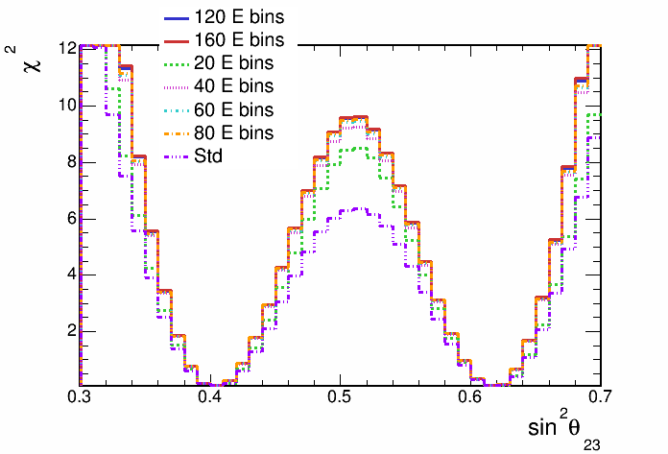
Non-max mixing contours, 4 had frac bins

Slide 16
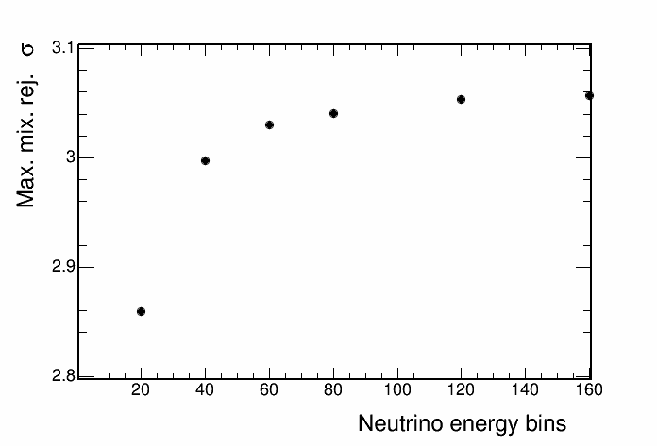
Non-max mixing contours, 4 had frac bins

Slide 17
Backup

Slide 18
Recap
Following slides show the stats. only ( and no extrap.) sensitivity with 4 hadronic energy fraction bins

Slide 19
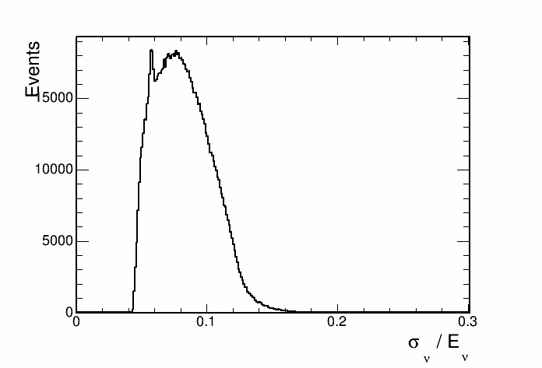
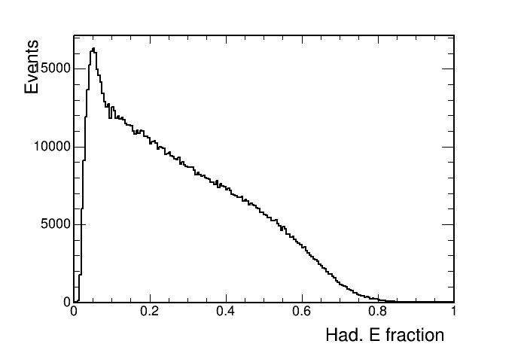
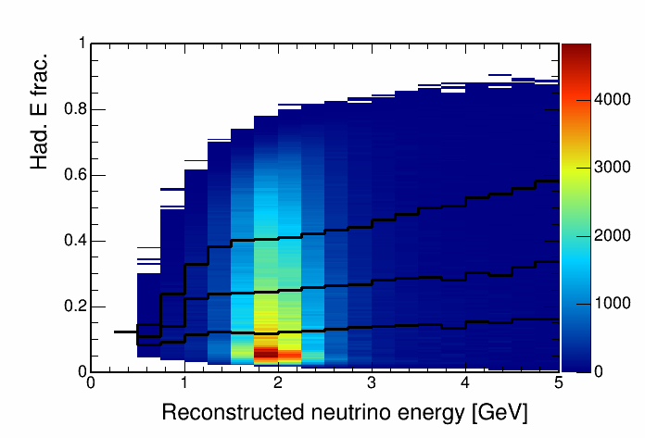
Hadronic energy fraction vs. reco. energy
This histogram is used to seperate events into quantiles of energy resolution.

Slide 20
SA numu result paramters (ssqth23 = 0.4022) sensitivity

Slide 21
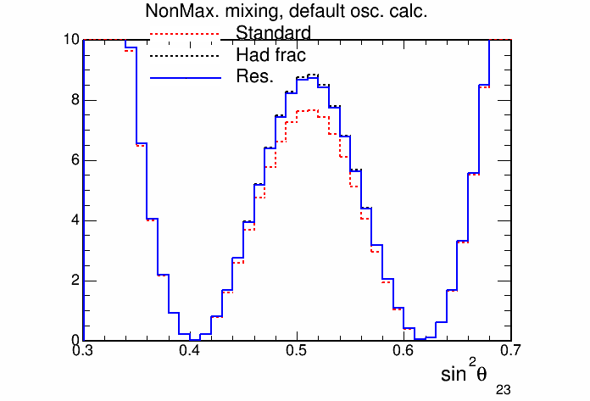
SA numu result paramters (ssqth23 = 0.4022) sensitivity

Slide 22
Fine ReMId binning
Binning scheme:
split remid into 2 coarse bins below 0.9
0.4 <= remid< 0.75
0.75 <= remid < 0.9
split into 8 fine bins above 0.9
72/80 <= remid < 73/80
73/80 <= remid < 74/80
……….. etc.
80/80 <= remid

Slide 23
Stats only sensitivity with fine ReMId binning

Slide 24
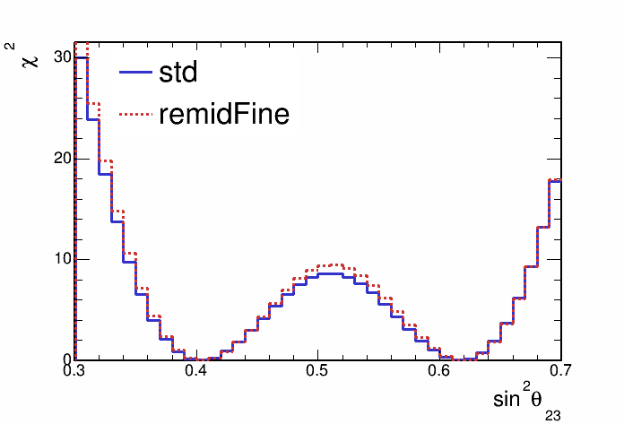
Stats only sensitivity with fine ReMId binning

Slide 25
Hadronic energy fraction binning
Split events into hadronic energy quantiles
Quantiles made for each bin of reconstructed neutrino energy
Up next, sensitivities with events split into 2,3,4 and 5 hadronic energy fraction quantiles

Slide 26
Sensitivity with hadronic energy fraction binning

Slide 27
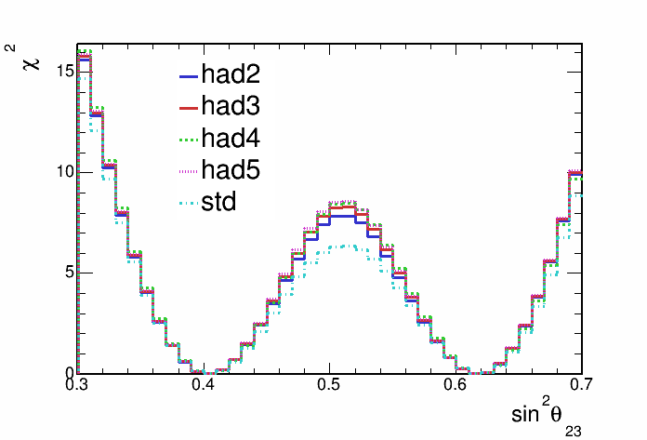
Sensitivity with hadronic energy fraction binning

Slide 28
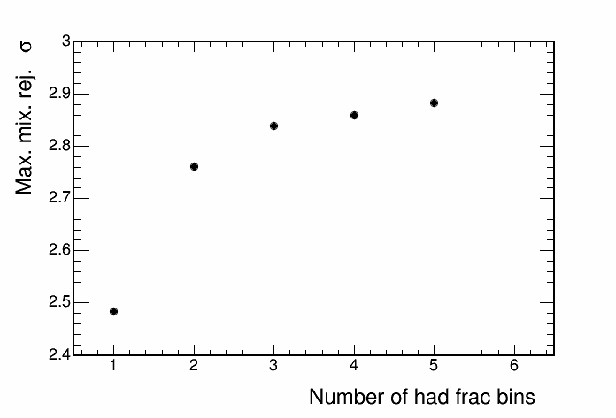
Sensitivity with hadronic energy fraction binning

Slide 29
2D Hadronic energy fraction and remid binning
Split events into 4 hadE frac. quantiles and 2 remid bins (0.4-0.75, 0.75-1.0)
HadE frac. quantiles made for each bin of reconstructed neutrino energy and for each remid bin

Slide 30
Sensitivity with hadronic energy fraction binning

Slide 31
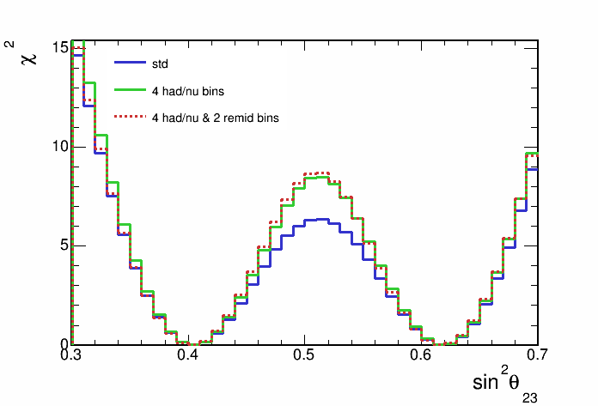
Sensitivity with hadronic energy fraction binning

Slide 32
Hadronic energy fraction
This histogram is used to seperate events into quantiles of energy resolution.

Slide 33
Max. mixing paremeters sensitivity

Slide 34
4 had frac. bins and 0.125 GeV neutrino energy binning

Slide 35
Contours with and without cosmic bkg

Slide 36
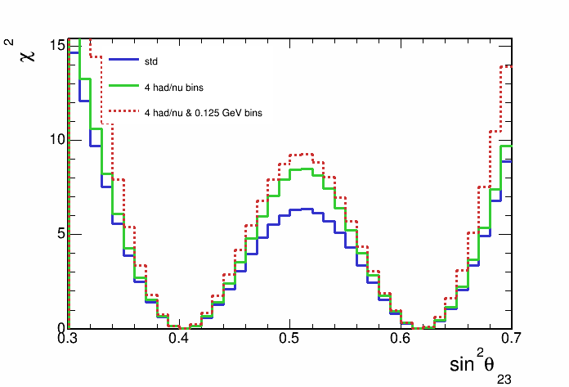
Contours with and without cosmic bkg

Slide 37
4 had frac. bins and 0.0625 GeV neutrino energy binning

Slide 38
Contours with and without cosmic bkg

Slide 39
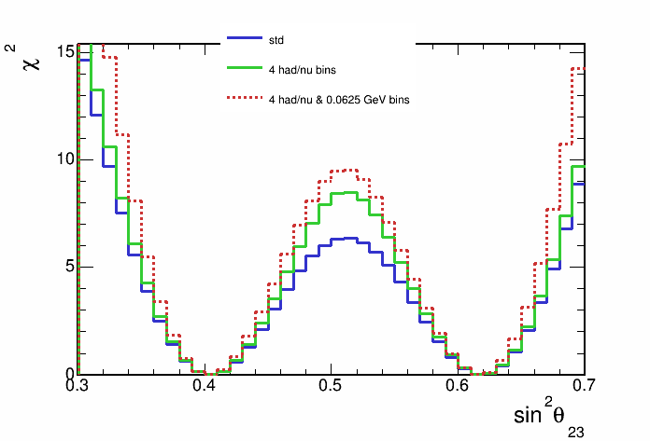
Contours with and without cosmic bkg

Slide 40
Cosmic background

Slide 41
Contours with and without cosmic bkg

Slide 42
Contours with and without cosmic bkg

