Slide 1
Sensitivity improvements with hadronic energy fraction binning
NuMu group, Oct. 2016
Luke Vinton, University of Sussex

Slide 2
Version details
Running in S16-09-13
Using FD and ND NuMu decafs found here: /pnfs/nova/persistent/production/concat/R16-03-03-prod2reco.d/

Slide 3
Outline
All Sensitivities shown:
made with the SA NuMu (non max mixing) oscillation parameters
Include all NuMu systematics but not the cosmic background
Sensitivity with cvn-remid hybrid selection & finer neutrino energy binning & Ehad frac binning
Tune of cvn-remid hybrid selection
for contour area
for max mixing rejection
Sensitivity with varying number of neutrino energy bins and 4 Ehad frac bins.

Slide 4
Oscillation parameters
SetL(810);
SetRho(0); // No matter effects
SetDmsq21(7.59e-5);
SetDmsq32(2.6746e-3);
SetTh12(.601);
SetTh13(.1567);
SetdCP(0);
SetTh23(0.68696); // non max (ssqth23 = 0.4022)

Slide 5
CVN and ReMId hybrid selection
Kirk introduced a hybrid remid and cvn FD cut designed for efficiency studies in the FD:
const Cut kKirkSATuneFD(
{"sel.cosrej.anglekal", "sel.remid.pid","sel.cvn.numuid", "slc.nhit", "sel.nuecosrej.pngptp”,"sel.cosrej.numucontpid"},
[](const caf::StandardRecord* sr)
{ return (sr->sel.remid.pid > 0.5
&& sr->sel.cvn.numuid > 0.5
&& sr->sel.cosrej.anglekal > 0.4
&& sr->slc.nhit < 400
&& sr->sel.nuecosrej.pngptp < 0.9
&& sr->sel.cosrej.numucontpid > 0.51);
}
);
I created a similar cut for the ND omitting the cosmic rejection and nhit cuts.

Slide 6
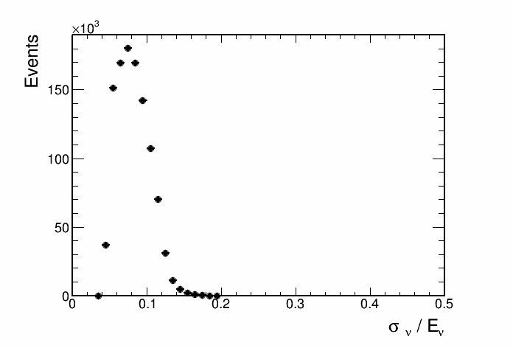
Contours with and without cosmic bkg
std: 0.25 GeV bins
Fine bins: 0.125 GeV bins
hybrid: remid & cvn selection

Slide 7
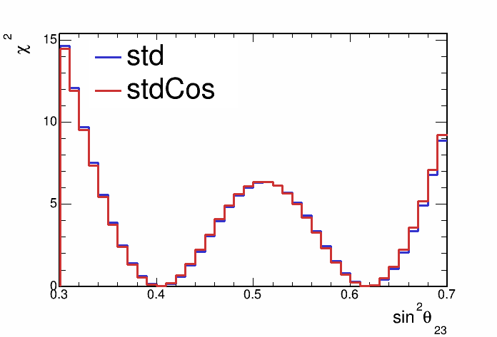
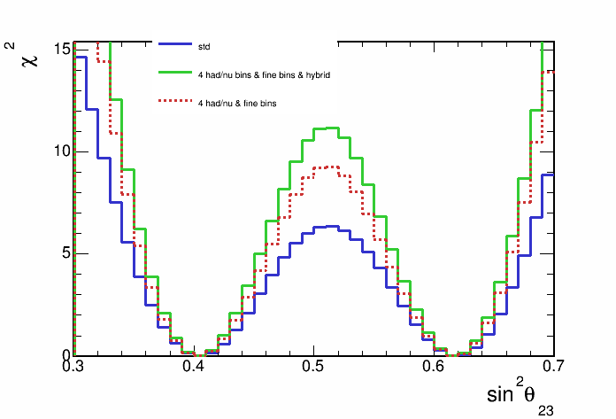
Contours with and without cosmic bkg
Rejection of max. mixing increased to 3.3 σ with combination of hybrid selection, finer energy binning and hybrid selection
std: 0.25 GeV bins
Fine bins: 0.125 GeV bins
hybrid: remid & cvn selection

Slide 8
Optimising CVN and ReMId hybrid selection
Following plots are the result of making a std (no had. energy fraction binning) non-max mixing full-syst. sensitivity contour for each value of the remid and cvn cuts.
First, number of bins within the contour shows a approximation of the contour size.
Second, the rejection of maximal mixing is shown for each value of the remid and cvn cut.

Slide 9
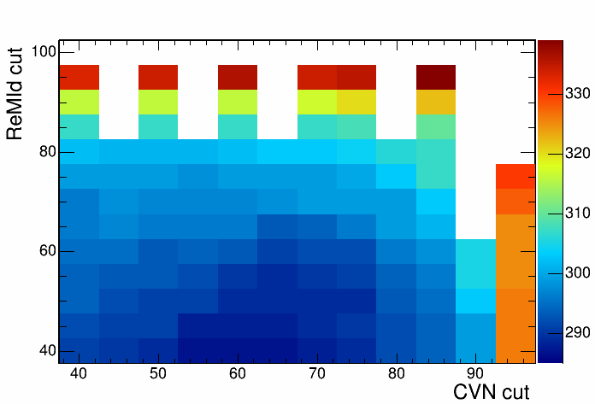
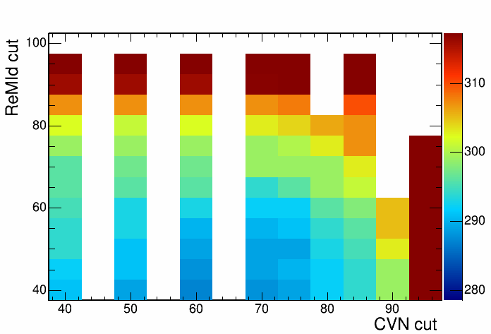
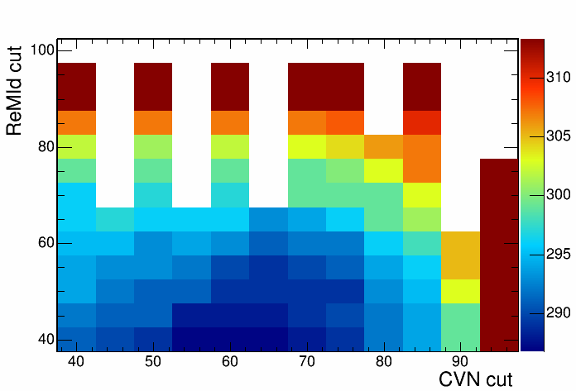
Number of bins within 90% C.L.
No. bins within contour
Current parameters used in tuned hybrid cut (291 bins)
Least number of bins within contour (287 bins)

Slide 10
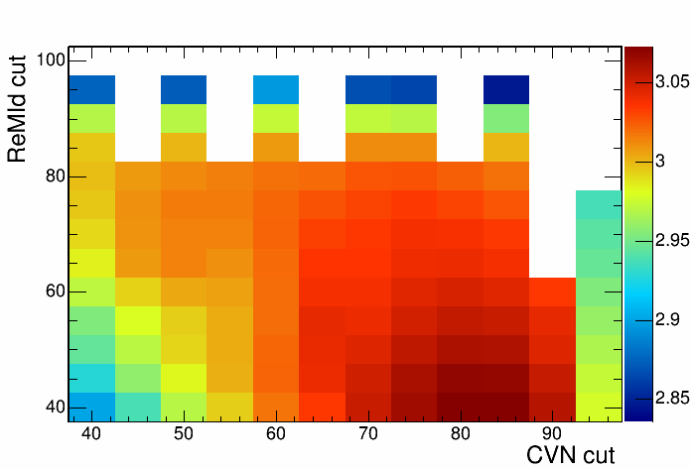

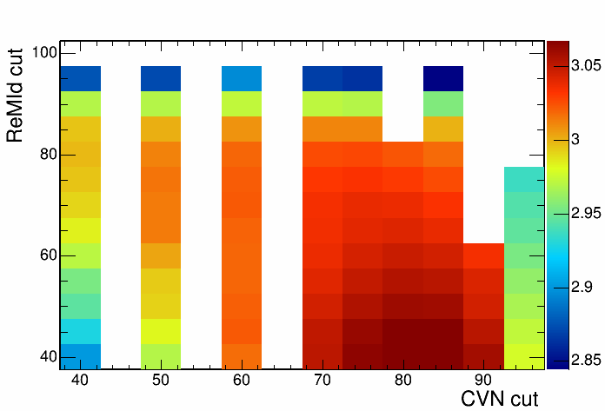
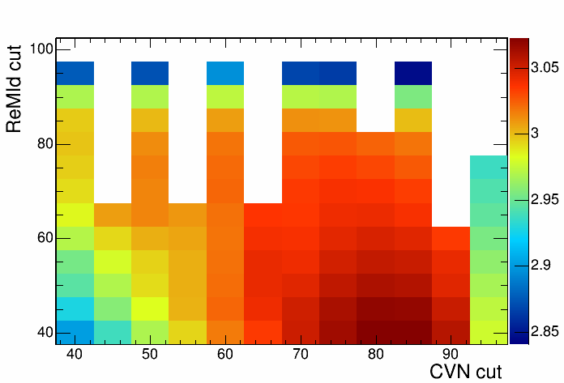
Sensitivity to reject maximal mixing
Max. mix. rejection σ
Current parameters used in tuned hybrid cut (2.992 σ)
Largest maximal mixing rejection sensitivity (3.073 σ)

Slide 11
4 had frac. bins and vary number neutrino energy bins {20,40,60,80,120,160}
We can use Ehad/Enu to divide our better and worse resolved events
A finer binning would take advantage of the well resolved portion of events

Slide 12
Non-max mixing contours, 4 had frac bins
Bins from 0 - 5 GeV

Slide 13
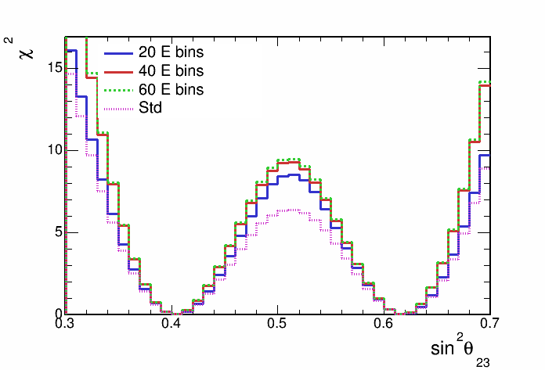
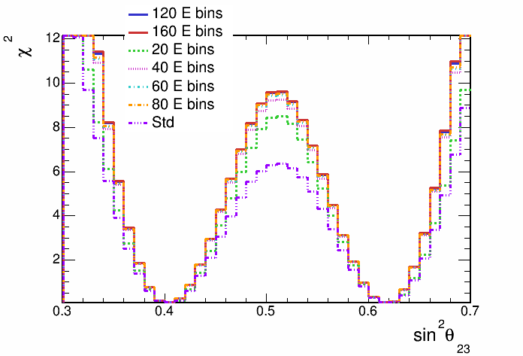
Non-max mixing contours, 4 had frac bins

Slide 14
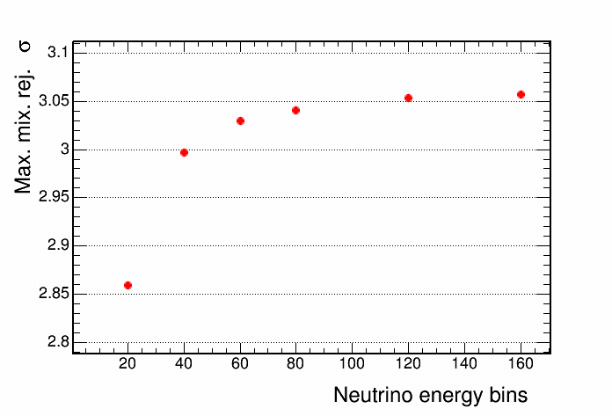
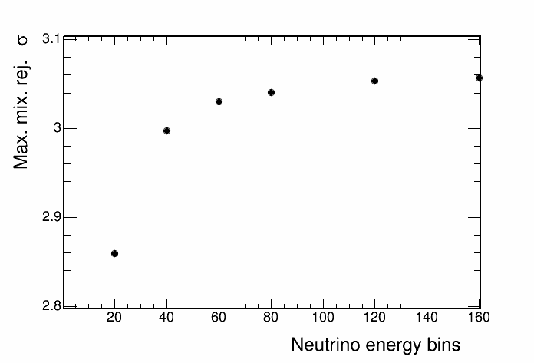
Non-max mixing contours, 4 had frac bins

Slide 15
Summary
Using hybrid selection along with finer neutrino energy binning and had. frac binning increases sensitivity (at SA NuMu parameters) to reject maximal mixing to 3.3 σ
Sensitivity to rejection of maximal mixing is fairly flat vs. the hybrid selection values
but would be slightly increased with adjustment (increase in max. mixing rejection of 0.08 σ)
“Optimal” value of cuts probably not shown, need to assess lower region of remid and cvn
Rejection vs. number of neutrino energy bins shows that 50 or 60 neutrino energy bins is about optimal for rejection and computing time
Future plan
Use variable neutrino energy binning and reduce number of bins
finer in most statistically powerful region
coarser in less powerful regions
optimise for 4 had frac divisions

Slide 16
Backup

Slide 17
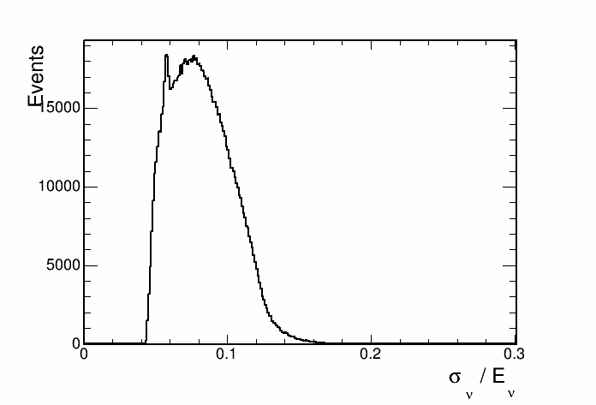
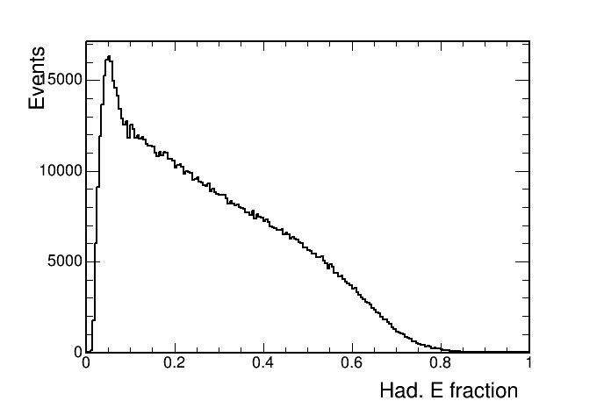
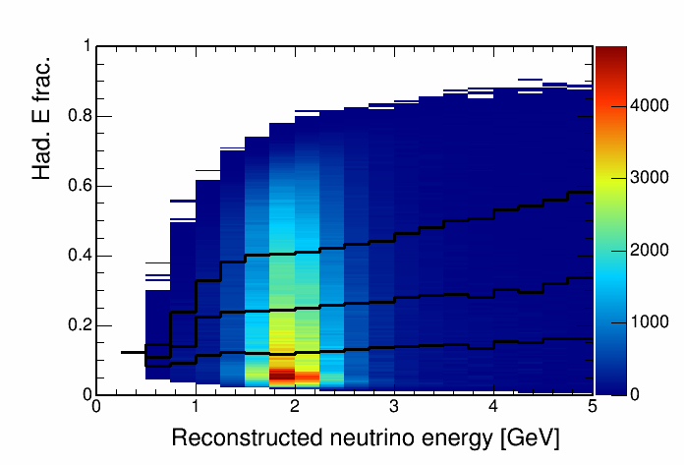
Hadronic energy fraction vs. reco. energy
This histogram is used to separate events into quantiles of energy resolution.

Slide 18
Cosmic background

Slide 19
Contours with and without cosmic bkg

Slide 20
Contours with and without cosmic bkg

Slide 21
Hadronic energy fraction binning
Split events into hadronic energy quantiles
Quantiles made for each bin of reconstructed neutrino energy
Up next, sensitivities with events split into 2,3,4 and 5 hadronic energy fraction quantiles

Slide 22
Sensitivity with hadronic energy fraction binning

Slide 23
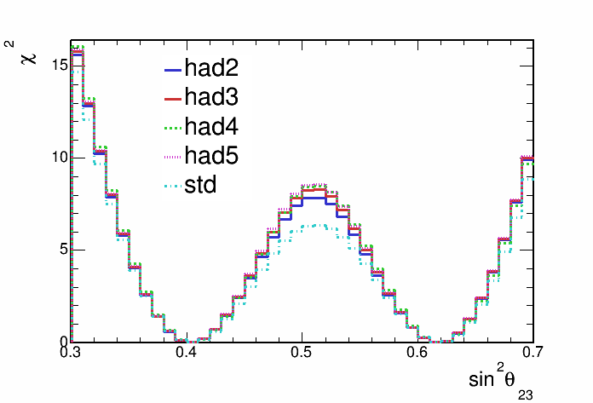
Sensitivity with hadronic energy fraction binning

Slide 24
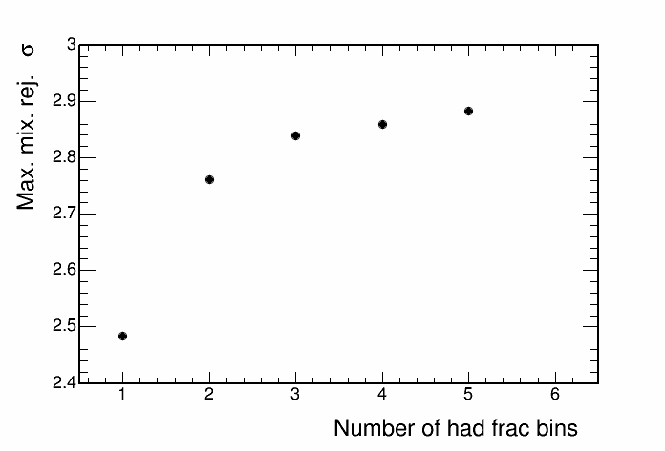
Sensitivity with hadronic energy fraction binning

