Slide 1
Overview and status of
the validation framework
Reco. forum, Sep. 2016
Luke Vinton, University of Sussex

Slide 2
Outline
Framework designed by Matthew Tamsett
More details found here: https://cdcvs.fnal.gov/redmine/projects/novaart/repository/entry/trunk/Validation/analysis/README
Last update given by Bruno Zamorano in DocDB-14824
useful overview of the website
Introduction to the validation framework
Brief guide on how the framework works
Histogram naming convention
Current state
To-do list

Slide 3
The validation framework
The validation framework was designed to lessen the load of validation plot making
Instructions on installing and running the framework can be found here: https://cdcvs.fnal.gov/redmine/projects/novaart/repository/entry/trunk/Validation/analysis/README
Validation framework works by running a python script which points to a CAFAna macro via json configuration file
The json file contains configurations for the novasoft release, validation plot version, datasets and shell scripts to be run
Each run over a macro produces a root file containing histograms defined by the macro and dataset
Example:
python $NOVAANAVALID_DIR/core/controller/analysis_validation.py –c /nova/app/users/vinton/ana_valid/nu_mu/configurations/caf_numu_nd_cutflow.json
The shell scripts each point to a CAFAna macro
For example, one of the shell scripts pointed to by caf_numu_nd_cutflow.json is nu_mu/components/run_caf_numu_nd_cutflow.sh, which runs: cafe -bq caf_numu_nd_cutflow.C

Slide 4
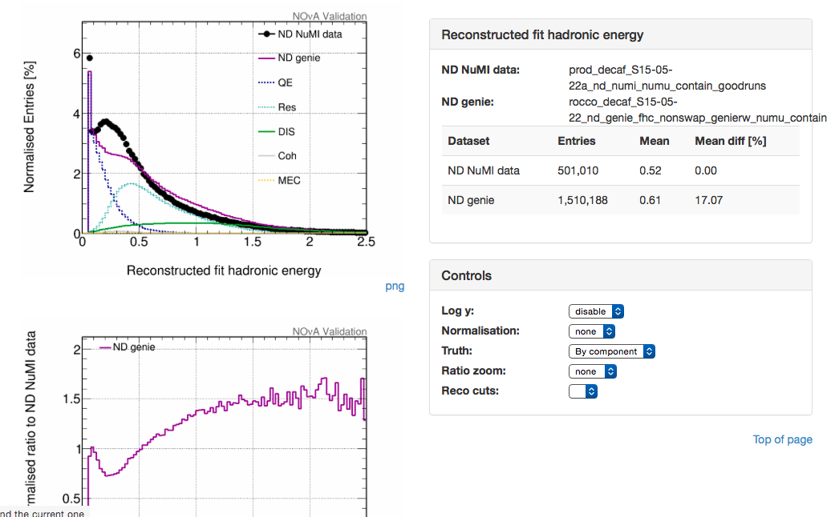
The validation framework
A website displaying all validation components created by a user can be generated with: python $NOVAANAVALID_DIR/core/view/makeHTMLView.py
The website is created at: http://nusoft.fnal.gov/nova/users/<USERNAME>/validation/
The website user can select the datasets they want to compare
Cuts can be selected from a dropdown menu next to a plot (If the CAFAna macro produced hists for different cuts, see “naming convention” slide)

Slide 5
Aside: naming convention
All histograms must follow the naming convention:
<category>-<variable>-<reco_level>-<true_level>
category: logical category the plots fall into (reco, true, mixed, sam)
variable: observable
reco_level: reconstruction cuts
true_level: QE,Res,DIS,Coh
both reco_level and true_level are optional
Examples of acceptable names:
reco-reco_numu_energy
reco-reco_numu_energy-QE
true-numu_energy
true-numu_energy-n_minus_1_preselection
The website user can choose the truth and reco level for each plot, provided there are multiple reco_levels and/or true_levels per <category>-<variable> combination

Slide 6
Changes needed to run art modules
The validation CAFAna jobs currently dump output histograms in a flat format directly to a directory
However, Art modules dump the histograms into a subdirectory within a file. To enable use of the framework with art modules we should choose one of the two output file structures and apply to both art and CAFAna validation jobs
Both the output file structure and the use of multiple module Art jobs need attention before art modules can be run with the framework

Slide 7
Current state
Website populated with image files (eps)
Can produce plots comparing variables in multiple datasets (data or MC)
validation with CAFAna working smoothly
work needed to enable running art modules
Unfortunately, I don’t have the time to develop this any further, framework needs a new champion
further development will require some understanding of json, python and bash
Future plans
framework needs adjusting to run art jobs
I don’t plan to have the time to develop this further
framework needs a new champion!
Sussex group can provide support to get started
Framework is not complicated, get stuck in!
Great way to learn and hone transferable computing skills

Slide 8
Backup

