Slide 1
Sensitivity improvements with hadronic energy fraction and remid binning
Numu group, Sep. 2016
Luke Vinton, University of Sussex

Slide 2
Version details
Running in S16-09-13
Using FD and ND numu decafs found here: /pnfs/nova/persistent/production/concat/R16-03-03-prod2reco.d/

Slide 3
Outline
All Sensitivities shown made with the SA numu (non max mixing) oscillation parameters
Review of last talk (DocDB – 16087)
hadronic energy fraction vs. reco. neutrino energy
No-extrap stats-only non-max. mixing sensitivity contour
Sensitivity (no systs, full extrap) with fine remid binning
Sensitivities (full systs, full extrap) with:
hadronic energy fraction binning
with 2D combination of remid and hadronic energy binning

Slide 4
Oscillation parameters
SetL(810);
SetRho(0); // No matter effects
SetDmsq21(7.59e-5);
SetDmsq32(2.6746e-3);
SetTh12(.601);
SetTh13(.1567);
SetdCP(0);
SetTh23(0.68696); // non max (ssqth23 = 0.4022)

Slide 5
Recap
Following slides show the stats. only ( and no extrap.) sensitivity with 4 hadronic energy fraction bins

Slide 6
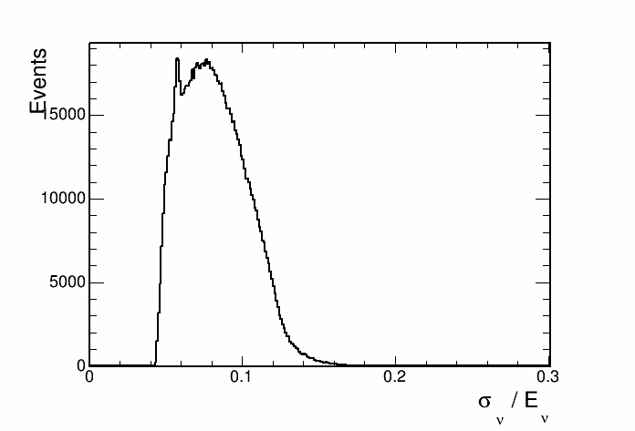
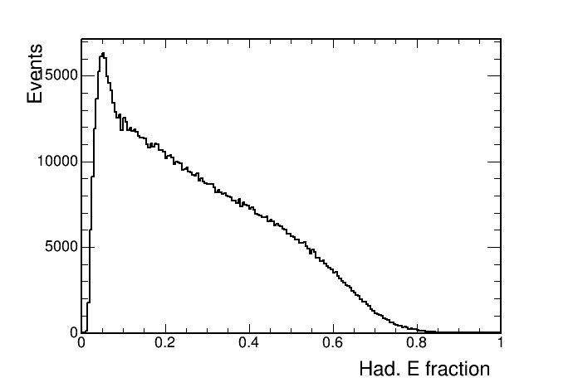
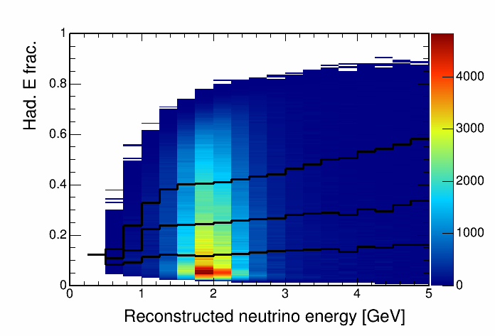
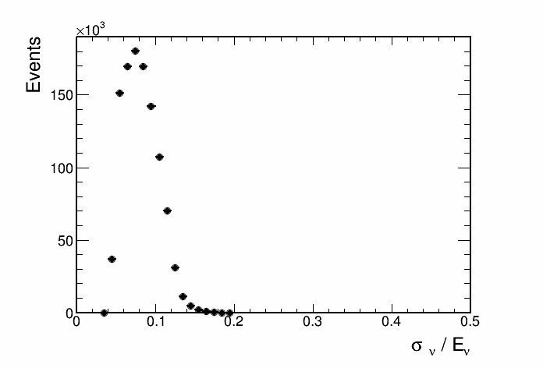
Hadronic energy fraction vs. reco. energy
This histogram is used to seperate events into quantiles of energy resolution.

Slide 7
SA numu result paramters (ssqth23 = 0.4022) sensitivity

Slide 8
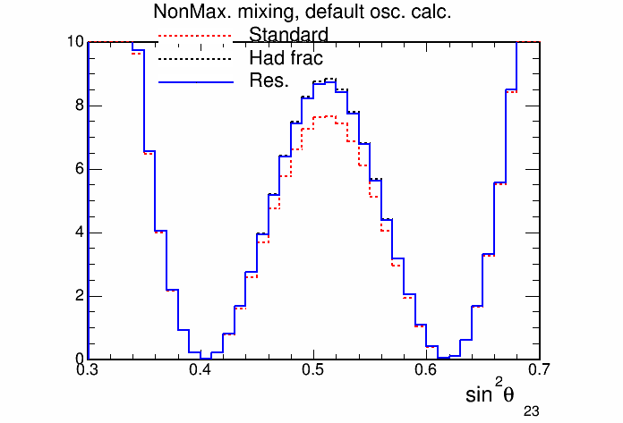
SA numu result paramters (ssqth23 = 0.4022) sensitivity

Slide 9
Fine ReMId binning
Binning scheme:
split remid into 2 coarse bins below 0.9
0.4 <= remid< 0.75
0.75 <= remid < 0.9
split into 8 fine bins above 0.9
72/80 <= remid < 73/80
73/80 <= remid < 74/80
……….. etc.
80/80 <= remid

Slide 10
Stats only sensitivity with fine ReMId binning

Slide 11
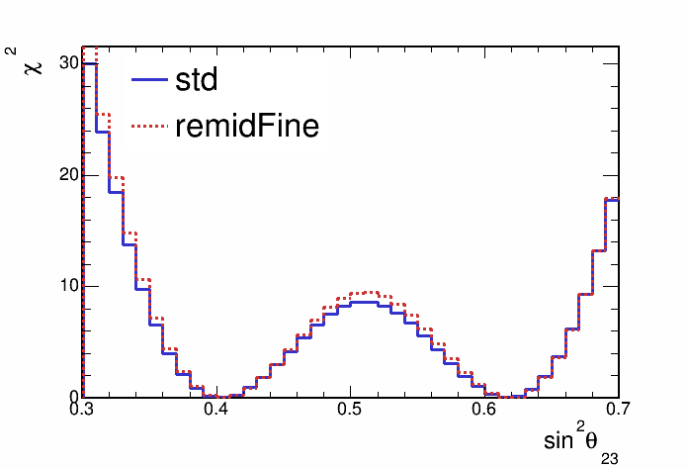
Stats only sensitivity with fine ReMId binning

Slide 12
Hadronic energy fraction binning
Split events into hadronic energy quantiles
Quantiles made for each bin of reconstructed neutrino energy
Up next, sensitivities with events split into 2,3,4 and 5 hadronic energy fraction quantiles

Slide 13
Sensitivity with hadronic energy fraction binning

Slide 14
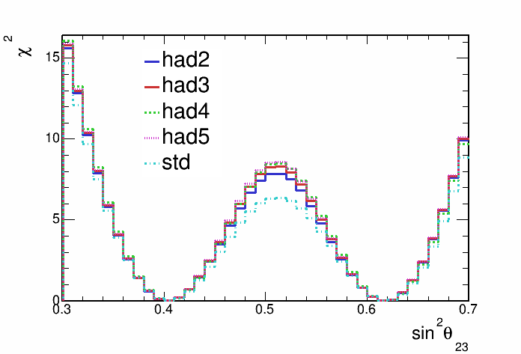
Sensitivity with hadronic energy fraction binning

Slide 15
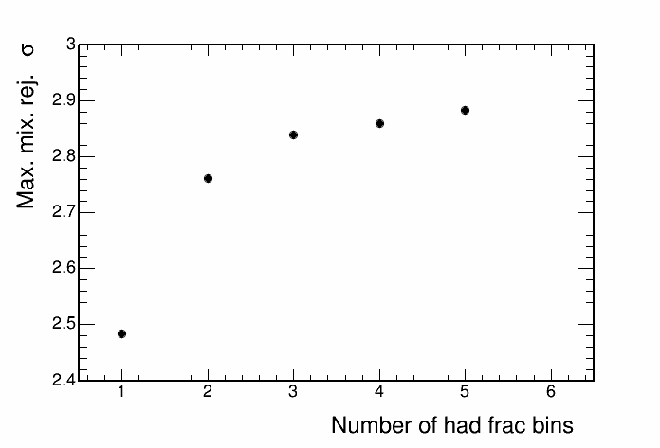
Sensitivity with hadronic energy fraction binning

Slide 16
2D Hadronic energy fraction and remid binning
Split events into 4 hadE frac. quantiles and 2 remid bins (0.4-0.75, 0.75-1.0)
HadE frac. quantiles made for each bin of reconstructed neutrino energy and for each remid bin

Slide 17
Sensitivity with hadronic energy fraction binning

Slide 18
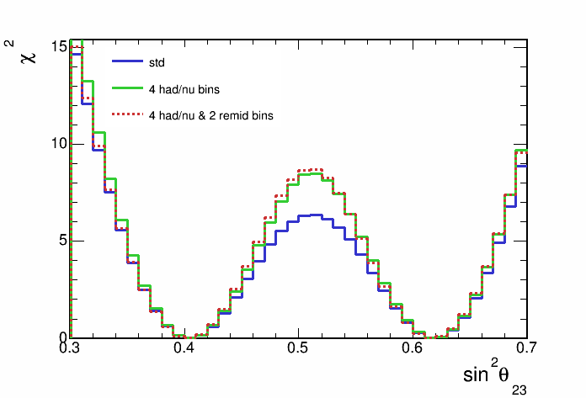
Sensitivity with hadronic energy fraction binning

Slide 19
Summary
Stats only sensitivity improves slightly when splitting events using fine remid binning
Improvement of using hadE frac. binning over standard increases with addition of systematics and extrapolation
senstivity improves with the number of hadE frac bins. Sensitivity gain is less with each extra bin
2D binning in hadE frac and remid improves rejection of maximal mixing over just hadE frac binning
However there is some strange behaviour. The contour becomes larger in some parts. Most notably at sinSqTh_23 ~ 0.35

Slide 20
Backup

Slide 21
Hadronic energy fraction
This histogram is used to seperate events into quantiles of energy resolution.

Slide 22
Max. mixing paremeters sensitivity

