Slide 1
Energy resolution parameterisation
Numu group, Aug 2016
Luke Vinton, University of Sussex

Slide 2
Version details
Using tagged release: S16-08-04
Using a decaf nonswap FD file:
/pnfs/nova/persistent/production/concat/R16-03-03-prod2reco.d/prod_decaf_R16-03-03-prod2reco.e_fd_genie_nonswap_fhc_nova_v08_epoch1-3c_numu_contain_v1_prod2-snapshot.root

Slide 3
Energy resolution parameterisation
Using the MC to measure the the abs. resolution (reco-true) of muon and hadronic energy vs. (muon or had.) energy. Fit a polynomial to the res. vs energy plot, the fit is used to “look up” the resolution for a given energy
Absolute neutrino energy resolution is defined for each event as:
σ_{ν} = √(σ_{μ}(Ε_{μ}) ² + σ_{had.}(E_{had.})²)
(Assuming no correlation)
σ_{ν} / Ε_{ν} is then used to define the energy resolution for each event
Using truth selection for resolution parameterisation
Note: At this stage parameterisation is done without applying oscillations to the FD MC

Slide 4
Selection
Use the standard numu FD selection (kNumuFD) and also the truth selection (kIsNumuCC)
Need to use the truth selection to remove troublesome background. In particular the NC events, for which the true muon energy will be zero. That’s a problem when we want to measure (reco. E – true E)

Slide 5
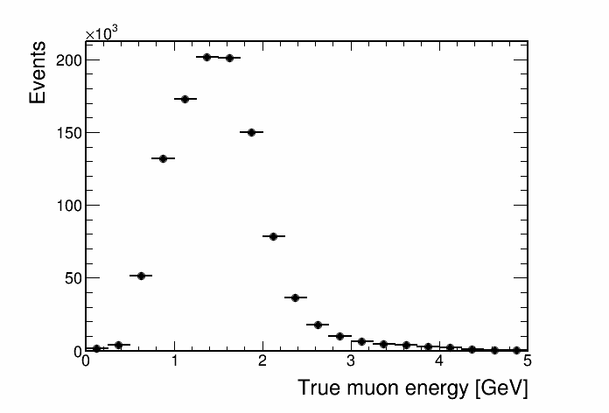
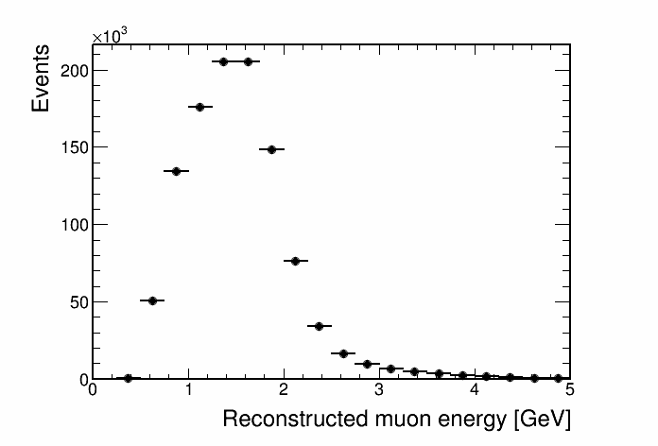
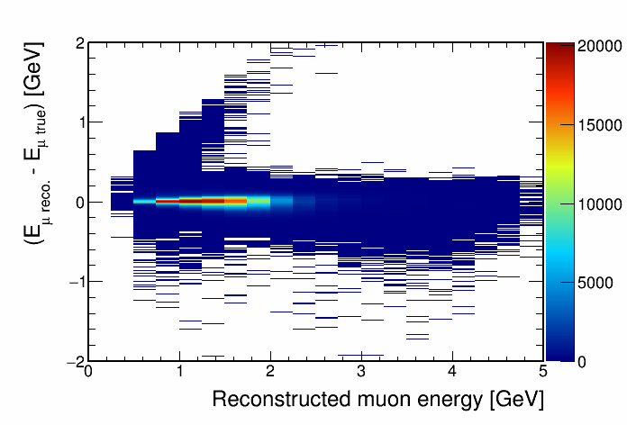
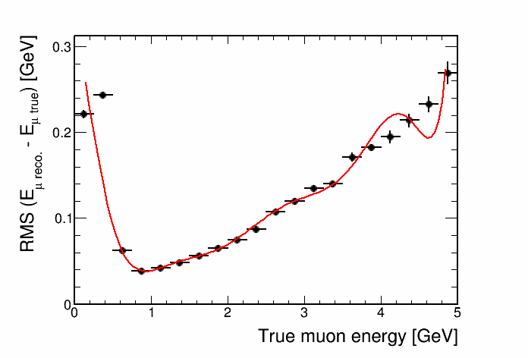
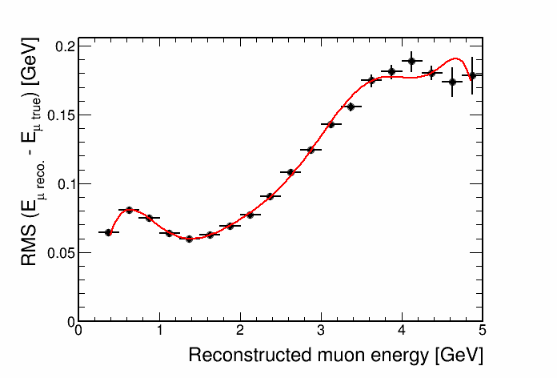
Muon energy resolution

Slide 6
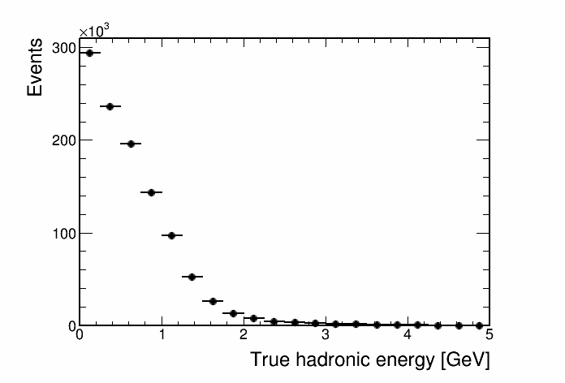
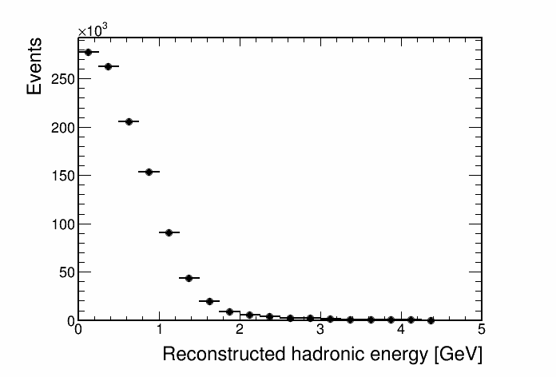
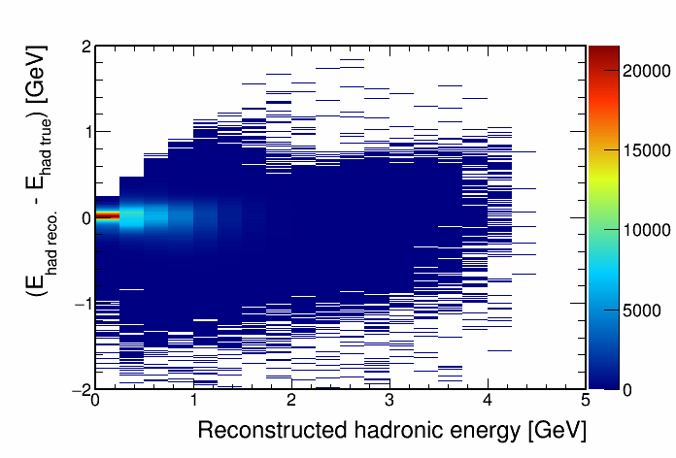
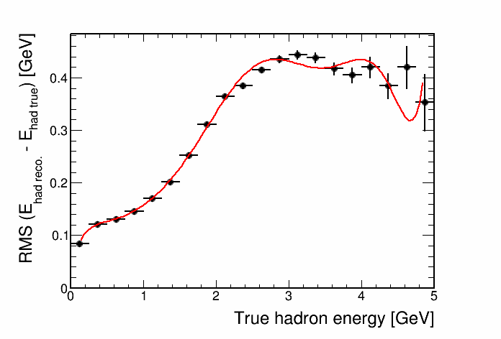
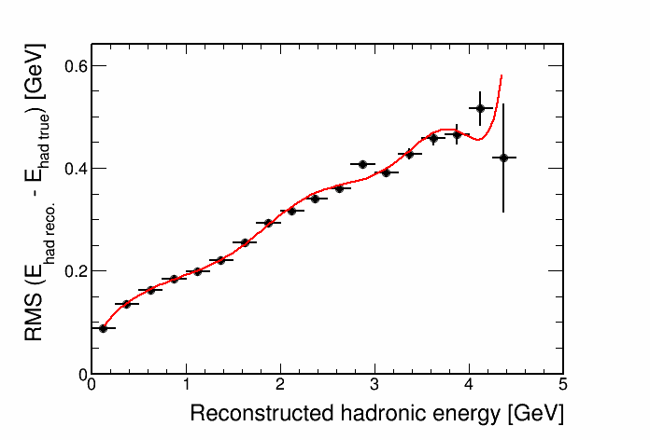
Hadronic energy resolution
put true spec above
put reco. spec above

Slide 7
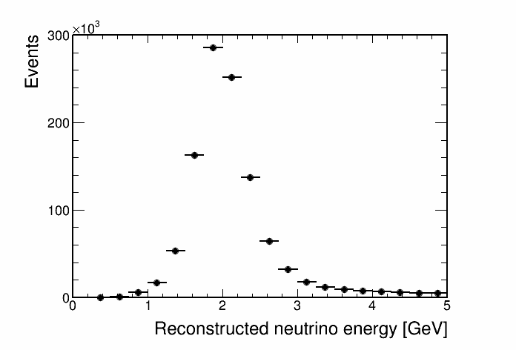
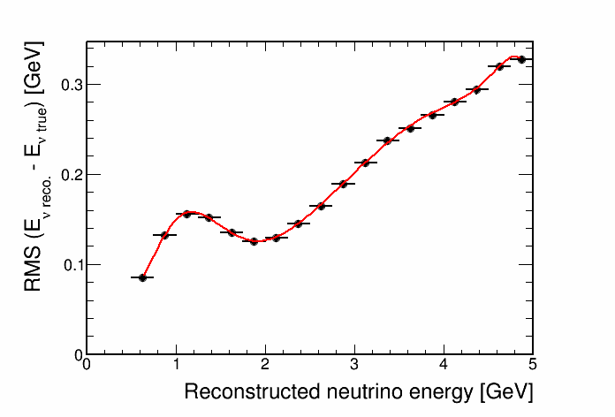
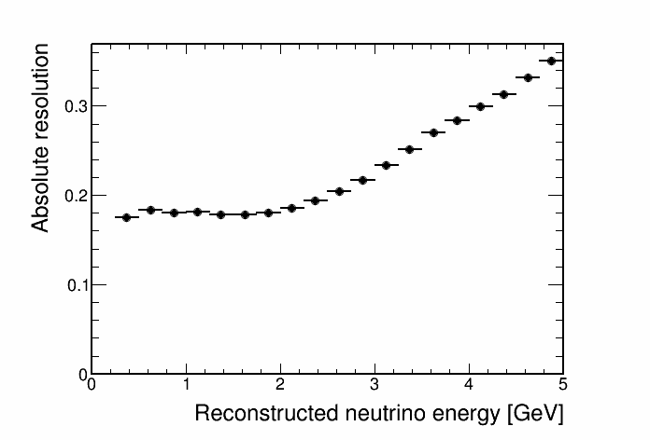
Neutrino energy resolution
Direct
Combination

Slide 8
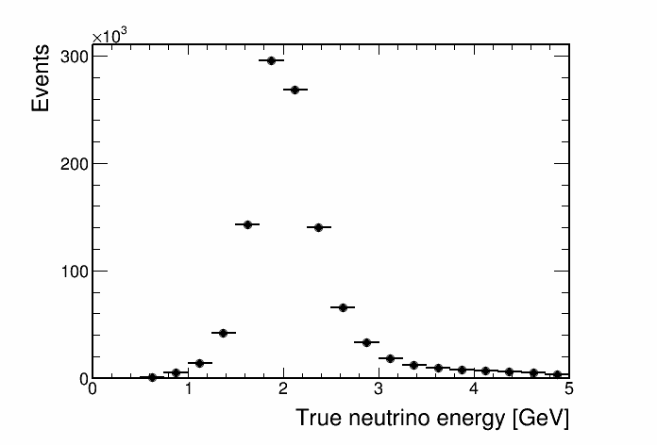
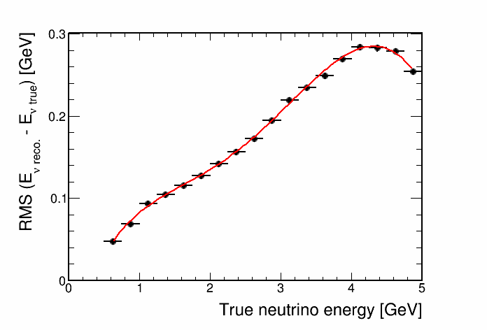
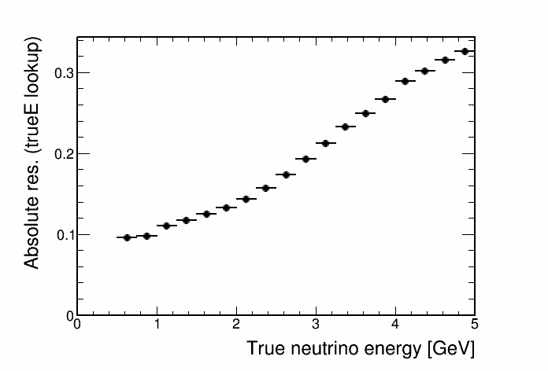
True neutrino energy resolution

Slide 9
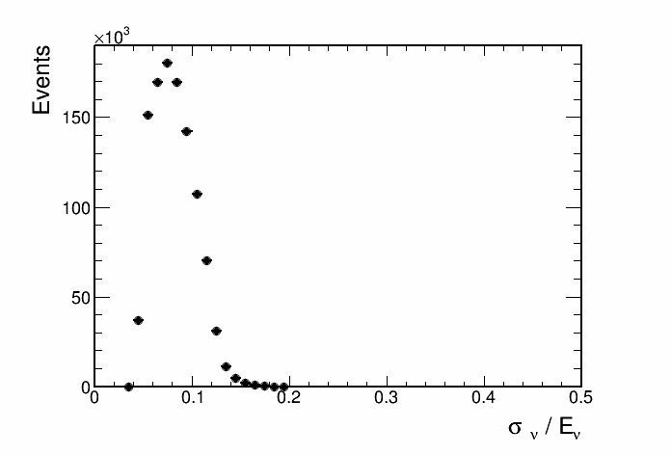
Neutrino energy resolution

Slide 10
Future plan
Summary
Made first pass at parameterising the neutrino energy resolution as a function of muon and hadronic energy
Produce the energy spectrum (oscillated and un-oscillated) for energy resolution bins
Make contours at max. mixing for combinations of energy res. bins
look for initial signs of improvement in the sensitivity

Slide 11
Backup

