Slide 1
Sensitivity with number of hadronic energy fraction bins
Numu group, Sep. 2016
Luke Vinton, University of Sussex

Slide 2
Version details
Running in development
Using FD decafs: /pnfs/nova/persistent/production/concat/R16-03-03-prod2reco.d/

Slide 3
Outline
Hadronic energy fraction vs. neutrino energy
Sensitivity contours with hadronic energy binning
Full numu systematics
Extrapolation
Hadronic energy fraction vs. nprongs and vs. ReMId

Slide 4
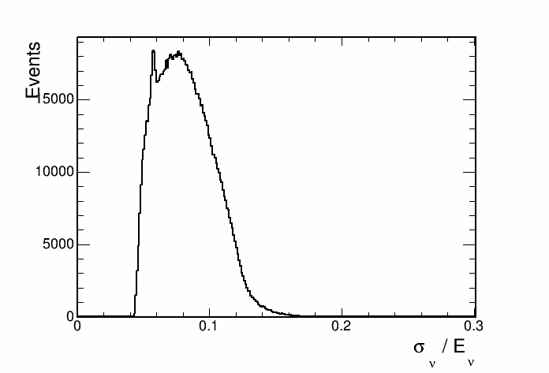
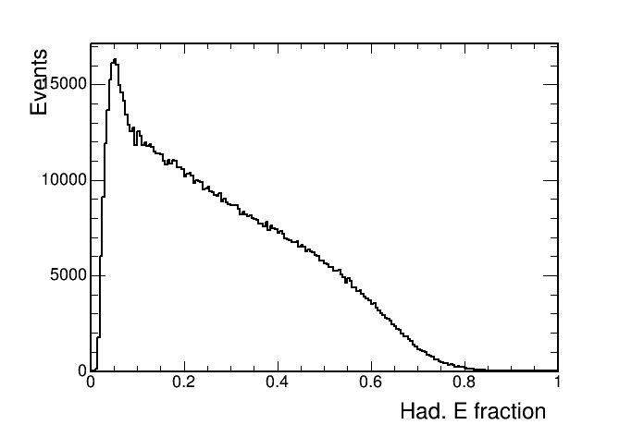
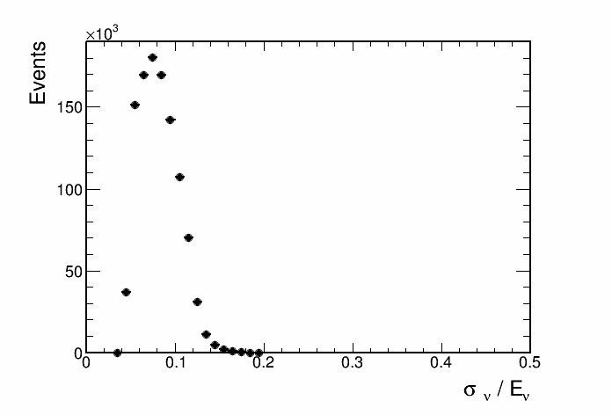
Hadronic energy fraction

Slide 5
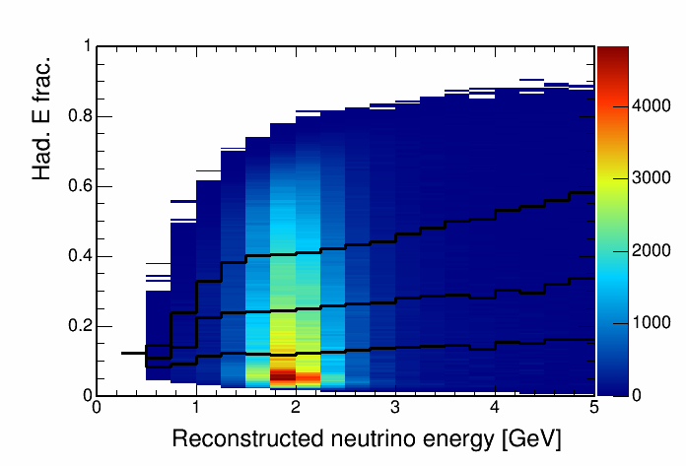
Hadronic energy fraction vs. reco. energy, 4 quantiles
This histogram is used to seperate events into quantiles of energy resolution.

Slide 6
Sensitivity with hadronic energy fraction binning

Slide 7
Sensitivity with hadronic energy fraction binning

Slide 8
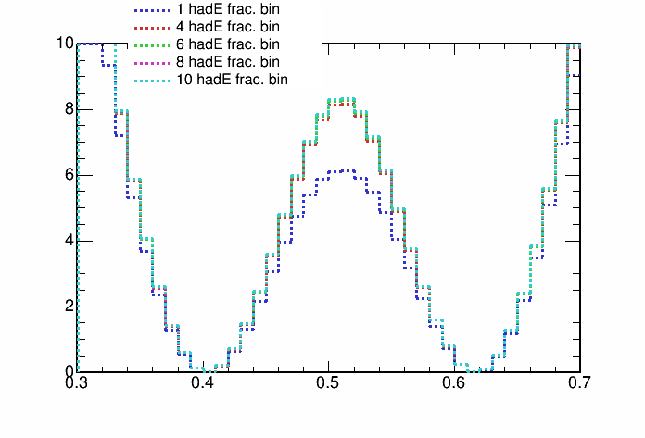
Sensitivity with hadronic energy fraction binning

Slide 9
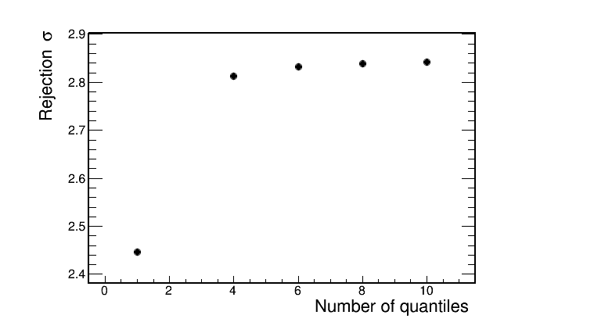
Sensitivity with hadronic energy fraction binning

Slide 10
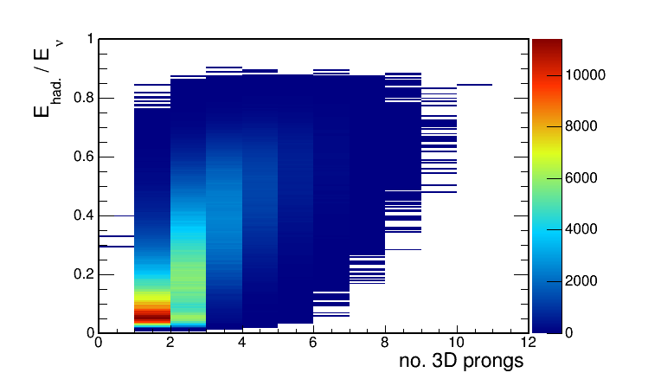
Hadronic energy fraction vs. no. 3D prongs
This histogram is used to seperate events into quantiles of energy resolution.

Slide 11
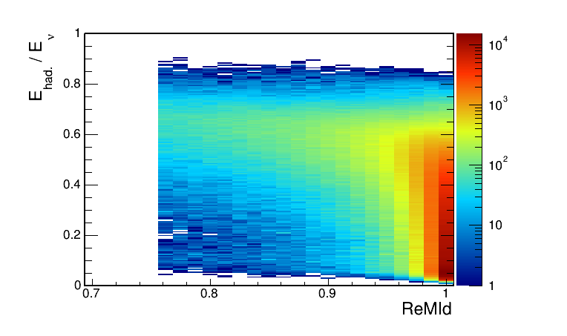
Hadronic energy fraction vs. ReMId
This histogram is used to seperate events into quantiles of energy resolution.

Slide 12
Future plan
Summary
Bin
Re

Slide 13
Backup

