Slide 1
Sensitivity improvements with hadronic energy fraction binning
Numu group, Sep. 2016
Luke Vinton, University of Sussex

Slide 2
Version details
Running in S16-09-13
Using FD and ND numu decafs found here: /pnfs/nova/persistent/production/concat/R16-03-03-prod2reco.d/

Slide 3
Outline
All Sensitivities shown made with the SA numu (non max mixing) oscillation parameters

Slide 4
Oscillation parameters
SetL(810);
SetRho(0); // No matter effects
SetDmsq21(7.59e-5);
SetDmsq32(2.6746e-3);
SetTh12(.601);
SetTh13(.1567);
SetdCP(0);
SetTh23(0.68696); // non max (ssqth23 = 0.4022)

Slide 5
Cosmic background

Slide 6
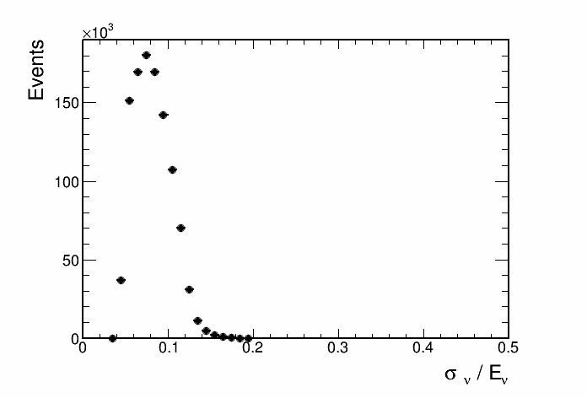
Contours with and without cosmic bkg

Slide 7
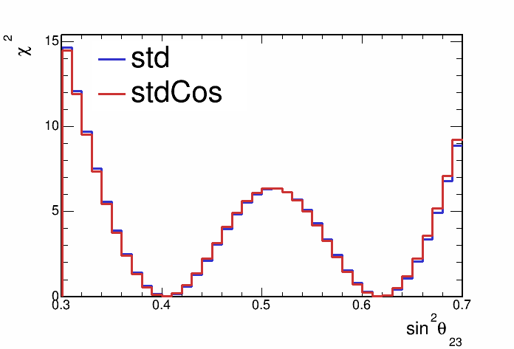
Contours with and without cosmic bkg

Slide 8
4 had frac. bins and 0.125 GeV neutrino energy binning

Slide 9
Contours with and without cosmic bkg

Slide 10
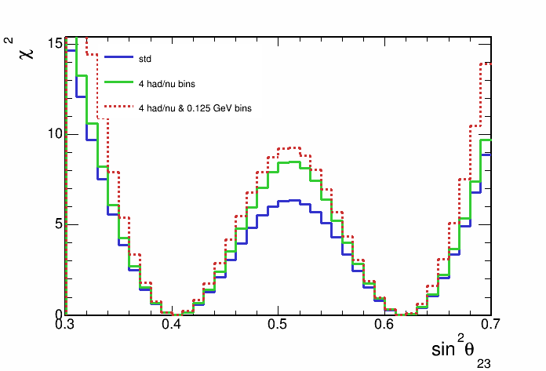
Contours with and without cosmic bkg

Slide 11
CVN and ReMId hybrid selection

Slide 12
Contours with and without cosmic bkg

Slide 13
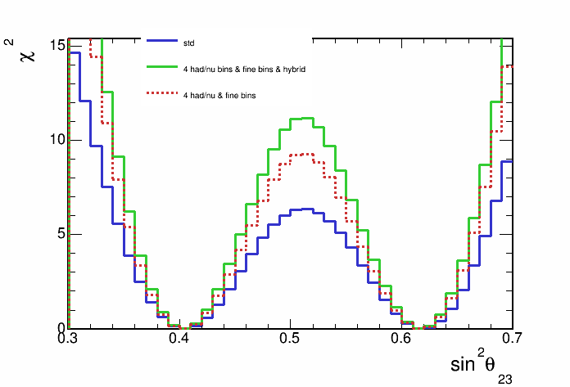
Contours with and without cosmic bkg

Slide 14
Backup

Slide 15
Recap
Following slides show the stats. only ( and no extrap.) sensitivity with 4 hadronic energy fraction bins

Slide 16
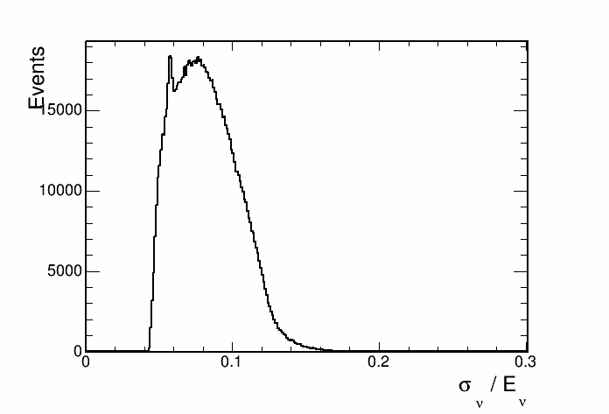
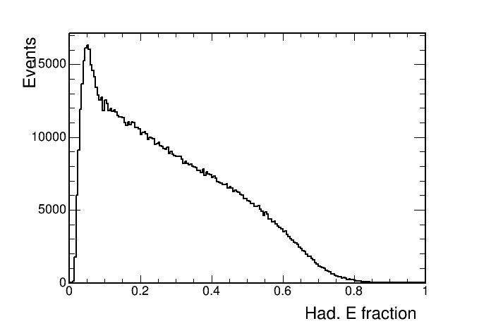
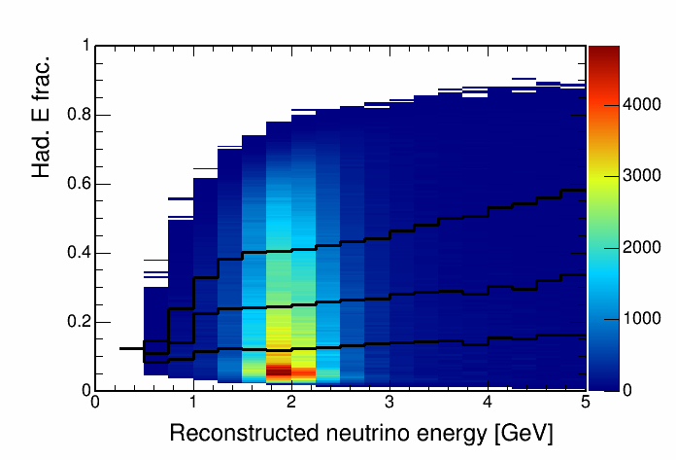
Hadronic energy fraction vs. reco. energy
This histogram is used to seperate events into quantiles of energy resolution.

Slide 17
SA numu result paramters (ssqth23 = 0.4022) sensitivity

Slide 18
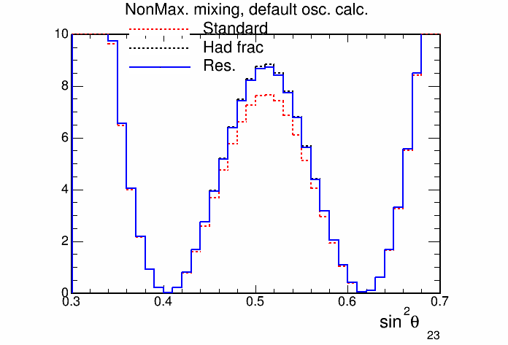
SA numu result paramters (ssqth23 = 0.4022) sensitivity

Slide 19
Fine ReMId binning
Binning scheme:
split remid into 2 coarse bins below 0.9
0.4 <= remid< 0.75
0.75 <= remid < 0.9
split into 8 fine bins above 0.9
72/80 <= remid < 73/80
73/80 <= remid < 74/80
……….. etc.
80/80 <= remid

Slide 20
Stats only sensitivity with fine ReMId binning

Slide 21
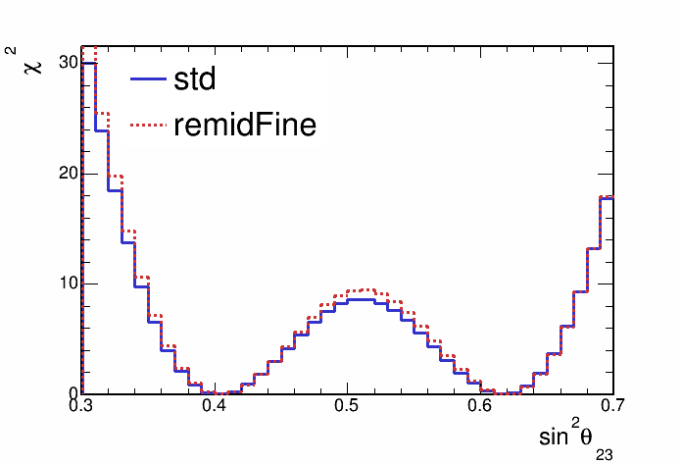
Stats only sensitivity with fine ReMId binning

Slide 22
Hadronic energy fraction binning
Split events into hadronic energy quantiles
Quantiles made for each bin of reconstructed neutrino energy
Up next, sensitivities with events split into 2,3,4 and 5 hadronic energy fraction quantiles

Slide 23
Sensitivity with hadronic energy fraction binning

Slide 24
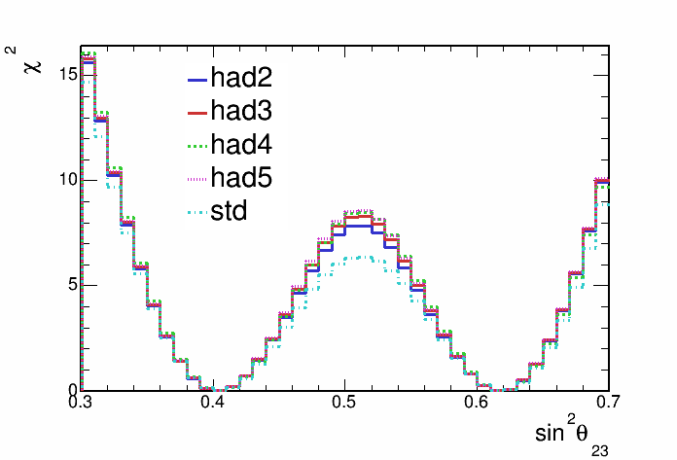
Sensitivity with hadronic energy fraction binning

Slide 25
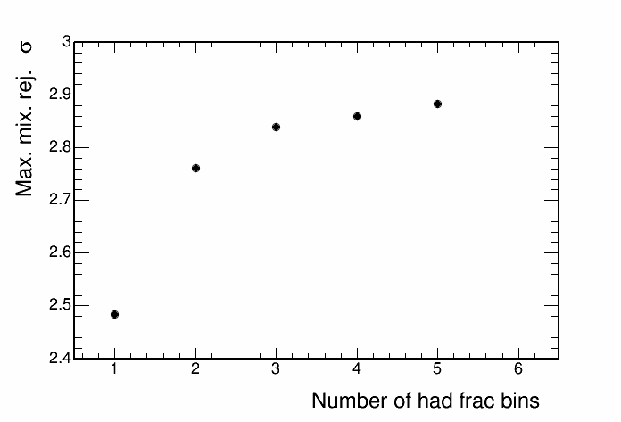
Sensitivity with hadronic energy fraction binning

Slide 26
2D Hadronic energy fraction and remid binning
Split events into 4 hadE frac. quantiles and 2 remid bins (0.4-0.75, 0.75-1.0)
HadE frac. quantiles made for each bin of reconstructed neutrino energy and for each remid bin

Slide 27
Sensitivity with hadronic energy fraction binning

Slide 28
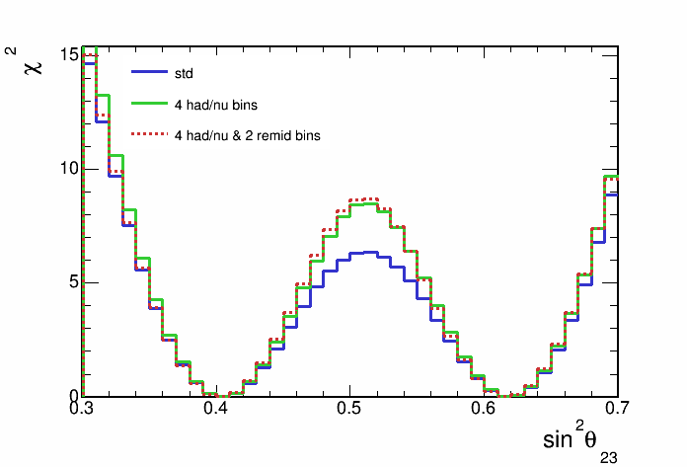
Sensitivity with hadronic energy fraction binning

Slide 29
Hadronic energy fraction
This histogram is used to seperate events into quantiles of energy resolution.

Slide 30
Max. mixing paremeters sensitivity

