Slide 1
Ehad/Enu binning & custom neutrino energy binning
NuMu group, Oct. 2016
Luke Vinton, University of Sussex

Slide 2
Version details
Running in S16-10-07
Using FD and ND NuMu decafs: /pnfs/nova/persistent/production/concat/R16-03-03-prod2reco.d/

Slide 3
Outline
Three calculators used for: SA result, non-max and MINOS best fit
Chi squared vs. neutrino energy for comparisons of SA with non-max mixing and the MINOS best fit
Sensitivity contours using custom neutrino energy binning
Using second analysis POT
will update to use 9e20 POT

Slide 4
SA oscillation parameters
SetL(810);
SetRho(0); // No matter effects
SetDmsq21(7.59e-5);
SetTh12(.601);
SetTh23(0.68696); // non max (ssqth23 = 0.4022)
SetDmsq32(2.6746e-3);
SetTh13(.1567);
SetdCP(0);

Slide 5
“MINOS” oscillation parameters
SetL(810);
SetRho(0); // No matter effects
SetDmsq21(7.53e-5);
SetTh12(asin(sqrt(.846))/2);
SetTh23(0.8);
SetDmsq32(0.00237);
SetTh13(asin(sqrt(.085))/2);
SetdCP(0);

Slide 6
Max mixing oscillation parameters
SetL(810);
SetRho(0); // No matter effects
SetDmsq21(7.53e-5);
SetTh12(asin(sqrt(.846))/2);
SetTh23(M_PI/4);
SetDmsq32(2.44e-3);
SetTh13(asin(sqrt(.085))/2);
SetdCP(0);

Slide 7
Findings to date
Hadronic energy fraction binning increases the sensitivity of the numu analysis. Rejection of max. mixing increased from 2.5 to 2.86 sigma with 4 had frac. bins (docdb 16210)
Dividing sample into 4 had frac bins and 2 remid bins (0.4-0.75, 0.75-1.0) slightly improves sensitivity (docdb 16210)
Using more neutrino energy bins increases the rejection of maximal mixing. Using 60 Enu bins along with 4 had frac. bins increases the rejection of max. mixing to 3.03 sigma (docdb 16292)
Using a hybrid selection of remid and cvn along with half size bins and 4 had frac. bins increases max mixing rejection to 3.3 sigma (docdb 16292)

Slide 8
Custom binning motivation
Using finer neutrino energy binning reduces the size of the sensitivity contour and increases the sensitivity to reject maximal mixing (see DocDB 16292)
However with 60 neutrino energy bins and 4 Ehad/Enu bins there will be 60 X 4 = 240 bins in the fit
To work around this unwieldy number of bins let’s consider the statistical power of each neutrino energy region with an eye to reduce the total number of bins
There will be regions where more bins would help distinguish oscillation shape and regions where we can get away with using less bins

Slide 9
Chi squared vs. neutrino energy
Comparing
max. and non-max. mixing
MINOS best fit and non-max mixing
make comparison for each of four Ehad/Enu bins
The relative statistical strength of each bin will guide the choice of the custom bin boundaries

Slide 10
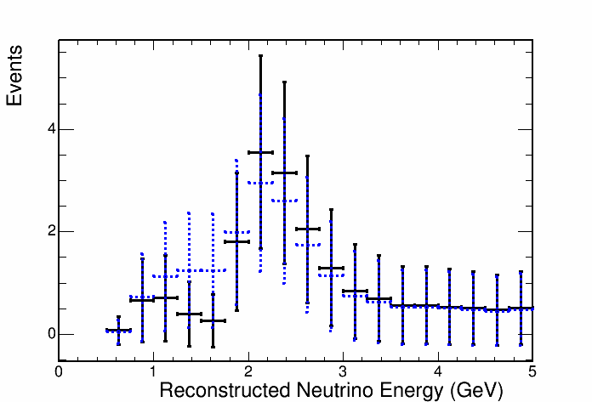
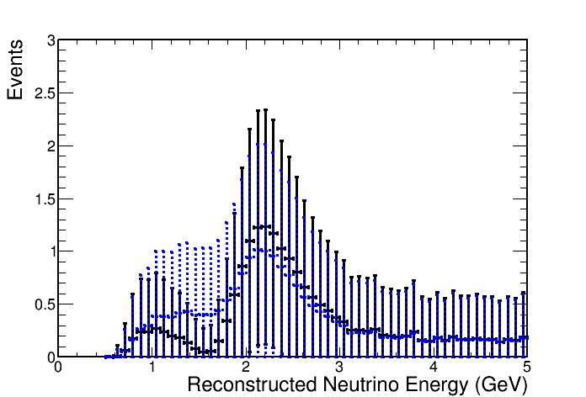
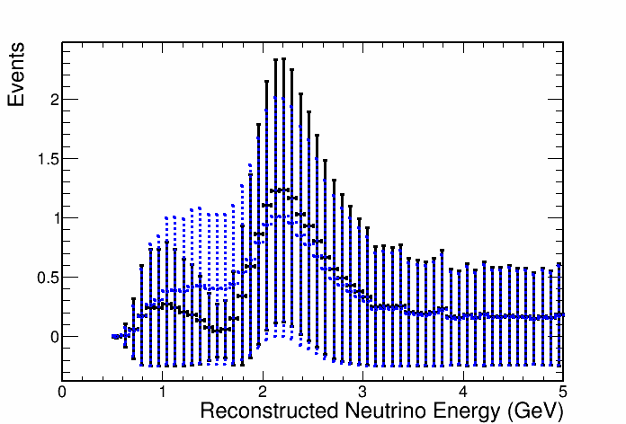
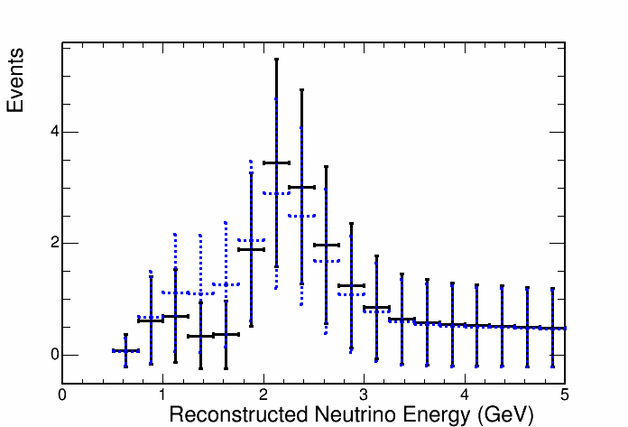

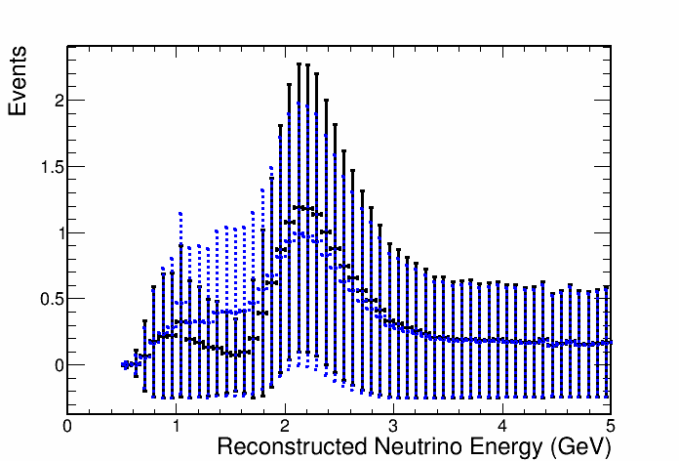
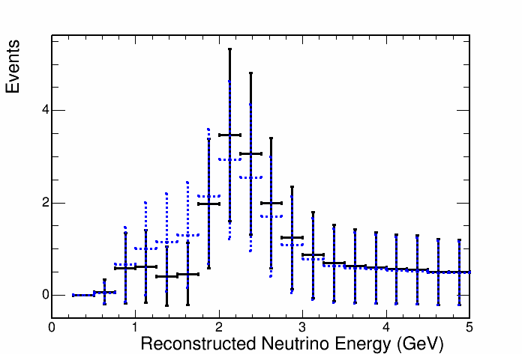
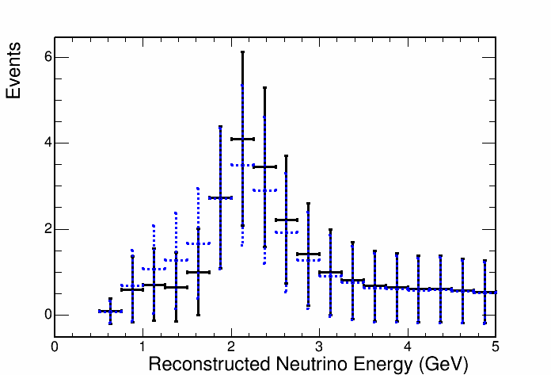
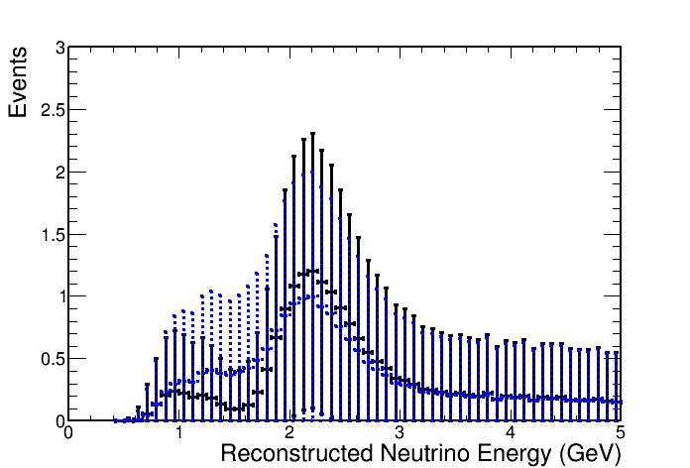
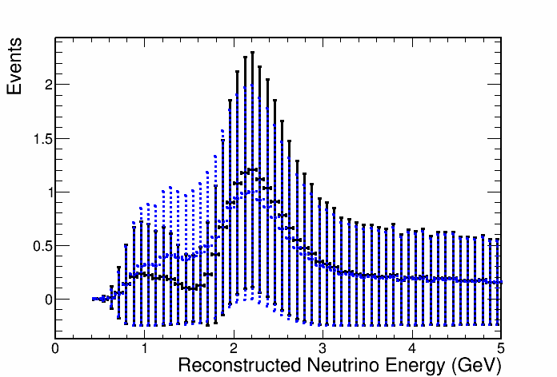

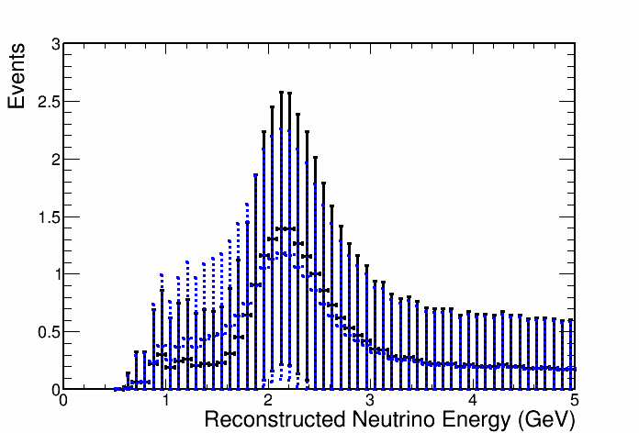
Max and non-max mixing
Non-max. mixing
Max. mixing
Ehad/Enu bin
Ehad/Enu bin
1
2
1
2
1
2
3
4
3
4
3
4

Slide 11
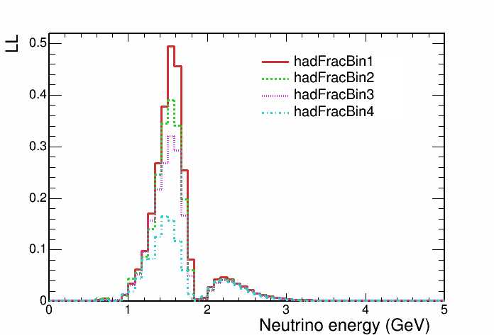
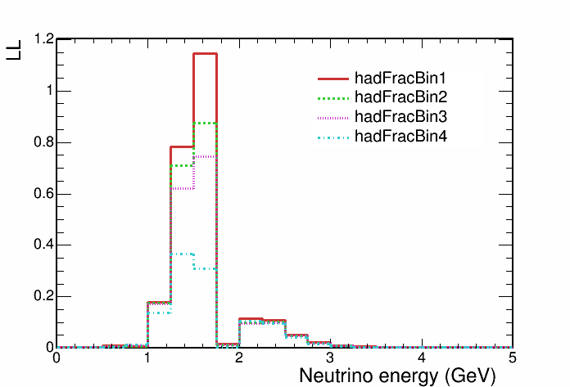
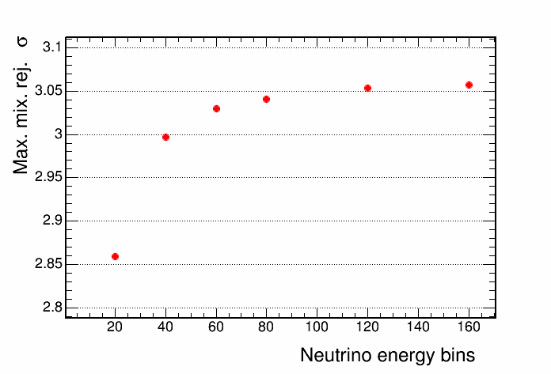
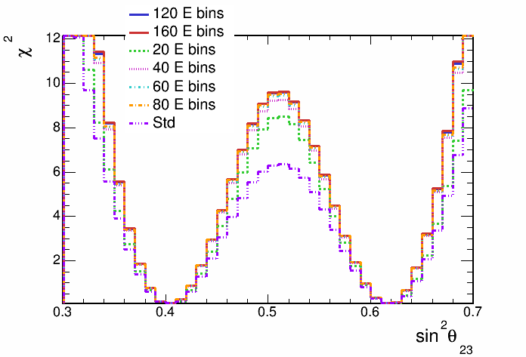
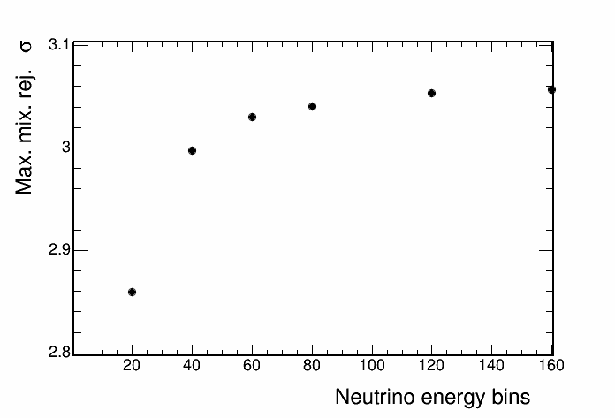
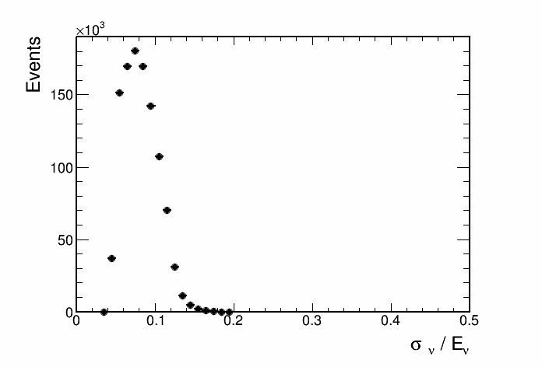
Max and non-max mixing

Slide 12
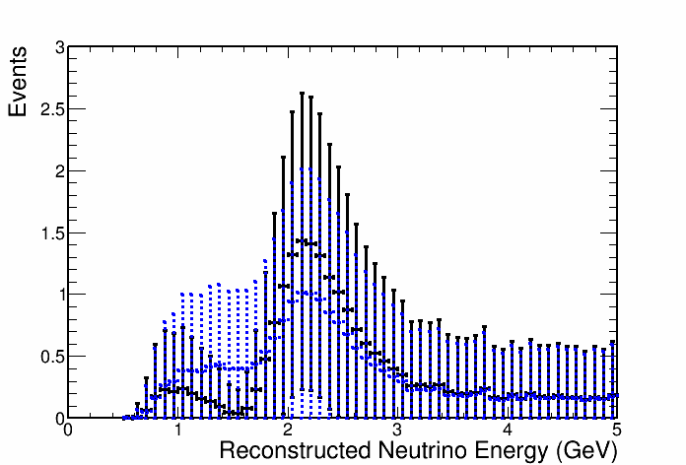
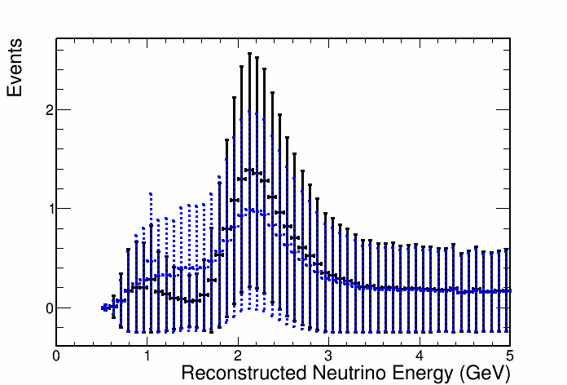

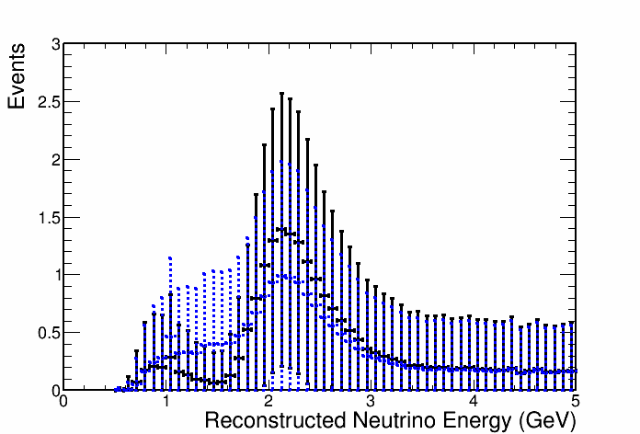
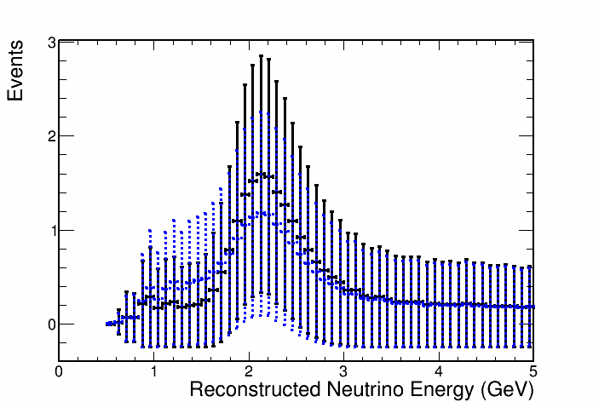
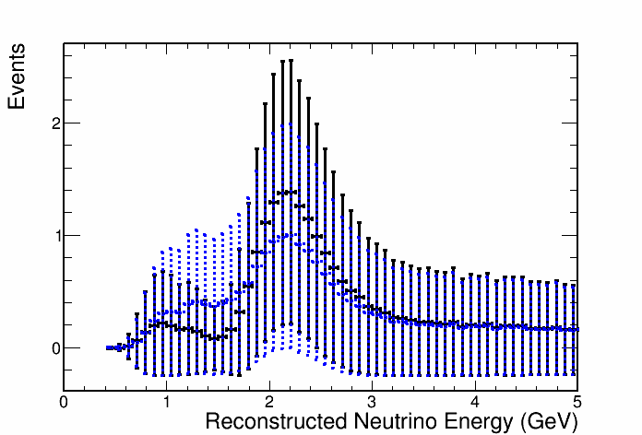
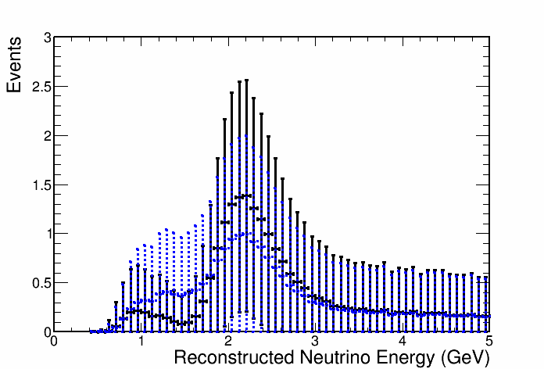
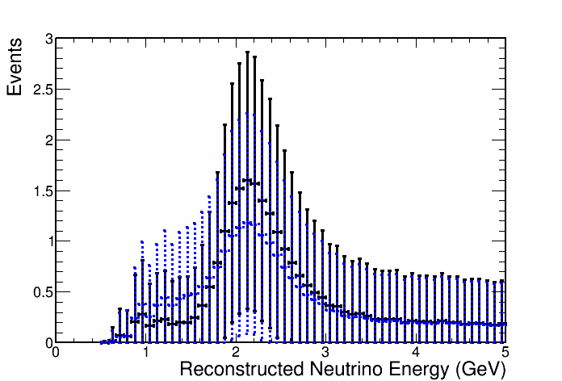
MINOS best fit and non-max mixing
Non-max. mixing
MINOS best fit
Ehad/Enu bin
Ehad/Enu bin
1
2
1
2
3
4
3
4

Slide 13
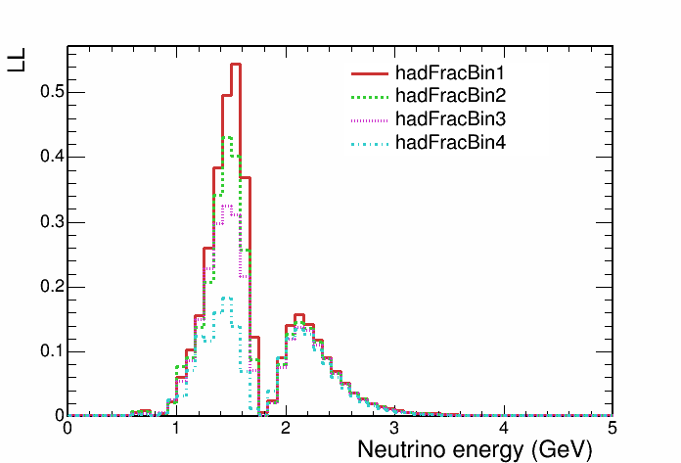
MINOS best fit and non-max mixing

Slide 14
Try three custom neutrino energy binning settings
standard binning between 0 and 1 GeV : 0,0.25,0.5,0.75,1.0
constant binning between 3 and 5GeV : 3,3.5,4,5
Custom binning settings between 1 and 3 GeV:
custA:
40 bins 1-2 GeV
40 bins 2-3 GeV
custB:
40 bins 1-2 GeV
4 bins 2-3 GeV
custC:
10 bins 1-2 GeV
4 bin 2-3 GeV

Slide 15
Using custom binning and 4 Ehad/Enu bins

Slide 16
Sensitivity contours, 4 Ehad/Enu bins
std. binning + 4 Ehad/Enu bins

Slide 17
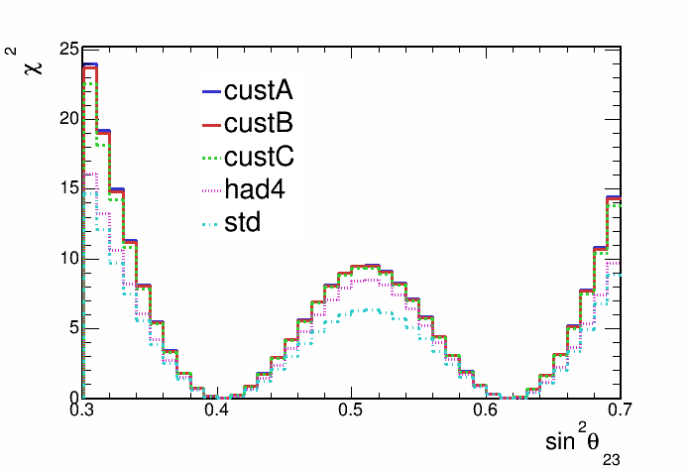
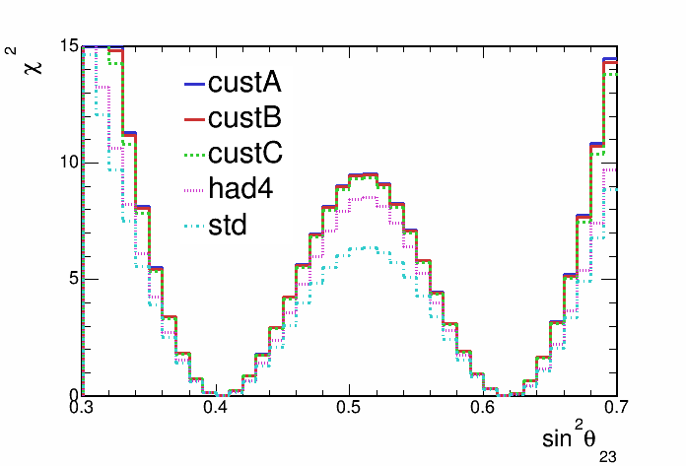
Sensitivity contours, 4 Ehad/Enu bins

Slide 18
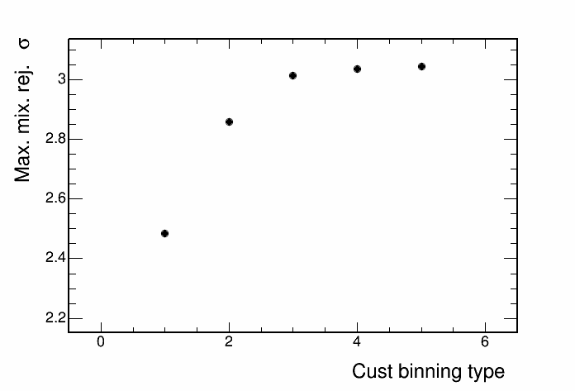
Sensitivity to reject max. mixing, 4 Ehad/Enu bins
custC
custB
custA
std Enu binning
4 had/nu
std analysis

Slide 19
Using custom binning and 5 Ehad/Enu bins

Slide 20
Sensitivity contours, 4 Ehad/Enu bins
std binning + 4 Ehad/Enu bins

Slide 21
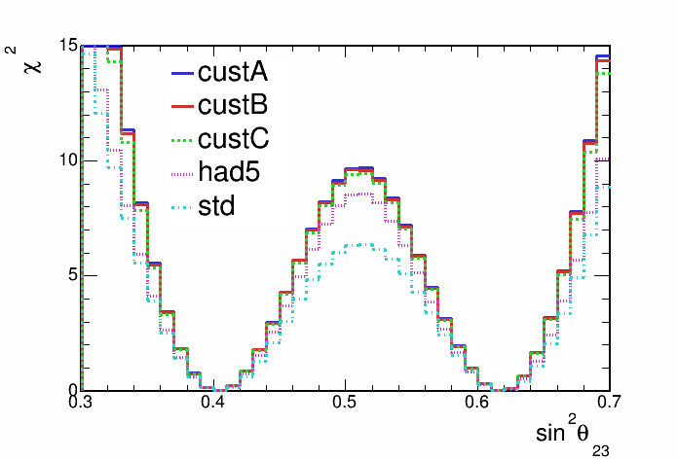
Sensitivity contours, 4 Ehad/Enu bins

Slide 22
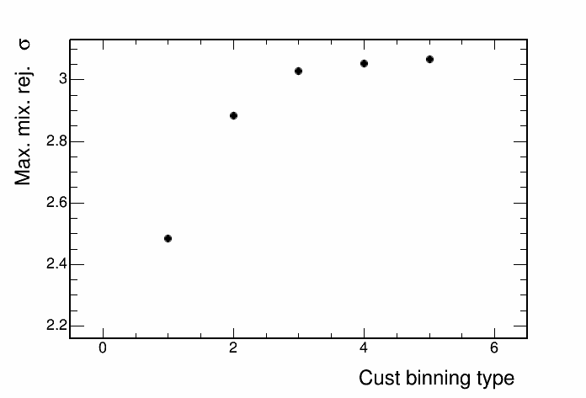
Sensitivity to reject max. mixing, 4 Ehad/Enu bins
custC
custB
custA
std Enu binning
5 had/nu
std analysis

Slide 23
Summary
Using custom binning to increase bins in region of statistical power significantly reduces contour size and increases sensitivity to reject maximal mixing
Sensitivity to reject max mixing with 60 neutrino energy bins and 4 Ehad/Enu bins is 3.030 sigma.
Retain most of the rejection sensitivity with introduction of custom binning option C (21 bins in total) whilst reducing the number of neutrino energy bins by almost 2/3
with 4 Ehad/Enu bins: 3.014 sigma
with 5 Ehad/Enu bins: 3.027 sigma
Future plan
Remake contours with 9e20 POT
Make similar contours using max-mixing oscillation parameters

Slide 24
Backup

Slide 25
4 had frac. bins and vary number neutrino energy bins {20,40,60,80,120,160}
We can use Ehad/Enu to divide our better and worse resolved events
A finer binning would take advantage of the well resolved portion of events

Slide 26
Non-max mixing contours, 4 had frac bins
Bins from 0 - 5 GeV

Slide 27
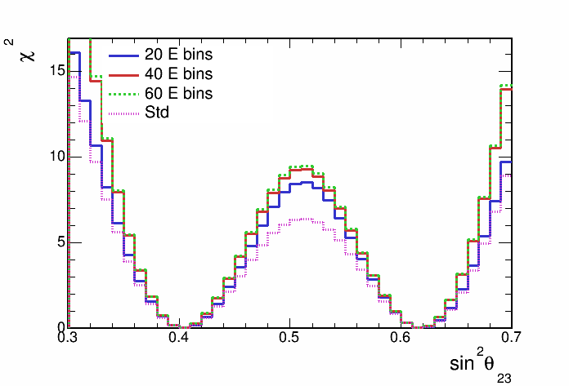
Non-max mixing contours, 4 had frac bins

Slide 28
Non-max mixing contours, 4 had frac bins

Slide 29
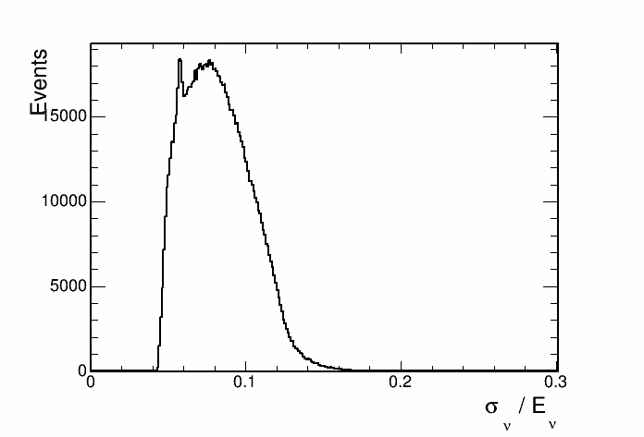
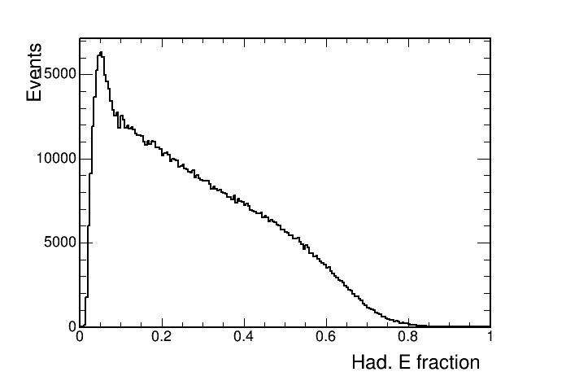
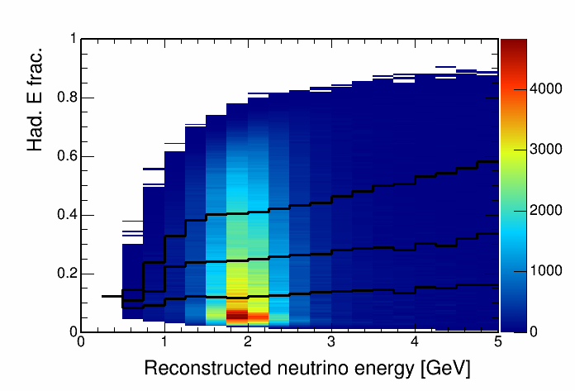
Hadronic energy fraction vs. reco. energy
This histogram is used to separate events into quantiles of energy resolution.

Slide 30
Cosmic background

Slide 31
Contours with and without cosmic bkg

Slide 32
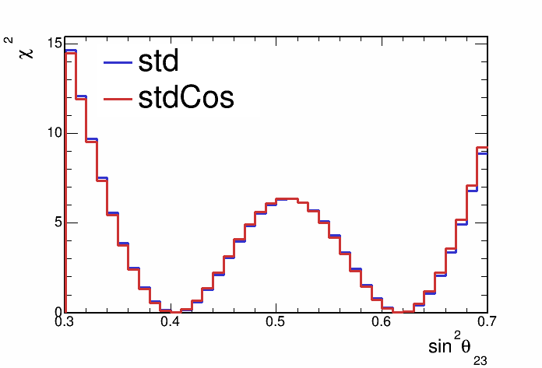
Contours with and without cosmic bkg

Slide 33
Hadronic energy fraction binning
Split events into hadronic energy quantiles
Quantiles made for each bin of reconstructed neutrino energy
Up next, sensitivities with events split into 2,3,4 and 5 hadronic energy fraction quantiles

Slide 34
Sensitivity with hadronic energy fraction binning

Slide 35
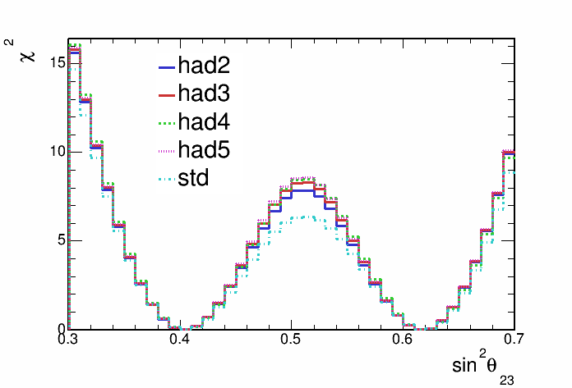
Sensitivity with hadronic energy fraction binning

Slide 36
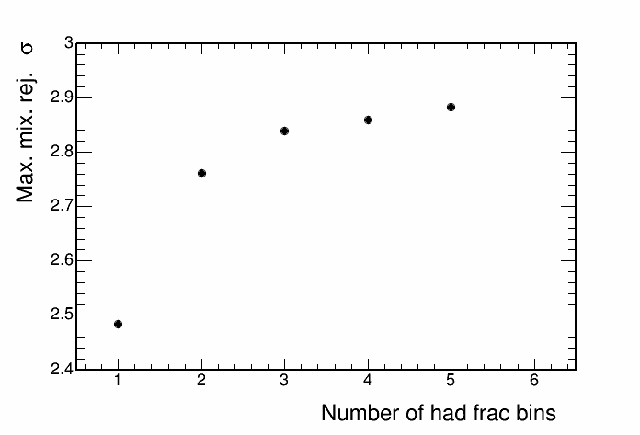
Sensitivity with hadronic energy fraction binning

