Slide 1
Sensitivity with: HadE frac. binning & custom neutrino energy binning & hybrid selection
NuMu group, Oct. 2016
Luke Vinton, University of Sussex

Slide 2
Version details
Running in S16-10-07
Using FD and ND NuMu decafs: /pnfs/nova/persistent/production/concat/R16-03-03-prod2reco.{d,f}/

Slide 3
Outline
Sensitivity using all the improvements found so far:
4 hadE frac. bins
custom binning (finer in region of interest)
0-1 GeV: (0,0.75,1.0)
1-2 GeV: 10 x 0.1 GeV bins
2-3 GeV: 4 x 0.25 GeV bins
3-4 GeV: 2 x 0.5 GeV bins
4-5 GeV: 1 bin
hybrid selection (based on Kirk’s selection)
Note:
no cosmic background in the following sensitivity plots
Scaling to second analysis POT

Slide 4
SA oscillation parameters
SetL(810);
SetRho(0); // No matter effects
SetDmsq21(7.59e-5);
SetTh12(.601);
SetTh23(0.68696); // non max (ssqth23 = 0.4022)
SetDmsq32(2.6746e-3);
SetTh13(.1567);
SetdCP(0);

Slide 5
Findings to date
Hadronic energy fraction binning increases the sensitivity of the numu analysis. Rejection of max. mixing increased from 2.5 to 2.86 sigma with 4 had frac. bins (docdb 16210)
Dividing sample into 4 had frac bins and 2 remid bins (0.4-0.75, 0.75-1.0) slightly improves sensitivity (docdb 16210)
Using more neutrino energy bins increases the rejection of maximal mixing. Using 60 Enu bins along with 4 had frac. bins increases the rejection of max. mixing to 3.03 sigma (docdb 16292)
Using a hybrid selection of remid and cvn along with half size bins and 4 had frac. bins increases max mixing rejection to 3.3 sigma (docdb 16292)

Slide 6
Using custom binning, 4 Ehad/Enu bins and remid-cvn hybrid selection

Slide 7
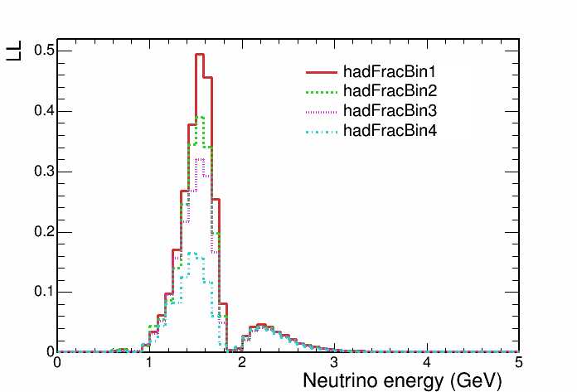
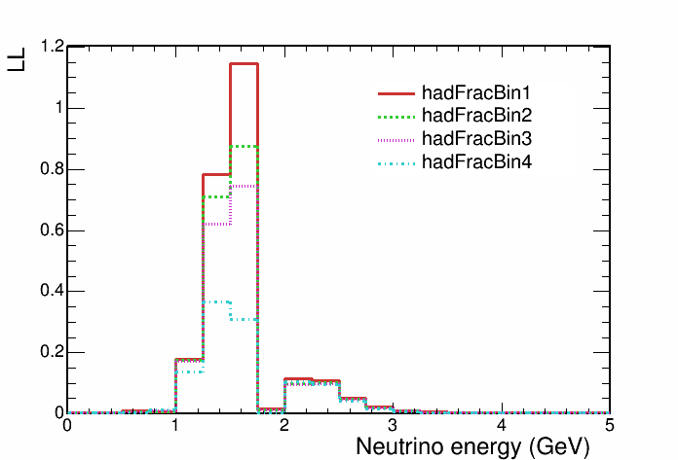
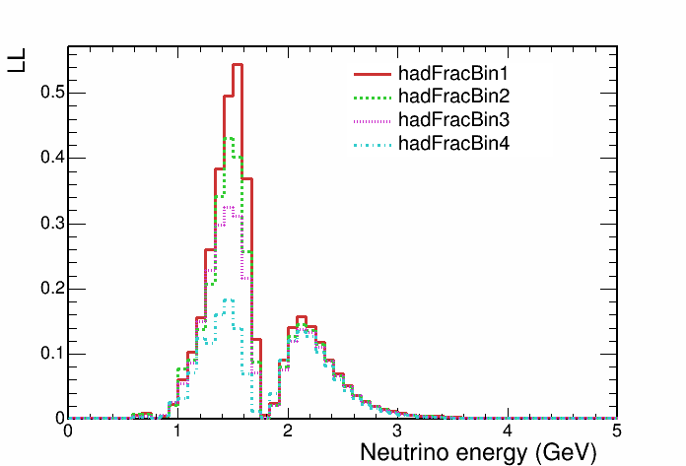
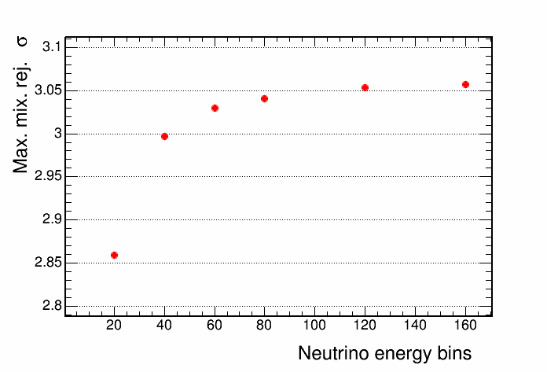
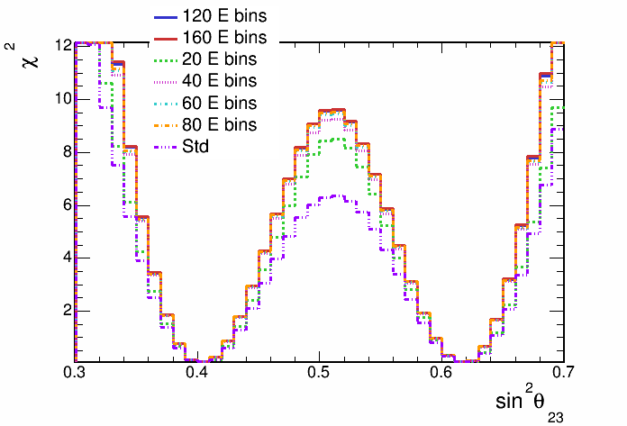
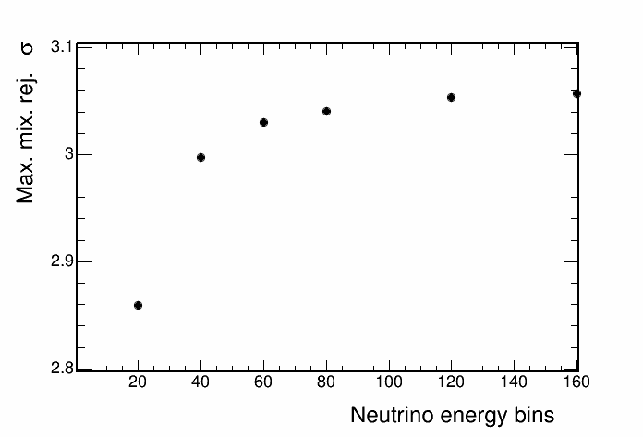
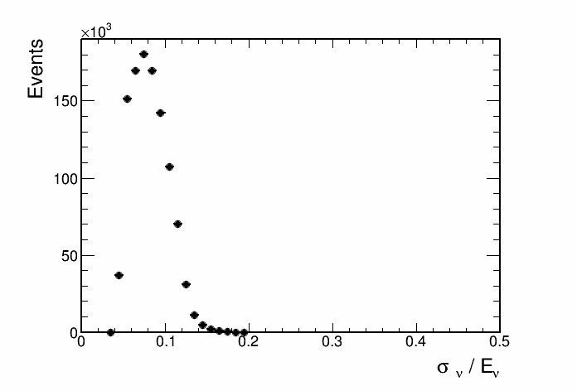
All improvements vs. standard sensitivity
std. binning + 4 Ehad/Enu bins

Slide 8
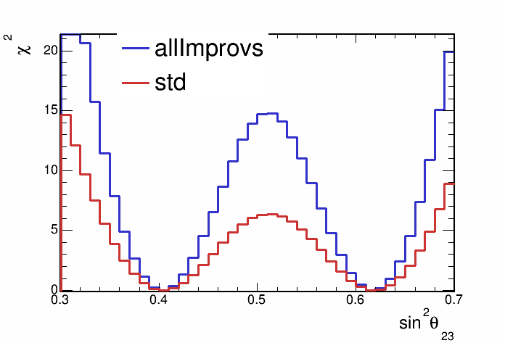
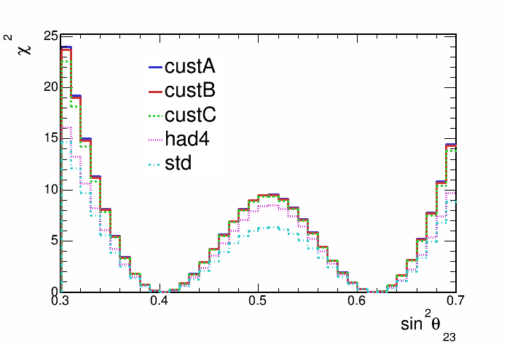
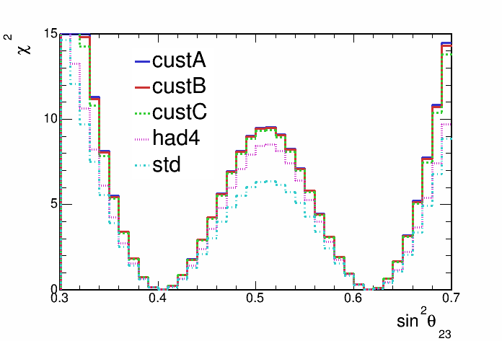
All improvements vs. standard sensitivity
Max mix rej:
3.78 sigma
2.48 sigma

Slide 9
Backup

Slide 10
4 had frac. bins and vary number neutrino energy bins {20,40,60,80,120,160}
We can use Ehad/Enu to divide our better and worse resolved events
A finer binning would take advantage of the well resolved portion of events

Slide 11
Non-max mixing contours, 4 had frac bins
Bins from 0 - 5 GeV

Slide 12
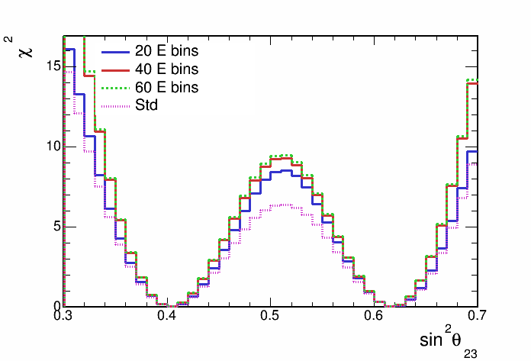
Non-max mixing contours, 4 had frac bins

Slide 13
Non-max mixing contours, 4 had frac bins

Slide 14
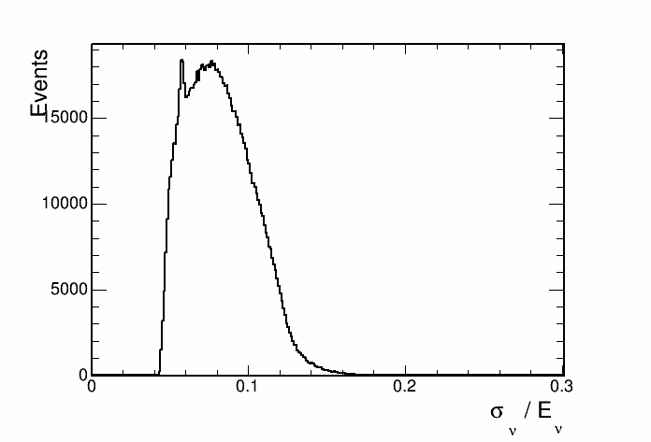
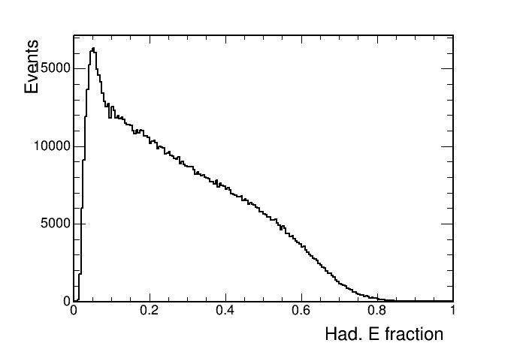
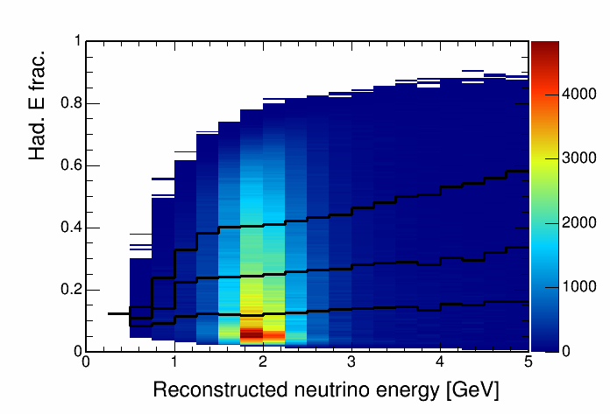
Hadronic energy fraction vs. reco. energy
This histogram is used to separate events into quantiles of energy resolution.

Slide 15
Cosmic background

Slide 16
Contours with and without cosmic bkg

Slide 17
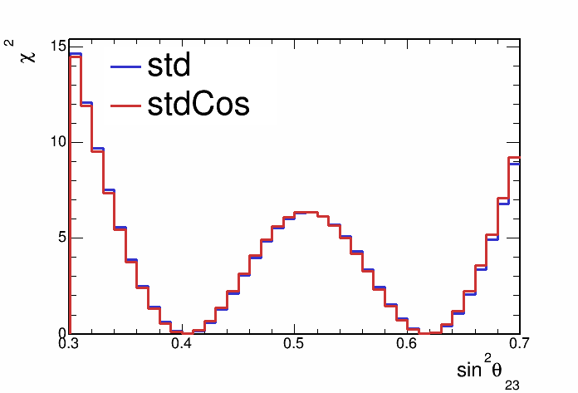
Contours with and without cosmic bkg

Slide 18
Hadronic energy fraction binning
Split events into hadronic energy quantiles
Quantiles made for each bin of reconstructed neutrino energy
Up next, sensitivities with events split into 2,3,4 and 5 hadronic energy fraction quantiles

Slide 19
Sensitivity with hadronic energy fraction binning

Slide 20
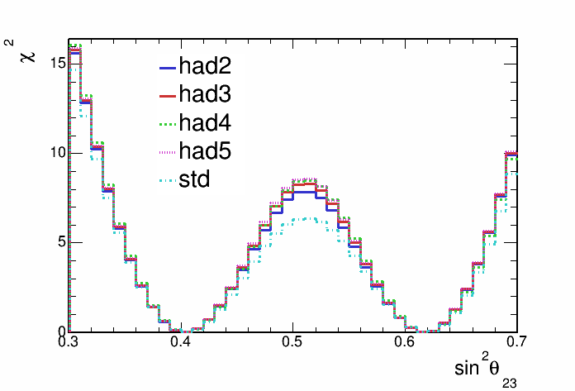
Sensitivity with hadronic energy fraction binning

Slide 21
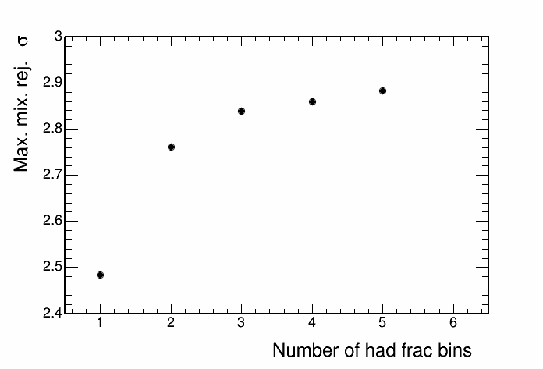
Sensitivity with hadronic energy fraction binning

