Slide 1
Poster Review

Slide 2
I could try to describe everything that makes a poster good, but I think it's better to walk through and look at posters.

Slide 3
First, Let's look at some 1st and 2nd place posters from last spring's hackathon

Slide 4
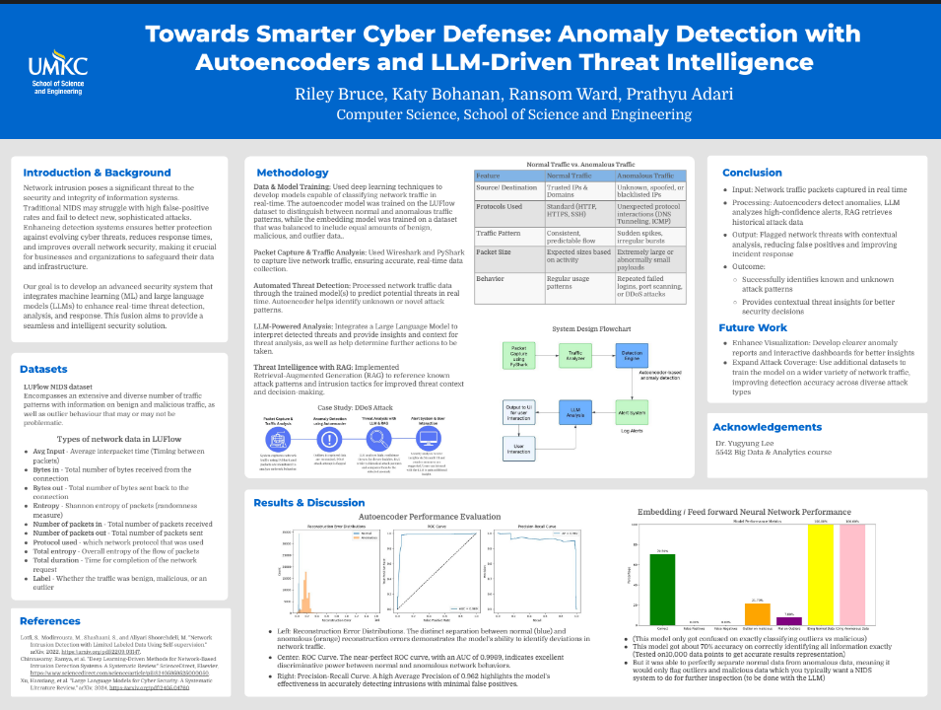

Slide 5
MS, Data Science Track
The poster isn't overcrowded.
Colorful but tasteful graphics
Headings stand out from text
Uses boxes to break up the poster

Slide 6
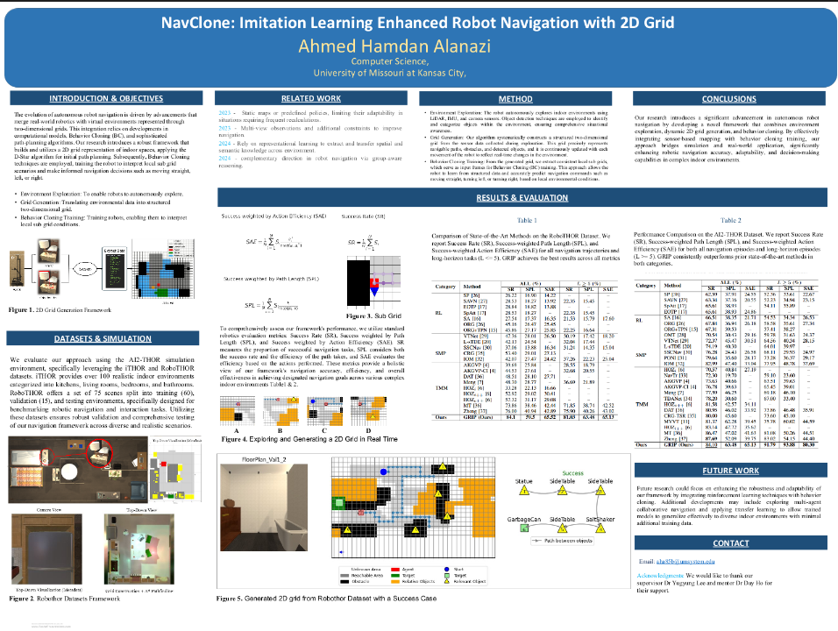

Slide 7
They keep text limited.
The images allow you to tell a story
Uses header bars to break up the poster into elements
Can spot the 'results' tables from far away.

Slide 8


Slide 9
A little denser, but they use graphics to break up text boxes
consistent color
The graphics are interesting.
Similar to before, title and headings stand out.

Slide 10
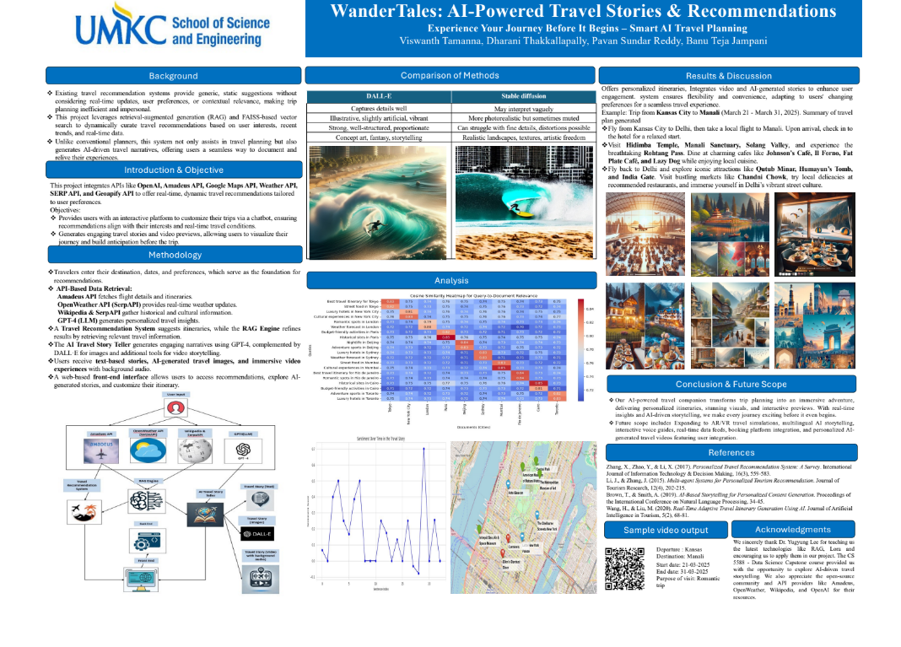

Slide 11
I'm not sure what's going on with that wave, but I want to.
Limited text
Clear headings
If it was mine, I'd want some more white space between columns

Slide 12
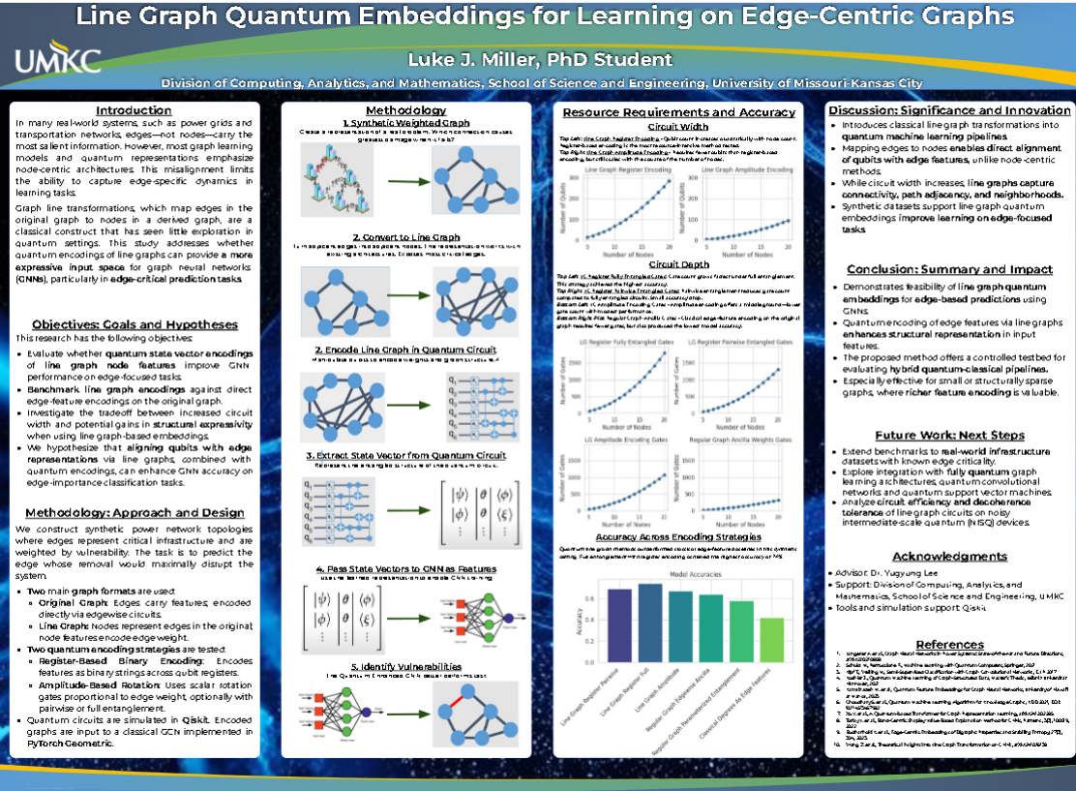

Slide 13
Instead of color, uses space to mark headings.
Graphics central
Uses boxes to break up poster

Slide 14
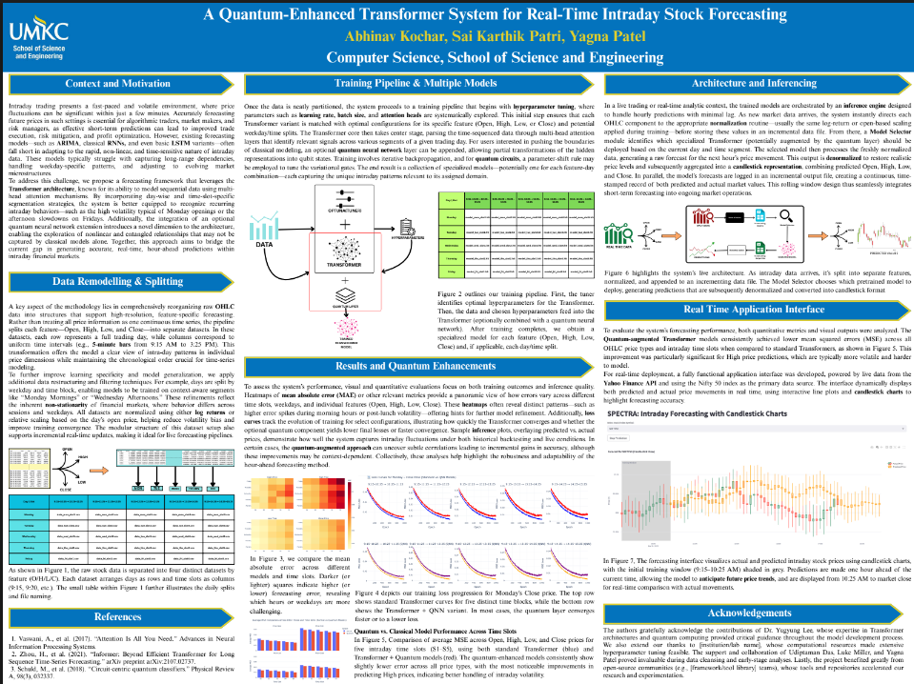
Now for some runners up

Slide 15
More dense, but uses graphics to break 'walls of text'
Clear headings

Slide 16
Now let's look at some that didn't win
Their project may have been good, but it's difficult to find that out in a minute or two when you stop by a poster.

Slide 17
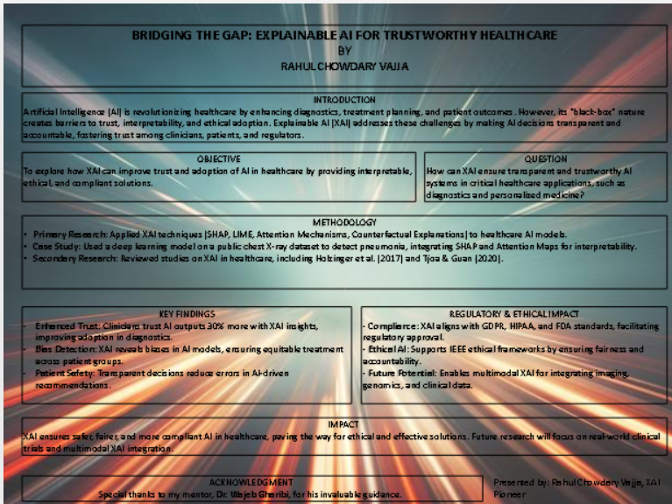

Slide 18
Hard to read
No visual elements
Poor contrast

Slide 19
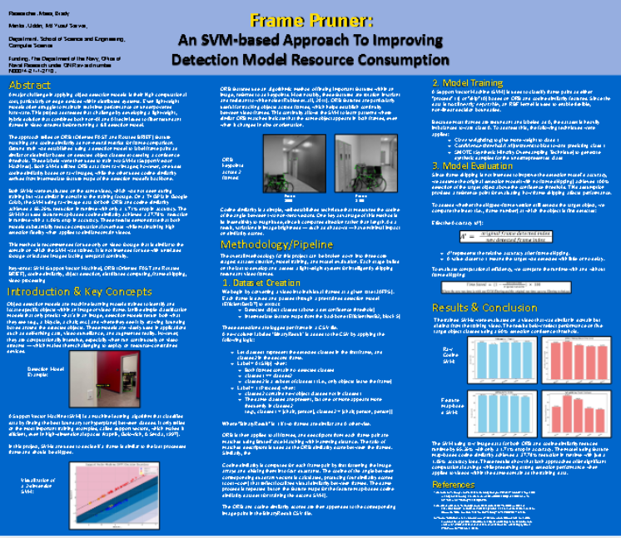

Slide 20
Poor color contrast for text
No boxes or header bars to break apart the columns
Could have cut some text to make images larger or add more of them

Slide 21
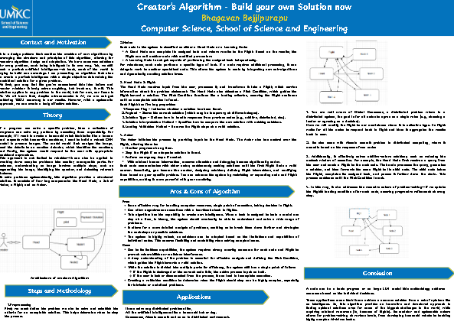

Slide 22
Wall of text
No color
Nothing 'grabs the eye'
Very little negative space
It kind of feels intimidating to approach. Where do I start? This is going to require focus to understand.

Slide 23
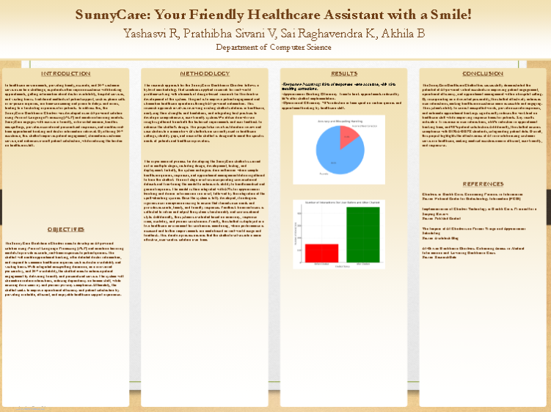

Slide 24
Color contrast
They didn't use the available space. It seems low effort. You want negative space, but not huge blank areas
2 simple visuals

Slide 25
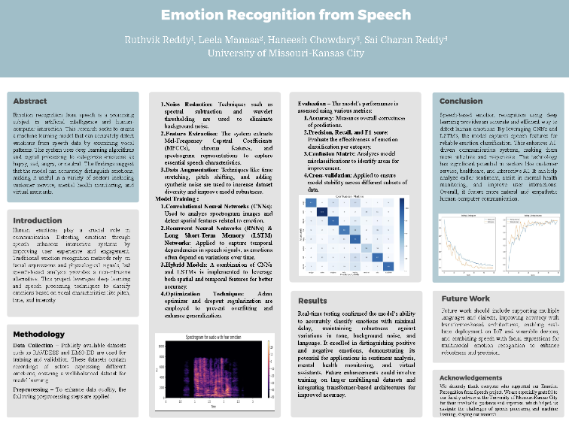

Slide 26
This one is pretty good. It's just so subdued. Nothing is interesting from 10 feet away.
Could probably have some more visual elements.

Slide 27
I can almost predict the winners without reading text.
  >5 visual elements
  Legible text (high contrast)
  Clear headings and sections
  Sufficient negative space between elements
  Something interesting from 10 feet away.

Slide 28
The elevator pitch
You have less than a minute to convince someone your project is cool.
The poster is behind you. The pitch is what makes them turn around and read it.

Slide 29
Four beats
Motivate the problem. What are you solving, and why does anyone care?
Say what you did that is interesting, and why it is interesting.
Highlight a few interesting findings.
Stop. Let them ask for more.
  The details are on the poster. Questions mean the pitch worked.

Slide 30
What not to do
Do not regurgitate facts, results, or mathematics from your poster.
Do not give a presentation on the methods.
Do not read a script in a monotone with your eyes on the floor.
  You don't have to be Jim Carrey. You do have to make eye contact and show a little excitement.

Slide 31
Practice
Memorize your beats, not every word.
  The basic points you want to make, in order.
Practice the pitch 5 to 10 times before the event.
Time it. Under a minute.
Say it to a friend who knows nothing about your project, and watch their face.

