Slide 1
Understanding and Optimizing GPU Energy Consumption of DNN Training
CS345
03/24/2024

Slide 2
Credits
Some of the slides were used in their original form.

Slide 3
Paper Details
Title
Zeus: Understanding and Optimizing GPU Energy Consumption of DNN Training
Authors
Jie You, Jae-Won Chung, and Mosharaf Chowdhury, University of Michigan
Venue
The 20th USENIX Symposium on Networked Systems Design and Implementation (NSDI '23)
Citations
26

Slide 4
Overview
Problem: challenging.
Approach: Mw How?
Us.
Findings:

Slide 5
Outline
Background
Motivation
Measurement Study
Zeus
Evaluation
Summary and Discussion

Slide 6
Outline
Background
Motivation
Measurement Study
Zeus
Evaluation
Summary and Discussion

Slide 7
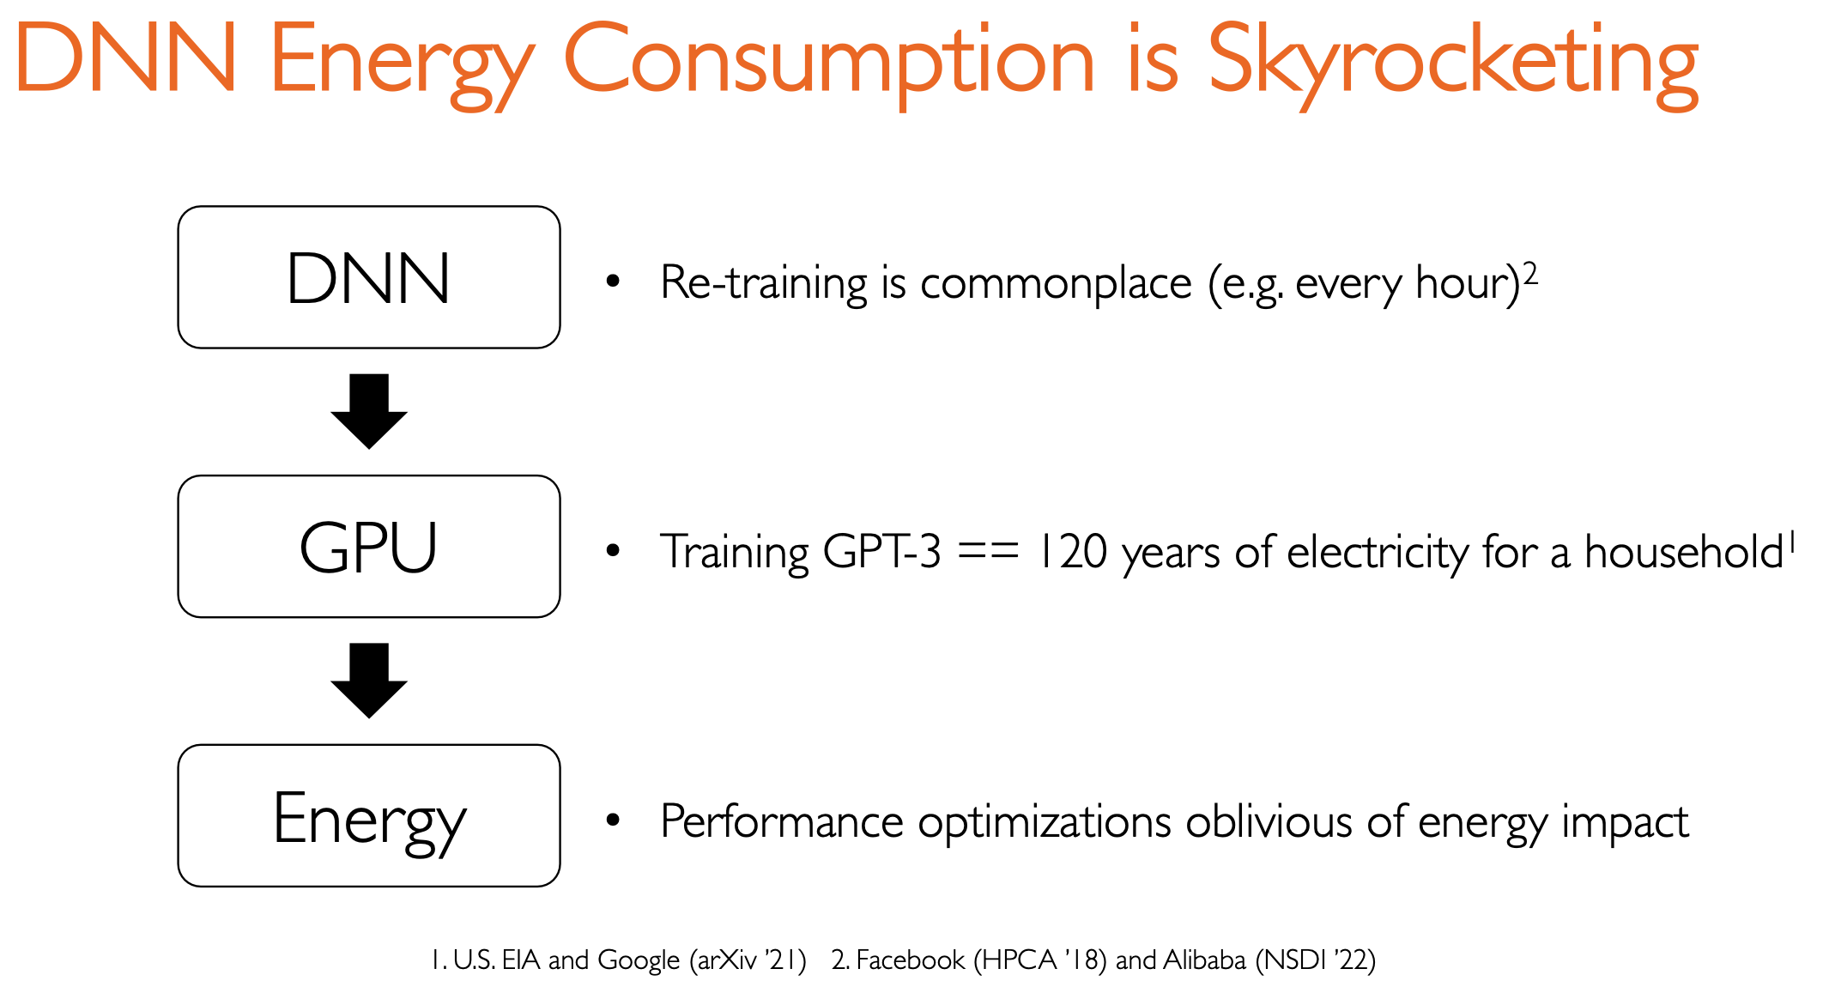

Slide 8
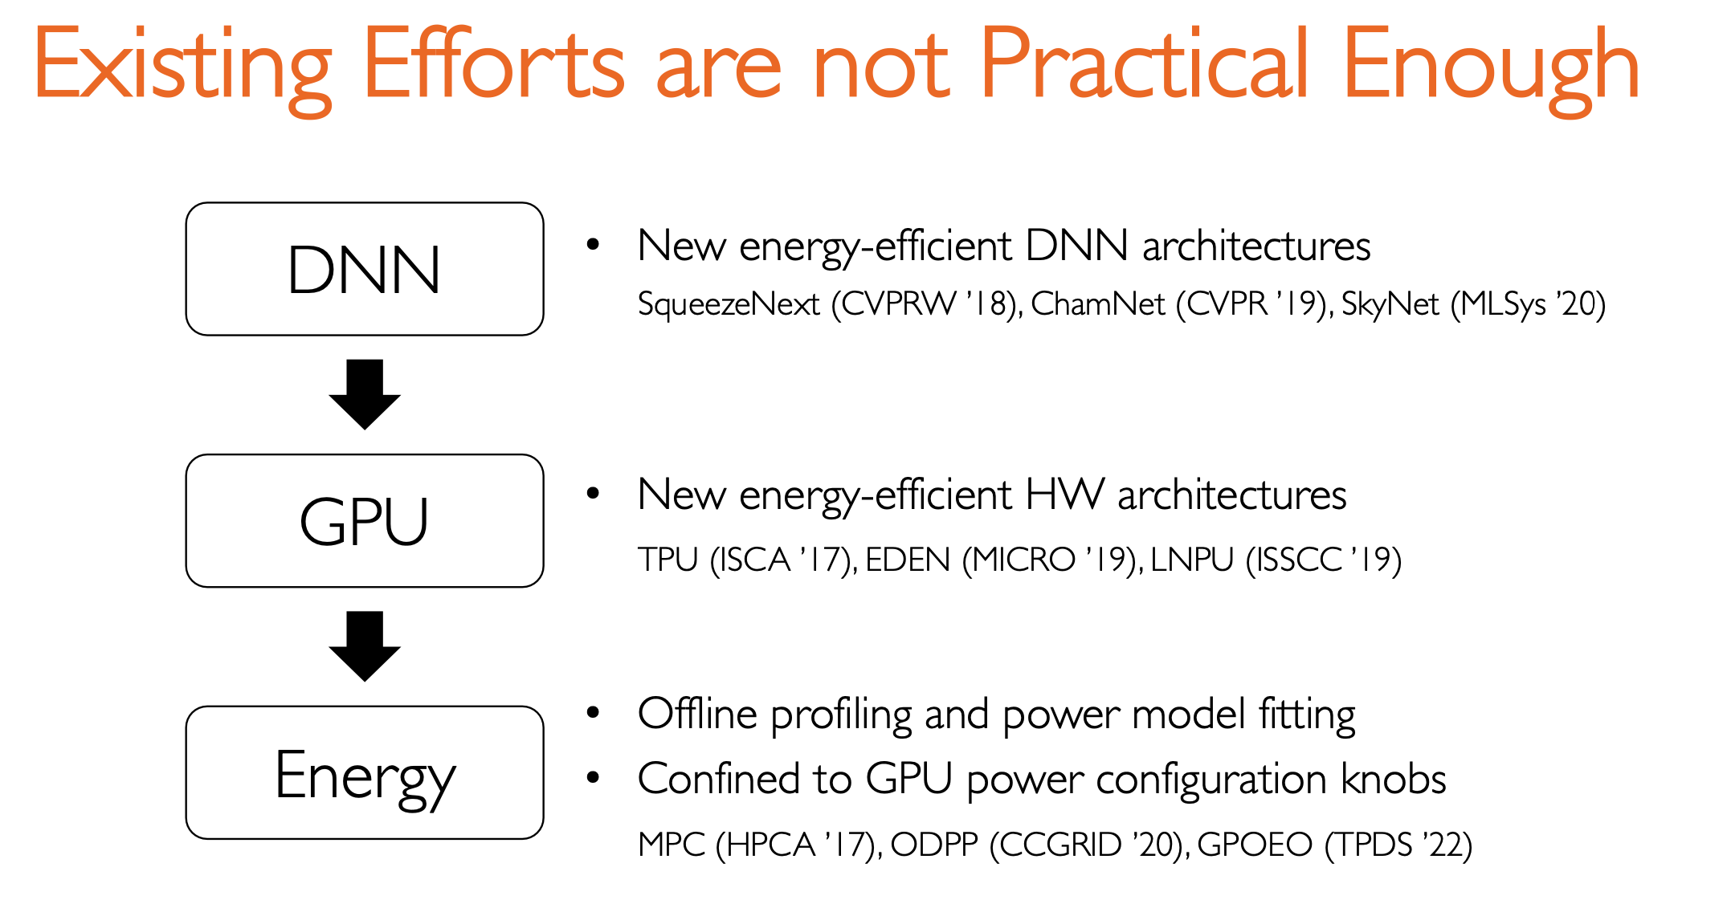
==> Companies created their own DNNs already
==> Companies bought thousands of GPUs already
==> cannot generalize and have high overhead.
Notes:
Rely on offline profiling and power model fitting, bcannot genera

Slide 9
Outline
Background
Motivation
Measurement Study
Zeus
Evaluation
Summary and Discussion

Slide 10
Understanding GPU Energy Consumption
Energy to Accuracy (ETA)
Energy needed to reach the user-specified target accuracy
Energy-counterpart of Time to Accuracy (TTA)

Slide 11
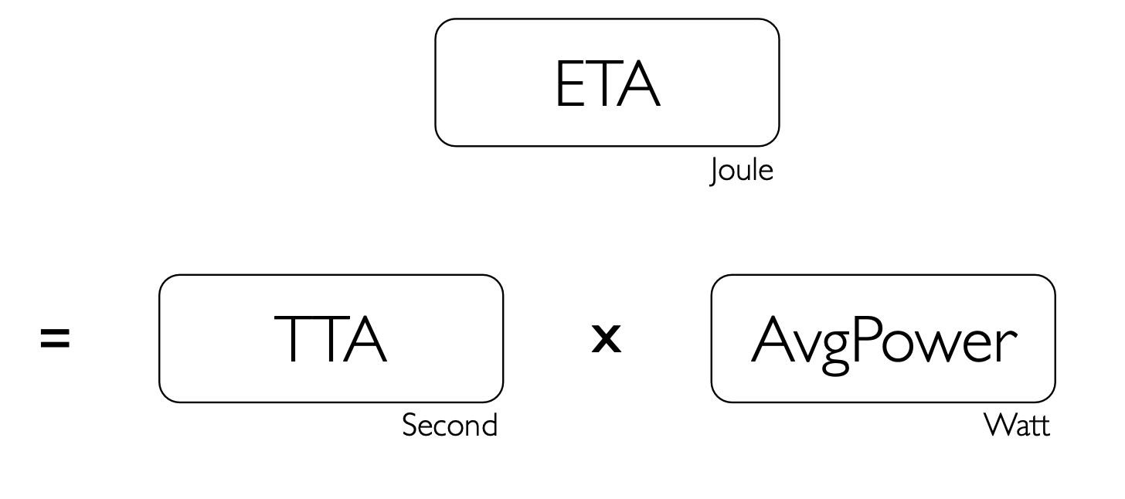
Understanding GPU Energy Consumption

Slide 12
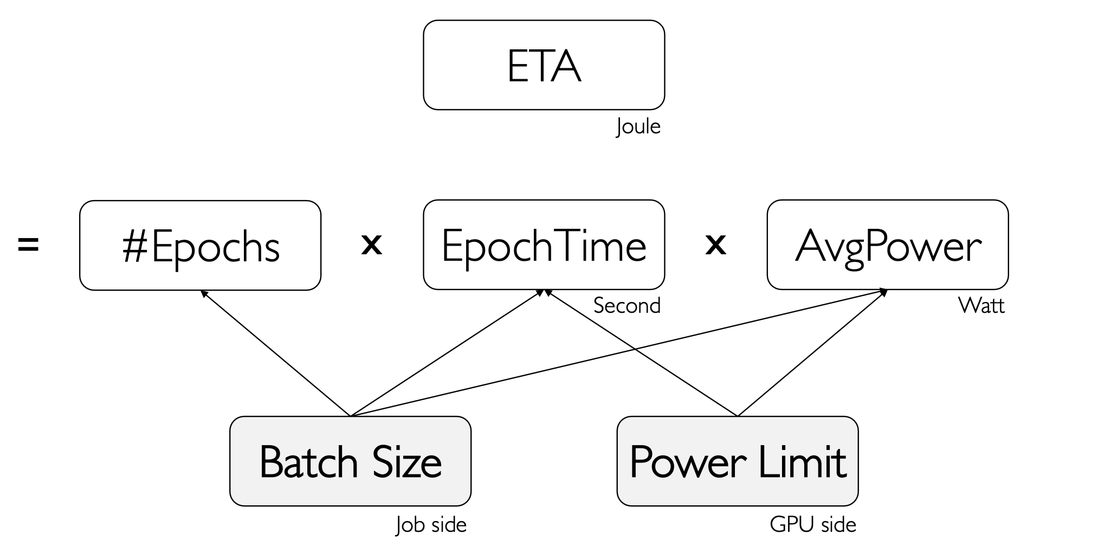
Understanding GPU Energy Consumption

Slide 13
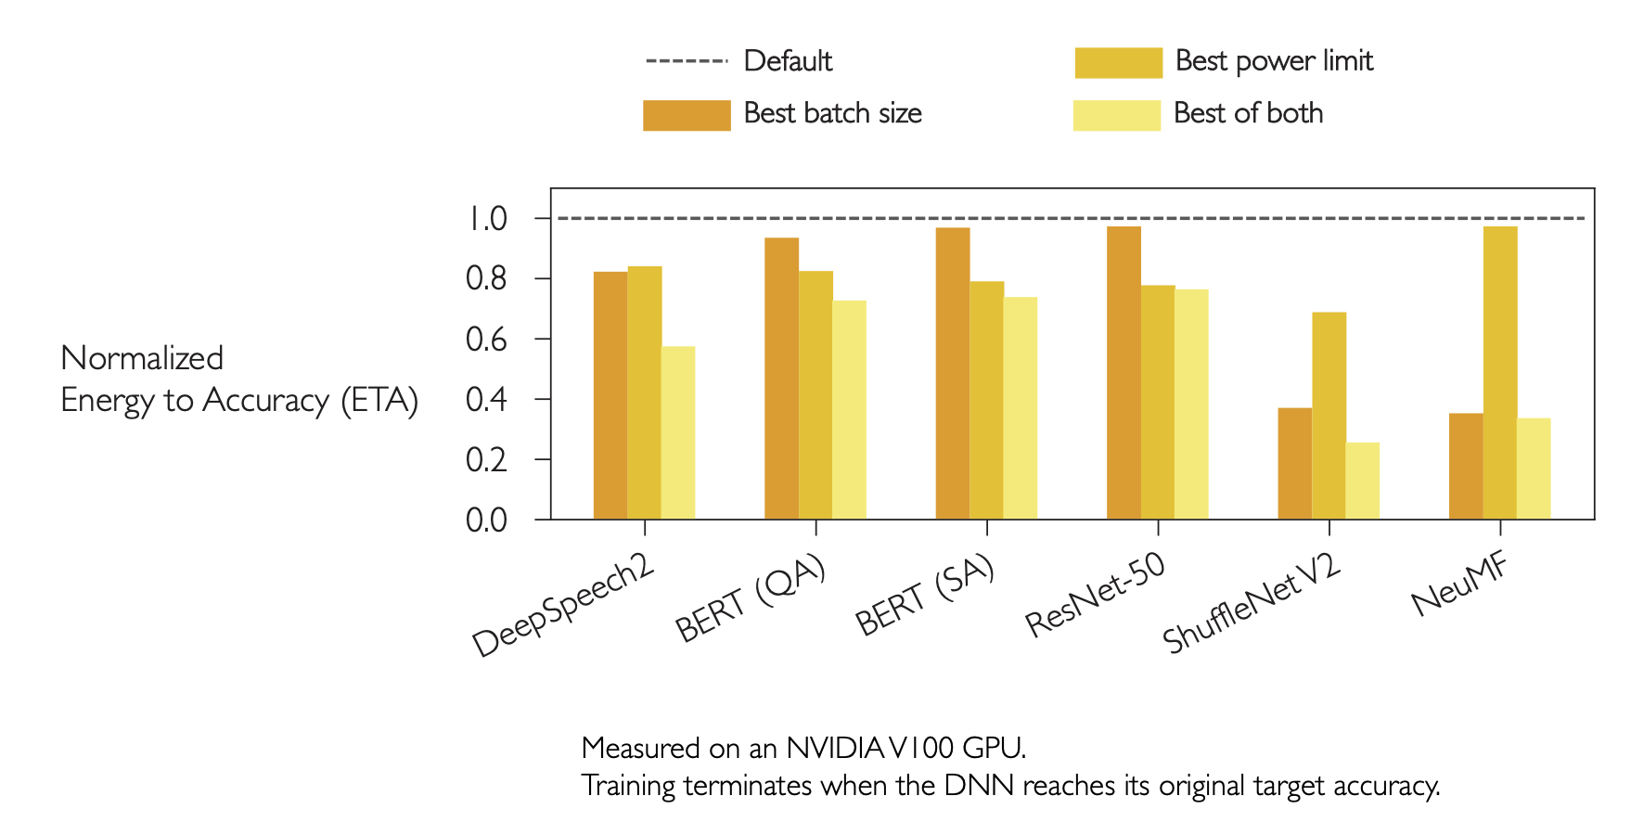
Opportunity for Energy Savings
Sweep of feasible batch sizes and power limits
24~75%
energy reduction

