Slide 1
Understanding and Optimizing GPU Energy Consumption of DNN Training
CS345
03/24/2024

Slide 2
Credits
Some of the slides were used in their original form.

Slide 3
Paper Details
Title
Zeus: Understanding and Optimizing GPU Energy Consumption of DNN Training
Authors
Jie You, Jae-Won Chung, and Mosharaf Chowdhury, University of Michigan
Venue
The 20th USENIX Symposium on Networked Systems Design and Implementation (NSDI '23)
Citations
26

Slide 4
Overview
Problem: challenging.
Approach: Mw How?
Us.
Findings:

Slide 5
Outline
Background
Motivation
Overview
Method
Evaluation
Summary and Discussion

Slide 6
Outline
Background
Motivation
Overview
Method
Evaluation
Summary and Discussion

Slide 7
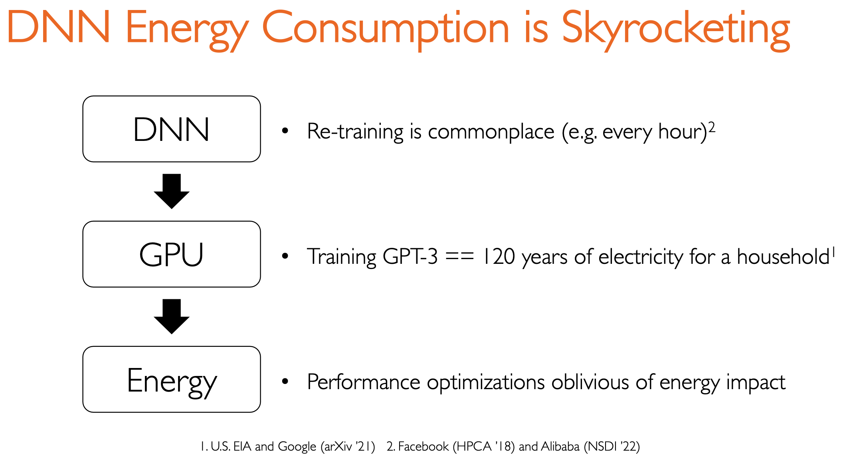

Slide 8
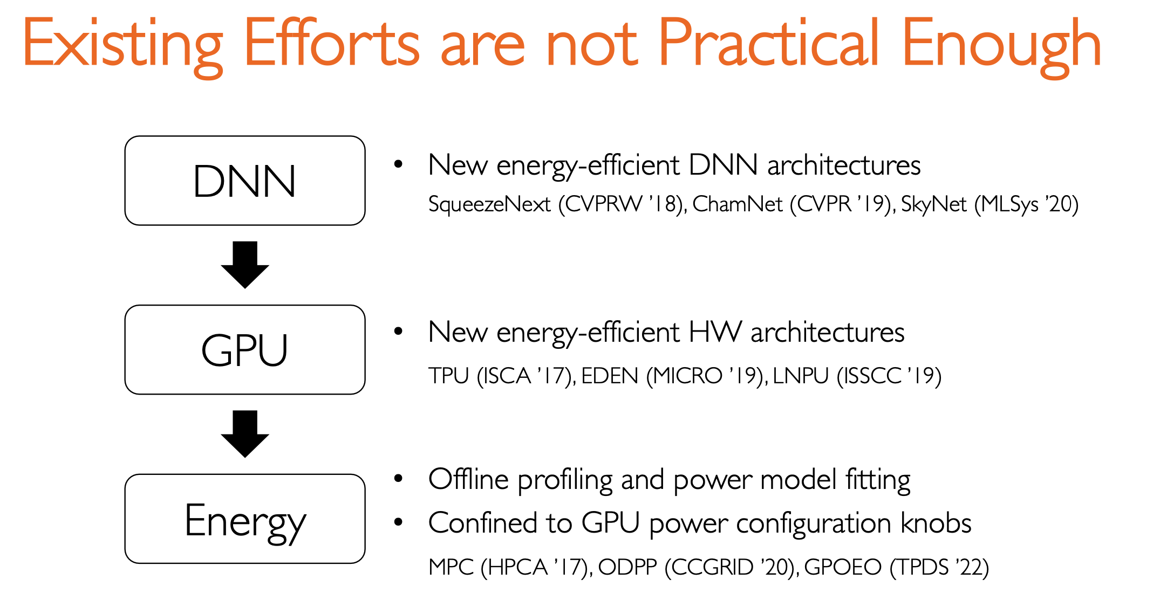
==> Companies created their own DNNs already
==> Companies bought thousands of GPUs already
==> cannot generalize and have high overhead.
Notes:
Rely on offline profiling and power model fitting, bcannot genera

Slide 9
Understanding GPU Energy Consumption
Energy to Accuracy (ETA)
Energy needed to reach the user-specified target accuracy
Energy-counterpart of Time to Accuracy (TTA)

Slide 10
Outline
Background
Motivation
Overview
Method
Evaluation
Summary and Discussion

Slide 11
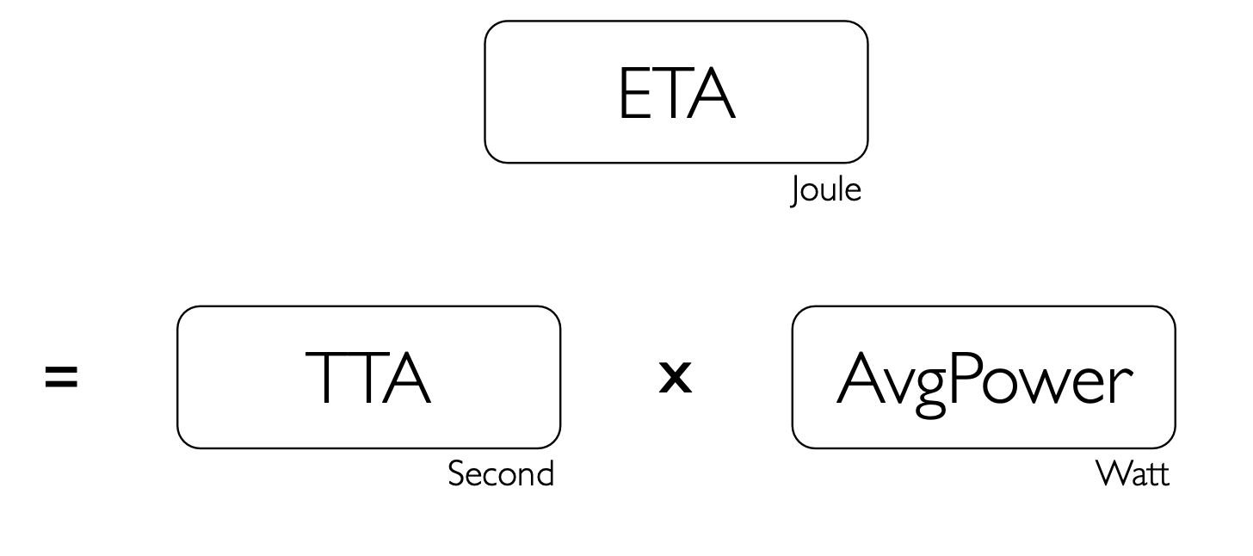
Understanding GPU Energy Consumption

Slide 12
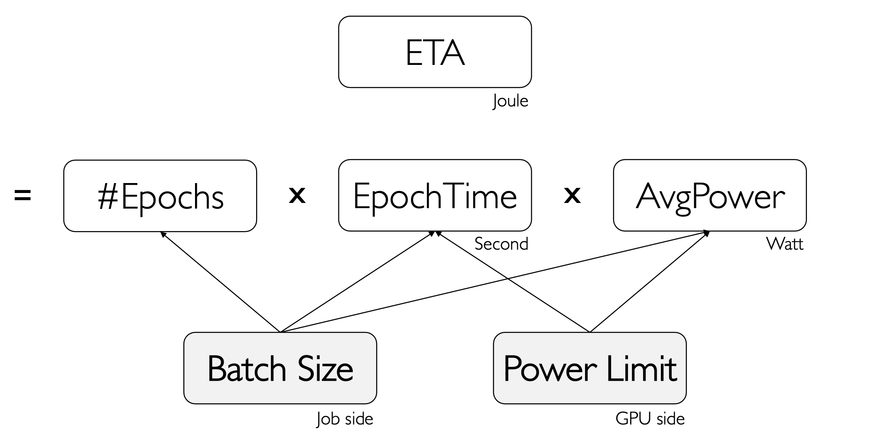
Understanding GPU Energy Consumption

Slide 13
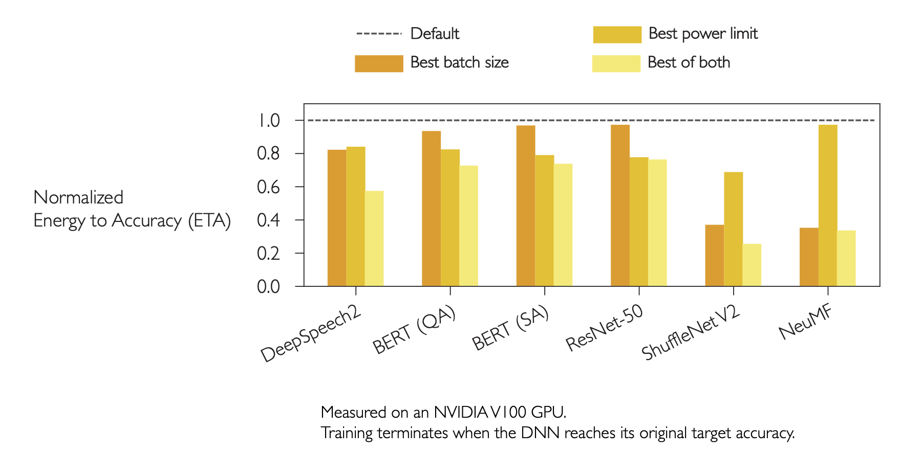
Opportunity for Energy Savings
Sweep of feasible batch sizes and power limits
24~75%
energy reduction

Slide 14
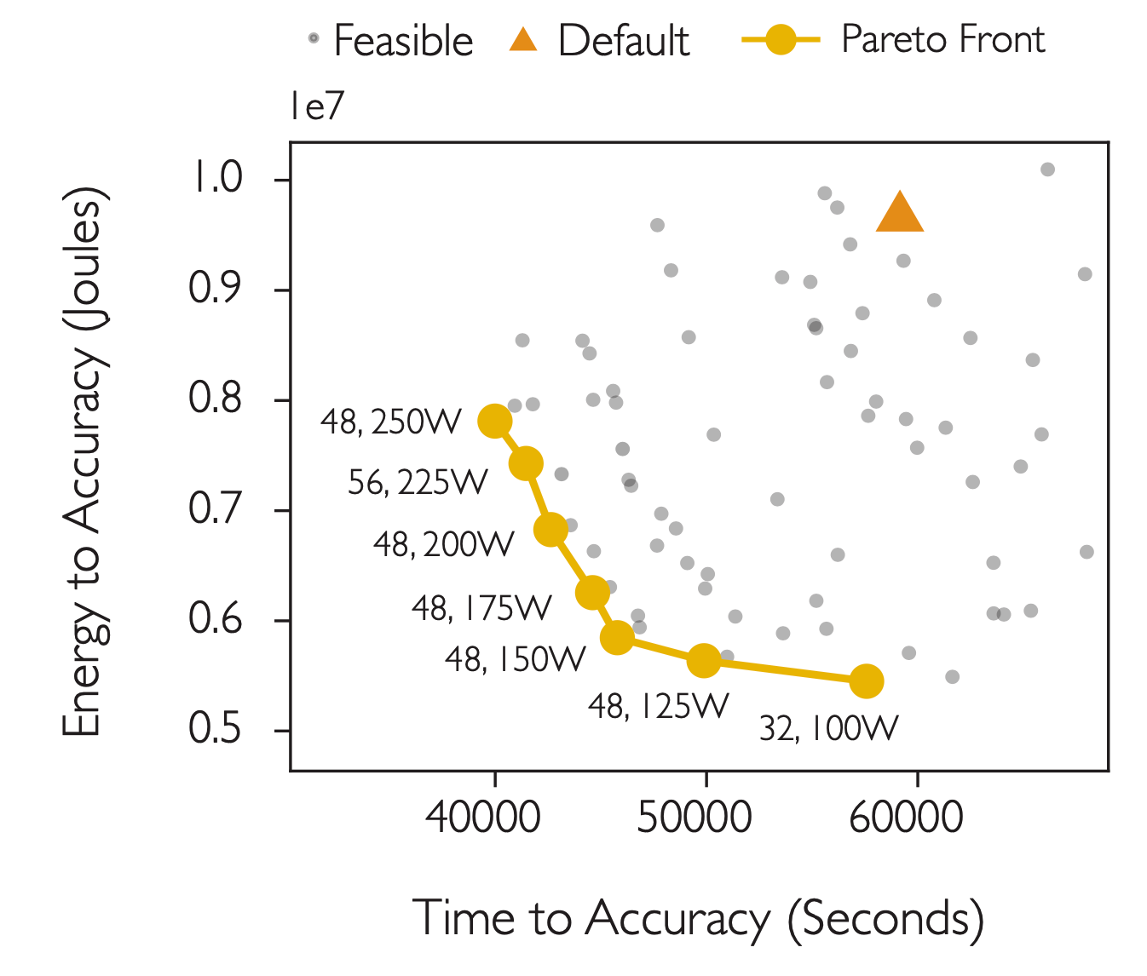
Relationship Between Time and Energy
faster != energy efficient
Efficient time and energy show a trade-off
Results from training DeepSpeech2 on LibriSpeech on an NVIDIA V100 GPU. Similar trends found across 6 DL workloads and 4 GPU generations.

Slide 15
Relationship Between Time and Energy
Which yellow point is the best?
Cost=𝜂⋅ETA+ 1−𝜂 ⋅MaxPower⋅TTA
Results from training DeepSpeech2 on LibriSpeech on an NVIDIA V100 GPU. Similar trends found across 6 DL workloads and 4 GPU generations.

Slide 16
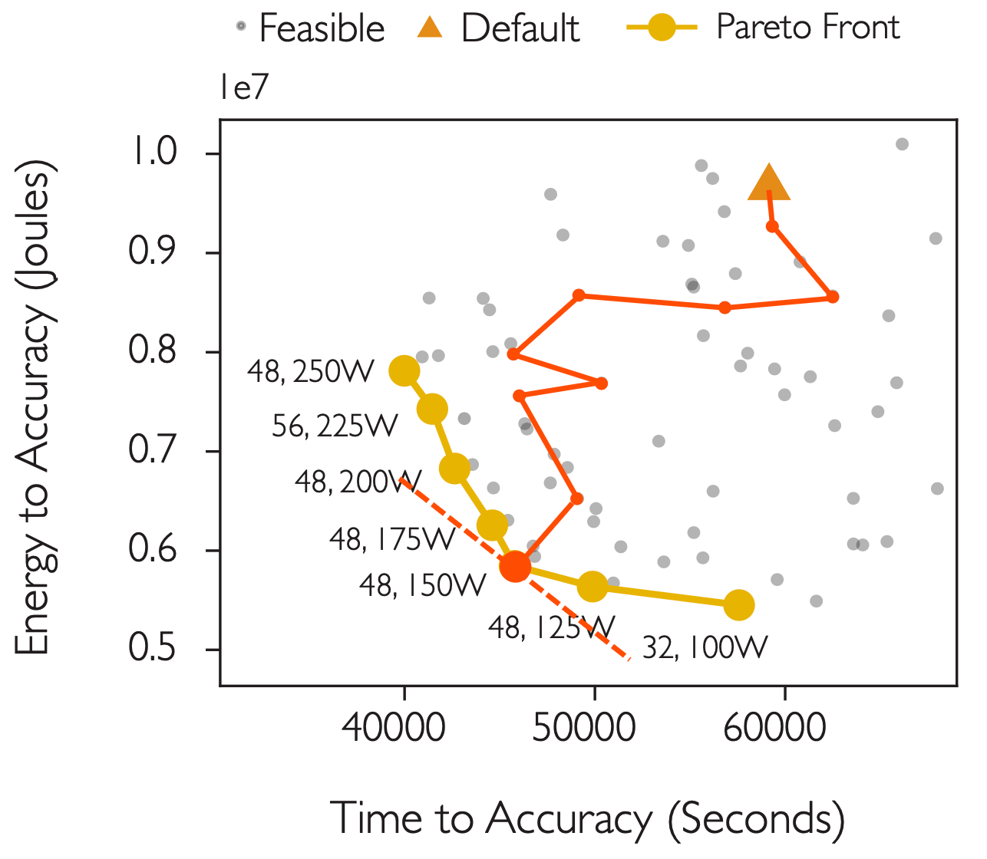
Relationship Between Time and Energy
Which yellow point is the best?
Cost=𝜂⋅ETA+ 1−𝜂 ⋅MaxPower⋅TTA
Brute force every combinations
One dot can take days or weeks
Results from training DeepSpeech2 on LibriSpeech on an NVIDIA V100 GPU. Similar trends found across 6 DL workloads and 4 GPU generations.

Slide 17
Outline
Background
Motivation
Overview
Method
Evaluation
Summary and Discussion

Slide 18
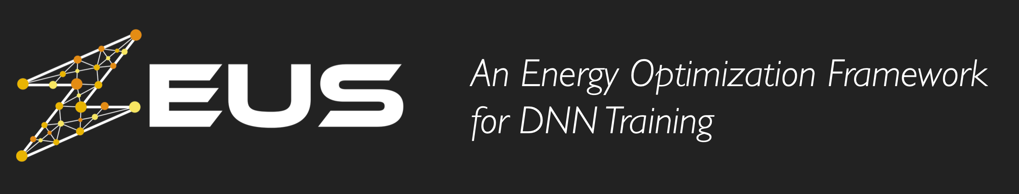
Optimizes the cost
of an arbitrary DNN model
on an arbitrary GPU type
in an efficient manner
without any
offline profiling,
hardware modification, or
accuracy degradation
Identify optimal batch size and power limit

Slide 19
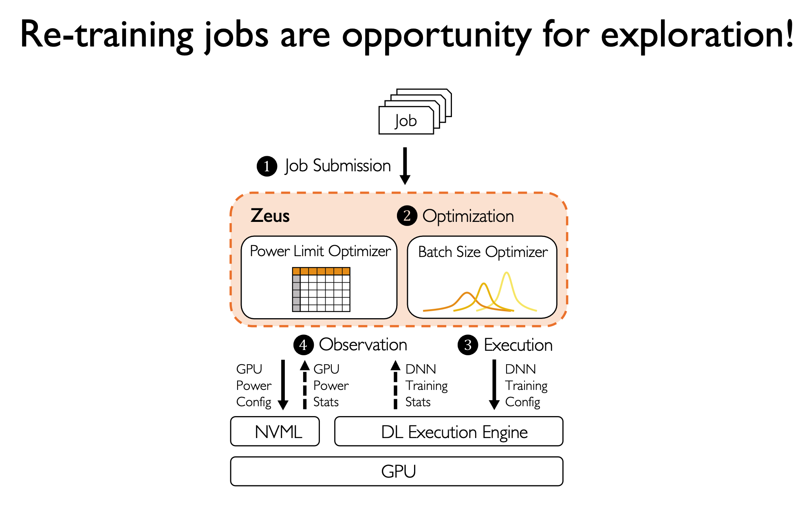
Overall Workflow
Learn how cost behave when retrain
Decoupling Variables
Power Limit Optimizer
Batch Size Optimizer

Slide 20
Outline
Background
Motivation
Overview
Method
Evaluation
Summary and Discussion

Slide 21
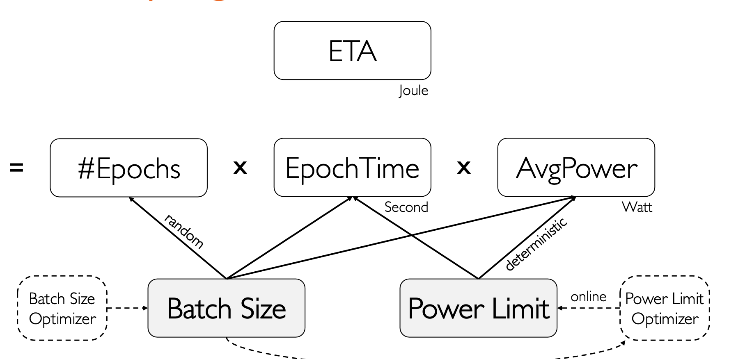
1. Decoupling Batch Size and Power Limit
power limit is easier

Slide 22
2. Power Limit Optimizer
Just-in-time online profiler
Profiles the power and throughput of each power limit (at the beginning of training)
Five seconds per power limit is enough (each batch size do once)
Low overhead
Profile only once for each batch size
Profiling contributes to the training process
Notes:
一开始， go through each power limit

Slide 23
3. Batch Size Optimizer
A good solution must
1. Incorporate the stochasticity of DNN training
2. intelligently trade-off exploration and exploitation
Multi-Armed Bandit
Cost=𝜂⋅ETA+ (1−𝜂 )⋅MaxPower⋅TTA
Models cost as a Gaussian random variable
Automatically controls exploration and exploitation
Notes:
一开始， go through each power limit

Slide 24
Outline
Background
Motivation
Overview
Method
Evaluation
Summary and Discussion

Slide 25
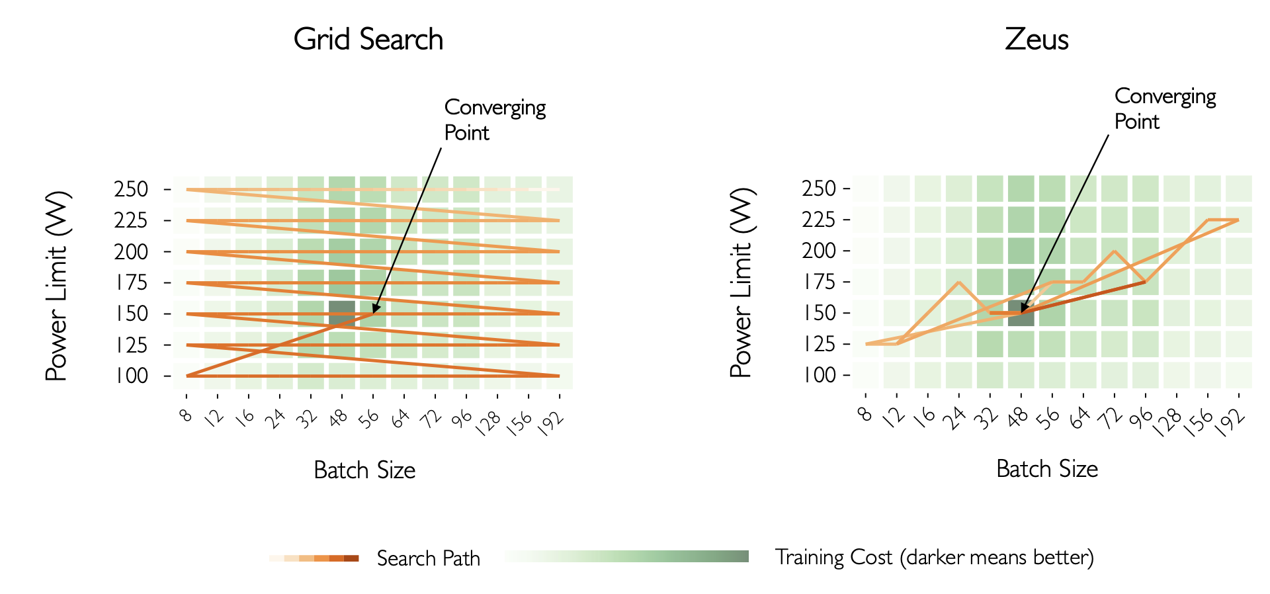
Compare with Grid Search
Aware of stochastic nature of DNN training!

Slide 26
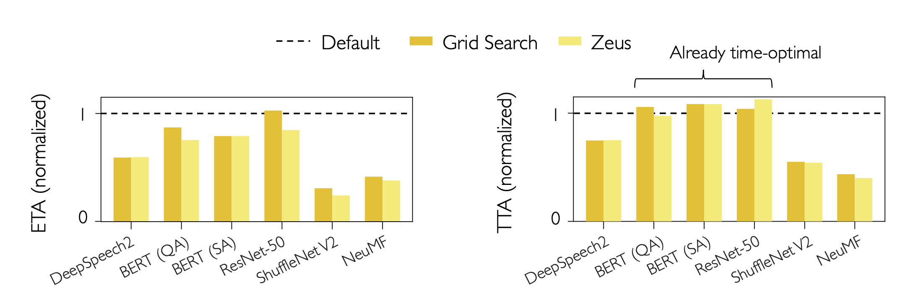
Results
15 ~ 76% energy reduction
Up to 60% time reduction （really? Cannot find in this figure）
Results obtained on an NVIDIA V100 GPU

Slide 27
Outline
Background
Motivation
Overview
Method
Evaluation
Summary and Discussion

Slide 28
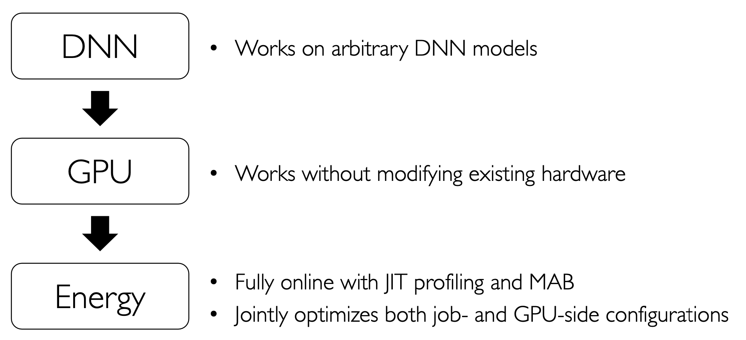
Conclusion

Slide 29
Weakness
1. The energy is not the important things. Mostly we pay attention to the training time.
Strength
1. we can learn how to optimize something across retraining jobs.

