Slide 1
Hardware-aware Matrix Multiplication Acceleration
Project Final presentation
08/05/2024

Slide 2
What is the problem?
Training Neural Networks involves substantial money and time, with a significant portion of these resources dedicated to matrix multiplication.
Accelerating matrix multiplication computation is essential for deep neural network training and inference.

Slide 3
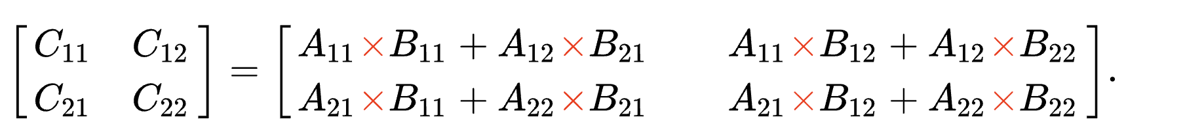
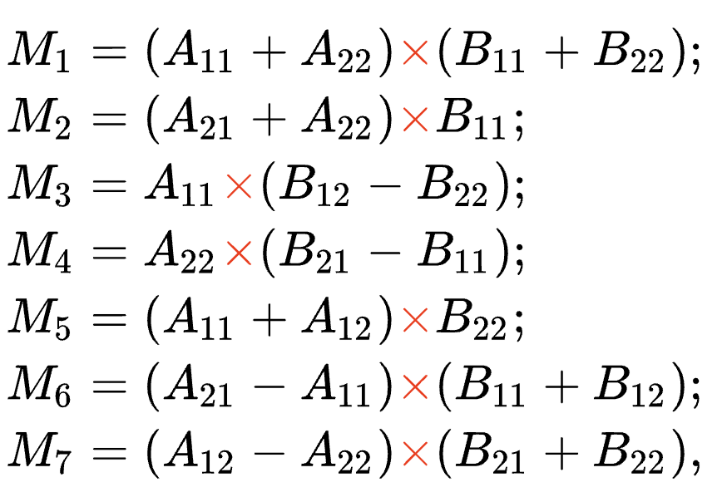
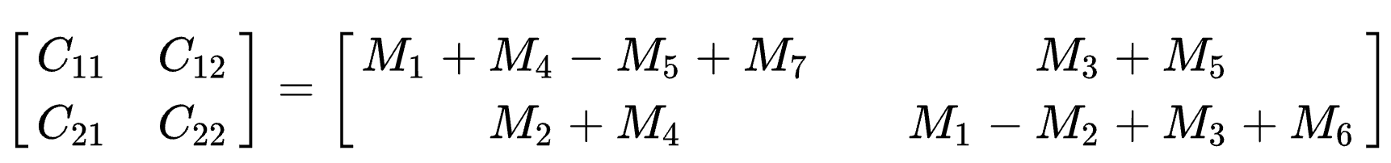
Motivation
The naive algorithm
The Strassen algorithm
Strassen has only 7 multiplications instead of 8
But have 18 matrix additions

Slide 4
Previous works
Previous work [1] shows Strassen algorithm can benefit in their Convolutional MM. However, for the Normal MM, they don‘t consider cache-aware optimization.
[1] Cong, Jason, and Bingjun Xiao. "Minimizing computation in convolutional neural networks." International conference on artificial neural networks. Cham: Springer International Publishing, 2014.

Slide 5
Motivation
Strassen is faster than the standard matrix multiplication algorithm for large matrices.
Computation complexity:
Problem:
Extra space to save temporary matrix

Slide 6
A positive startling statement
We could optimize Strassen algorithm in a cache friendly way
Our naïve Strassen method can reach 3.47x speed up
Reorder layout for Strassen can reach 6.95x speed up
Tiling + Strassen +vectorize + parallel can reach 110x speed up

Slide 7
A positive startling statement
We could optimize GEMM in GPU in a cache friendly way
Our naïve tiling method can reach 5.63x speed up
Parallel read into share memory can reach 21.2x speed up
Parallel read + solve bank conflict can reach 25x speed up
Parallel read + solve bank conflict + vectorize can reach 32x speed up

Slide 8
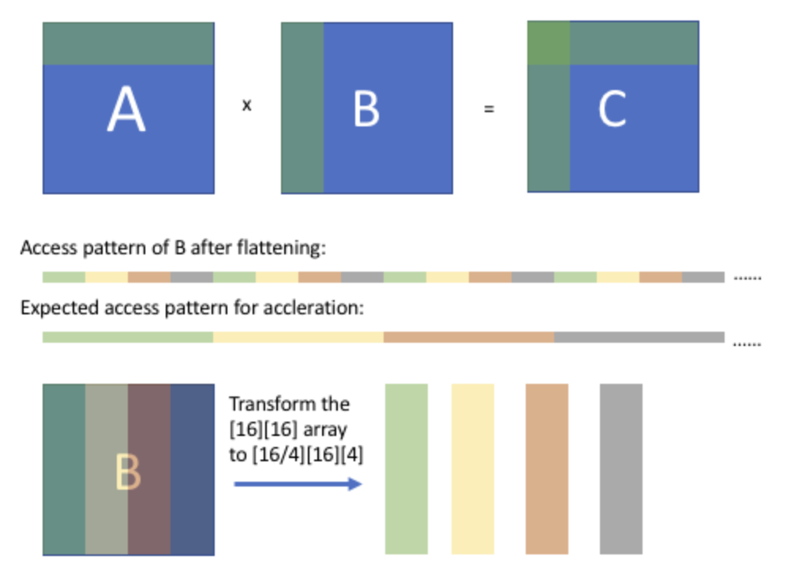
Array packing
For A100 GPU Tensorcore, we need to transform to [N/16][N/16][16][16]
Because tensor core can process 2-D 16x16 matrix multiplication
Notes:
Array packing is still an important way in our GPU experiment, because of memory access pattern, default the program will access in continues way. For example,

Slide 9
Tiling + Strassen + vectorize
We tiling the matrix, calculate each block with Strassen algorithm
Then we reduce each block to get the whole matrix results
The advantage is we don’t need extra space, the inner loop can be computed in-place
Vectorize: pass the continuous memory to vector processor
a11
a12
a21
a22
Setting:
Single thread
block size = 64
Matrix size = 1024 x 1024
Notes:
We still need to introduce tiling,

Slide 10
Evaluation Setting
CPU experiment, are executed on 2021’s 16’ MacBook equipped with Apple M1 Pro Chip. The cache line size is 128 bytes.
M1 Pro has 256-bit LPDDR5-6400 SDRAM memory, 204GB/s bandwidth
L1 dcache size = 128KB/ 64KB
L2 cache size = 4MB
L2 cache bandwidth = 400 GB/s
Unable to find the specific bandwidth of the L1 cache

Slide 11
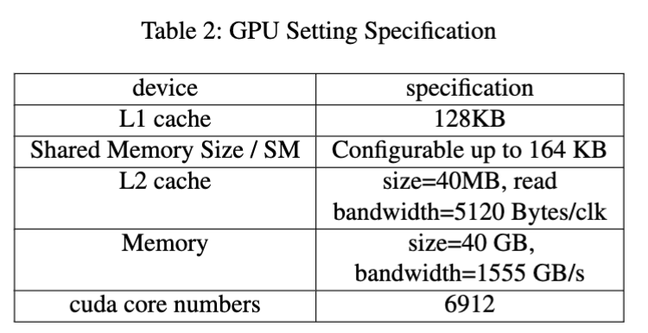
Evaluation Setting
Our GPU setting experiments are executed in NVIDIA A100 GPU.

Slide 12
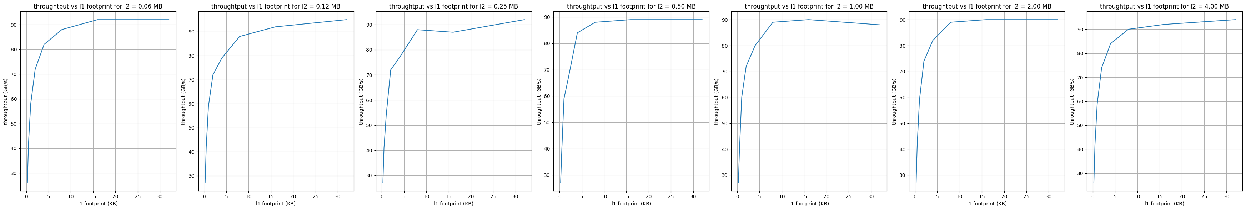
CPU Results
However, we can not occupy 64KB space in l1 cache. It is not optimal.
We implement a benchmark to measure the effect of memory access footprint
We find when we has 4K float number(i.e. 16KB) is the optimal.
=> 64 * 64 matrix can fit entirely in L1.
After footprint > 4K, the throughput increase rate slow down, because data swap out l1 cache.
Notes:
Taking the square root gives us 2^6, so we know a 64 * 64 matrix can fit entirely in L1.

Slide 13
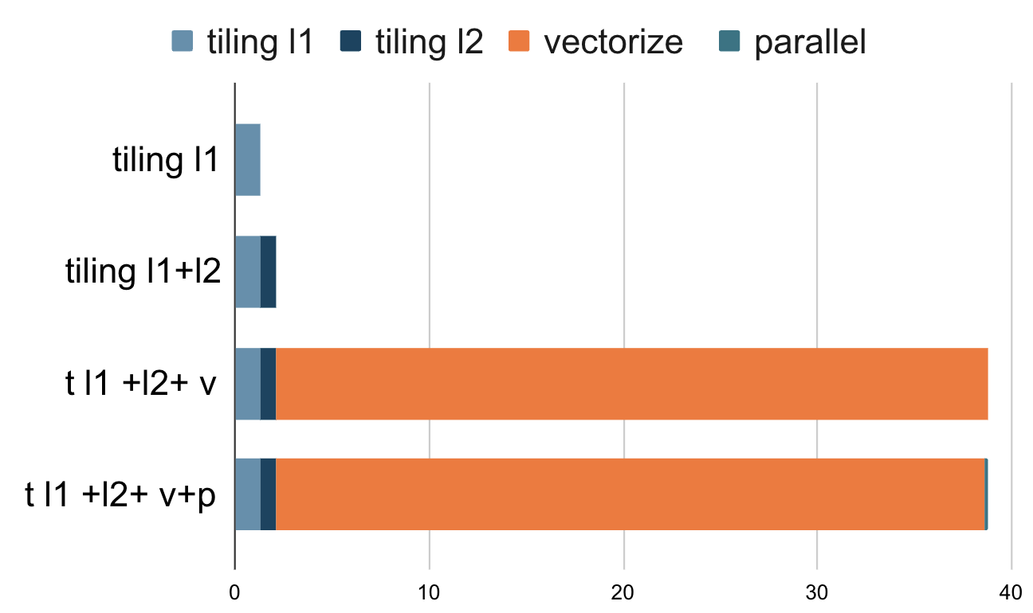
CPU Results
L2 tiling can further speed up to 1.62x
data chunk will be computed block by block. The memory access inside the block is a small neighborhood which is with high memory locality
Setting:
L1 block size = 64
L2 block size = 256
Matrix size = 1024 x 1024

Slide 14
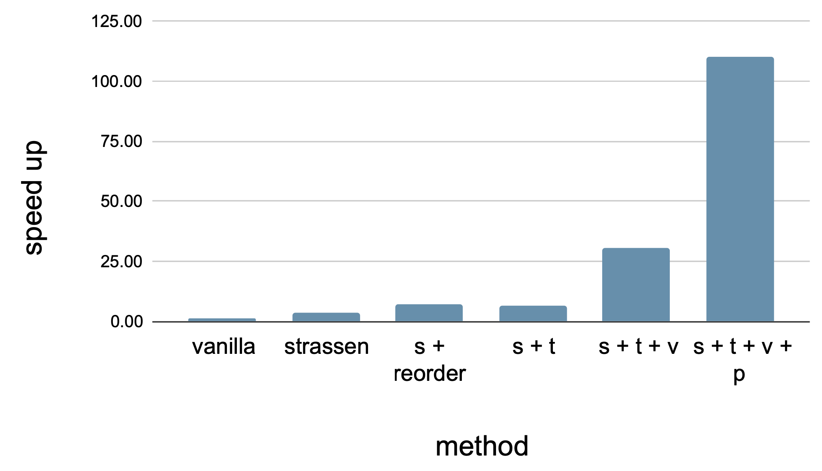
CPU Results
Our cache-aware Strassen algorithm can achieve23% performance improvement over NumPy matrix multiplication
Speed up for all methods. s represents Strassen,
t represents tiling, v represents vectorize, p represents parallel

Slide 15
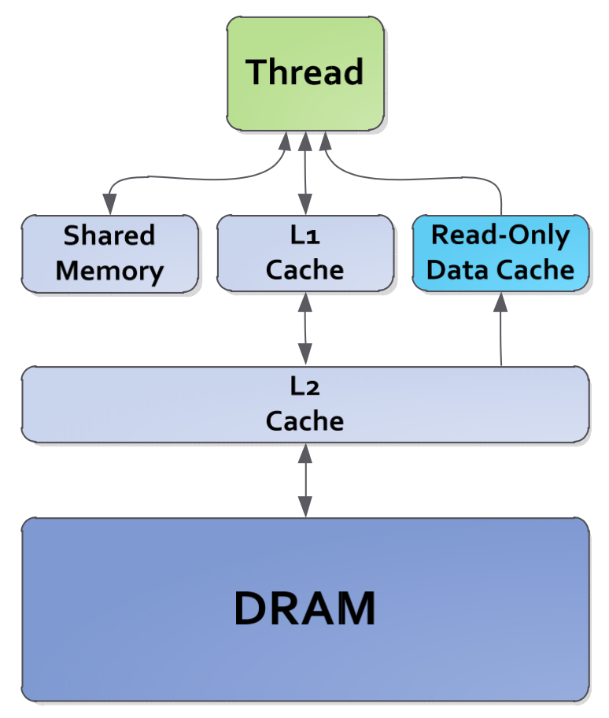
GPU optimization
All thread in a block will share the shared memory.
Difference is, Instead of black box L1 cache in CPU, now we can manually control the tiling data movement.
We need to parallelize the reading of tiling data into shared memory.
Gpu memory hierarchy
Notes:
In GPU, we need to specify the memory hierarchy for buffers. shared memory, which is managed by programmers.

Slide 16
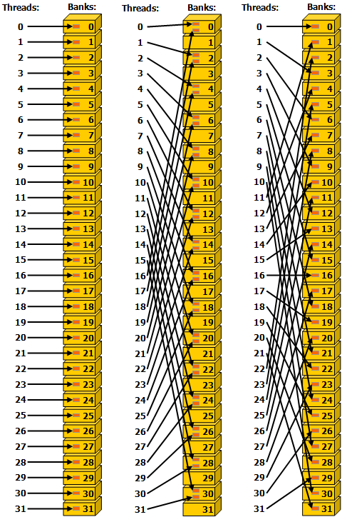
Bank conflict
Shared memory has 32 banks
Successive 32-bit words map to successive banks
Left:
arr[threadIdx.x]
Linear addressing with a stride of one 32-bit word (no bank conflict)
Middle:
arr[threadIdx.x*2]
Linear addressing with a stride of two 32-bit words (two-way bank conflict)
Right
arr[threadIdx.x*3]
Linear addressing with a stride of three 32-bit words (no bank conflict)

Slide 17
如果Tm是4的倍数， 他就会conflict。

Slide 18
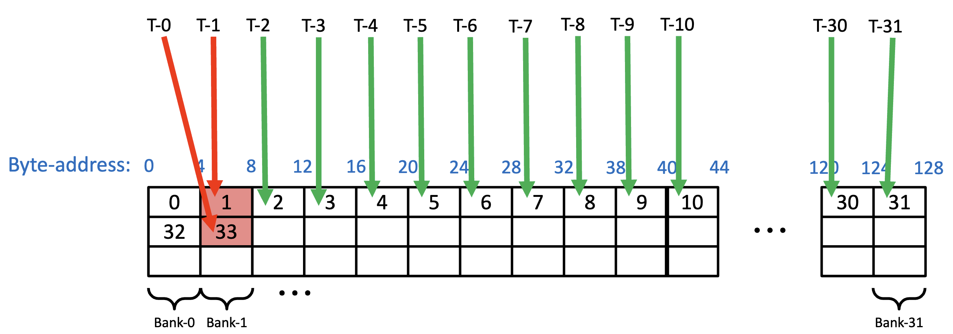
GPU optimization
A bank conflict occurs when, inside a warp:
2 or more threads access within different 4B words in the same bank
Solutions：
Store A in Shared Memory along column
Split original block into 2 or 4 blocks
Bank Conflict
Notes:
However, parallel read is not trivial. Shared memory is divided into multiple memory bank, allowing multiple concurrent read and write. The benefit is that bandwidth can be very large. However, if we don’t assign thread to access data properly, two thread may access same bank and it cannot be parallel. So we need to further split the block again. Column can let memory access, Don’t be Successive. Change stride from 32 to 16.

Slide 19
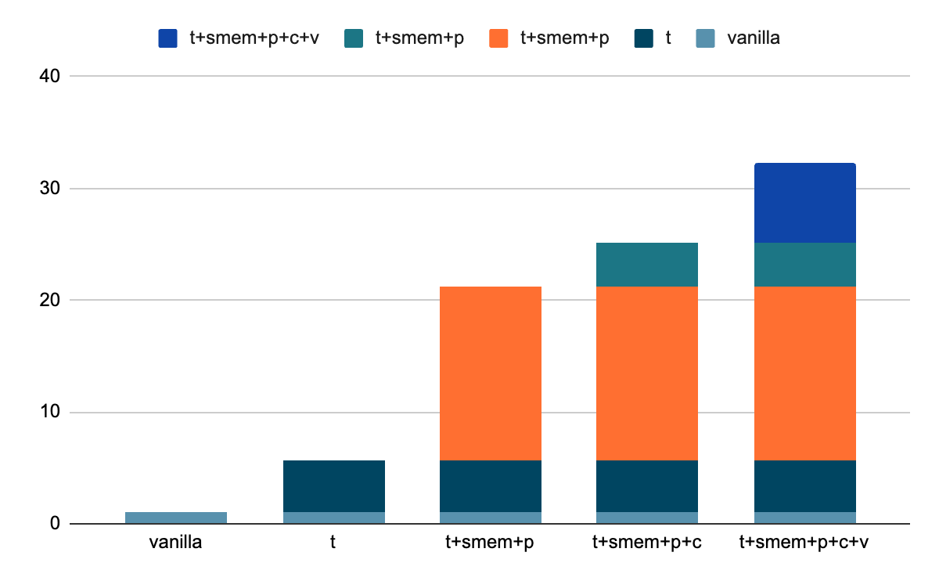
GPU results
Speed up
method
Speed up for GPU methods. t represents tiling, smem+p represents parallel share memory read and write, c represents solving bank conflict, v represents vectorize
Notes:
We find shared memory parallel reading can greatly speed up. Vectorize can also greatly increase the speed.

Slide 20
Progress
1. Implement a benchmark to measure the effect of memory access footprint. align the inner loop with the size of the L1 cache, and align the outer loop with the size of the L2 cache √
2. Implement MM using the Strassen algorithm to reduce the theoretical FLOPs.√
3. On the foundation of the Strassen algorithm, we use Strassen to calculate 64x64 matrix block multiplication. √
4. On A100 GPU, We implement a benchmark similar with CPU version. We use optimization such as loop tiling, share cache read, parallel read, vectorize. We solve bank conflict. √

