Slide 1
Zeus: Understanding and Optimizing GPU Energy Consumption of DNN Training
CS345
03/24/2024

Slide 2
Credits
Some of the slides were used in their original form.

Slide 3
Paper Details
Title
Zeus: Understanding and Optimizing GPU Energy Consumption of DNN Training
Authors
Jie You, Jae-Won Chung, and Mosharaf Chowdhury, University of Michigan
Venue
The 20th USENIX Symposium on Networked Systems Design and Implementation (NSDI '23)
Citations
30
Notes:
From Michigan university, nsdi 2023, has 30 citations

Slide 4
Outline
Background
Insight
Overview
Method
Evaluation
Summary and Discussion

Slide 5
Background

Slide 6
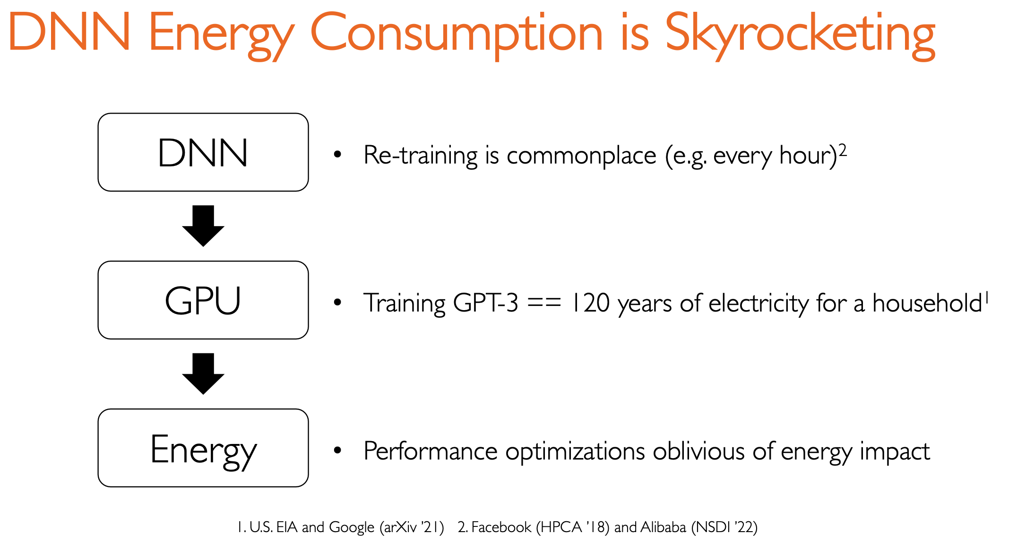
Notes:
However , previous performance optimizations ignore energy impact.

Slide 7
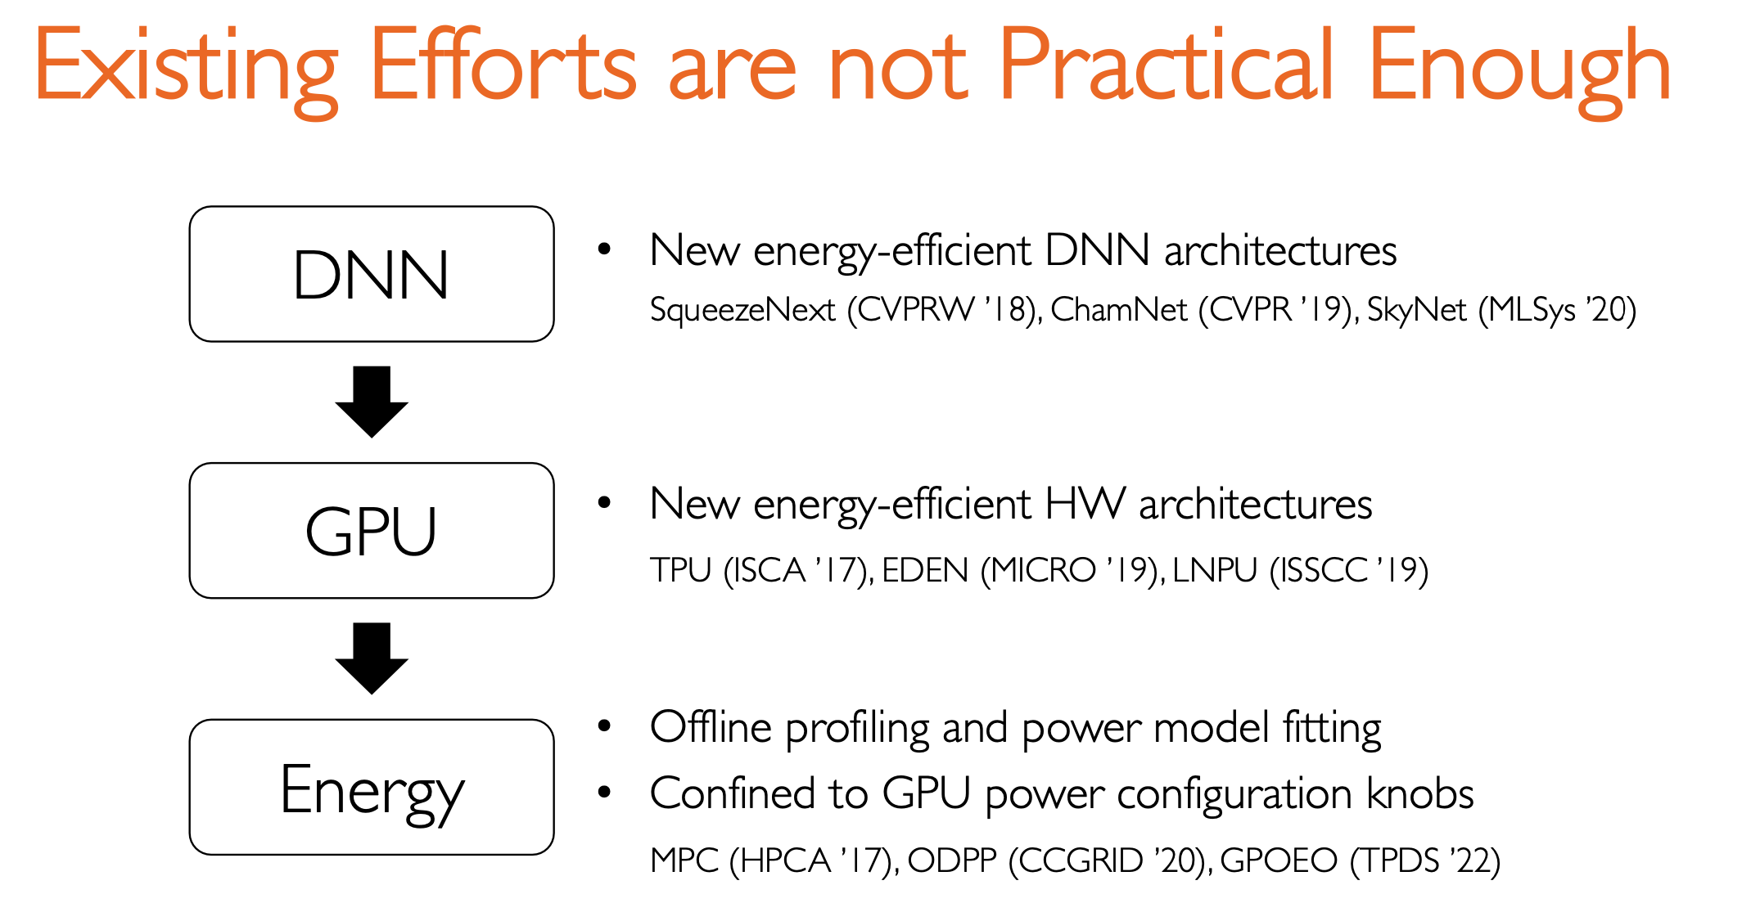
==> Companies created their own DNNs already
==> Companies bought thousands of GPUs already
==> cannot generalize and have high overhead.
Notes:
Firstly, companies have already built their own DNN models for their specific applications. It is infeasible for them to use new DNN architectures. Secondly, They don’t have extra money to buy new hardware. What’s more, Rely on offline profiling and power model fitting, cannot be generalized

Slide 8
Motivation
Notes:
Therefore, they want to propose a new method to reduce energy consumption

Slide 9
Understanding GPU Energy Consumption
Energy to Accuracy (ETA)
Energy needed to reach the user-specified target accuracy
Energy-counterpart of Time to Accuracy (TTA)
Notes:
They define the energy consumption of DNN training until it reaches its target accuracy as its energy-to-accuracy. It is an important metrics in their experiment. Commonly people pay attention to TTA, time to accuracy.

Slide 10
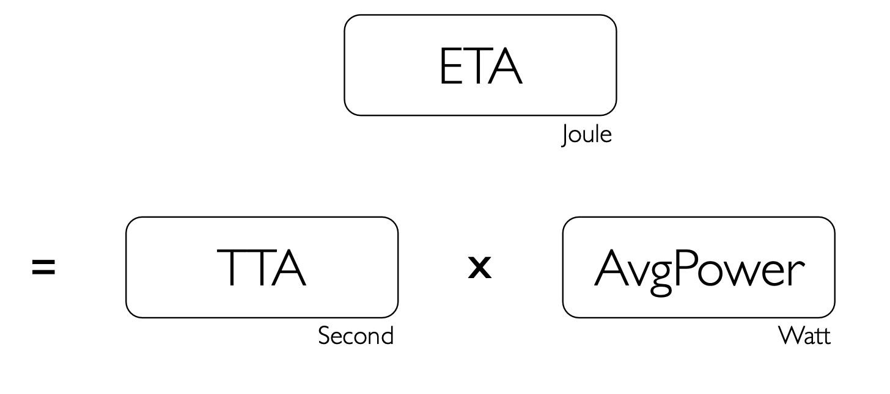
Understanding GPU Energy Consumption
Notes:
ETA can divide two main part, TTA and avg power.

Slide 11
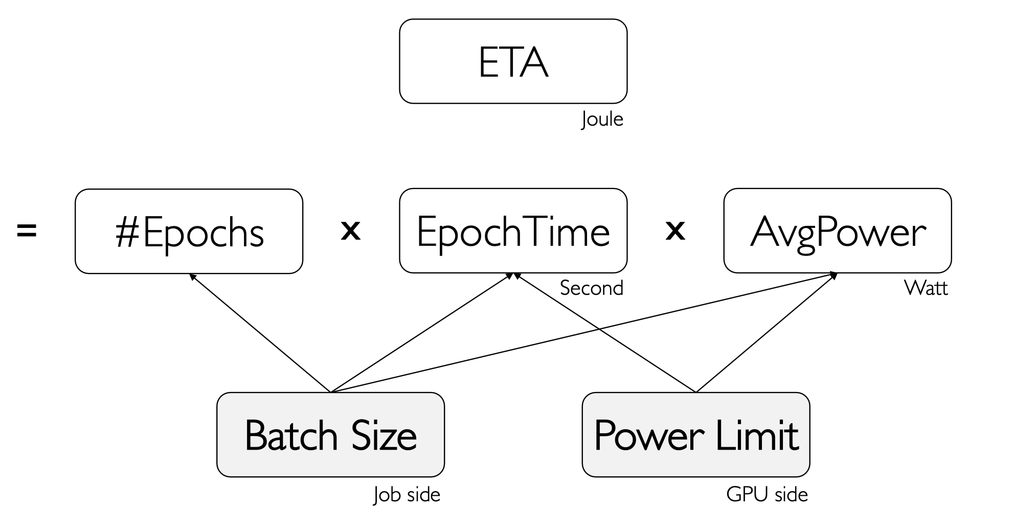
Understanding GPU Energy Consumption
Notes:
This idea is similar with Pollux, we discussed in the previous class, it discuss batch size and another parameter, in this paper they adjust also batch size and power limit.

Slide 12
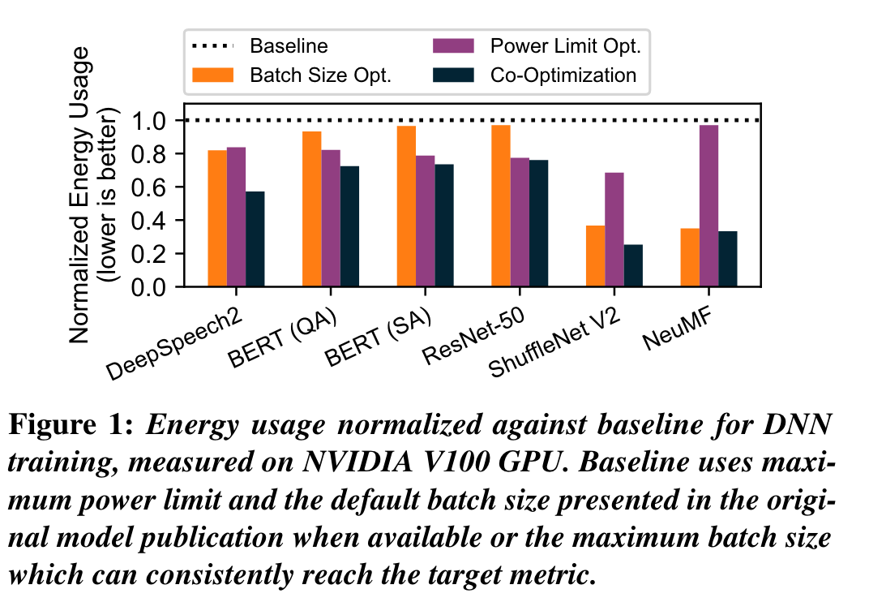
Opportunity for Energy Savings
Sweep of feasible batch sizes and power limits
24~75%
energy reduction
Notes:
Experient shows When they adjust batch size and power limit, best energy reduction can save 24-75%.

Slide 13
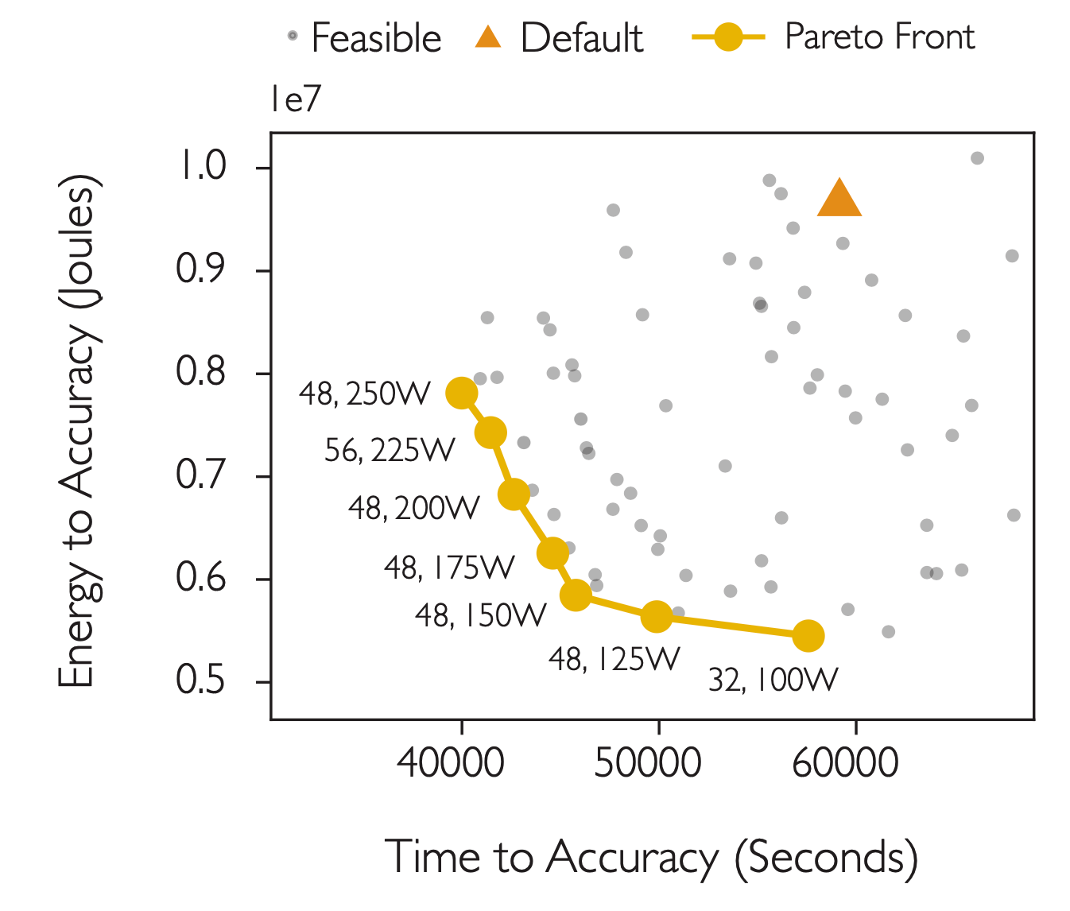
Relationship Between Time and Energy
faster ≠ energy efficient
Efficient time and energy show a trade-off
Results from training DeepSpeech2 on LibriSpeech on an NVIDIA V100 GPU. Similar trends found across 6 DL workloads and 4 GPU generations.
Notes:
They find faster training may not be energy efficient. Because it has large power. 应该用不等于号， 不用 ！=不然别的专业可能看不懂。

Slide 14
Relationship Between Time and Energy
Which yellow point is the best?
Cost=𝜂⋅ETA+ 1−𝜂 ⋅MaxPower⋅TTA
Results from training DeepSpeech2 on LibriSpeech on an NVIDIA V100 GPU. Similar trends found across 6 DL workloads and 4 GPU generations.
Notes:
Therefore, they formulate the tradeoff problem and try to solve it.

Slide 15
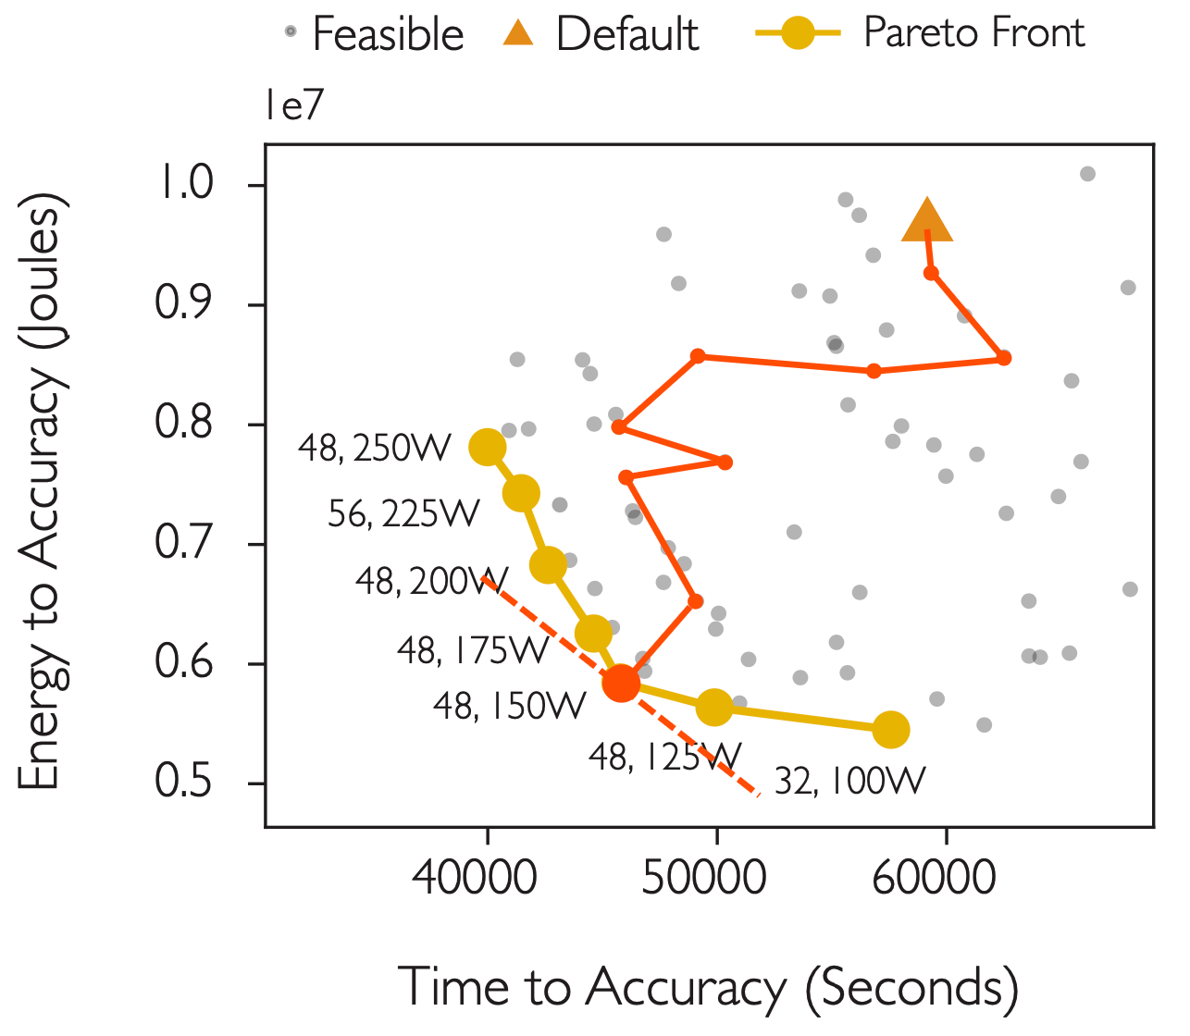
Relationship Between Time and Energy
Which yellow point is the best?
Cost=𝜂⋅ETA+ 1−𝜂 ⋅MaxPower⋅TTA
Brute force every combinations
One dot can take days or weeks
Results from training DeepSpeech2 on LibriSpeech on an NVIDIA V100 GPU. Similar trends found across 6 DL workloads and 4 GPU generations.
Notes:
Brute force to find the best combination takes days or weeks. They need to find a more efficient way to explore best combinations

Slide 16
Overview

Slide 17

Optimizes energy cost
of an arbitrary DNN model
on an arbitrary Nvidia GPU type
without any
offline profiling,
hardware modification, or
accuracy degradation
Identify optimal batch size and power limit
Notes:
They proposes zeus, it can optimize the energy cost.

Slide 18
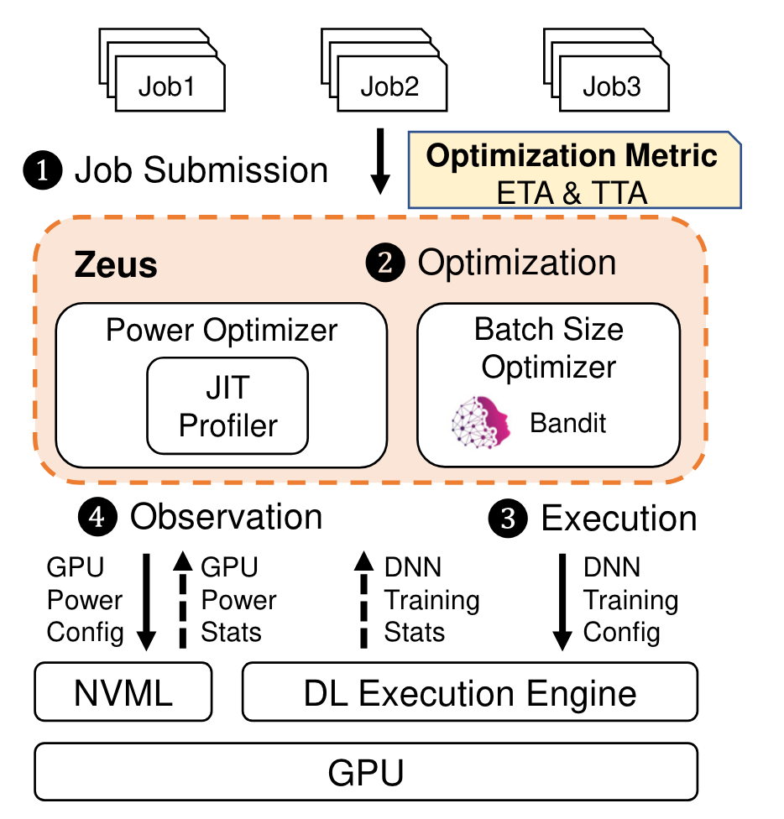
Overall Workflow
Learn how cost behave when retrain
Decoupling Variables
Power Limit Optimizer
Batch Size Optimizer
Notes:
A just-in-time (JIT) online profiler, which efficiently profiles the energy characteristics of the training job online. Multi-Armed Bandit (MAB)

Slide 19
Method

Slide 20
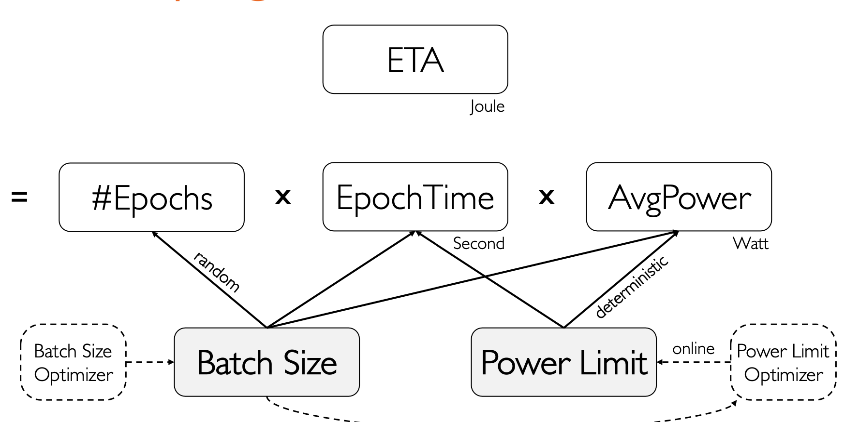
1. Decoupling Batch Size and Power Limit
power limit is easier

Slide 21
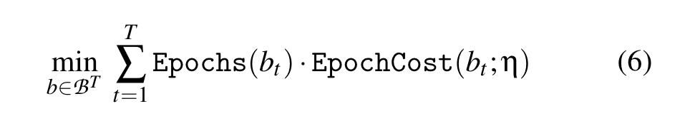
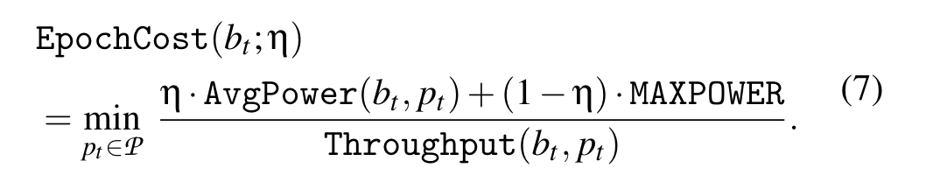
1. Decoupling Batch Size and Power Limit
Notes:
Firstly decide which batch size to used based on equation 6, Zeus will pick the optimal power limit based on Equation7.

Slide 22
2. Power Limit Optimizer
Just-in-time online profiler
Profiles the power and throughput of each power limit (at the beginning of training)
Five seconds per power limit is enough (each batch size do once)
Low overhead
Profile only once for each batch size
Profiling contributes to the training process
Notes:
At beginning， go through each power limit

Slide 23
2. Power Limit Optimizer
partition the epoch into slices at iteration boundaries
Power limit 1
Power limit 2
Power limit 3
… …
First epoch of job
Notes:
When a job with batch size decision b is submitted, our just in-time (JIT) profiler is triggered and checks if this batch size had been profiled before. dynamically changing the GPU power limit for each slice. Find the optimal power limit of the batch size. The rest of the epochs are executed with the optimal power limit.

Slide 24
3. Batch Size Optimizer
A good solution must
1. Incorporate the stochasticity of DNN training
2. intelligently trade-off exploration and exploitation
Multi-Armed Bandit
Cost=𝜂⋅ETA+ (1−𝜂 )⋅MaxPower⋅TTA
Models cost as a Gaussian random variable
Automatically controls exploration and exploitation
Notes:
Grid search has too high exploration cost. They formulate the problem is multi armed bandit.

Slide 25
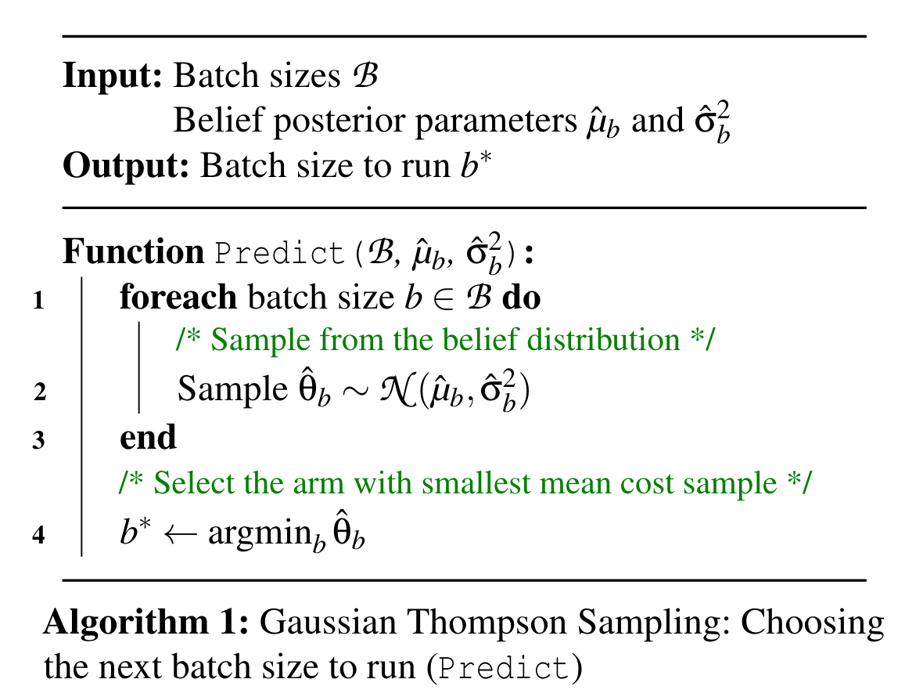
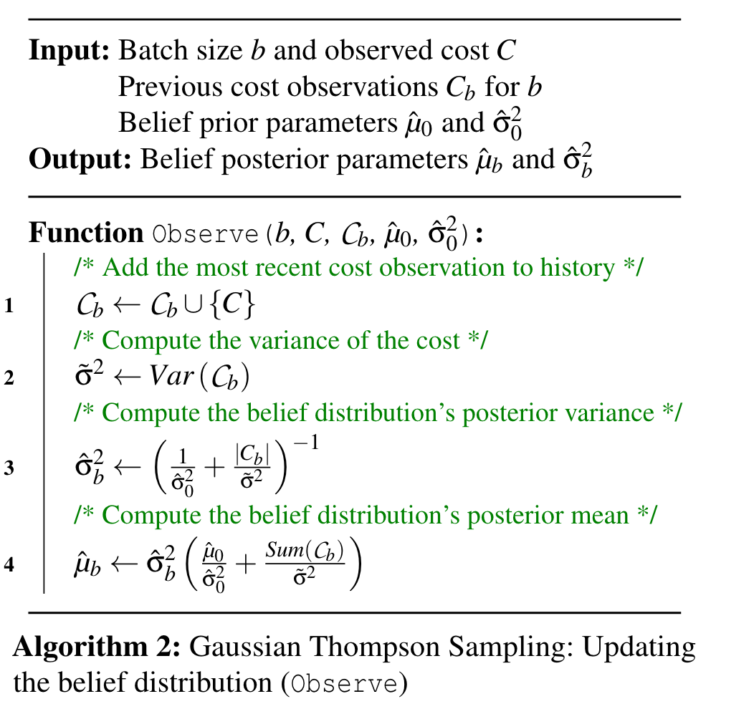
3. Batch Size Optimizer
Does anybody have experience in MAB?
Notes:
They adopt the Thompson Sampling. For each batch size, sample from the belief distribution, select the arm with smallest mean cost sample.

Slide 26
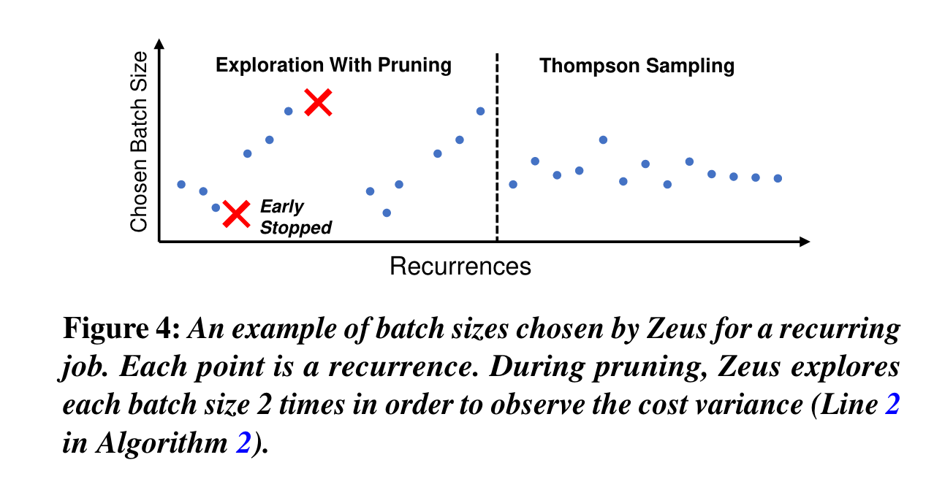
3. Batch Size Optimizer
Cannot reach target metric -> prune
Early stopping: when cost is to exceed β times the minimum cost observed so far, stop the job and retry with another batch size.
Notes:
Firstly , they will try small batch size and eliminate these choice. And then they try large batch size and eliminate these choice.

Slide 27
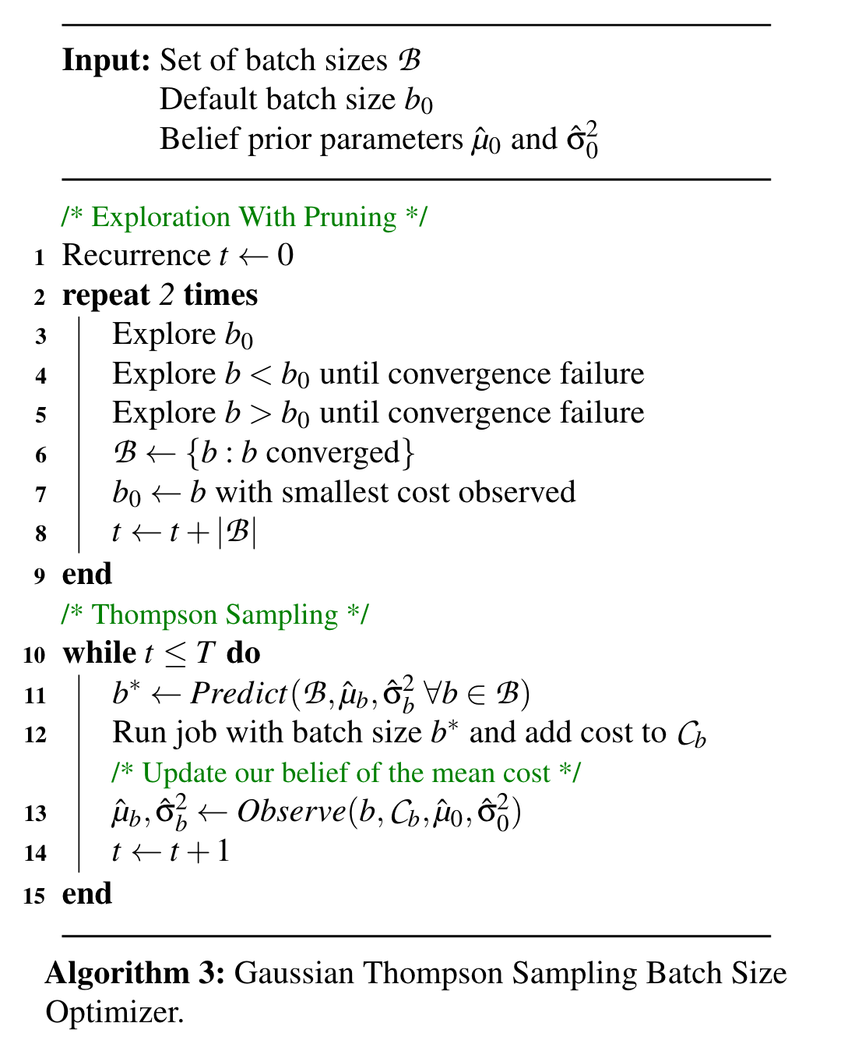
3. Batch Size Optimizer
Notes:
This is their algorithm I have mentioned.

Slide 28
Evaluation

Slide 29
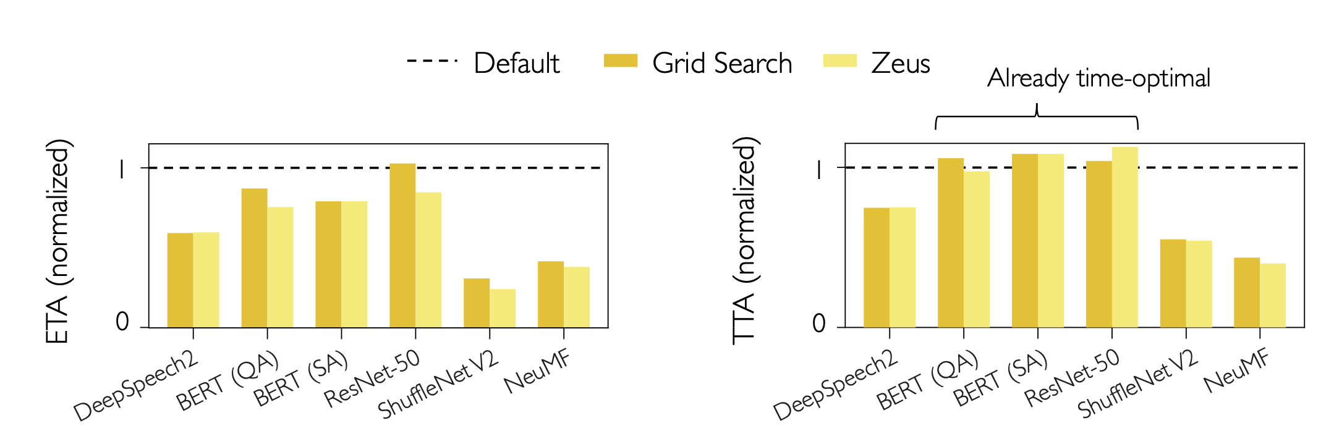
Results
15 ~ 76% energy reduction
Up to 60% time reduction
Results obtained on an NVIDIA V100 GPU

Slide 30
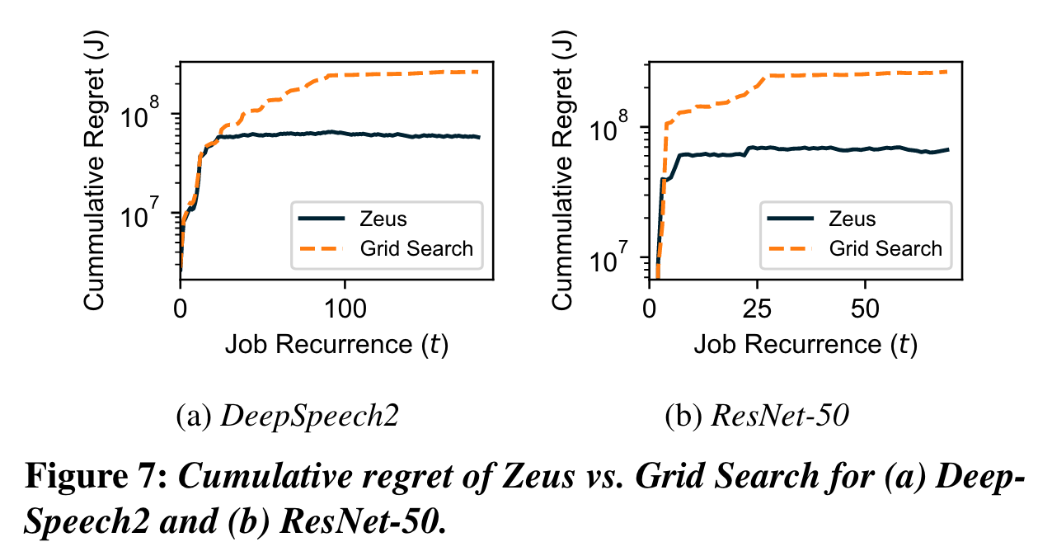
Results
Zeus achieve better regret from the first job recurrence
Zeus uses significantly smaller amount of resources to converge

Slide 31
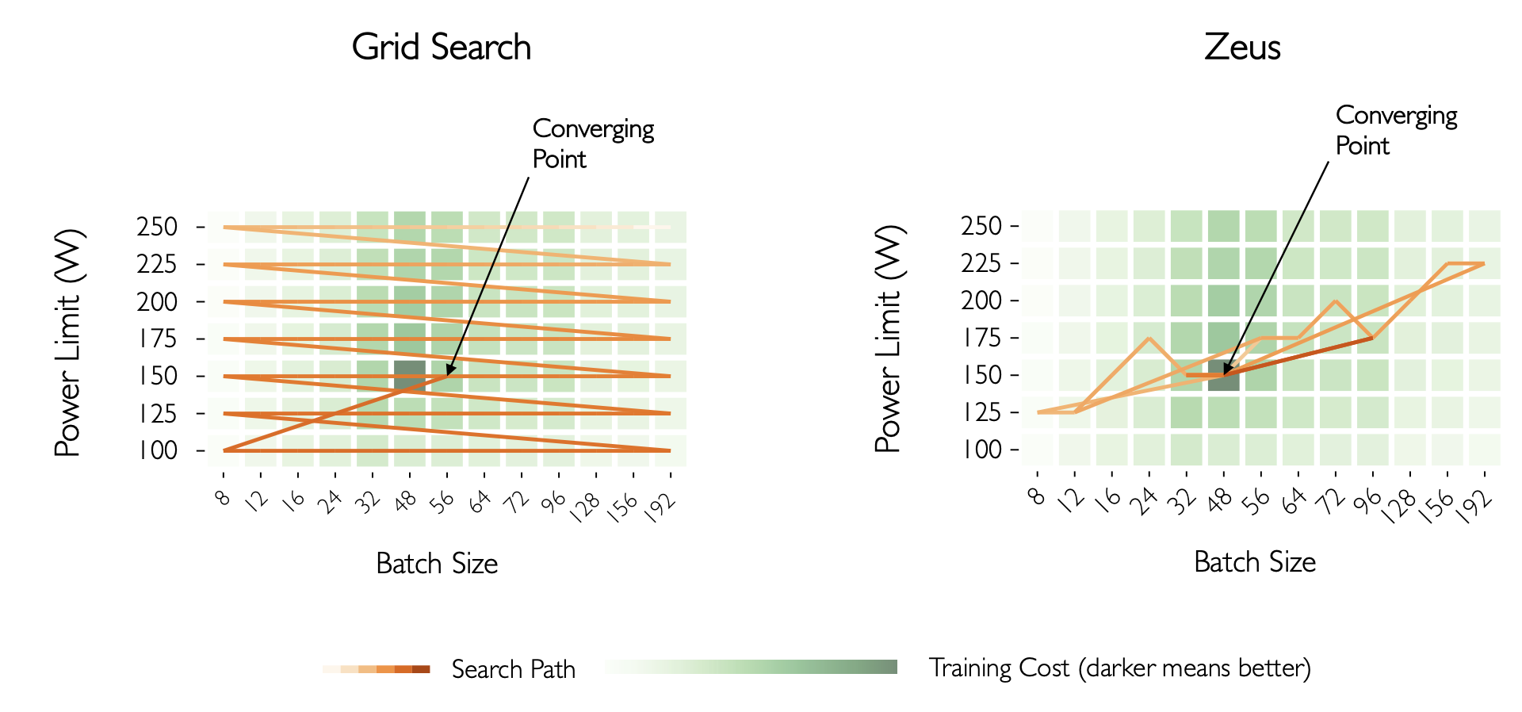
Compare with Grid Search
Aware of stochastic nature of DNN training!
Notes:
Their method has great converge speed and result.

Slide 32
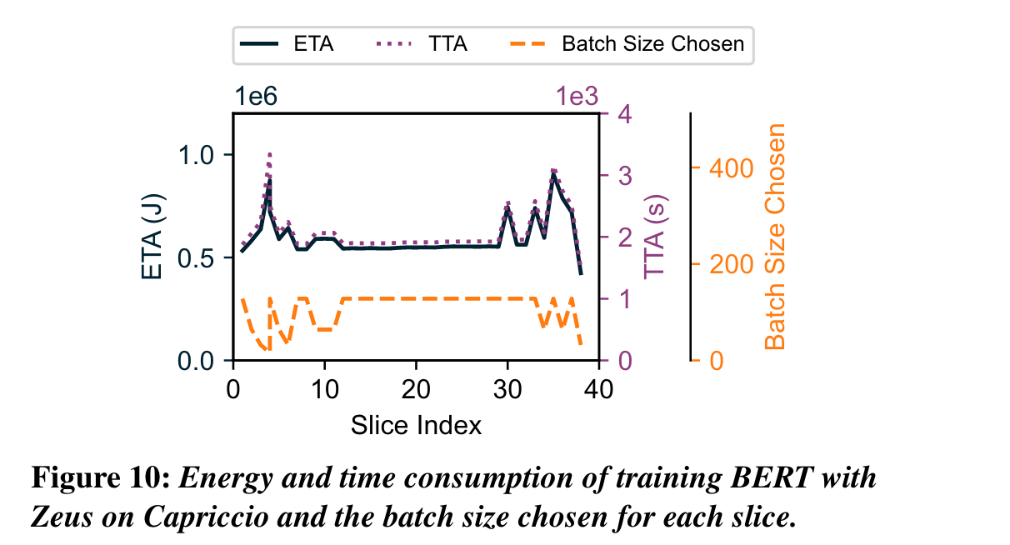
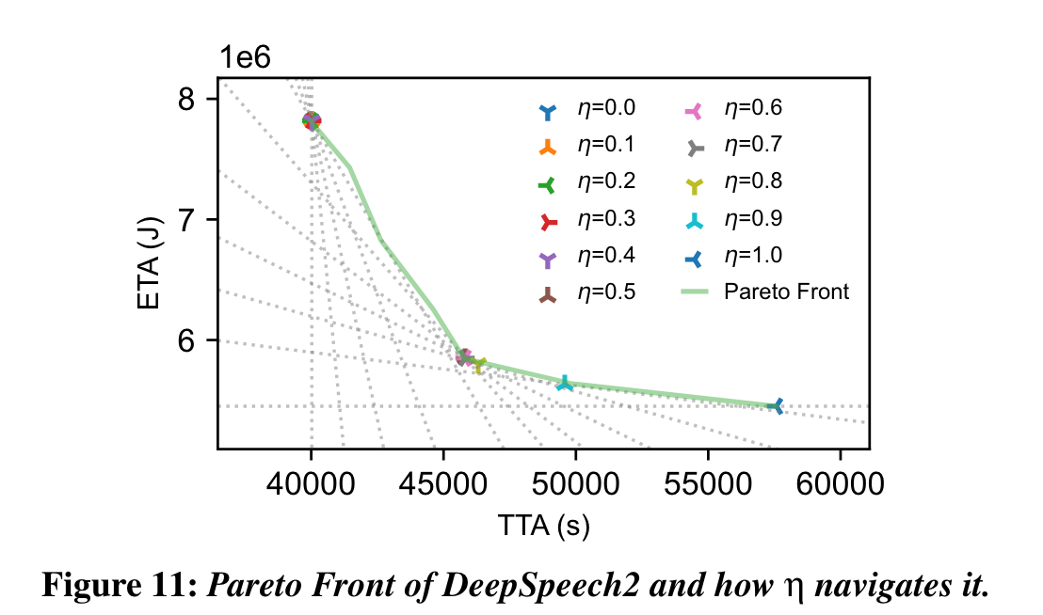
Results
Handling Data Drift
As expected, these lines form an envelope around the Pareto Front.
Notes:
When data distribution changed , the batch size can adapt the change.

Slide 33
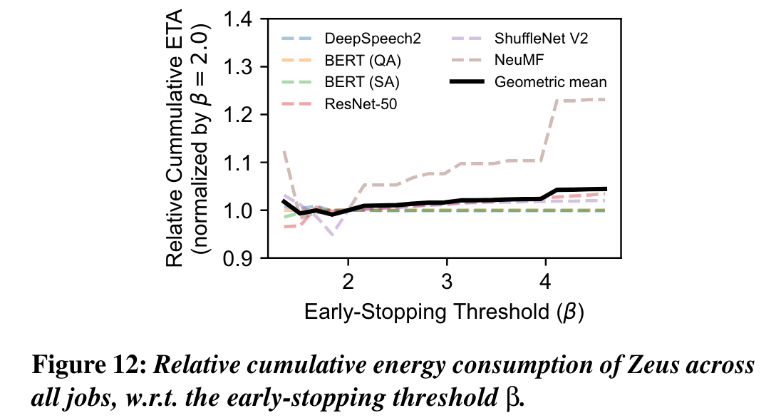
Results
Compare with Pollux, Zeus consumes 12% more time but 21% less energy. (Training DeepSpeech2 on LibriSpeech on four NVIDIA A40 GPUs)
Why they choose β = 2.0
Notes:
Beta is high , it encourage exploration. Beta is low, it stop too early.

Slide 34
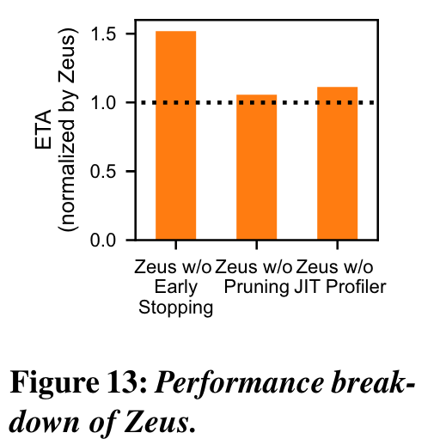
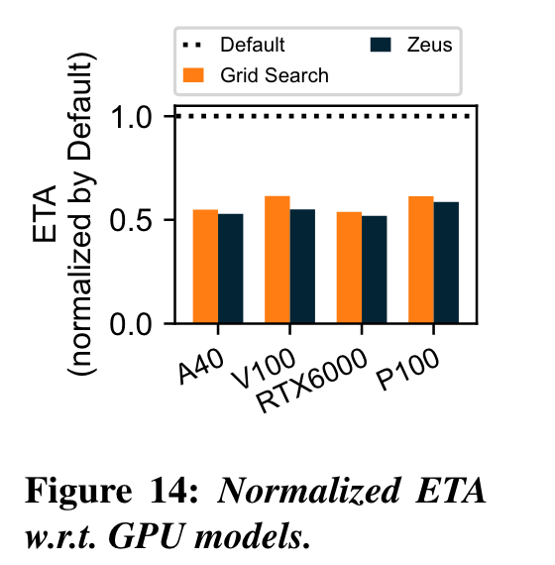
Results
Early stop is the most important part
Can this be used in AMD GPUs?
Zeus achieves consistent ETA reductions across four generations of NVIDIA GPUs

Slide 35
Summary and Discussion

Slide 36
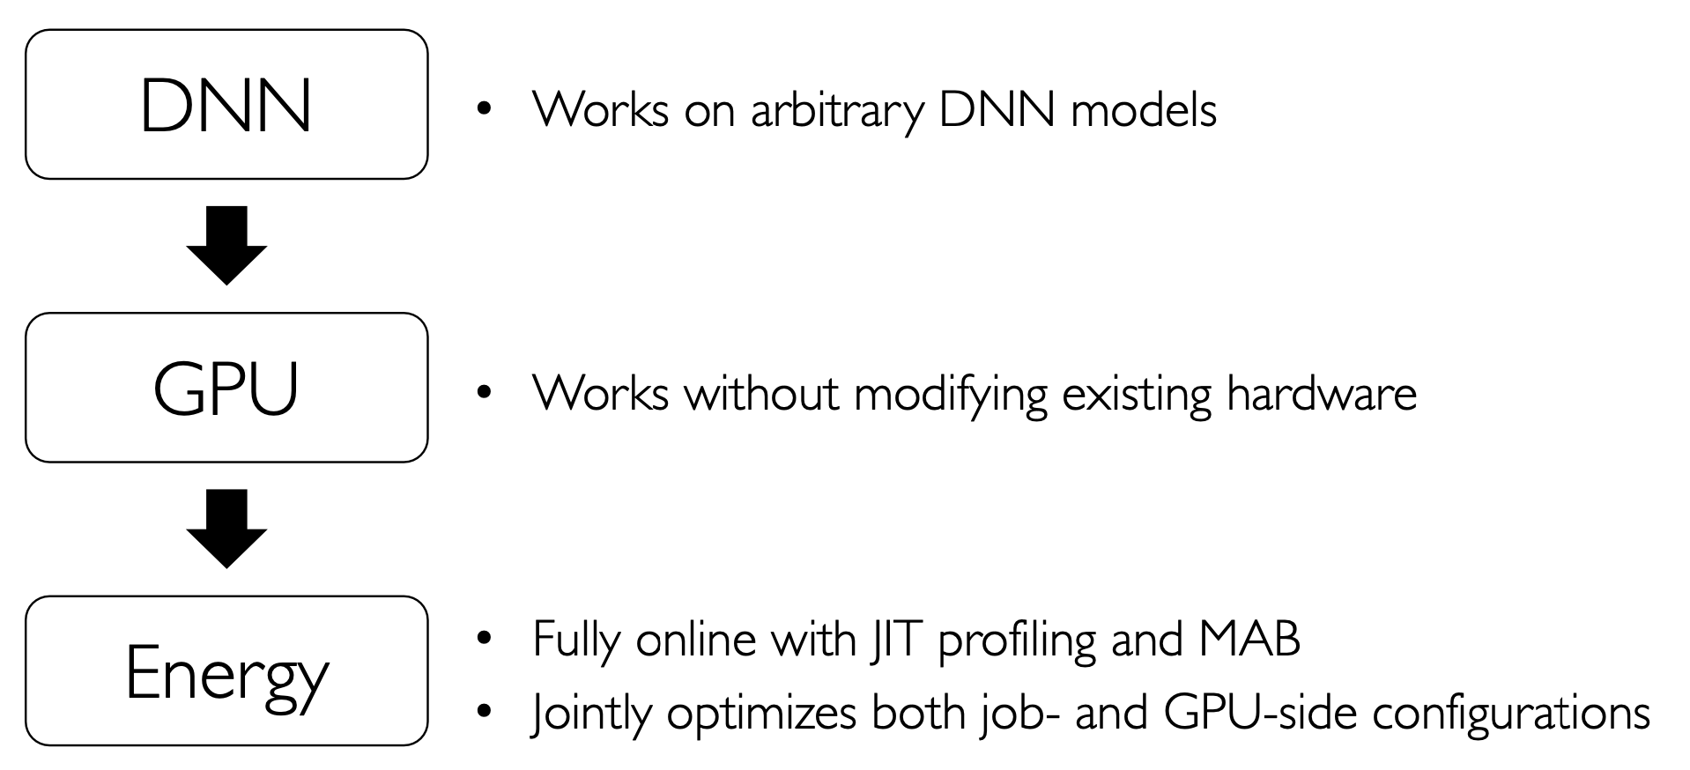
Conclusion

Slide 37
Weakness
It still takes more time in some cases.
It doesn‘t evaluate in GPU production clusters
Strength
we can learn how to optimize metrics(speed/energy) across retraining jobs.
Notes:
In cluster training, the batch size selection is a different story with the setting in the paper. And it don't consider different parallel training which are commonly used in real training scanrio. The envpipe paper(ATC'23) notices this problem and gives a inspiring solution.

Slide 38
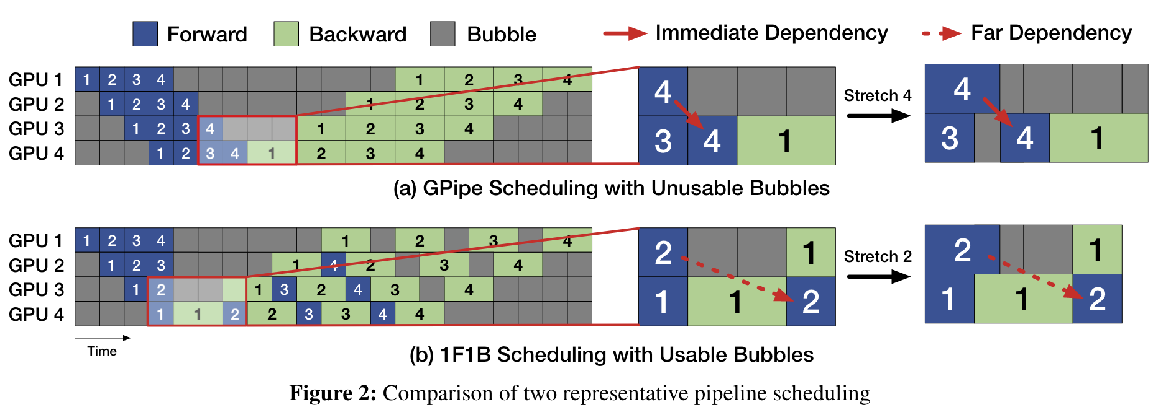
EnvPipe
Insight
Notes:
Previous work sacrificed training throughput, so this paper aims to conserve energy while not significantly reducing training efficiency.
Looking at the existing pipeline training mode, there are many bubbles. Taking one of these blocks, performance degradation does not affect the overall. Fully utilizing this structure (Figure 2), energy consumption can be reduced without lowering overall training efficiency. However, for dependent structures (unusable bubbles), reducing the frequency of SM (Streaming Multiprocessor) to reduce energy consumption means affecting overall training efficiency.
Therefore, the goal of this paper is to increase the number of usable bubbles as much as possible and utilize them to save energy.

Slide 39
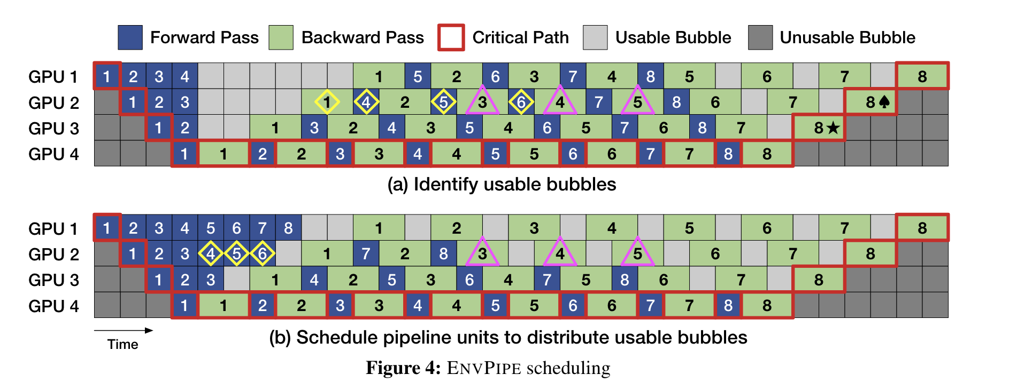
EnvPipe
Method
Notes:
It is divided into three modules: Profiler for obtaining basic information about model execution; Scheduler for adjusting the parallel execution process of the pipeline; Planner for adjusting the frequency of SM. Scheduler trying to advance the forward propagation of 1F1B as much as possible to increase the number of usable bubbles. This work proposes adaptive adjustments based on VRAM conditions.

Slide 40
Comparation
 | zeus | envpipe
insight | grid search takes too much time. We need a better search solution. | Pipeline parallel is widely used, and it has a lot of bubbles.
method | Multi-armed Bandit, early stopping | schedule pipeline parallel, decrease SM frequency when computation has bubbles.
results | reduces energy consumption (ETA) by up to 15.3%–75.8% | 1% throughput <-> 28.5% energy
Advantages | we can learn how to optimize metrics(speed/energy) across retraining jobs. | more suitable for GPU cluster, production environment

Slide 41
Further reading
1. https://cse.engin.umich.edu/stories/cse-researchers-receive-mozilla-funding-for-research-on-ai-energy-use Zeus join the 2024 cohort of the Mozilla Tech Fund

