Slide 1
Hardware-aware Matrix Multiplication Acceleration
Project Mid term presentation
27/03/2024

Slide 2
What is the problem?
Training Neural Networks involves substantial money and time, with a significant portion of these resources dedicated to matrix multiplication.
Accelerating matrix multiplication computation is essential for deep neural network training and inference.

Slide 3
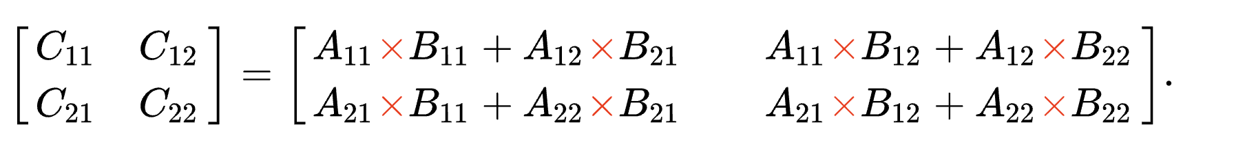
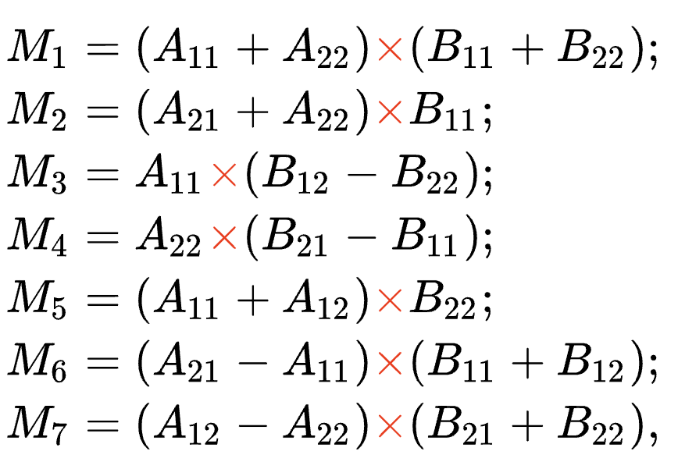
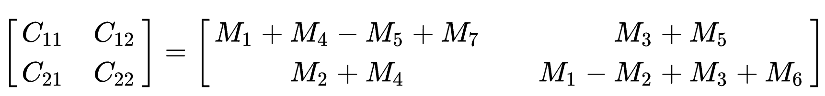
Motivation
The naive algorithm
The Strassen algorithm
Strassen has only 7 multiplications instead of 8
But have 18 matrix additions

Slide 4
Previous works
Previous work [1] shows Strassen algorithm can benefit in their Convolutional MM. However, for the Normal MM, they don‘t consider cache-aware optimization.
Previous work [2] claims the Strassen algorithm still cannot bring too many benefits.
[1] Cong, Jason, and Bingjun Xiao. "Minimizing computation in convolutional neural networks." International conference on artificial neural networks. Cham: Springer International Publishing, 2014.
[2] Chellapilla, Kumar, Sidd Puri, and Patrice Simard. "High performance convolutional neural networks for document processing." Tenth international workshop on frontiers in handwriting recognition. Suvisoft, 2006.

Slide 5
Motivation
Strassen is faster than the standard matrix multiplication algorithm for large matrices.
Computation complexity:
Problem:
Extra space to save temporary matrix

Slide 6
A positive startling statement
We could optimize Strassen algorithm in a cache friendly way
Theoretically, it only takes 1024^2.8/(1024^3)= 25.00% time. 4x speed up
Our naïve Strassen method can reach 3.47x speed up
Reorder layout for Strassen can reach 6.95x speed up
Tiling + Strassen +vectorize can reach 11.08x speed up

Slide 7
Evaluation Setting
All the experiment results mentioned below, are executed on 2021’s 16’ MacBook equipped with Apple M1 Pro Chip. The cache line size should be 128 bytes
M1 Pro has 256-bit LPDDR5-6400 SDRAM memory, 204GB/s bandwidth
L2 cache bandwidth = 400 GB/s
Unable to find the specific bandwidth of the L1 cache

Slide 8
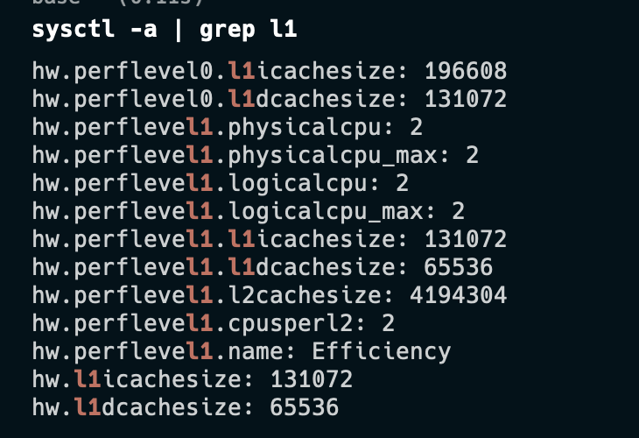
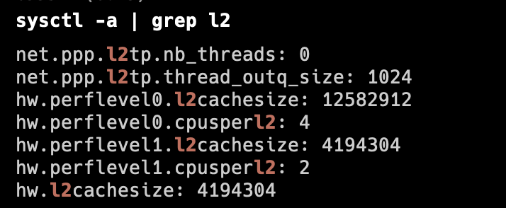
Evaluation Setting
L2 cache size = 4MB
L1 dcache size = 128KB/ 64KB

Slide 9
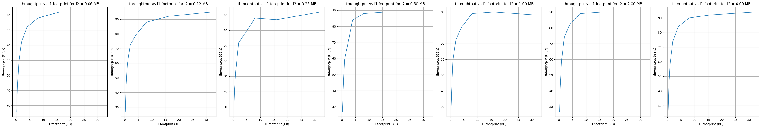
Results
However, we can not occupy 64KB space in l1 cache. It is not optimal
We implement a benchmark to measure the effect of memory access footprint
We find when we has 4K float number(i.e. 16KB) is the optimal.
=> 64 * 64 matrix can fit entirely in L1.
After footprint > 4K, the throughput increase rate slow down, because data swap out l1 cache.
Notes:
Taking the square root gives us 2^6, so we know a 64 * 64 matrix can fit entirely in L1.

Slide 10
Results
method | run time(s) | speed up
vanilla | 1.32 | 1.00
array packing | 1.28 | 1.03
tiling l1 | 0.99 | 1.33
tiling l1+l2 | 0.61 | 2.16
tiling l1+l2 + vectorize | 0.04 | 33.00
tiling l1+l2 + vectorize + parallel | 0.04 | 33.00
L2 tiling can further speed up to 1.62x
data chunk will be computed block by block. The memory access inside the block is a small neighborhood which is with high memory locality
Setting:
Single thread
L1 block size = 64
L2 block size = 256
Matrix size = 1024 x 1024

Slide 11
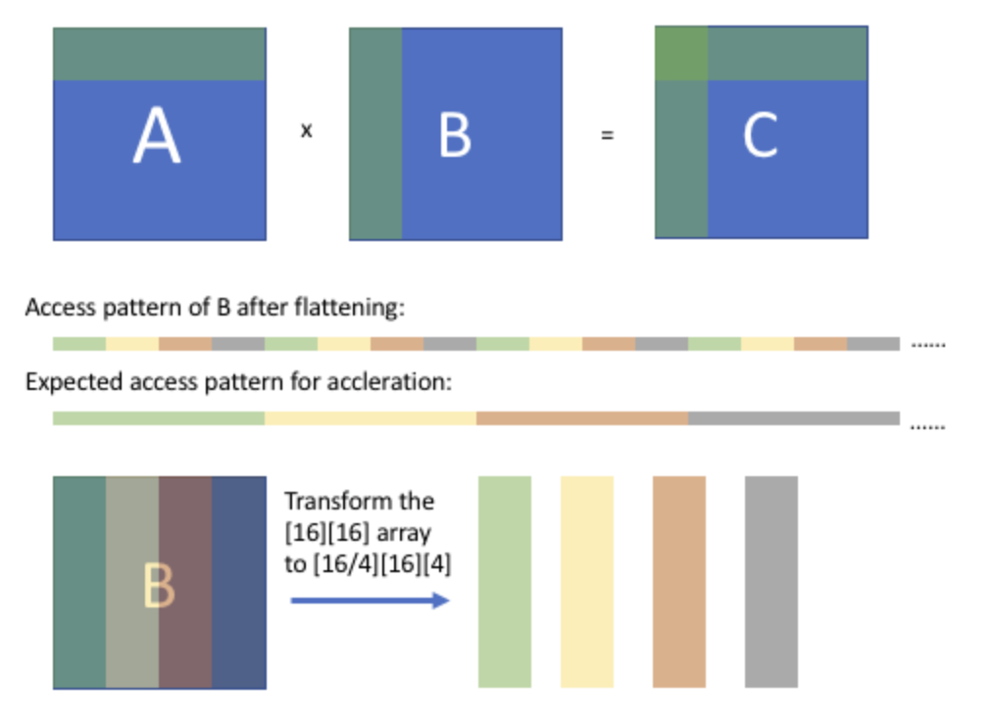
Array packing

Slide 12
Reorder
Because computing the results of the first quadrant of the matrix requires data from the fourth quadrant, we propose an optimization strategy.
Based on Strassen's characteristics, we reorder the data to tightly arrange the required data.
1
2
3
4

Slide 13
Reorder
1
2
3
4

Slide 14
Tiling + Strassen + vectorize
We tiling the matrix, calculate each block with Strassen algorithm.
Then we reduce each block to get the whole matrix results.
The advantage is we don’t need extra space, the inner loop can be computed in-place.
Vectorize: pass the continuous memory to vector processor
a11
a12
a21
a22
Setting:
Single thread
block size = 64
Matrix size = 1024 x 1024

Slide 15
Progress
1. Implement a benchmark to measure the effect of memory access footprint. align the inner loop with the size of the L1 cache, and align the outer loop with the size of the L2 cache √
2. Implement MM using the Strassen algorithm to reduce the theoretical FLOPs.√
3. On the foundation of the Strassen algorithm, we use Strassen to calculate 64x64 matrix block multiplication. √
4. Combine existing method to achieve the NumPy performance 3.27- 4.10
5. Apply our MM to practical NNs and evaluate its performance. 4.10-4.22
6. Implement our method on GPU with TVM. 4.22 - 5.6

