Slide 1
Assignment2

Slide 2
Setting up
Remote server location: Google Cloud southamerica-west
Local Server: mac multipass VM
Linux version: Ubuntu 22.04
Iperf version: 3.9

Slide 3
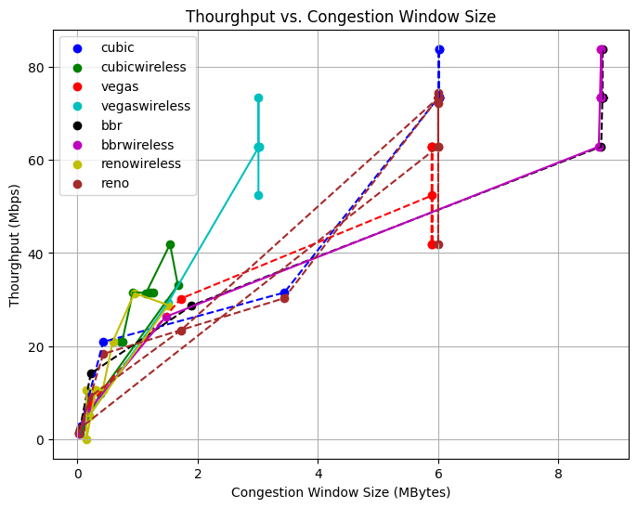

Slide 4
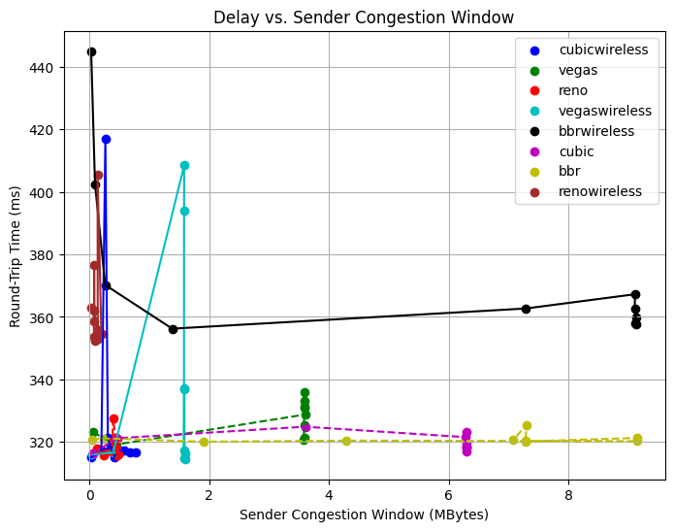

Slide 5
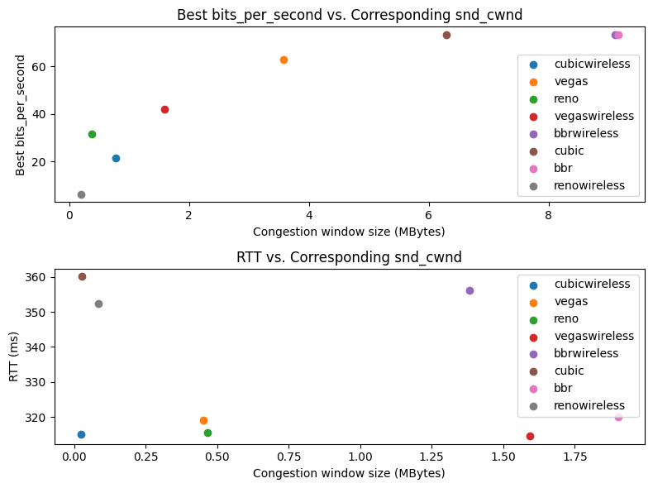

Slide 6
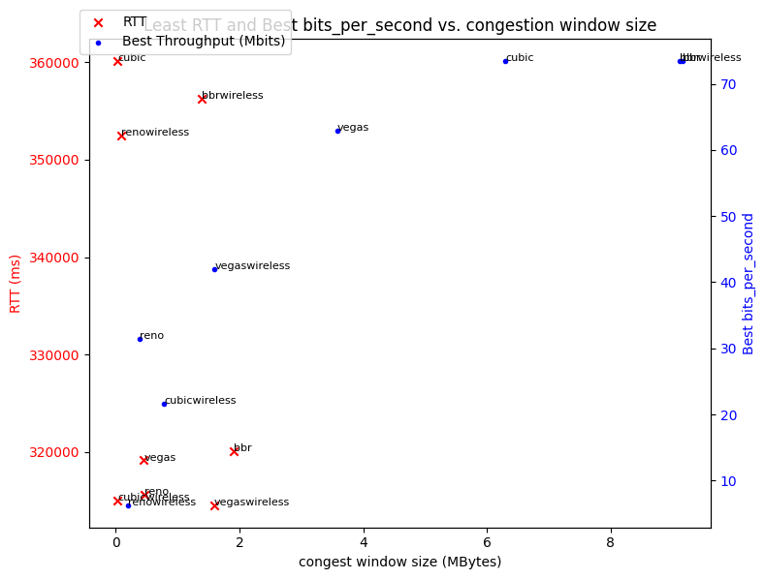

Slide 7
algorithm | throughput | delay | Congestion window | reason
bbr | high | low | large | maximize the utilization of available bandwidth
Bbr wireless | high | high | large | considers bandwidth as another factor. tradeoff to get performance
Vegas | middle | low | small | It is pretty sensitive to RTT. Fairness.
Vegas wireless | middle | low | small | detects congestion by monitoring changes in RTT
Reno | high | low | small | Fast reduce, fairness
reno wireless | low | high | small | High packet loss -> aggressive reduce cwnd
cubic | high | low | large | well-suited for high-speed, high-bandwidth networks
Cubic wireless | low | low | small | High packet loss -> aggressive reduce cwnd

