Slide 1
Assignment3

Slide 2
Setting up
Remote server location: Google Cloud southamerica-west
Local Server: mac multipass VM
Linux version: Ubuntu 22.04
Iperf version: 3.9

Slide 3
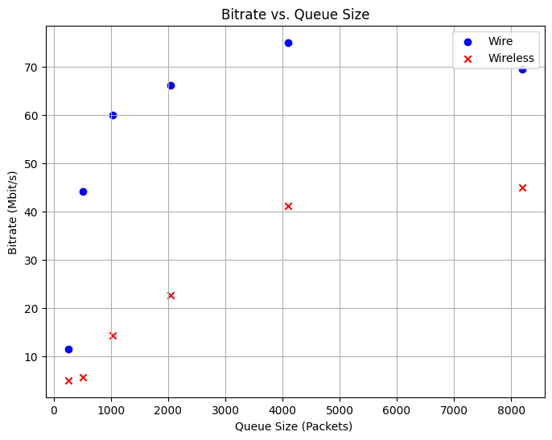
Large queue size can reduce packet loss and significantly increase wireless network throughput.
But too large queue size cannot benefit the wire network, because the network is available but the queue absorbs traffic

Slide 4
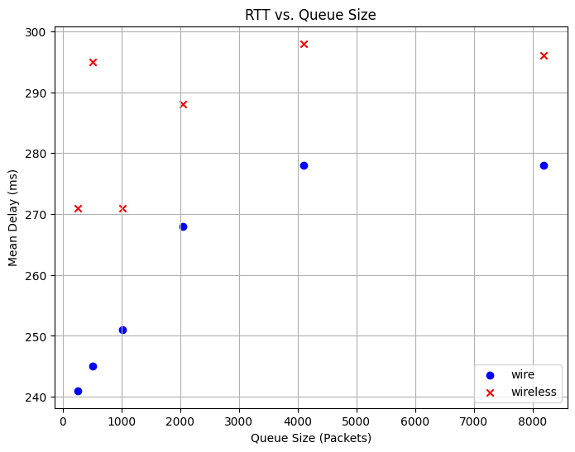
Packets spend more time in the queue before being processed.

Slide 5
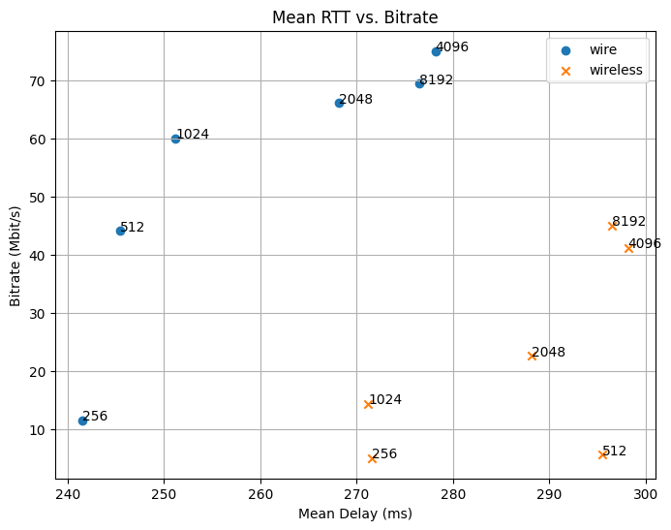
If we select mean delay < 270ms for the wired network, we can choose the 2048 queue size.

Slide 6
Conclusion
Large queue size can significantly increase wireless network throughput. However, a too large queue size cannot benefit the wire network.
Too large queue size has another problem: data or requests spend more time in the queue before being processed.
Wire
If we choose mean delay < 270ms, we can choose 2048 queue size.
Wireless
If we choose mean delay < 290ms, we can choose 2048 queue size.

