Slide 1
About me:
Lin Juyi
Zhejiang University
ISEE
Junior student(third grade)
Notes:
Good , professor! This is Lin Juyi. I am a junior student from Zhejiang University. My ranking in my department is about top 10%. I have achieved A grades in Linear Algebra, Data communication and computer network and so on. Furthermore, I have obtained a Second-Class Scholarship, no more than 8% of students awarded it. Now I’d like to tell some of my experience.

Slide 2
DL Clusters Scheduler
Transactional Memory
Class Project
Notes:
Previously, I have worked the summer research in Prof. C.Wu in HKU. My project is hierarchical reinforcement learning to jointly allocate GPU resources and place jobs on devices. What’s more, I have researched at the Lab for Computer Architecture under the guidance of Prof. Bu Kai since my sophomore year. My major project is memory acceleration.

Slide 3


DL Clusters Scheduler
How many GPU?
Cluster Scheduler
Submit # GPU to scheduler
Notes:
Nowadays, leading IT companies operate ML clusters, where deep learning (DL) models are trained for providing various AI-driven services. Efficient resource scheduling is essential for maximal utilization of expensive DL clusters.

Slide 4
DL Clusters Scheduler
Parameters Server Architecture
gradient
parameters
parameters
gradient
gradient
Submit # GPU to scheduler

Slide 5
DL Clusters Scheduler
Colocated jobs
Job1
Job2
CPU cache sharing
core1
core2
L1cache
L1cache
L2cache
L2cache
L3cache
Notes:
Even though recent elastic schedulers can automatically select an appropriate amount of resources for each job, the problem is that the workers and PSs may well be distributed onto different physical servers, when they cannot be completely hosted on one server, or to maximize resource utilization on servers. However, even without over-subscription of resources, co-located ML jobs on the same server may interfere with each other negatively.

Slide 6
DL Clusters Scheduler
Colocated jobs
Disk sharing
Job3
Job3
Job4
Job4
core1
core2
core3
core4
L1cache
L1cache
L1cache
L1cache
L1cache
L2cache
L2cache
L2cache
L2cache
L2cache
L3cache
L3cache
Disk

Slide 7
Device placement
 | Key idea | weakness
Spotlight: Optimizing Device Placement for Training Deep Neural Networks 2018 | Base on PPO RL | Don’t take colocated multiple jobs into account.
Tiresias: A GPU Cluster Manager for Distributed Deep Learning nsdi 2019 | Improves “optimus”, Proposed the method of GPU resource configuration and placement | 1.The scheduling mechanism and target policy are strongly coupled so that it is difficult to support other more complex strategies. 2.users are required to submit the number of GPUs, which belongs to non-scale-adaptive scheduling.
A HIERARCHICAL MODEL FOR DEVICE PLACEMENT 2018 | Hierarchical model, using FNN and RNN, based on data flow | not consider interference in a multiple-type job cluster

Slide 8
DL Clusters Scheduler
Limitation
not consider interference in a multiple-type job cluster
only optimize the training time for a target model (e.g., a TensorFlow graph)
If we meet another model, we need to retrain this planner
We use PS architecture
Using one NN to produce both resource allocation and placement decisions is challenging, mainly because of the significantly larger action space. That is why we want to use hierarchical RL to schedule.

Slide 9
Job owner
api
State s
State s
Job type
Job type
Allocate worker/PS
Resource demand
Run time
placement
Policy NN
Worker/PS
Policy NN
Remaing epoch
available resource
Domain resource
Current placement
Job’s worker/PS
api

Slide 10
Background
Transactional Memory
Class Project
Notes:
What’s more, I have researched at the Lab for Computer Architecture under the guidance of Prof. Bu Kai since my sophomore year. My major project is memory acceleration.

Slide 11
Transactional Memory
Parallel Programming
Between concurrent tasks, writing the same variable requires a synchronization mechanism to ensure its coherence. Some parallel programs use the lock or the semaphore mechanisms. But these mechanisms make parallel programs difficult to design, debug, and generally perform poorly.
We use transaction memory to improve the performance of parallel programs, and ensure the efficiency of programming.
Notes:
In this work, we develop a novel logging mechanism. We use transaction memory to improve the performance of parallel programs, and ensure the efficiency of programming.

Slide 12
Transactional Memory
TM（Transactional Memory），事务内存。
Find independent tasks in the algorithm
Map tasks to execution units (e.g. threads)
Define and implement synchronization among tasks
Parallel Programming
Avoid races and deadlocks …
Compose parallel tasks
Transactional Memory
Recover from errors
Ensure scalability
Manage locality
...
Notes:
Transactional memory could recover from errors, rollback , implement synchronization among tasks.

Slide 13
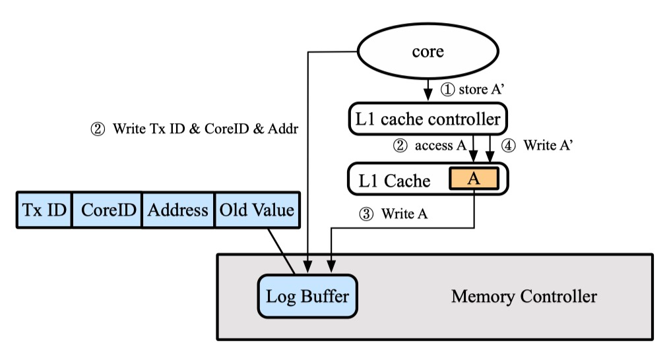
Limitation?
Logging eagerness: coupling store and log
Notes:
The previous methods write log into memory controller before writing data into cache, the core collects meta-log，get old value，write old value into memory controller, then write new value into the cache. Writing through old value wastes time and spatial locality.

Slide 14
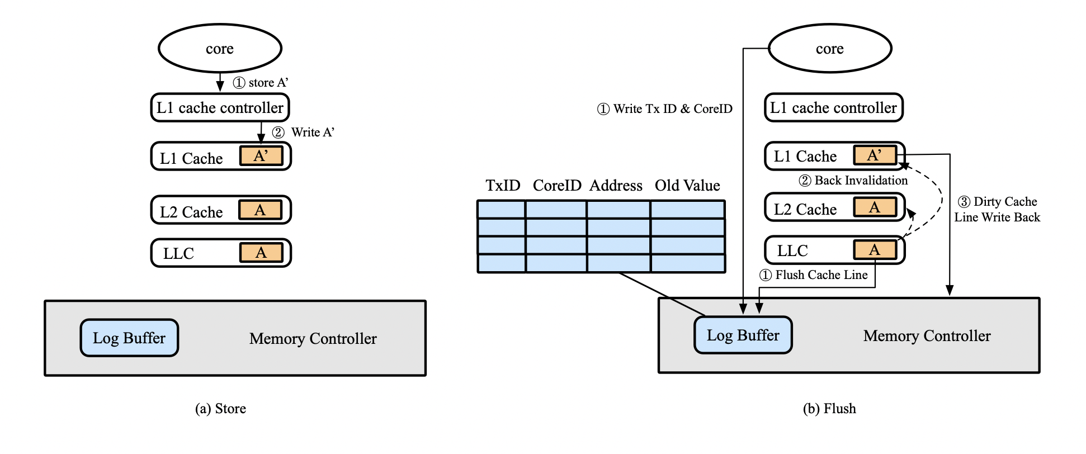
Lazy Logging
Notes:
Our method is generating log before eviction. Update cache immediately when store. Generating log when commiting, we use flush to evict cache line.

Slide 15
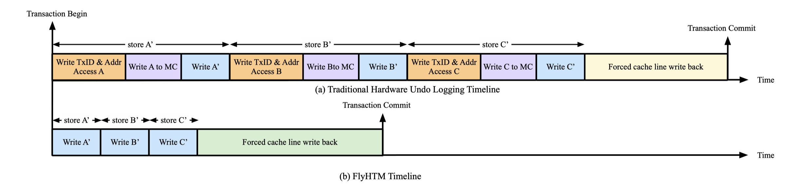
Lazy Logging
Shortened execution of store instructions.
Inherent support of log coalescing.

Slide 16
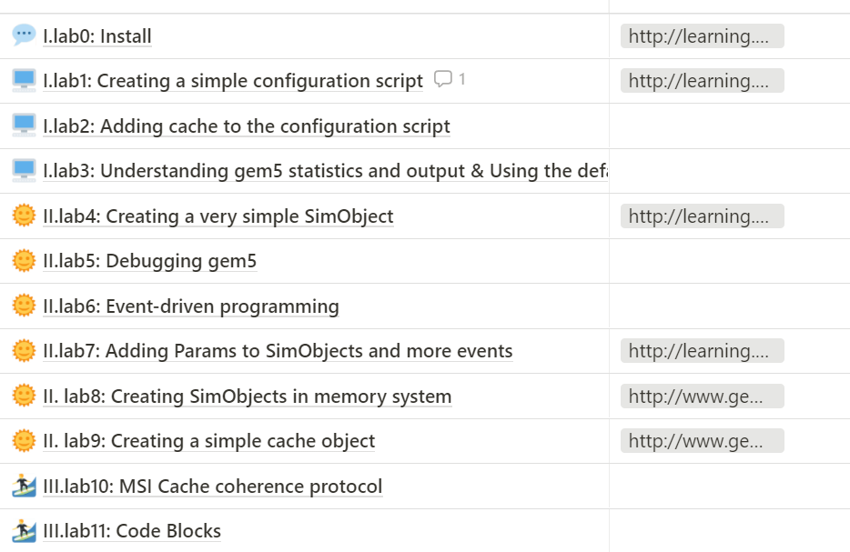
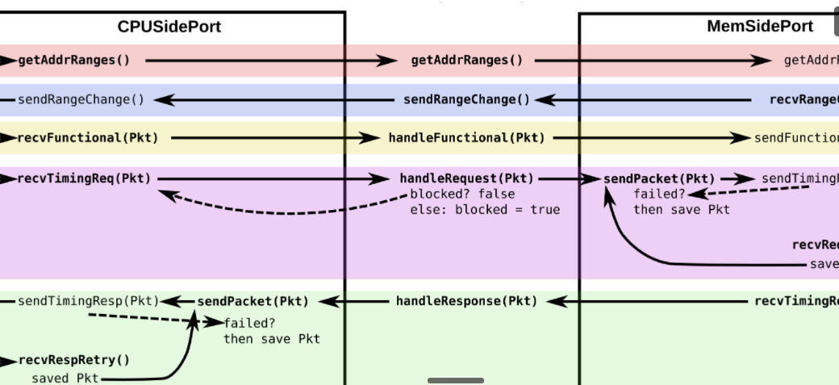
Design the optimization method and make a theoretical comparison
Learn gem5 and the experiment
Notes:
I finished the experiment with gem5 framework， mainly c++. This is my learning notion and a piece of gem5.

Slide 17
Class Project
AI project
I implement a particle filter algorithm to track the specified target.
I implement a reinforcement learning project using Q-learning
Java Application
I used JavaFX as UI, implemented an online chat room, which has group chat\private chat\login\register, and other functions。It supports multiple clients connection.

Slide 18
Thanks.

