Slide 1
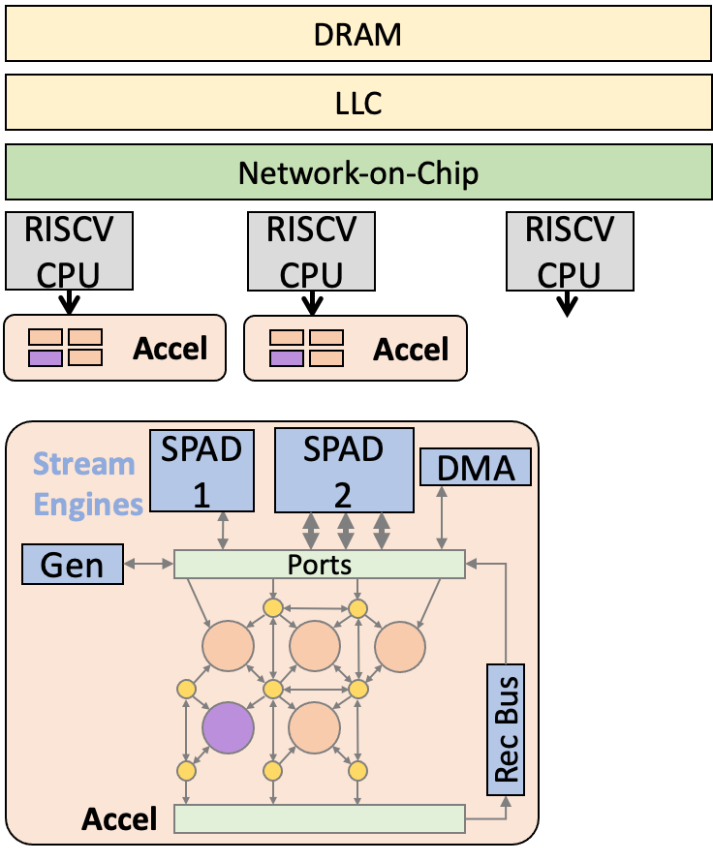

DSE Goal Overview
What’s the best hardware architecture for a given set of application workloads?
Notes:
Take a set of input applications, how to create optimal hardware architecture for these applications. Specifically, how to automatically design the spatial and system design parameters to achieve the best performance. Fundamentally, this algorithm must balance generality and specialization degree. While system design parameters (# of tiles, # of banks, ect.) are concrete lets go into example on what spatial parameters are.

Slide 2
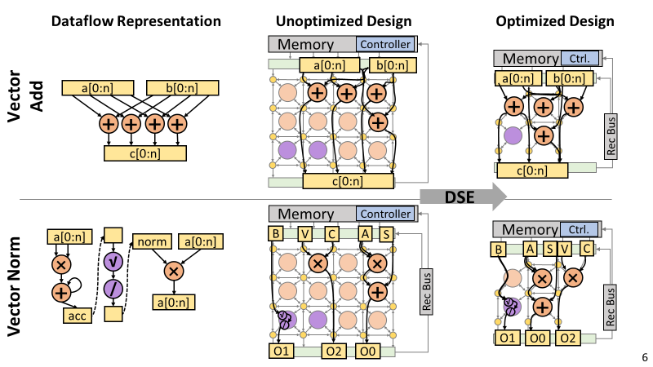
DSE Intuition
Notes:
We take a regular mesh-like pattern with a given dfg. We get a more irregular pattern that is closer to the original dataflow.

Slide 3
Basic DSE Algorithm
2. Recompile Programs
Background and set of DSE going for tutorial purposes
How do we model performance?
How do we model resources?
How does the spatial DSE work? (and how to make it fast)
How does the system-level DSE work?
How does it work in practice, and what do the resulting designs look like?
1. Randomly Modify ADG
3. Check Area and Performance
4. Select ADG?

Slide 4







Auto-Extraction of DFG Files
$ cd $SS/dsa-apps/demo
$ python3 extract.py
Extract.py

Slide 5
mDFG Recap
Array C
Size: N
Array B
Size: N
Array D
Size: NxN
Having memory information helps the DSE make better decisions (more on this later)
Memory Enhanced DFGs include:
Array Nodes
Array Capacity
Array Reuse Rate
Autogenerated for local arrays
For global arrays, currently must hint:
arrayhint(void* array, int size, int reuse)
c[0:n]
Reuse:N
b[]
Reuse:N
d[0:n,0:n]
Reuse:1
a[0:n]
Reuse:N
✖️
✖️
＋
＋
Array A
Size: N
a[0:n]
Reuse:N
$ [text-editor] dfgs/mv/mv_0_2.dfg
Memory-enhanced Dataflow Graph

Slide 6
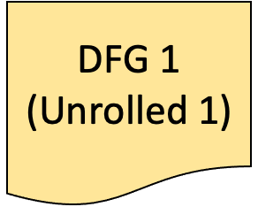



Specifying DSE Input DFGS
DSE utilizes dfgs.list file for different workloads
Contains workloads used for DSE Exploration
Different workloads are separated by “%%”
Within a workload, DSE will choose between the different vectorization degrees
Workloads can also have optional weight parameter, for workloads with multiple different dfgs
%%
%%
$ [text-editor] dfgs.list
Notes:
The compiler generates different vectorization degrees for a given workload. The DSE will choose the best vectorization degree between percentage signs. Additionally, weight parameter to specify how much to focus on this workload in comparison to others, use geometric mean

Slide 7
Starting the DSE
$ ss_sched dfgs.list ../adg/Mesh7x5-Full64-Full7I5O.json -x -f -m 200 --dse-timeout=500
ss_sched dfgs.list [adg] -x -f [options]
Option | Default | Description
f, fpga | false | Use FPGA-based model. Required for DSE
m, max-iters | 20,000 | Maximum Iterations of Scheduling Attempts
t, timeout | 86,400 | Scheduling timeout (s)
dse-timeout | None | DSE timeout (s)
w, sched-workers | 1 | Number of workers used for scheduling.
e, seed | None | Set random seed
Notes:
Command to run dfg. Currently, our DSE only supports fpga-based exploration, but will support ASIC-based exploration in the immediate future.

Slide 8
Analytical Models
Array C
Size: N
Array B
Size: N
Array D
Size: NxN
Array C
Size: N
Array B
Size: N
Array D
Size: NxN
SPAD 1
SPAD 2
DMA
c[0:n]
Reuse:N
b[]
Reuse:N
d[0:n,0:n]
Reuse:1
a[0:n]
Reuse:N
Gen
Ports
✖️
✖️
＋
＋
Rec Bus
Array A
Size: N
Array A
Size: N
a[0:n]
Reuse:N
mDFG
adg
Bottleneck-based Model to Estimate IPC using mDFG
Notes:
Streams, know the access pattern and everything flowing into the accelerator

Slide 9
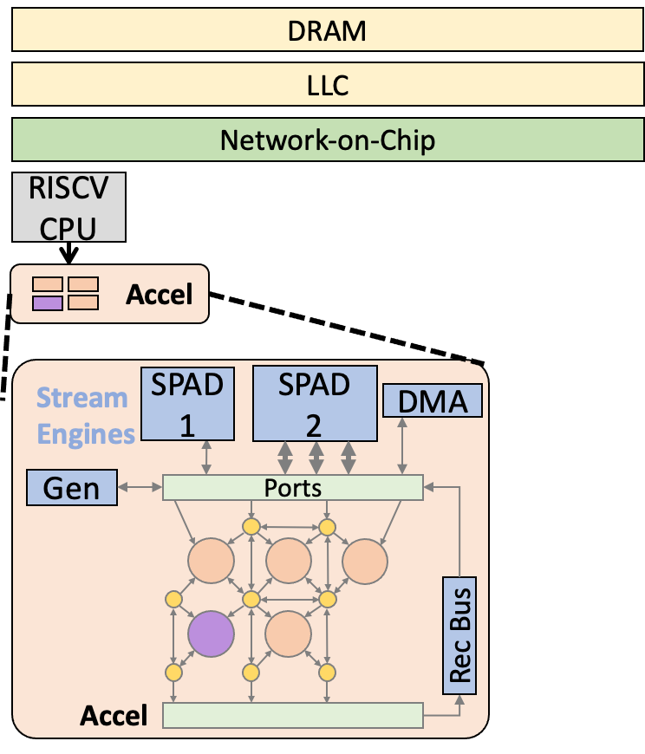
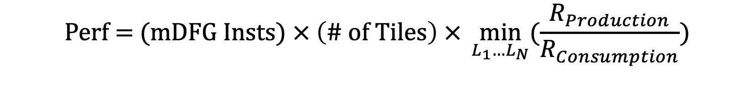
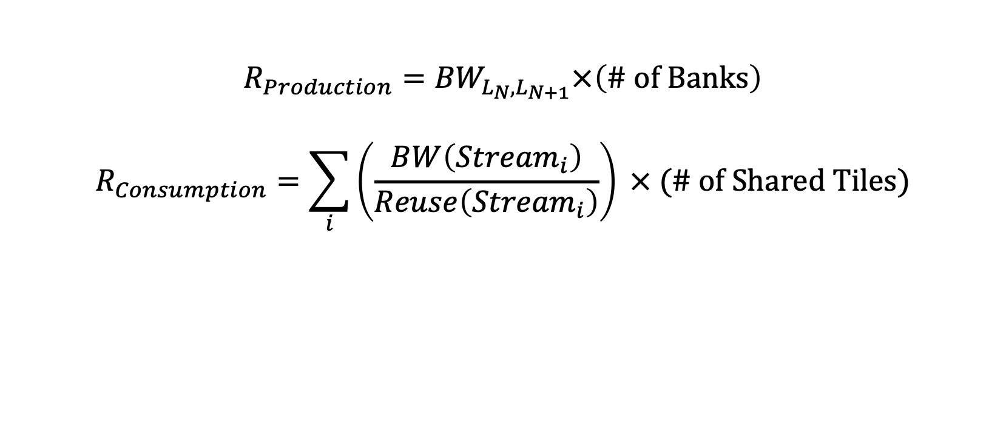
Analytical Models
L₄
L₃
L₂
L₁
Notes:
On a basic, the performance is the number of instructions times the number of tiles times the bottleneck factor. Bottleneck factor is calculated differently for each layer of the memory hierarchy, but for each layer it amounts to basically the amount of data that can be produced for that layer divided by the amount of data that can be used for that layer.
Rec bus, for forwarding loop-carried dependencies, is special. Only cares about latency within the computation and whether it can hide the latency of recurrence.
Spad: Local memory that’s on each tile. Cares about capacity of this scratchpad and bus size.
LLC: Shared amongst all tiles, highly depends on reuse rate.
DRAM: Final memory layer, has a fixed production bandwidth that doesn’t change during exploration
Finally take min

Slide 10
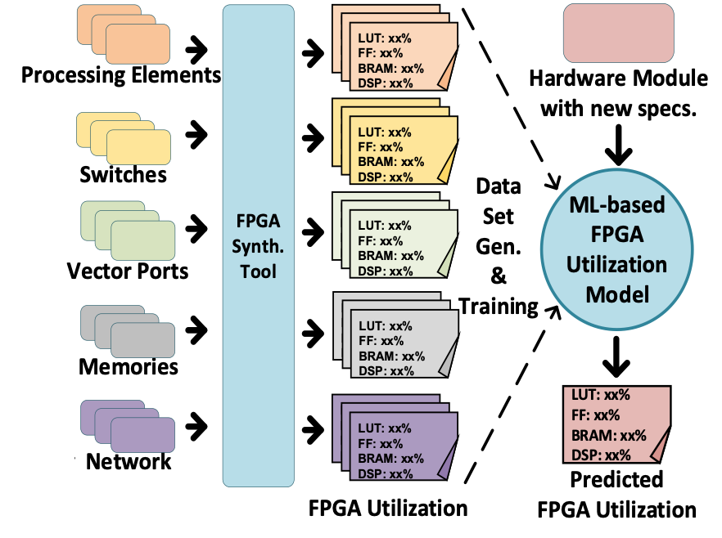
Resource Estimation Models
Component-Based
3-layer MLP
80/10/10 Train/Test/Validation Split
Notes:
Synthesis takes hours, we modify every iteration. Doesnt need to be tooo accurate, motivates using machine learning. Predict all the different fpga resources, the DSE algorithm uses the most constrained resources when choosing designs.

Slide 11
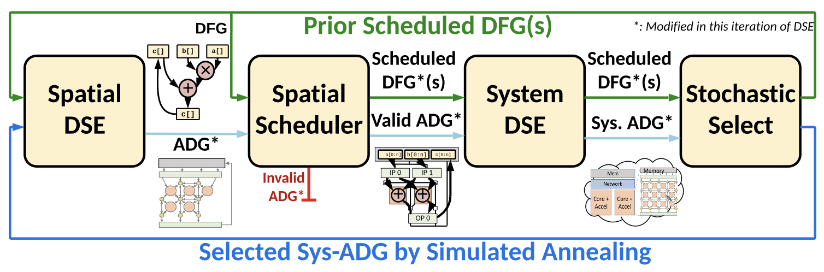
Design Space Explorer
Notes:
At an overview of the algorithm we implemented, it first performs spatial exploration, then scheduling (which is most intensive), then goes into system design and will finally select

Slide 12
Spatial Design Space Exploration
DMA
DMA
DMA
SPAD
+
+
+
+
+
+
+
+
+
+
+
+
+
+
+
+
+
+
+
+
+
+
+
+
×
×
×
×
×
×
×
×
×
×
Remove Functionality
+ Save resources
- Less flexibility
- Lower Performance
- Recompile : )
Add Functionality
+ Generality
+ Performance
- More resources
Alternatively, We can modify functionality (e.g. fifo depth, operation support)

Slide 13
Spatial Scheduling
Vector Port
1
1
1
2
×
×
2
3
3
+1
4
4
＋
＋
Vector Port
How is the dependence graph of computational instructions mapped?
Placement: Map instruction to PE’s with corresponding capability.
Routing: Routing the dependence edges thru the spatial network.
Timing: If necessary, balance the timing of data arrival
If one of 1-3 is not successful, revert some nodes and repeat 123

Slide 14
Spatial Scheduling
Vector Port
×
＋
Vector Port
Relaxing constraints to make scheduling easier
Allowing over-provisioning and timing violations during first scheduling passes
Gradually make process by rerouting over-provisioning and timing violations

Slide 15
Spatial Scheduling
Scheduling is computationally intensive. Takes ~90% of DSE Time
Solutions:
Don’t fully recompile! Partial compile from the last step.
How to partial compile as the architecture (i.e. the ISA) is changing?
Solution: Compiler generates many versions of each program region that could be useful, and try to schedule all of these versions. E.g. Same program region with many different unrolling degrees (vector widths).
Carefully change hardware to not invalidate compiled programs!
Technique: schedule preserving transformations
Explore ALL system parameters at each step of DSE -> Cheap + Faster Convergence

Slide 16
Schedule-Preserving Transformations
Delete Middle Switch
SW
PE
SW
PE
SW
PE
No Connections for DFG Edges
Edge from
DFG 1
Edge from
DFG 2
Edge from
DFG 1
Edge from
DFG 2
SW
SW
PE
SW
PE
SW
PE
Naïve ADG Transform
Schedule-preserving Transform
Snippet of Scheduled ADG
+ ADG simplified
- Extra Compile time
- Lower HW applicability
+ ADG simplified
+ No Extra compile
+ HW applicability preserved
Notes:
Effectively reduces design space, only exploring schedules that are very likely to succeed versus ones that are not

Slide 17
System Design Exploration
Spatial Scheduling is Expensive!
Takes up 90% of DSE Time!
Changing system parameters doesn’t require recompilation
and only will require a performance recalculation (which is cheap)
Nested Exhaustive Search of:
# of Tiles
# of Banks
System Bus Size
Notes:
Tie in performance, we would choose design with more tiles.

Slide 18
Design Space Explorer
Few Big vs Many Smaller Tiles
More Compute vs More Network
Datapath Specialization Degree
L2 vs Scratchpad Size
Notes:
Overview, we go through steps.
In practice, we found this algorithm effective in exploring different tradeoffs such as:
Few Big vs Many Smaller Tiles, Vectorization degree depends highly on reuse rate (algorithm tended to add more tiles)
L2 vs Scratchpad Size, Tradeoff between adding capacities at different levels of hierarchy.
More Compute vs More Network: Incremental Workload (Generality). At beginning all fus contain one operation, but as more workload is added, we get fewer function al units with multiple operations and more generalized network
Datapath specialization: How generalized to make datapath? Explored in Leave-one-out

Slide 19
Graph Visualization
$ python3 $SS/scripts/adg_visualization.py viz/prunned-schedadg.json
$ python3 $SS/scripts/sched_visualization.py viz/prunned-schedadg.json
$ python3 $SS/scripts/dse_graphs/adg_analysis_graph.py viz/prunned-schedadg.json
$ python3 $SS/scripts/dse_graphs/dse_resource_bar.py viz/objectives.csv
$ python3 $SS/scripts/dse_graphs/dse_graphs.py viz/objectives.csv

Slide 20
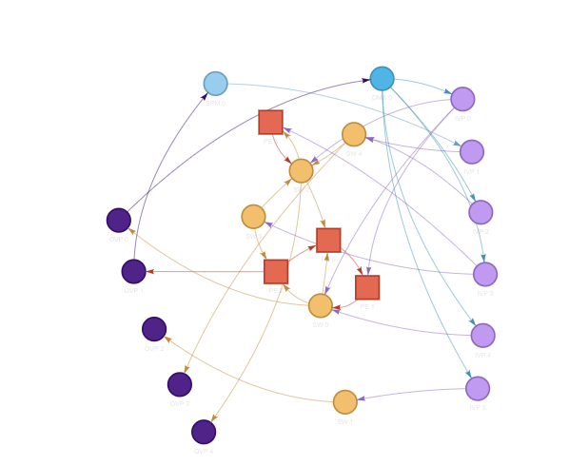
Graph Visualization
Scratchpad
DMA
Output Ports
Processing
Element
Input Ports
Switch
viz/prunned-schedadg.html

Slide 21
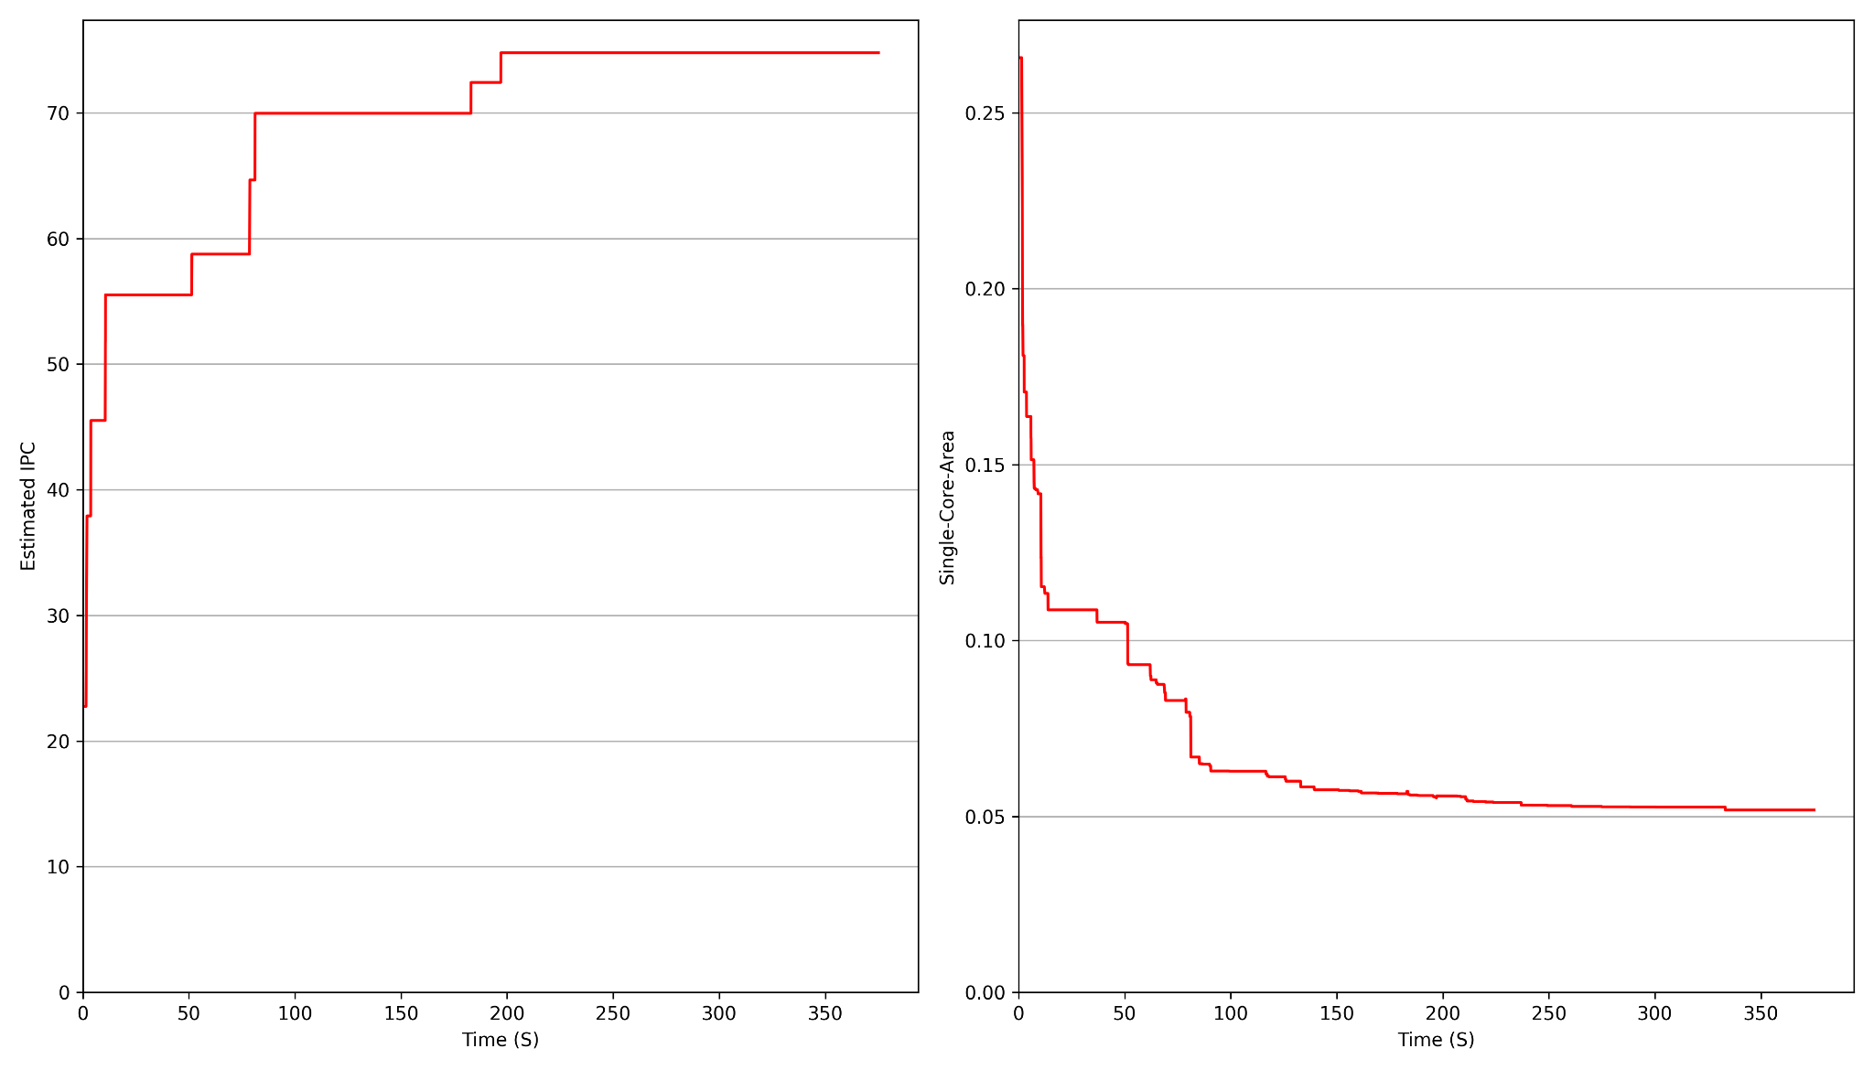
Estimated Performance + Single-Core Resources
viz/dse_graphs/dse-objective.png

Slide 22
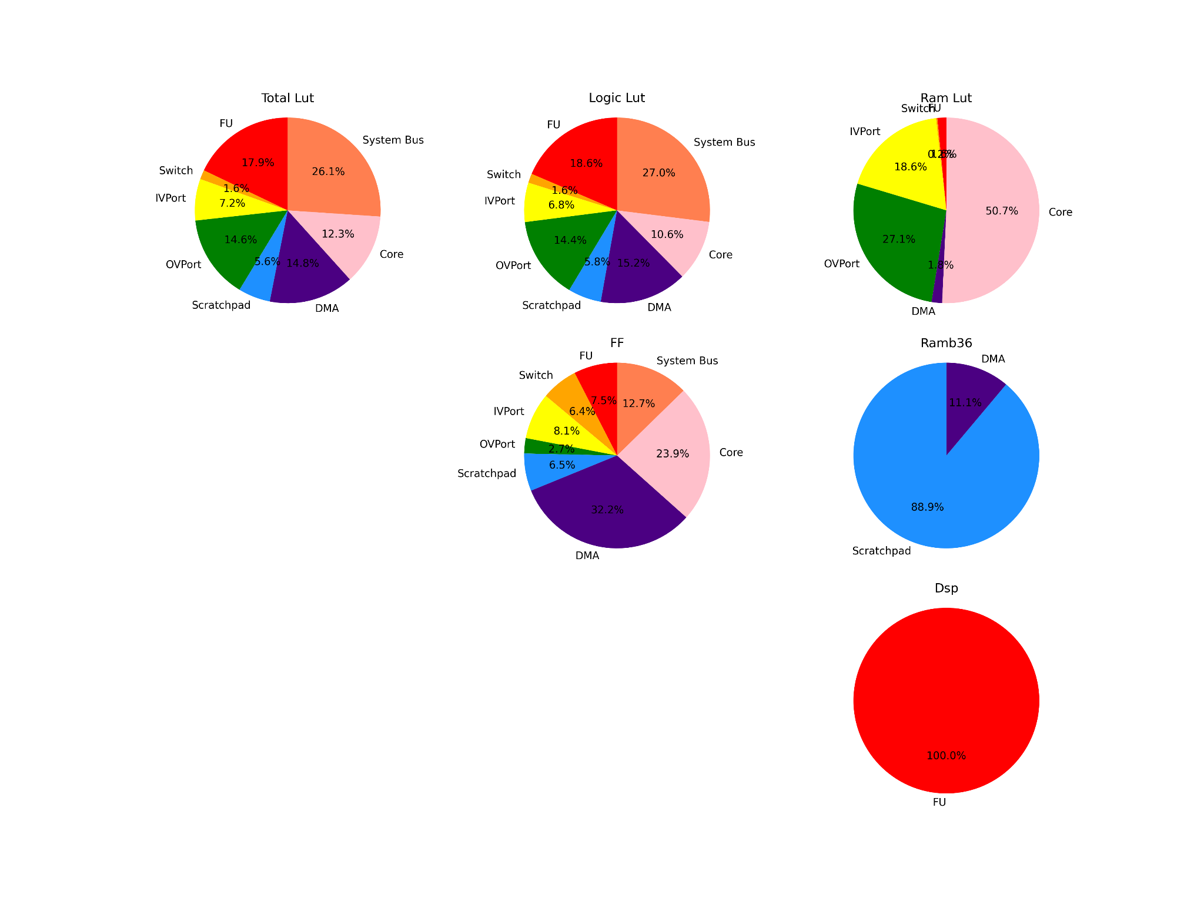
Final Resources
viz/dse_graphs/dse-final-resources.png

Slide 23
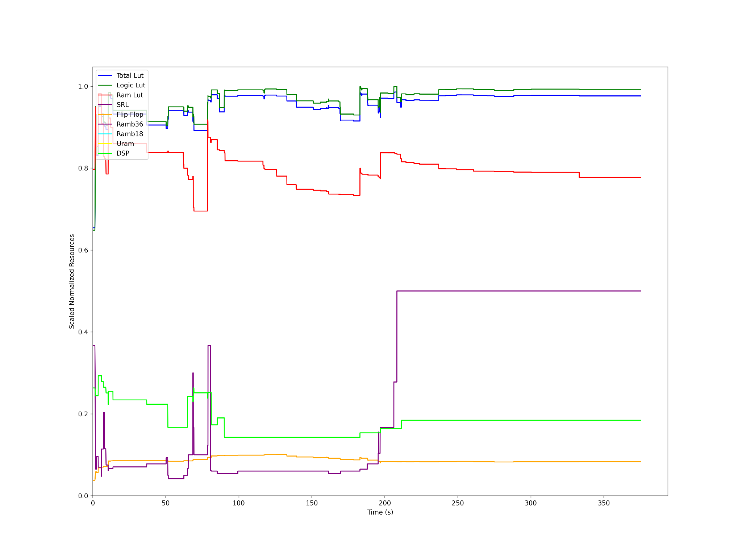
Normalized over time
viz/dse_graphs/dse-scaled-normalized-resources.png

Slide 24

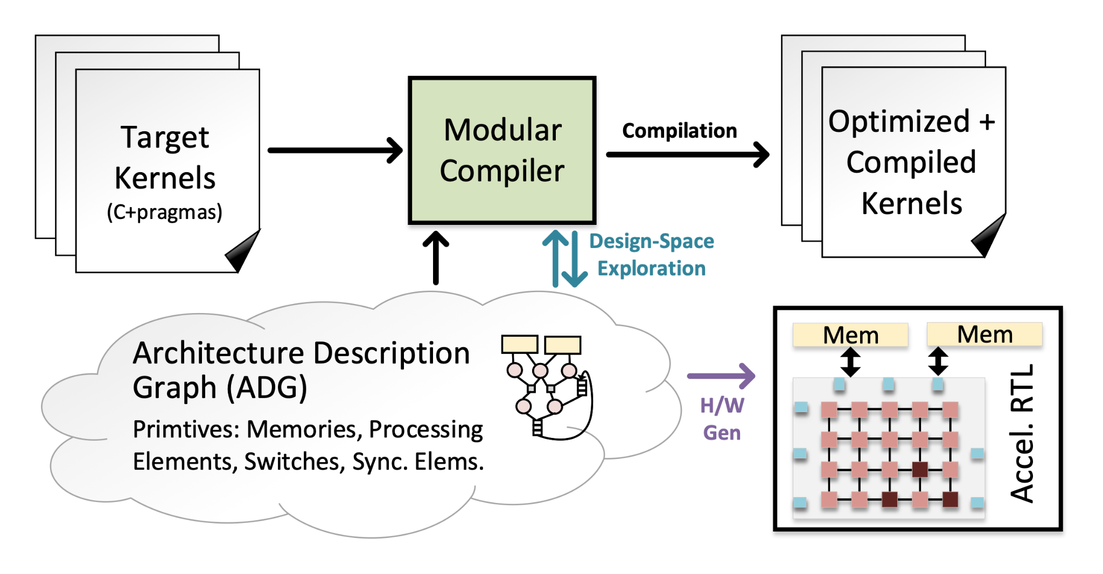
Notes:
An automated full-stack end-to-end method competitive with HLS Synthesis

