Slide 1

Abstraction, Compilation, Visualization, and Functional Simulation
Jian Weng
PolyArch Research Group
University of California, Los Angeles
Oct 2nd, 2022; MICRO 2022 Tutorial
Notes:
OK. Let’s continue to my section.
This section is mainly about the high-level programming abstraction, and how it is compiled.
For the demonstration purpose, I will also show you how to visualize the result of compilation and feed the compiled binaries to functional simulation.

Slide 2
Roadmap
High-level Abstraction
Pragma annotation
Compilation Flow
Understanding the flow
Visualizing the ADG and Mapped DFG
Slightly more on spatial execution
Functional Simulation
Understanding the simulation log
Notes:
Here is an outline of this section. We first look at the high-level programming interface.

Slide 3
Access our Server
SSH to our Server
ssh micro2022@pyrito.cs.ucla.edu # password: micro2022
ssh [user-name]@micro2022
User Name: user[1-50]
Password: [random-generated]
Wait to be assigned
Sanity Check
$ dsa-framework
$ source setup.sh # We are already on zsh!
$ cd dsa-apps/sdk/compiled
$ ./run.sh ss-vecadd.out
If you see the message below, the infra is setup properly
Notes:
Before starting, I just want to make sure everyone is on-board.
If so, you can try the command above to see if it works.
In the rest of this section, I will explain what happens in this run.sh script.

Slide 4
Compiling High-Level Lang. to Decoupled Spatial
ADG
?
DFG
Decoupled-Spatial Binaries
Apps
Pragma Annotation
Modular XFROM
Mem. Stream
Goal: Compiling high-level language to decoupled-spatial architectures.
Map program behaviors to specialized different components.
Pragma Hints:
How should the program be decoupled and rewritten?
How to deal with the code concurrency?
Robust across any design points within this space.
Modular transformations
Notes:
Our compiler is for domain-specific accelerator design automation, but when designating the design space, we should assume we are domain agnostic. Therefore, we should start with a general-purposed high-level abstraction, so we adopt C.
This also leaves our programming interface open to be a backend for a domain-specific stack like TVM.
As I mentioned before, we have two main challenges: 1. Instructions are executed on different components, how can we decouple them; 2. We are targeting a family of architecture, so our compiler should be robust across any design points.

Slide 5
Compiling High-Level Lang. to Decoupled Spatial
ADG
?
DFG
Decoupled-Spatial Binaries
Apps
Pragma Annotation
Modular XFROM
Mem. Stream
Goal: Compiling high-level language to decoupled-spatial architectures.
Map program behaviors to specialized different components.
Pragma Hints:
How should the program be decoupled and rewritten?
How to deal with the code concurrency?
Robust across any design points within this space.
Modular transformations
Notes:
Our compiler is for domain-specific accelerator design automation, but when designating the design space, we should assume we are domain agnostic. Therefore, we should start with a general-purposed high-level abstraction, so we adopt C.
This also leaves our programming interface open to be a backend for a domain-specific stack like TVM.
As I mentioned before, we have two main challenges: 1. Instructions are executed on different components, how can we decouple them; 2. We are targeting a family of architecture, so our compiler should be robust across any design points.

Slide 6
An Example of Pragma Annotation (dsa-apps/demo/mv.c)
← dfg region in this compound body are concurrent
#pragma ss config
{
#pragma ss stream
for (i=0; i<n; ++i) {
acc=0;
#pragma ss dfg
for (j=0; j<m; ++j)
acc += a[i*n+j] * b[i];
c[i] = acc;
}
}
← The memory accesses below will be restricted
← The computational instructions below will be offloaded
Notes:
From inner to outer.
the offload pragma ...
the stream pragma ...
the config pragma ...
Next, I will demonstrate how the compiler take advantage of these pragmas to analyze and rewrite the program.
Some LLVM pseudo-IR will be presented, but I guess it is OK. You can get it without knowing what it exactly it.

Slide 7

Parse the Pragma w/ Extended Clang
$ cd dsa-apps/demo/
$ make mv.ll
$ [open-text-file] mv.ll
Our extended Clang is invoked to parse the pragmas.
The parsed pragma are encoded in metadata of LLVM module.
Look at ! at the end of the .ll file
❗ We are approaching a hard/sleepy part.

Slide 8
Understanding the Encoded Hints in LLVM IR (mv.ll)
Also look at !llvm.loop !10
br is the backward-jump of a for-loop
Scroll down to the very last to read the associated values
!10 = {!10, !11} "The 1st arg of a loop metadata is always itself
!11 = {!"llvm.loop.ss.dedicated", i32 1} "Annotated by #pragma dfg
Dedicated and Temporal corresponds to the execution model we discussed just now
The integer is the unrolling degree encoded in the unroll clause
We will play with it later
Search for !llvm.loop !8
!8 = {!8, !9} "The 1st arg of a loop metadata is always itself
!9 = {!"llvm.loop.ss.stream", i32 1} "Annotated by #pragma stream
Look at llvm.ss.config.{start()/end()} pair
The scope of compound body annotation.

Slide 9
Pragma Annotated Matrix-Vector Multiply w/ Metadata Encoded in LLVM IR
%begin = llvm.ss.config.begin()
#pragma ss config
{
#pragma ss stream
for (i=0; i<n; ++i) {
acc=0;
#pragma ss dfg
for (j=0; j<m; ++j)
acc += a[i*n+j] * b[i];
c[i] = acc;
}
}
!9 = {!"llvm.loop.ss.stream", i32 1}
!11 = {!"llvm.loop.ss.dedicated", i32 1}
call llvm.ss.config.end(%begin)

Slide 10
Compiling High-Level Lang. to Decoupled Spatial
ADG
?
DFG
Decoupled-Spatial Binaries
Apps
Pragma Annotation
Modular XFROM
Mem. Stream
Goal: Compiling high-level language to decoupled-spatial architectures.
Map program behaviors to specialized different components.
Pragma Hints:
How should the program be decoupled and rewritten?
How to deal with the code concurrency?
Robust across any design points within this space.
Modular transformations
Notes:
Our compiler is for domain-specific accelerator design automation, but when designating the design space, we should assume we are domain agnostic. Therefore, we should start with a general-purposed high-level abstraction, so we adopt C.
This also leaves our programming interface open to be a backend for a domain-specific stack like TVM.
As I mentioned before, we have two main challenges: 1. Instructions are executed on different components, how can we decouple them; 2. We are targeting a family of architecture, so our compiler should be robust across any design points.

Slide 11
Decoupled-Spatial Paradigm: Summary
for (int i = 0; i < n; ++i)
c[i] += a[i] * b[i];
RISCV-Core
Imperative Control Flow:
Control Commands:
Memory
Mem. Controller
loop:
%1 = load a[i]
%2 = load b[i]
%3 = %1 * %2
%4 = load c[i]
%5 = %3 + %4
store %5, c[i]
i = i + 1
br i < n, loop
a[0:n]
A
A
B
C
b[0:n]
B
×
c[0:n]
C
c[0:n]
＋
D
c[0:n]
barrier
D
Notes:
Specific to our implementation, the host controller is a light-weighted single-issue riscv-core, so programming a decoupled-spatial architecture is essentially encode and embed these specialized program idioms in the RISCV assembly code. This can be done either manually embed the assembly code in the von-neumann program or transformed by a compiler.
Comparing against conventional CGRA, “decoupled” memory access keeps the computational resources simple.
Also, because the memory accesses are encoded in idiomatic patterns, the memory requests are no longer fragmented scalars, which leads to better b/w utilization.
On the other hand, it explicitly separate the executions b/t compute and mem access, which brings more challenges in compilation.
In next section, I will elaborate the high-level programming interface and the flow of compilation.

Slide 12
Decoupled Spatial Transformation
$ make ss-mv.ll
$ [ur-favorite-editor] ss-mv.ll
Then you have 2 files to under the folder
ss-mv.ll: The transformed IR with
Computational instructions offloaded/erased
Memory streams encoded in inlined assembly
mv_0_1.dfg: The extracted DFG with
Computational graph
Metadata encoded
Notes:
Next we have two things to do.
Understand the mv.dfg
Try different unrolling degree

Slide 13
Encoded Host Control Commands: Bitstream & Barrier
We use ss_cfg_param for bit stream loading
See the 1st command!
(addr, size-of-bitstream)
ss_wait is the barrier
Wait for all the streams before this barrier retire, so that the program can move forward
Refer dsa-riscv-ext/ for more details
dsaintrin.h
intrin_impl.h

Slide 14
Encoded Host Control Commands: Memory Stream
Scalar? Vector?
“Stream”: A set of memory accesses under canonical loop nest
Dense Memory Generator
Sparse
for (i=0; i<n; ++i)
for (j=0; j<m; ++j)
for (k=0; k<p; ++k)
// request a[i*si+j*sj+k*sk], linear combination
for (i=0; i<m; ++i)
for (j=0; j<n[i]; ++j)
// request a[b[i]+j], another level of mem access involved

Slide 15
Encoded Memory Streams (CONT’D)
Dense Memory Generator
Open ss-mv.ll
ss_cfg_param configs registers in gray boxes
Load trip count/coefficients of each dimension
Load data dtype of the access
ss_lin_strm instantiates streams
Encode the flags of a stream: read/write; memory flag; port
Streams w/ same ports will be executed in the order of they appear
Streams w/ different ports will be concurrently round robin
for (i=0; i<n; ++i)
for (j=0; j<m; ++j)
for (k=0; k<p; ++k)
// request a[i*si+j*sj+k*sk], linear combination

Slide 16
Pragma Annotated Matrix-Vector Multiply w/ Metadata Encoded in LLVM IR
#pragma ss config
{
#pragma ss stream
for (i=0; i<n; ++i) {
acc=0;
#pragma ss dfg
for (j=0; j<m; ++j)
acc += a[i*n+j*1] * b[i];
c[i] = acc;
}
}
for (i=0; i<n; ++i)
for (j=0; j<m; ++j)
for (k=0; k<p; ++k)
// request a[i*si+j*sj+k*sk]
Notes:
From inner to outer.
the offload pragma ...
the stream pragma ...
the config pragma ...
Next, I will demonstrate how the compiler take advantage of these pragmas to analyze and rewrite the program.
Some LLVM pseudo-IR will be presented, but I guess it is OK. You can get it without knowing what it exactly it.

Slide 17
Fully Pipelined Loop-Carried Addition
for (i=0; i<n; ++i) {
acc=0;
for (j=0; j<m; ++j)
acc += a[i*n+j] * b[i];
c[i] = acc;
}
Q1: How to specialize for the loop-carried operand?
S1: Intermediate result should be stored in PE-local register.
Q2: How to execute the different behaviors within different loop nest?
Notes:
Another use of the stream state is the accumulator idiom. Assuming each processing element has local register and supports conditional execution.
Then the dataflow graph should look like this: One operand is from the port and the other is from the local register. A control signal goes to the PE to tell: 1 and 2. These predicate can easily be encoded in the stream state. This can naturally be encoded in the stream state.

Slide 18
Understanding Stream State (CONT'D)
Response Packet
Data:
State:
for (i=0; i<n; ++i) {
acc=0; // reset before j starts
for (j=0; j<m; ++j)
// produce value when j ends
acc += a[i*n+j] * b[i];
c[i] = acc; // consume the value
}
Start of 1d
End of 1d
Start of 2d
End of 2d
Start of 3d
A.state
A
B
End of 3d
×
Write intermediate result to reg!
Produce finalized result (end of 2nd dim)!
PE Specialization
Local registers: Store intermediate results
Conditional LUT
+
reg
Out
Notes:
Another use of the stream state is the accumulator idiom. Assuming each processing element has local register and supports conditional execution.
Then the dataflow graph should look like this: One operand is from the port and the other is from the local register. A control signal goes to the PE to tell: 1 and 2. These predicate can easily be encoded in the stream state. This can naturally be encoded in the stream state.

Slide 19
Compiling High-Level Lang. to Decoupled Spatial
ADG
?
DFG
Decoupled-Spatial Binaries
Apps
Pragma Annotation
Modular XFROM
Mem. Stream
Goal: Compiling high-level language to decoupled-spatial architectures.
Map program behaviors to specialized different components.
Pragma Hints:
How should the program be decoupled and rewritten?
How to deal with the code concurrency?
Robust across any design points within this space.
Modular transformations
Notes:
Our compiler is for domain-specific accelerator design automation, but when designating the design space, we should assume we are domain agnostic. Therefore, we should start with a general-purposed high-level abstraction, so we adopt C.
This also leaves our programming interface open to be a backend for a domain-specific stack like TVM.
As I mentioned before, we have two main challenges: 1. Instructions are executed on different components, how can we decouple them; 2. We are targeting a family of architecture, so our compiler should be robust across any design points.

Slide 20
Understanding the Dataflow Graph
The original instructions are rewritten.
Decoupled computational instructions are in mv_0_1.dfg
mv: The function from which this graph extracted.
0: The 0-based rank of this DFG in the function.
1: The unrolling degree of the DFG.
dfg has an optional clause unroll(x) to tune the resource occupation
If not specified x=1
If x=-1, the compiler will enumerate a feasible unrolling degree.
Decoupled memory access are encoded in stream intrinsics.
Notes:
Next we have two things to do.
Understand the mv.dfg
Try different unrolling degree

Slide 21
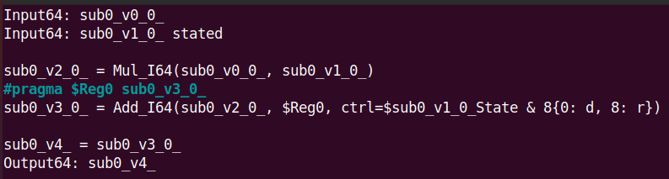
Understanding the Generated DFG: Instructions & State
We first focus on the dataflow graph itself
No Comments (For debugging)
No DFG Pragmas (For DSE)
No Arrays (Also for DSE, will be explained in DSE section)
A.state
A
B
×
+
reg
Out
$ ss_sched mv_0_1.dfg -f
$ neato –Tpng –o mv_0_1.png mv_0_1.gv

Slide 22
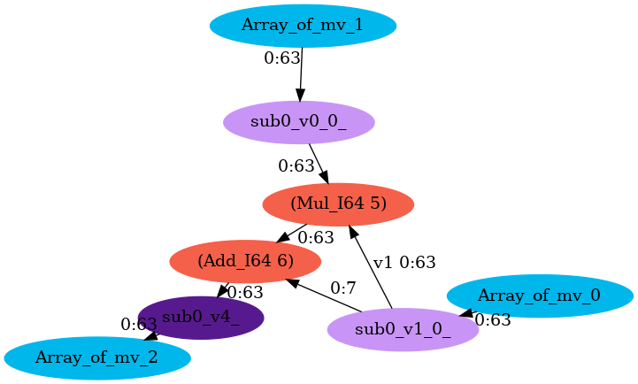

Slide 23
Address Generator: State of Memory Stream
“State”
Affiliated to memory response requested by address generator
1st/last iteration of each dimension are considered special
Response Packet
Data:
State:
a[0:n]
A[2]
A consumes 2 elements per instance
n % 2 == 1
1-d last is affiliated with last response
Implicitly pad a null element
Start of 1d
End of 1d
6 extra bits to indicate the state
Start of 2d
End of 2d
Start of 3d
End of 3d
Notes:
Besides the capability of the memory address generator, another interesting part to talk about is the memory state. The first and last iteration of each level of loop are considered special, so we attach these information to the memory response packet for each requested by the address generator.
These information is useful, which can both be used by the port and the PE control.
The port can use this information to implicitly pad non-divisible data residue.

Slide 24
Understanding the DFG-ADG Mapping
$ ss_sched spmv_0_1_1.dfg \
../adg/Mesh7x5-Simple64-Full7I5O.json -f
$ python $SS/scripts/sched_visualization.py \
viz/sched_adg.json
Find a html file in viz/sched_adg
A simulated annealing algorithm is invoked to find an isomorphism between the DFG and the ADG

Slide 25
Spatial Mapping
Sync
1
1
1
×
2
2
3
3
+1
＋
4
4
How is the dependence graph of computational instructions mapped?
Sync
Placement: Map instruction to PE’s with corresponding capability.
Routing: Routing the dependence edges thru the spatial network.
Timing: If necessary, balance the timing of data arrival
If one of 1-3 is not successful, revert some nodes and repeat 123
Notes:
We use this algorithm to map a dependence graph.
First, map the instructions to the proper PEs.
Second, route the dependence edges through the switches.
Third, if certain PEs adopt a static timing, we need to match the timing of data arrival.
If one of the step fails, we simply unmap some instructions and try each of these steps with randomness again. We repeat it iteratively until the objective converges. The objective captures high throughput and low latency.

Slide 26
Understanding Memory Allocation
A.state
A
B
×
+
reg
Out

Slide 27
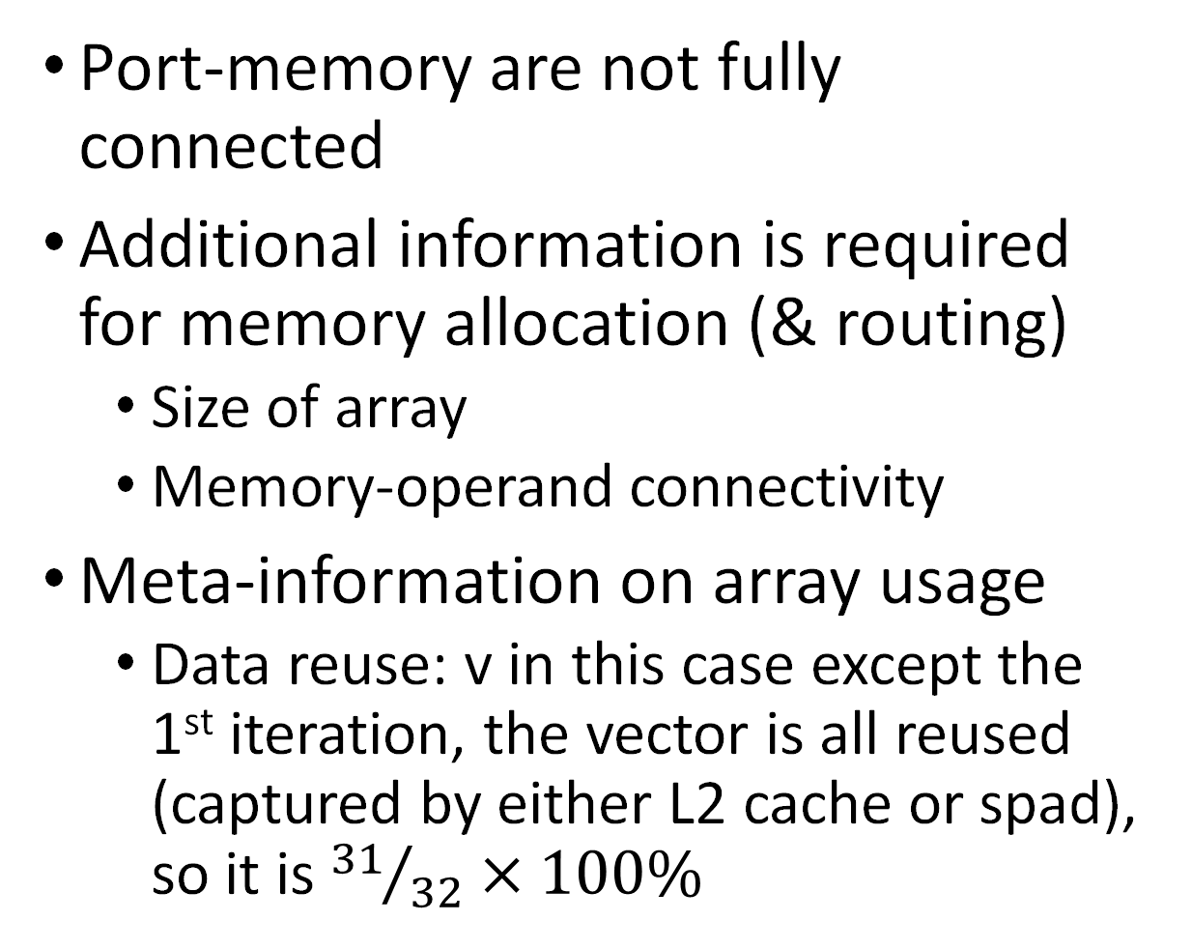
Understanding Memory Allocation
Port-memory are not fully connected
Additional information is required for memory allocation (& routing)
Size of array
Memory-operand connectivity
Meta-information on array usage
Data reuse: v in this case except the 1st iteration, the vector is all reused (captured by either L2 cache or spad), so it is ${31}/{32}×100\%$
m[8192]
DMA
v[256]
DMA
A
reuse=0
B
reuse=0.96
A.state
×
+
reg
C
reuse=0
res[256]
DMA

Slide 28
Understanding the Generated DFG --- (Programming Interface)
Look at the array_hint(void*, int, double) in mv.c
void*: The point to the array.
int: The size of the array.
double: the reuse ratio. If -1, it is analyzed by the compiler.
The array information will be dumped in DFG meta data
source/destination: The topology between the memory and port.
reuse: The ratio of reuse.

Slide 29
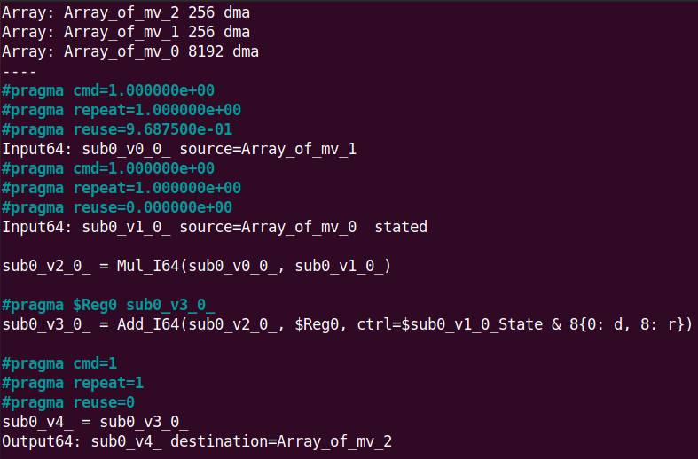
Understanding the mDFG (Incrementally Complicated)
Memory nodes are included for array allocation (and DSE)
m[8192]
v[256]
A
reuse=0
B
reuse=0.96
A.state
×
+
reg
Out, reuse=0
res[256]

Slide 30
Compiling High-Level Lang. to Decoupled Spatial
ADG
?
DFG
Decoupled-Spatial Binaries
Apps
Pragma Annotation
Modular XFROM
Mem. Stream
Goal: Compiling high-level language to decoupled-spatial architectures.
Map program behaviors to specialized different components.
Pragma Hints:
How should the program be decoupled and rewritten?
How to deal with the code concurrency?
Robust across any design points within this space.
Modular transformations
Notes:
Our compiler is for domain-specific accelerator design automation, but when designating the design space, we should assume we are domain agnostic. Therefore, we should start with a general-purposed high-level abstraction, so we adopt C.
This also leaves our programming interface open to be a backend for a domain-specific stack like TVM.
As I mentioned before, we have two main challenges: 1. Instructions are executed on different components, how can we decouple them; 2. We are targeting a family of architecture, so our compiler should be robust across any design points.

Slide 31
Put it all together!
$ make ultraclean # Start over the build
$ make ss-mv.s # Generate RISCV ASM
$ make ss-mv.out # Link to gem5 simulatable bin
$ ./run.sh ss-mv.out # Feed to gem5 simulation
Read the logs of functional simulation with different unrolling degree
Cycles
Memory bandwidth
#Instances
#Instructions & IPC
Cycle Breakdown
$ [edit] mv.c # edit unroll
# It actually does everything
# for you with one command!
$ ./run.sh ss-mv.out
Notes:
TODO: More details on read the logs.

Slide 32
Playing with the Unrolling Degree
Decoupled computational instructions are in mv_0_1.dfg
mv: The function from which this graph extracted.
0: The 0-based rank of this DFG in the function.
1: The unrolling degree of the DFG.
#pragma ss dfg has an optional clause unroll(x) to tune the resource occupation
x has to be a constant expression
If not specified x=1
If x=-1, the compiler will enumerate a feasible unrolling degree
Notes:
Next we have two things to do.
Understand the mv.dfg
Try different unrolling degree

Slide 33
Idiomatic Dataflow Vectorization (Unrolling)
Enumerate the unrolling degree
Duplicated instructions occupy more computational resources
Vectorization Idioms
// Accumulation
acc = 0;
for (i=0; i<n; ++i)
acc += b[i] * c[i];
// Elementwise
for (i=0; i<n; ++i)
a[i] = b[i] + c[i];
// Broadcast
for (i=0; i<n; ++i)
a[i] = b[i] * c;
B[2]
C[2]
B[2]
C
B[2]
C[2]
B.state
b0
c0
b1
c1
b0
c
b1
c
×
×
+
+
+
+
+
+
reg
A[2]
A[2]
A[2]
Notes:
To determine the resource occupation, the resource allocator enumerates the unrolling degree and transform the graph according to the idioms.
If the instruction is simply elementwise, we just duplicate the instructions and the port bandwidth. If the variable is a loop invariant, it should be broadcast. If an accumulation is detected, we transform the unrolled graph it into a reduction tree.
Then these transformed graphs are fed to the spatial mapper. The spatial mapper will map it and give a feedback.
If it succeeds, and how good is the performance. If fails, a more conservative resource allocation will be tried.

Slide 34


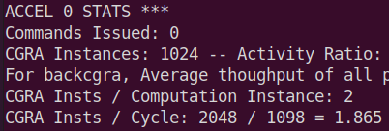
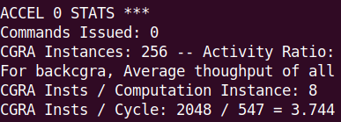
Understanding the Gem5 Simulation Log
Cycles
#Instances & IPC
Both executes 2048 instructions (1024 Adds + 1024 Muls)
Unroll by 1 has 1024 instances: 2 instructions each.
Unroll by 4 has 256 instances: 8 instructions each
Decoupled-Spatial essentially maximizes the ILP of a software pipeline

Slide 35
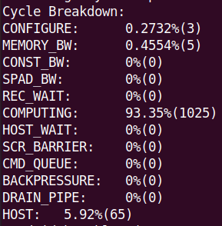
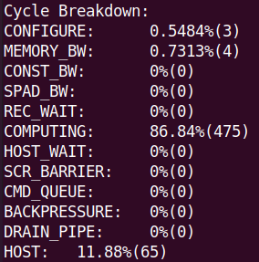
Understanding the Gem5 Simulation Log (CONT'D)
Cycle Breakdown
CONFIGURE: Load the bitstream
Mem b/w: DRAM bandwidth
Const b/w: Value generator
Spad b/w: Scratch Memory
Rec Wait: Wait for port-to-port latency
Computing: Doing computation
Cmd queue: Wait for command queue
Drain Pipe: Draining pipeline
Backpressure: N/w dynamic flow control
Host: Control core execution

Slide 36
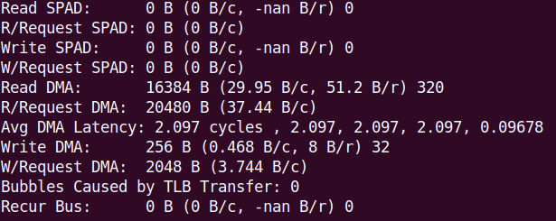
Understanding the Gem5 Simulation Log (CONT'D)
Cycle Breakdown
Requests are made in granularity of cachelines
Data are extracted from cachelines according to a bitmask

Slide 37
Binaries for RTL Simulation
$ make ss-mv.riscv ss-crs.riscv
We use different suffix to differentiate the purpose of different generated binaries, because:
Gem5 simulates a core other than Chipyard SoC
Spatial bitstream encodes in different formats for different simulation
Notes:
Next, let me pass the torch to my collaborator, Sihao.

