Slide 1

DSAGEN: Democratizing Spatial Accelerator Research
Tony Nowatzki, Jian Weng, Sihao Liu, Vidushi Dadu

Slide 2
Resources
Tutorial Website
http://www.seas.ucla.edu/~jianw/dsagen/tutorial.html
Released Source
https://github.com/PolyArch/dsa-framework
Binary and Docker
TBD
Hands-on Exercises
https://github.com/PolyArch/dsa-examples

Slide 3
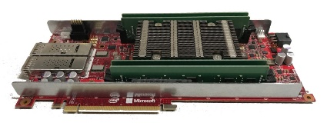
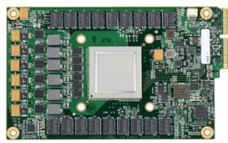
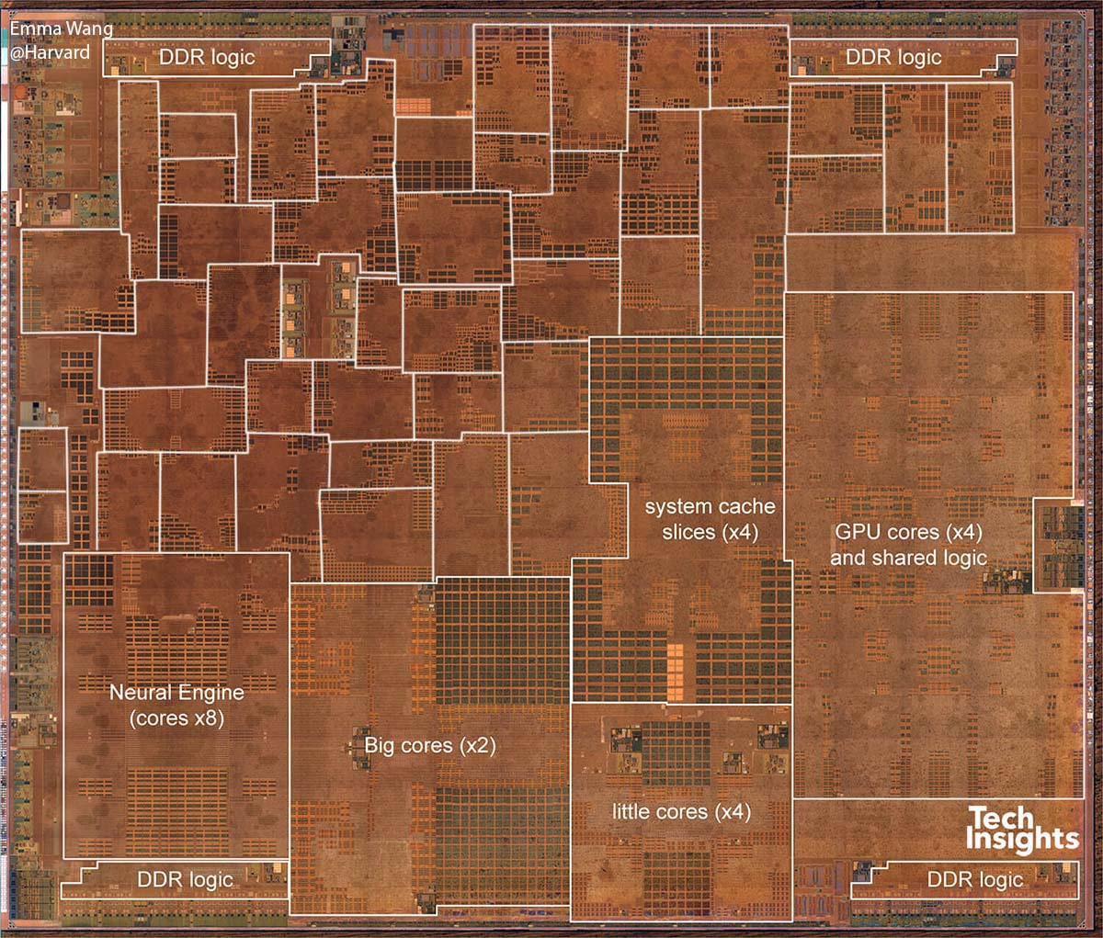
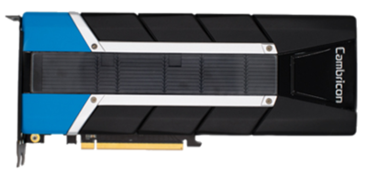
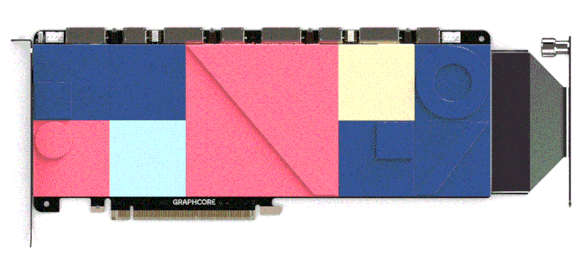
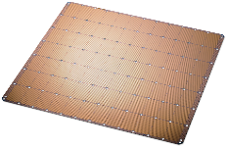
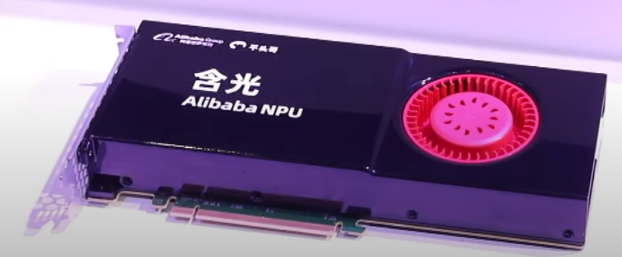
Accelerators are the answer to all our problems!
Accelerators prevalent on existing SoCs
Dedicated accel: one huge industry success
1/5~1/3 of publications in top conferences.
Microsoft
Brainwave
Google
TPU v1
Accelerators
General Purpose
Cambricon
MLU-100
GraphCore
Colossus
Apple A12
Cerebras
WSE
Cerebras
NPU
http://vlsiarch.eecs.harvard.edu/research/accelerators/die-photo-analysis/
Aggregate funding into the billions!

Slide 4
Programmable Accelerator
RTL
Domain-Specific
Design
Known Hardware Tricks
+ Sufficient Generality
+ Effective Designs
Apps
Manual Design /
Trial and Error
Domain-Specific ISA
- Time Consuming
Accel.
Config.
Compiler
or
Accel.
Config.
Accel.
Config.
Accel.
Config.
Hardware
Library
High-level Synthesis
+ Automated
+ Specialized Design
App
Compilation
Fixed-Function
Accelerator
- Fixed Function H/W
C Kernel
Notes:
Motivation: Current ways of generating accelerators are too specific or too slow:
High-level Synthesis: Generate Program from C + Pragmas
Only targets one application
Limited Range of Designs
Domain-specific Accelerators: Hand-design accelerator
Long development time in hardware & software
Usually only targets a limited set of applications

Slide 5
Principles Behind an Accelerator Design Framework
Generality
Modularity
Efficiency
Accelerators within the design space are reusable across workloads.
Features should be combinable; flexibility is optional.
Avoid VonNeumann overheads, achieve specialization benefits.
Develop a general purpose accelerator ISA.
Flexible hardware representation + modular compiler.
Decoupled spatial architecture paradigm.

Slide 6
DSAGEN: A framework for building decoupled-spatial accelerators.
Optimized
Compiled
Kernels
Target
Apps
Modular Compiler
+ Sufficient Generality
+ Specialized Design
+ Automated
Design-space
Exploration
Accel. ISA
Architecture
Description
Graph (ADG)
Primitives: Memory,
Processing Elem, Switch,
Sync. Elem.
Programmable Accelerator
RTL
Notes:
This is motivated by the emergence of specialized accelerators and it often requires intensive engineering effort to have a full stack implementation for the novel hardware.
An ideal approach to saving the engineering effort is to have a unified high-level abstraction while retaining the flexibility of changing the underlying hardware.

Slide 7
Background: Decoupled-Spatial Architecture
Address Generator
Control Core
for (int i = 0; i < n; ++i)
c[i] += a[i] * b[i];
Memory
Stream Control.
a[0:n]
b[0:n]
c[0:n]
c[0:n]
Streams
a[0:n]
b[0:n]
c[0:n]
Sync. Elem
(ports)
×
×
Dataflow
＋
＋
Processing Elements
c[0:n]
Switches
Notes:
Define Decoupled:
Spatial Paradigm: Low level network/storage is managed in the ISA

Slide 8
Stream-Dataflow: A “General” Accelerator ISA
for(i=0; i<n; ++i) {
if(i%2 == 0) {
} else {
}
}
config(datapath)
Address Generator
Control Core
a1[0:n]
->
A
Memory
Stream Control.
a[0:n]
b[0:n]
Ports
A
B
C
c[0:n]
c[0:n]
a2[0:n]
->
A
Sync. Elem
(ports)
×
A
B
C
B[0:n]
->
B
Compute
Dataflow
+
×
C[0:n]
->
C
Ports
O
＋
O
->
c[0:n]
Processing Elements
Von-Neumann Embedding
(currently embedded in RISCV ISA)
Switches
O

Slide 9
ADG Examples
Activation
+
+
+
×
×
×
×
Memory
Scratchpad
Switch
Func. Unit
S
S
S
S
Memory
Scratchpad
S
S
Sync. Elem.
S
MAERI-Style
Memory
Scratchpad
Softbrain-Style
Banked Scratch Memory
Plasticine-Style (PCU)
Plasticine-Style (PMU)

Slide 10
“Domain-specialized” ADG Examples
“Domain Specific” ADG
“Irregular” ADG
Memory
+
+
×
×
+
+
×
×
×
×
×
×
×
×
×
×
×
×
+
+
+
+
+
+
+
+
+
+
+
+
+
+
+
+
S
S
S
S
+
+
Complex Multiply
DianNao-Style
Notes:
Our framework can approximate a wide range of architectures including programmable architecture and some the domain specific architectures that uses the same primitives.
Also, we can represent custom irregular architectures tailored for very specific applications.
There is of course limitations of our work which is in detail explained in our paper. Moreover, we want clarify that our goal is not to replicate all prior accelerators can their compilers. Rather, we define an interesting and useful design space that can be understood by a general-purpose compiler.
Data Path of Complex Mul.

Slide 11
Example of Modularity -- PE Types
Static-Scheduled,
Single-instruction PE
Dynamic-Scheduled,
Single-instruction PE
Dynamic-Scheduled,
Multi-Instruction PE
MUX
MUX
MUX
MUX
MUX
MUX
Accum
Accum
Function
Unit
Control
Table (CLT)
Instruction Buffer
Function
Unit
Register
File
Config
Config
Function
Unit
Instruction Scheduler
Simplest / Limited Control Support
Join-based Control / Requires Flow Control
Flexible Control / Expensive Scheduler
Modular Compilation
Support Required:
Stream-join transformation
Outer-Loop dataflow

Slide 12
Programming for Decoupled Spatial
C + Pragma Programming
C + Intrinsics Programming
#pragma config
for (int i = 0; i < n; ++i)
{
#pragma ss stream
#pragma ss dfg unroll(4)
for (int j = 0; j < n; ++j) {
if(i%2) a=a1;
else a=a2;
c[j] = a[j] + b[j];
}
…
}
for(i=0; i<n; ++i) {
if(i%2 == 0) {
} else {
}
}
config(datapath)
a1[0:n]
->
A
Ports
A
B
C
a2[0:n]
->
A
×
B[0:n]
->
B
Compute
Dataflow
+
C[0:n]
->
C
Ports
O
O
->
c[0:n]

Slide 13


Manual
Program
DSAGEN Overview
Graphs
RISCV
GCC
Graphs
Clang/LLVM
Compiler
RISCV
Control
C/Pragma
App
RISCV Binary
RISCV Binary
RISCV Binary
Spatial
Sched.
Graphs
Graphs
Simulator
Dataflow
Graphs
Runs On
Design-space
Exploration
DSAGEN+
Rocket
Architecture
Description
Graph (ADG)
Scala ADG
DSL
HW
Gen
Generated RTL (Chisel)
Accel. ISA

Slide 14
Codesign Feature Matrix
 | Simulation (+ Assembly) | C Compiler Support | Hardware Generation | End-to-end
Streams/Dataflow for Affine Loops | ✓ | ✓ | ✓ | ✓
Scratchpad | ✓ | ✓- | ✓- | ✓
Shared-instr. PEs | ✓ | ✓- | ✓-
Parallel Indirect Access | ✓ | ✓ | ✓ | ✓
Decomposable Net. | ✓ | ✓ | ✓ | ✓
Inductive-Pattern Streams | ✓ | ✓
Multicore Remote Mem. Abstractions | ✓

Slide 15
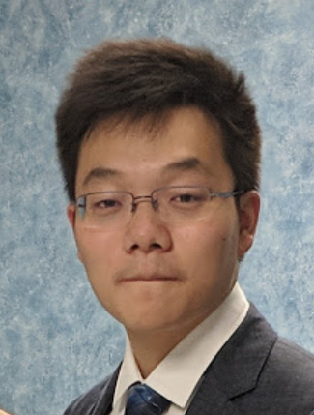

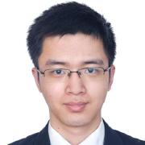
Tutorial Outline
Introduction and Manual Programming – Jian Weng
Core Concepts and Programming Examples
Data-dependence/Multicore Features – Vidushi Dadu
Support for irregular program idioms + multicore primitives
Compilation (and design-space Exploration?) – Jian Weng
Higher level pragma-based programming
Architecture Description/Generation – Sihao Liu
Scala DSL for architecture specification

