Slide 1
Gait Temporal Asymmetry Analysis
Methods · Group Comparisons · Clinical Relevance
BMED712 Track A | 216 subjects | 974 trials | IMU Gait Dataset
Healthy (n=70)
Ortho (n=35)
Neuro (n=82)

Slide 2
Background & Data Source
Clinical Context
Dataset
Gait asymmetry = difference in timing between left and right steps
216
974
Healthy walking has natural lateralization (preferred side leads)
Subjects
Valid Trials
Neurological & orthopedic conditions disrupt this pattern
Heel-Strike (HS) timing from wearable IMUs → objective measure
4
100 Hz
Key question: does |AI| differ across Healthy / Ortho / Neuro groups?
IMU Sensors
Sampling Rate
Groups
Healthy
Ortho
Neuro
n=70
n=35
n=82

Slide 3
Methods: How Asymmetry is Calculated
1
Extract Heel-Strike Events
From metadata: leftGaitEvents / rightGaitEvents → pair[1] = HS sample index U-turn segment excluded via uturnBoundaries. Quality filter: ≥3 HS per side, no duplicates.
2
Compute Step & Stride Times
Step time = interval R→next L (left step) and L→next R (right step) Stride time = consecutive same-foot HS intervals. Valid range: 0.2–3.0 s step, 0.4–5.0 s stride.
3
Five Asymmetry Metrics
Metric
Formula
Interpretation
Signed AI
(L−R) / mean(L,R)
Direction of asymmetry (positive = L dominates)
|AI|
|L−R| / mean(L,R)
Magnitude — our PRIMARY metric
|L−R| diff
|L−R| (seconds)
Absolute timing gap
Ratio
L / R
Ratio of left to right duration
CV
SD / mean (per side)
Within-trial variability
⚠ Subject-level aggregation: trial means averaged per subject → 216 data points (avoids pseudoreplication)

Slide 4
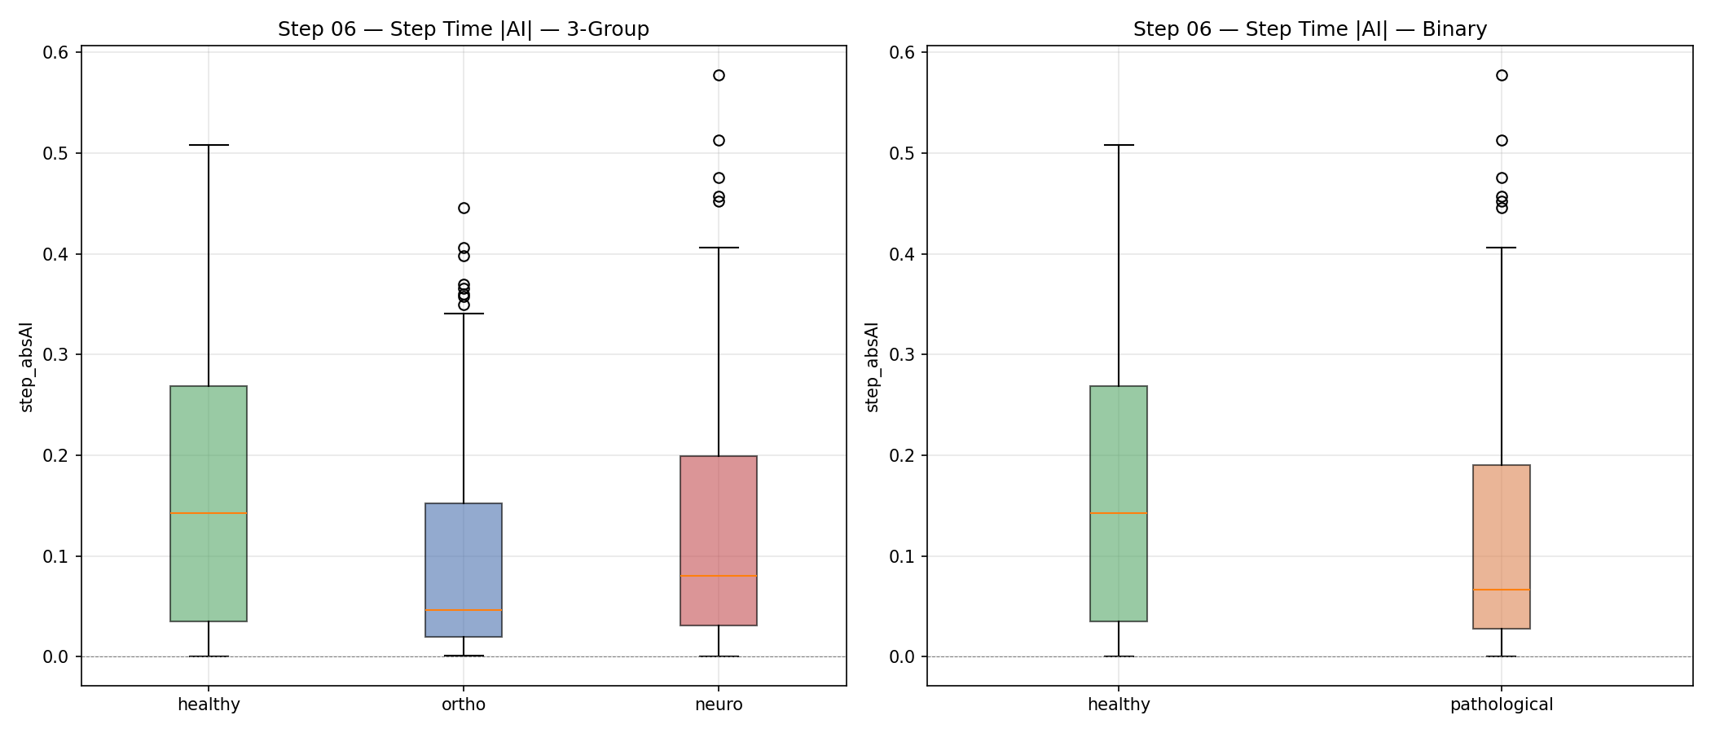
Key Finding: Healthy Gait is MORE Asymmetric
Counterintuitive but validated: neurological pathology leads to loss of natural motor lateralization → more symmetric gait
Cohen's d = 0.77
H vs N (Stride |AI|)
p < 0.001
Kruskal-Wallis
AUC = 0.716
Single-feature screening
83%
Specificity at optimal threshold

Slide 5
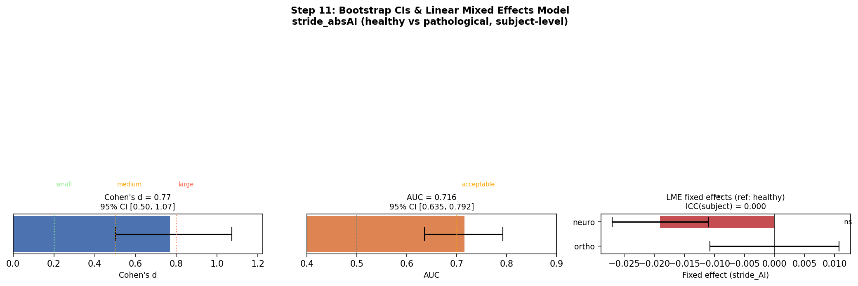
Statistical Validation
Bootstrap CI (n=10,000)
d = 0.77 [0.50, 1.07]
AUC = 0.716 [0.635, 0.792]
Linear Mixed Effects Model
stride_AI ~ group + (1|Subject)
Neuro: β=−0.019, p=3×10⁻⁶
Neuro vs Healthy
Significant loss of lateralization
Ortho: β≈0, p=1.00 (not affected)
Best subtype: RIL d=0.87 > PD d=0.77 > CVA d=0.73

Slide 6
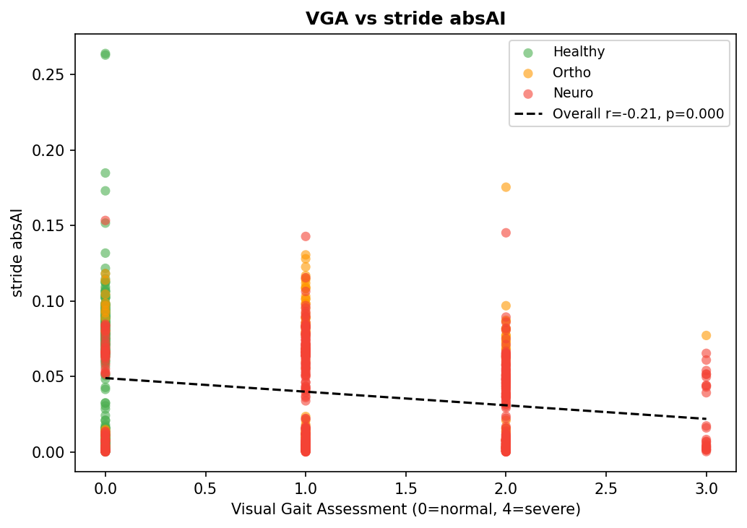
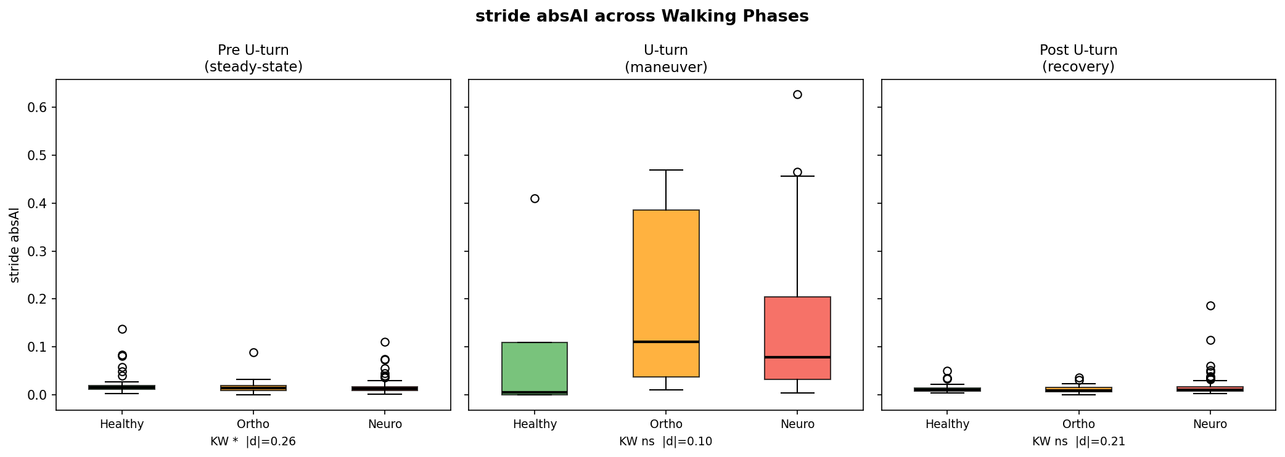
Clinical Relevance
VGA Correlation
Phase Analysis
Ortho U-turn Spike
r = −0.206, p = 2.3×10⁻¹⁰ (n=927 trials)
Pre-uturn p=0.026 U-turn: ns — no added value
|AI| = 0.110 vs 0.005 (healthy) Compensatory weight-shift

Slide 7
Conclusions
Healthy > Pathological asymmetry
Natural motor lateralization is lost in neurological disease — not gained
Stride |AI| is the strongest discriminator
Cohen's d = 0.77 [0.50, 1.07], AUC = 0.716 [0.635, 0.792] (bootstrap confirmed)
Neurological ≠ Orthopedic
LME: neuro β=−0.019 (p=3×10⁻⁶), ortho β≈0 (p=1.00) — different mechanisms
Clinically validated
Spearman r=−0.206 with VGA clinician rating (p=2.3×10⁻¹⁰, n=927 trials)
Steady-state walking carries the signal
Pre-uturn phase: p=0.026; U-turn adds noise not information

