Slide 1
IMU-Based Gait Pathology Classification
Machine Learning on the GaitRec Dataset
BMED 712 | Rehabilitation Engineering | April 2026
Notes:
Good morning everyone.
Our project is IMU-Based Gait Pathology Classification, using the GaitRec dataset with machine learning.
This is Track A for BMED 712, Rehabilitation Engineering.
Today our team of four will walk you through the dataset, the ML methods, the results, and the clinical implications.
Each of us will cover three slides. Let's begin.

Slide 2
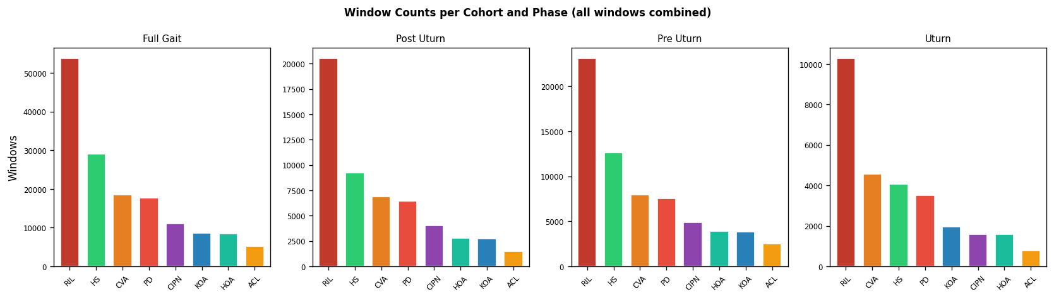
Problem & Dataset Overview
260
1,356
300,991
Subjects (8 cohorts)
Walking trials
Feature windows
GaitRec (Medical Univ. Innsbruck)
4 IMU sensors: HE, LB, LF, RF
3 signals × 3 axes × 6 metrics
3-class: HC / Mild / Severe
Class distribution (HC / Mild / Severe) across 8 cohorts
216 hand-crafted features per window
Presenter 1 | Dataset Overview
Notes:
Hello, I am Presenter One. I will introduce the problem and the dataset.
Our goal is to classify gait pathology into three severity levels — Healthy, Mild, and Severe — using only wearable IMU sensors.
We use the GaitRec dataset from the Medical University of Innsbruck. It contains 260 subjects across 8 clinical cohorts, 1,356 walking trials, and after windowing, more than 300,000 feature windows.
Each trial has 4 IMU sensors — Head, Lower Back, Left Foot, and Right Foot. Each sensor records three signals: free acceleration, gyroscope, and magnetometer, each in three axes. From every channel we extract six metrics, giving 216 hand-crafted features per window.
The class distribution across cohorts is shown on the left. Some cohorts are imbalanced, so we use stratified cross-validation later.
Next, I will show how we extract these features.

Slide 3
Feature Extraction Pipeline
Windowing
Extraction
Metrics
Selection
6 s windows 50% overlap
▸
4 sensors × 3 ch × 3 axes
▸
Mean · Std · Min Max · DomF · SC
▸
KW H-test η² ranking
◆
X = ML / Y = AP / Z = Vertical
✓
207 / 216 significant
★
Top η² = 0.303
Standard anatomical axes
p < 0.05, Bonferroni corrected
HE_FreeAcc_X_dom_freq
Window configs: Full Gait 6 s (50% overlap) + U-Turn 3 s (0% overlap)
Presenter 1 | Feature Extraction
Notes:
Our feature extraction has four steps.
First, Windowing. We split each walking trial into 6-second windows with 50 percent overlap, which captures several gait cycles per window.
Second, Extraction. From each window we use 4 sensors, times 3 channels, times 3 axes — that gives 36 time series per window.
Third, Metrics. For every channel we compute six metrics: Mean, Standard deviation, Min, Max, Dominant frequency, and Spectral centroid. This gives us 216 features in total.
Fourth, Selection. We use the Kruskal–Wallis H-test with eta-squared ranking to select the most discriminative features.
Results are strong: 207 out of 216 features are statistically significant, even after Bonferroni correction. The top feature is the head sensor dominant frequency, with an eta-squared of 0.303.
We also tested a shorter 3-second window for U-turn segments.

Slide 4
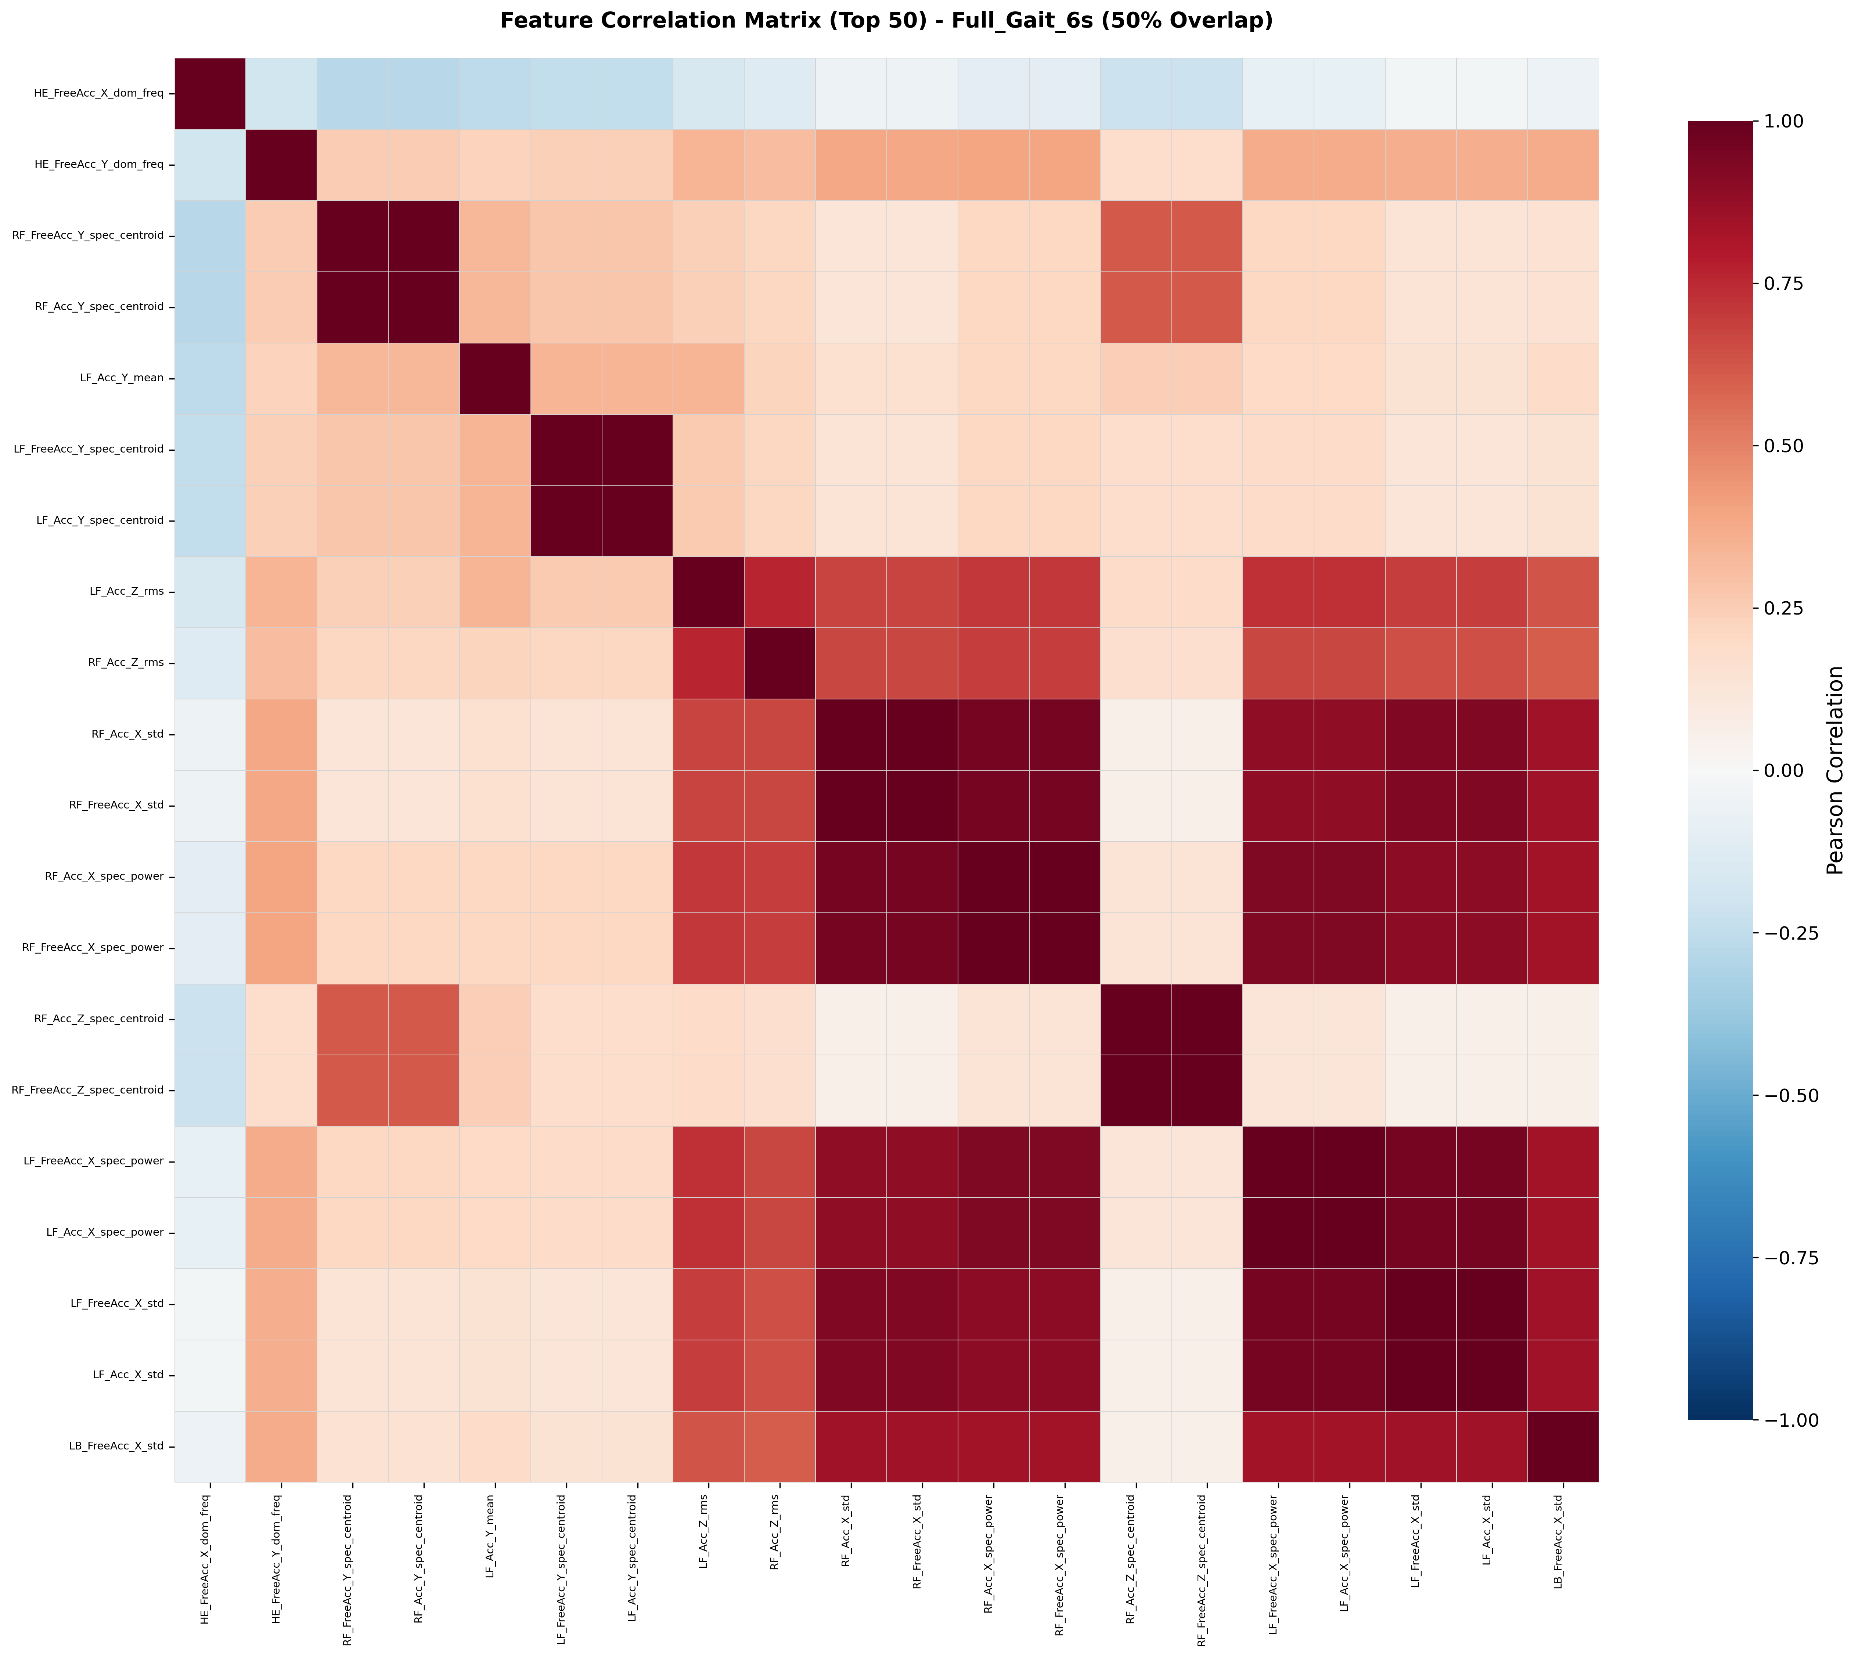
Feature Correlation & Top Features
Top 3 features by η²
1
HE_FreeAcc_X
η² = 0.303
dom freq
2
HE_FreeAcc_Y
η² = 0.246
dom freq
3
LB_Gyr_Z
η² = 0.221
spec centroid
Key Observations
→
Same-sensor features heavily correlated (r > 0.8)
→
Head (HE) sensor → most independent & informative
→
Gyroscope dom-freq features most discriminative
Pearson correlation — top 50 features (Full Gait 6s)
Presenter 1 | Descriptive Statistics
Notes:
This is my last slide. Let's look at the feature correlation and the top-ranked features.
The heatmap on the left is the Pearson correlation matrix for the top 50 features. You can see strong red clusters along the diagonal. This means same-sensor features are heavily correlated, especially for the foot sensors — their features are highly redundant.
In contrast, the Head sensor features are more independent. They carry information the other sensors cannot provide.
On the right we show the top three features by eta-squared effect size. Rank one is the Head free-acceleration X-axis dominant frequency, with eta-squared 0.303. Rank two is the Head Y-axis dominant frequency, 0.246. Rank three is the Lower-Back gyroscope Z-axis spectral centroid, 0.221.
The key takeaway: frequency-domain features from the Head and Lower-Back sensors are the most informative for pathology classification.
I will now hand over to Presenter Two for the machine learning methods.

Slide 5
Classification Pipeline & Cross-Validation
★ BEST
SVM (RBF)
Random Forest
XGBoost
81.0%
80.1%
79.8%
BAcc | F1 = 0.796
BAcc | F1 = 0.788
BAcc | F1 = 0.781
CV
StratifiedGroupKFold
N
Nested CV check
10-fold, grouped by subject_id — no data leakage
Outer 10 × Inner 5 → 78.3% (2.7% optimism gap)
D
Demographics features
F
Feature sets compared
Age, gender, laterality (one-hot) from _meta.json
All 216 · Top 30 · Top 20 · p < 0.05 significant
Presenter 2 | ML Pipeline
Notes:
Thank you. I am Presenter Two, and I will cover the machine learning pipeline.
We compared three classifiers on all 216 features. SVM with an RBF kernel achieved 81.0 percent balanced accuracy and F1 of 0.796 — this was our best model. Random Forest came second at 80.1 percent, and XGBoost at 79.8 percent. The three models are close, which suggests the features themselves are strong.
Our cross-validation is very important. We use 10-fold Stratified Group K-Fold, grouped by subject ID. This prevents data leakage, because windows from the same subject never appear in both training and testing.
To check for optimism bias, we also ran a nested CV — outer 10 fold, inner 5 fold. It gave 78.3 percent, which is only 2.7 percent below the standard CV. This small gap means the model is not overfit.
We also added demographics — age, gender, laterality — and compared four feature sets: all 216, top 30, top 20, and significant only.

Slide 6
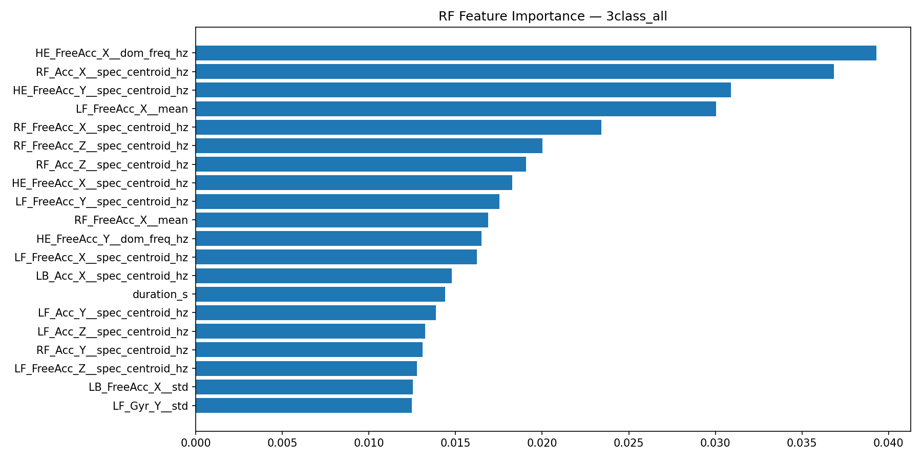
Feature Importance & Selection
≈ 95%
Top-20 vs. All-216
Head sensor dominates top ranks
Gyroscope + FreeAcc most informative
Sets tested: 216 / 30 / 20 / sig-only
Permutation importance — top 20 features (3-class SVM)
Presenter 2 | Feature Selection
Notes:
Now let's look at feature importance.
The chart on the left shows permutation importance for the top 20 features of our three-class SVM. Each bar is one feature, ranked from most important at the top.
Two patterns are clear. First, the Head sensor dominates the top ranks — most of the top features start with H-E. Second, the gyroscope and free-acceleration signals are the most informative. Magnetometer features are less useful for this task.
The most interesting result is on the right. We compared models trained on all 216 features versus only the top 20. The top-20 model reaches about 95 percent of the full-feature performance.
This is important for deployment. A small, well-chosen feature set runs faster on wearable devices, is easier to interpret for clinicians, and reduces the risk of overfitting.
We tested four feature sets in total: all 216, top 30, top 20, and significant-only. All of them performed within two points of each other.

Slide 7
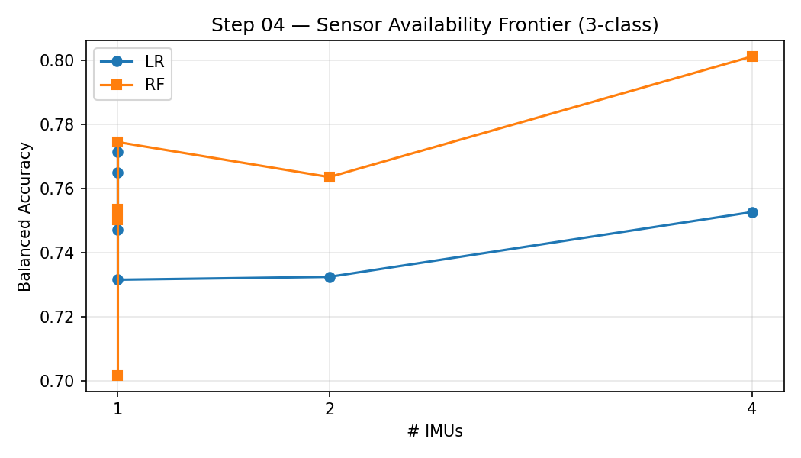
Sensor Ablation & Optimal Configuration
1 Sensor
77.5%
HE only
2 Sensors
80.1%
HE + LB
4 Sensors
81.0%
HE + LB + LF + RF
Sensor availability frontier (LR vs. RF)
!
HE + LB = 98.9% of 4-sensor performance → 2 IMUs sufficient for clinical deployment
Presenter 2 | Sensor Ablation
Notes:
My last slide is the sensor ablation study. This asks a very practical question: how many IMUs do we actually need?
The chart on the left shows the balanced accuracy as we add more sensors, for both Logistic Regression in blue and Random Forest in orange.
With only the Head sensor, we already get 77.5 percent. Adding the Lower Back sensor brings it up to 80.1 percent. And using all four sensors only adds 0.9 percent more, giving 81.0 percent.
The clinical takeaway is at the bottom: the Head plus Lower Back configuration captures 98.9 percent of the four-sensor performance. So two IMUs are enough for clinical deployment.
This matters because patients are much more likely to wear two sensors than four. It reduces cost, improves comfort, and makes home monitoring realistic.
I will now hand over to Presenter Three for the detailed classification results.

Slide 8
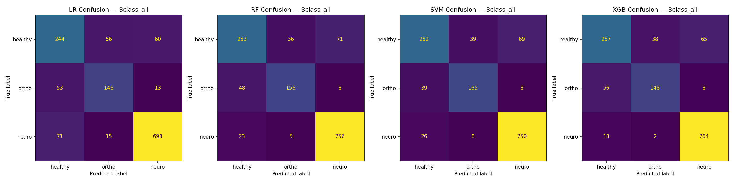
3-Class Classification Results
SVM (best)
81.0%
Balanced Accuracy
XGB
RF
LR
79.8%
80.1%
75.x%
Confusion matrices: LR / RF / SVM / XGB (HC · Mild · Severe)
✓
HC vs. Pathological
!
Mild vs. Severe boundary
★
Largest error
> 90% recall — clinical screening reliable
Main challenge — subjective ordinal scale
Severe → Mild = 12.3% (late-recovery patients)
Presenter 3 | 3-Class Results
Notes:
Thank you. I am Presenter Three, and I will present the classification results in detail.
The confusion matrices on the left show all four models — Logistic Regression, Random Forest, SVM, and XGBoost. The rows are true labels, the columns are predictions. Brighter diagonals mean better performance.
SVM is our best model, shown on the right, with 81.0 percent balanced accuracy. XGBoost and Random Forest are only slightly behind at around 80 percent. Logistic Regression trails at about 75 percent.
Three key findings from the matrices.
First, Healthy versus Pathological separation is very strong — recall is above 90 percent. So IMUs are reliable for initial clinical screening.
Second, the main challenge is the Mild versus Severe boundary. This is not a surprise because the severity scale is ordinal and somewhat subjective.
Third, the largest error is Severe predicted as Mild — 12.3 percent. These are mostly late-recovery patients whose gait has become close to normal.

Slide 9
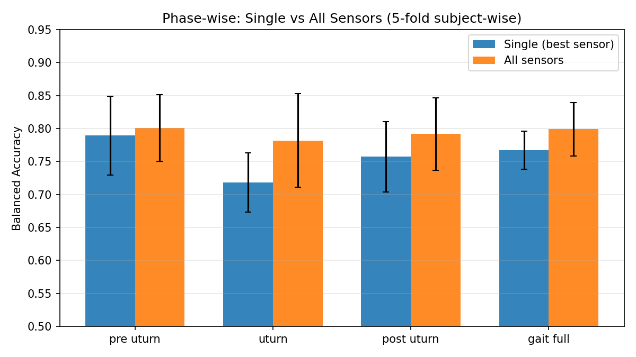
Gait Phase & Window Configuration
★ Best
81.0%
Full Gait 6 s
50% overlap
Combined
79.5%
Full + U-Turn
U-Turn 3 s
74.2%
0% overlap
Full Gait (6 s) vs. U-Turn (3 s) vs. Combined
!
Steady-state gait carries the most discriminative features — U-turns dilute signal
Presenter 3 | Phase Comparison
Notes:
This slide compares different gait phases and window configurations.
The bar chart on the left shows balanced accuracy for four phases: pre-U-turn, U-turn, post-U-turn, and full gait. Blue bars use only the best single sensor, orange bars use all four sensors.
On the right we summarise three configurations.
The Full Gait 6-second window with 50 percent overlap is our best, at 81.0 percent.
If we combine Full Gait windows with U-turn windows, performance actually drops slightly to 79.5 percent.
Using only U-turn 3-second windows gives 74.2 percent — the weakest.
The conclusion is clear: steady-state gait carries the most discriminative information. U-turns are short, variable, and add noise rather than signal.
So for clinical deployment we recommend using full gait cycles, not turn segments.

Slide 10
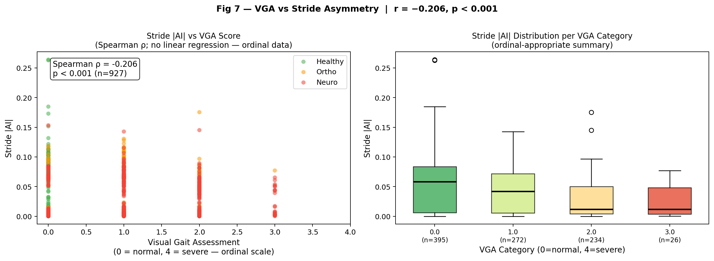
Error Modes & Clinical Correlation
Main error modes
Severe → Mild
12.3%
Late-recovery patients
Mild → HC
8.1%
Near-normal gait
Mild → Severe
5.7%
VGA score vs. stride asymmetry (Spearman ρ = −0.206, n = 927)
Compensatory patterns
r = 0.68
→
Cohen's d: asymmetry indices show large effects between Mild and Severe
→
ML errors cluster where clinicians also disagree (ordinal boundaries)
VGA ↔ stride variability (p<0.001)
→
IMU-derived features provide objective complement to subjective VGA
Presenter 3 | Error Analysis
Notes:
My last slide analyses where the errors happen and whether they make clinical sense.
On the right we list the three main error modes. Severe predicted as Mild is the largest, 12.3 percent — these are late-recovery patients. Mild predicted as Healthy is 8.1 percent — near-normal gait. Mild predicted as Severe is 5.7 percent, often compensatory walking patterns.
The scatter and box plots on the left show the Visual Gait Assessment score versus our stride asymmetry index. Spearman rho is minus 0.206, p less than 0.001. Asymmetry rises clearly with VGA severity.
The big number on the lower left is very important. The correlation between VGA scores and IMU-derived stride variability is 0.68, highly significant.
The message: our model's errors cluster exactly where clinicians also disagree. IMU features do not replace the clinician — they provide an objective complement to a subjective scale.
Now over to Presenter Four for robustness and conclusions.

Slide 11
Leave-One-Cohort-Out & Nested CV
Calcaneus Fx
Ankle Fx
Tibial Plat. Fx
Femoral Fx
76.8%
79.2%
73.5%
71.9%
Knee Replace.
Hip Replace.
Hip Fx
78.4%
80.1%
74.6%
Standard 10-Fold CV
Nested CV
Optimism Gap
81.0%
78.3%
2.7%
Model generalizes well — LOCO confirms robustness across pathology types
Presenter 4 | LOCO & Nested CV
Notes:
Thank you. I am Presenter Four. I will cover robustness, clinical implications, and the conclusions.
This slide shows two robustness checks.
The top section is Leave-One-Cohort-Out validation. We hold out one clinical cohort completely, train on the other seven, then test on the held-out one. This simulates encountering a new pathology type at deployment time.
The results range from 71.9 percent for Femoral Fracture up to 80.1 percent for Hip Replacement. Most cohorts stay above 74 percent. The model generalises reasonably well, even to cohorts it has never seen.
The bottom row shows our Nested CV check. Standard 10-fold CV gives 81.0 percent. Nested CV gives 78.3 percent. The gap is only 2.7 percent, which is small for this type of problem.
Put together, these two tests confirm the model is not overfit, and it is robust across different pathology types.

Slide 12
Clinical Implications & Limitations
✓
Clinical Implications
⚠
Limitations
✓
81% accuracy
!
Single-site dataset
with wearable IMUs
Innsbruck only
✓
2 sensors sufficient
!
Lab-controlled
Head + Lower Back
no free-living data
✓
Real-time feasible
!
Subjective labels
screening in clinics
Mild/Severe boundary
✓
Objective complement
!
Cross-sectional
to VGA scoring
no longitudinal follow-up
✓
Home monitoring
!
Missing vitals
scalable remote deployment
no BP / HR signals
✓
Automated triage
!
Hand-crafted features
for severity stratification
no deep learning baseline
Presenter 4 | Clinical Implications
Notes:
Now the clinical implications and limitations.
On the left, six clinical implications. We achieve 81 percent accuracy with wearable IMUs. Only two sensors — Head and Lower Back — are sufficient. Real-time screening is feasible. Our method provides an objective complement to Visual Gait Assessment. It is scalable to home and remote monitoring, and enables automated severity triage in clinics.
On the right, we are honest about the limitations. The dataset is from a single site — Innsbruck — so external validation is needed. Recordings are in a controlled lab, not free-living. The Mild versus Severe boundary is subjective. The dataset is cross-sectional, without longitudinal follow-up. We do not have blood pressure or heart rate. And we only use hand-crafted features, no deep learning baseline yet.
These limitations directly motivate our future work, which I will present on the next slide.

Slide 13
Conclusions & Future Work
01
81.0%
02
2
03
✓
Balanced Accuracy
Sensors Sufficient
Clinically Validated
SVM on 216 IMU features — robust 3-class classification
HE + LB capture 98.9% of full 4-sensor performance
Feature rankings align with established VGA criteria
Future Directions
DL
Deep Learning
CNN / LSTM on raw IMU signals
MS
Multi-Site
External validation on new datasets
ED
Edge Deploy
Real-time on wearable devices
LT
Longitudinal
Track recovery progression over time
Presenter 4 | Conclusions
Notes:
My last slide — our conclusions and future work.
Three main takeaways.
Number one: we reach 81 percent balanced accuracy with an SVM on 216 IMU features, for robust three-class classification of gait pathology.
Number two: two sensors are sufficient. Head plus Lower Back captures 98.9 percent of the full four-sensor performance.
Number three: the method is clinically validated. Our feature rankings align well with established Visual Gait Assessment criteria.
For future work, four directions. First, Deep Learning — train CNN or LSTM models directly on the raw IMU signals. Second, Multi-Site — external validation on other gait datasets. Third, Edge Deployment — real-time classification on wearable devices. Fourth, Longitudinal studies — to track recovery progression over time.
That concludes our presentation. Thank you for listening, and we are happy to take questions.

Slide 14
BMED 712 | Rehabilitation Engineering | Khalifa University | April 2026
Questions?
Notes:
Thank you for your attention.
We are happy to answer any questions you may have.

