Slide 1
Unsupervised Machine Learning for Stock Analysis
Why did we use the uml for this stock analysis project?
The scope of the project changed from the initial objective of correlating social media sentiment to stock prices.
We wanted to study the effects of social media sentiment to the change in stock price before and after the GME “explosion”.
Unfortunately, there was insufficient paired outcome of data to train and test on. We then decided to look for patterns in the stock's behavior before and after the explosion, rather than predict a classification.
In addition to comparing stock prices, we used PCA combined with K-means clustering to identify patterns in a small set of stocks before and after the explosion in stock price that occurred for game stop.

Slide 2
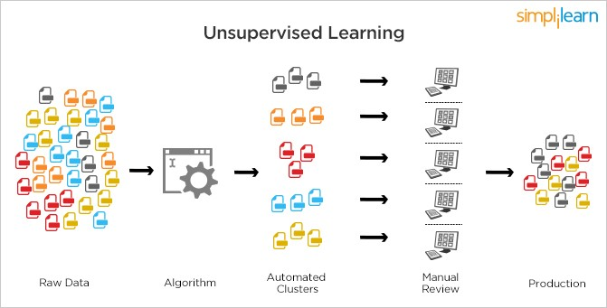
Unsupervised Machine Learning Algorithm
What is Unsupervised Machine Learning (uml)?
An uml is an unsupervised machine learning algorithm that is used to analyze and cluster unlabeled datasets.
It looks for hidden patterns or data grouping without any human intervention.
uml is a good algorithm to use for exploratory data analysis.
Image credit: Wikipedia

Slide 3
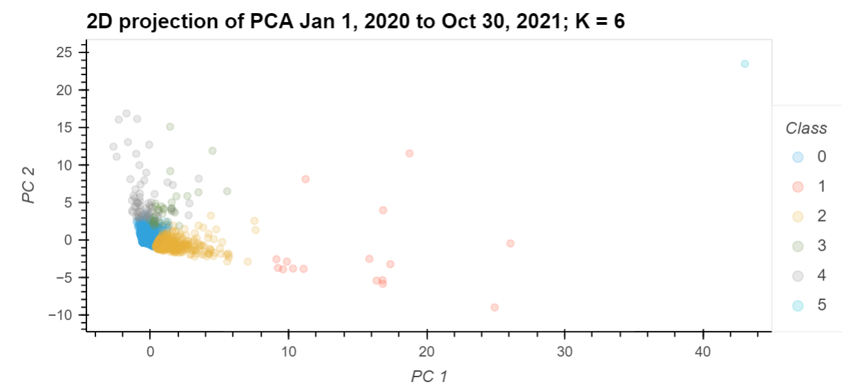
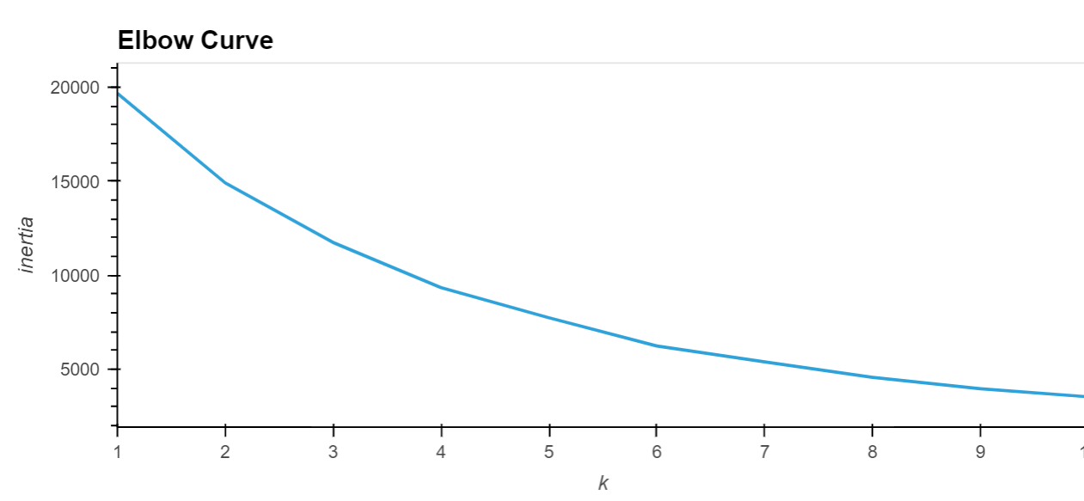
What is PCA (Principal Component Analysis?
PCA is a type of machine learning used to do exploratory data analysis and make predictive models.
It is used for dimensionality reduction of a dataset by projecting each data point onto the first few components to obtain a lower dimensional data while preserving as much of the data’s variation as possible.
What is K-Means Algorithm
K-means is a simple uml that identifies and groups similar datapoints by looking at the underlying patterns.
K-means looks for a fixed number (k) of clusters in a dataset.
The algorithm identifies k-number of centroids and allocates each data point to the nearest cluster.
Inertia: Sum of squared distance of samples to their closest cluster center.

Slide 4
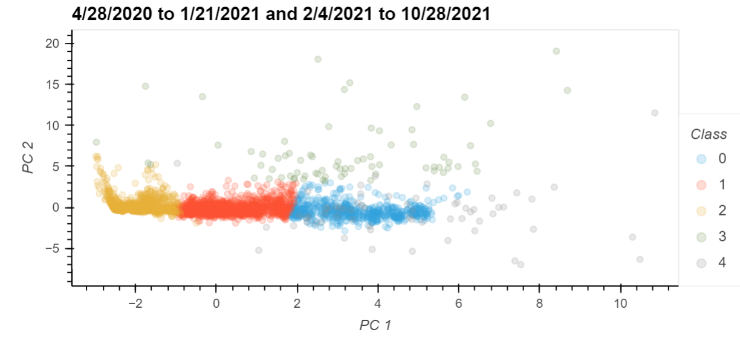
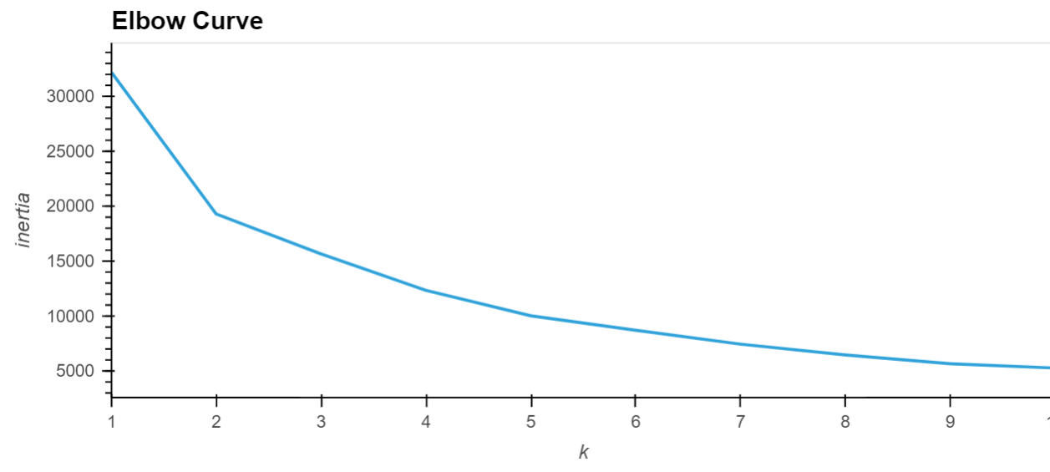
Method
Raw data from Yahoo Finance – Columns: Date, Open, Close, Adj Close, High, Low
Adjusted Columns – Date, Open, Adj Close, High, Low, Net Close, Net High, Net Low
Net_Close = Close - Open
Net_High = High – Open
Net_Low = Low - Open
PCA Components = 3
explained_variance_ratio
Looked at the value counts of different clusters
K-Means Algorithm clusters: k = 2, k = 4, k = 5, k = 6

Slide 5
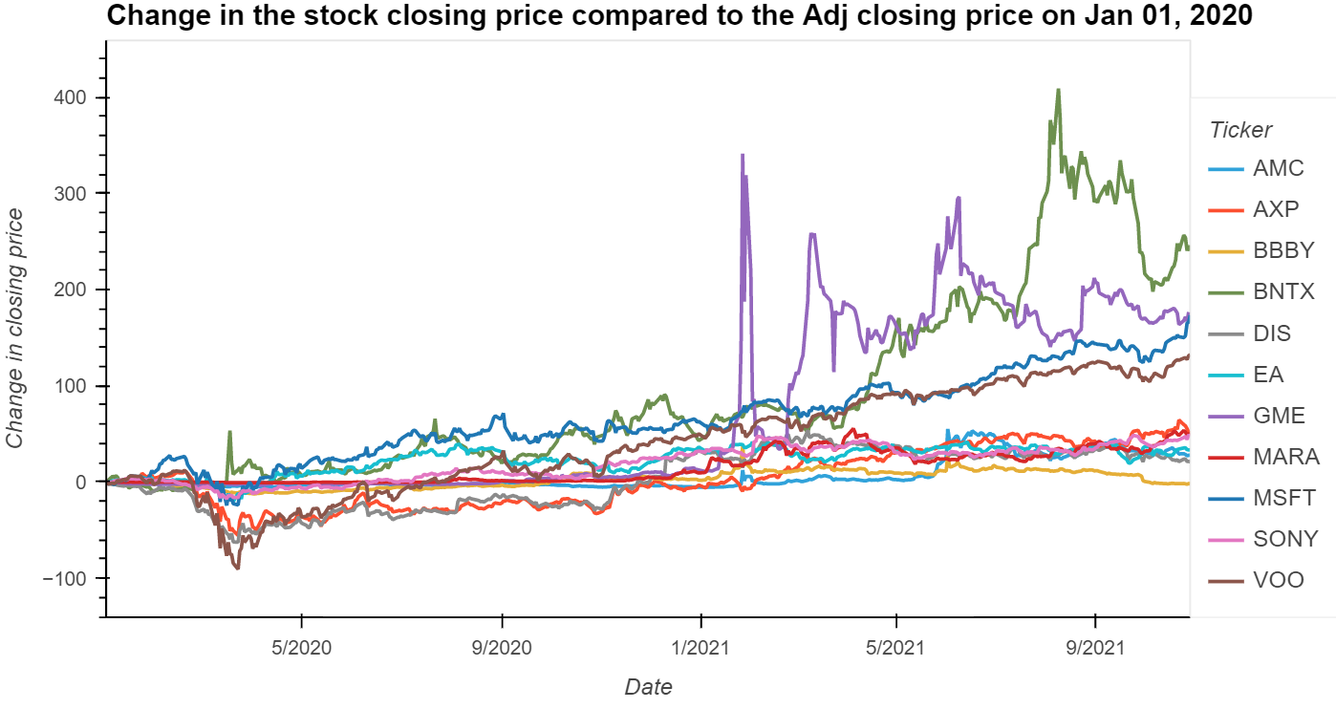
All stocks trends from Jan 01, 2020, until Oct 20, 2021
Preparing the Data

Slide 6
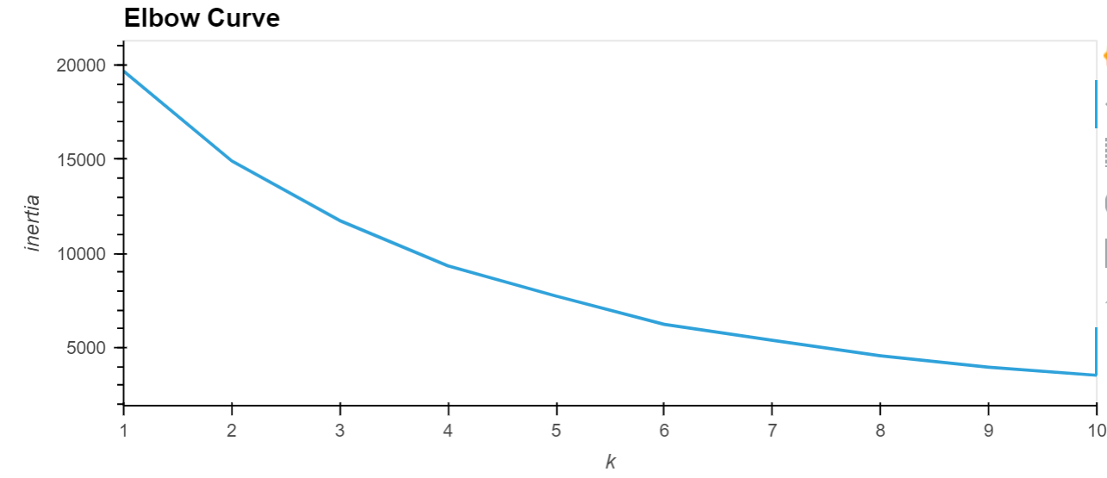
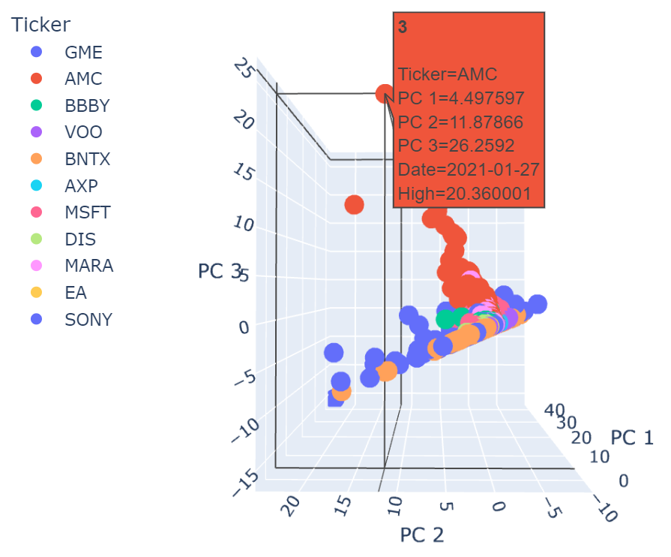
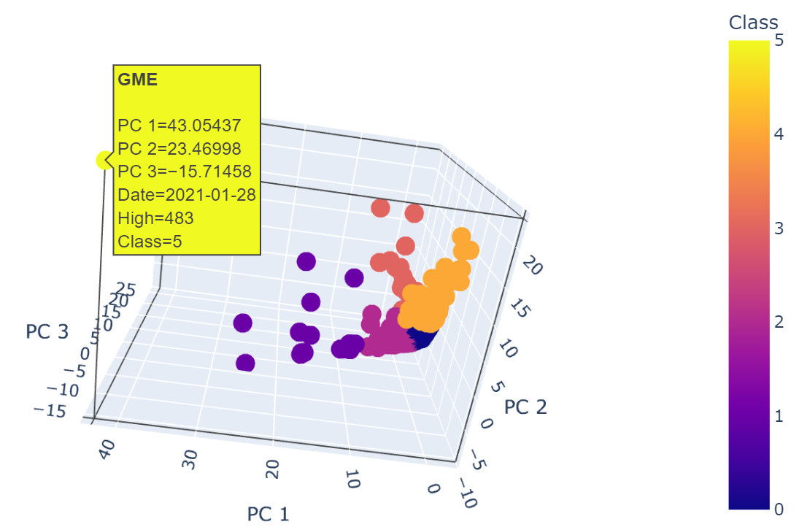
Results:11 stocks (1/1/2020 – 10/28/2021)
Expained_variance_ratio
PC1 | PC2 | PC3
0.4183 | 0.3174 | 0.2325
k = 6
Class | Value counts
0 | 4392
2 | 574
4 | 61
3 | 37
1 | 16
5 | 1
Fig.1
Fig.2

Slide 7
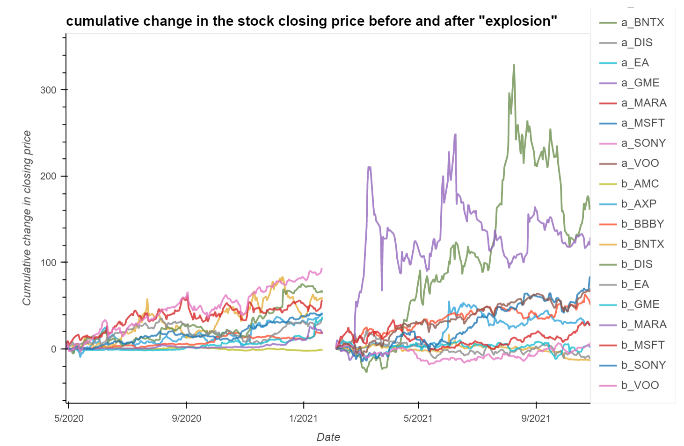

Check the trend in the change in stock price 186 days before and 186 days after the GME “explosion”
Preparing the Data
“Before”
April 28, 2020 – Jan 21, 2021
“After”
Feb 04, 2021 – Oct 28, 2021
GME Explosion

Slide 8
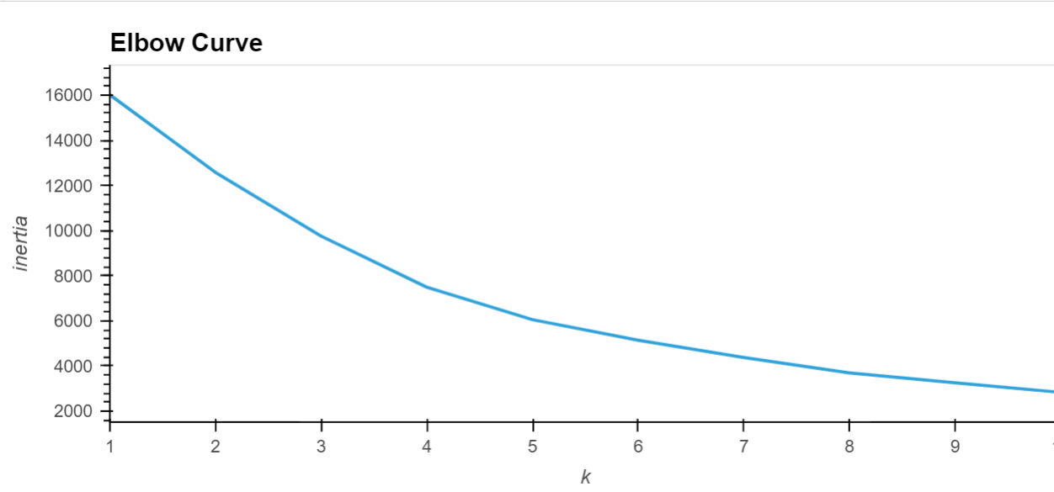
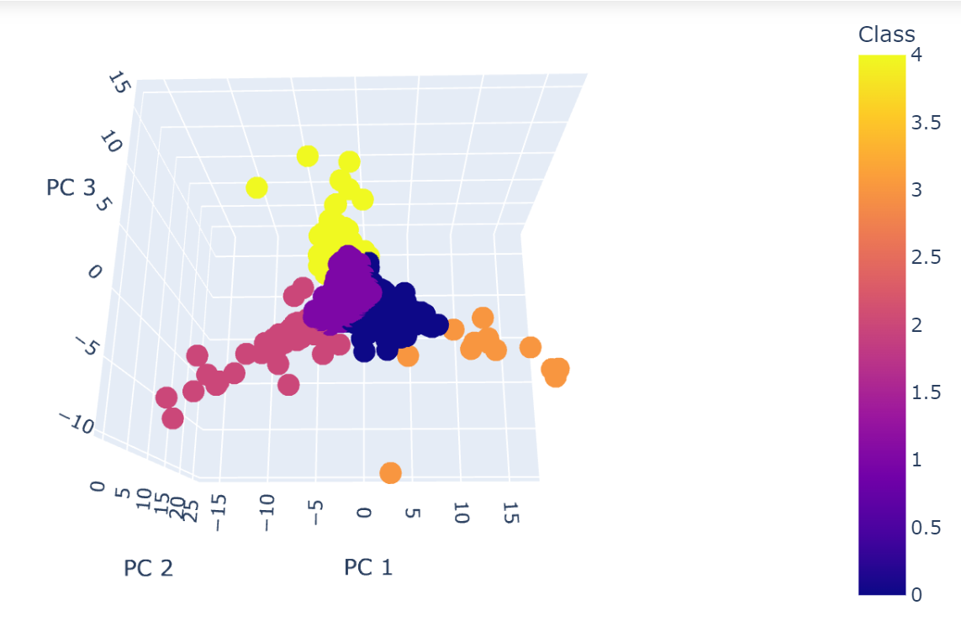
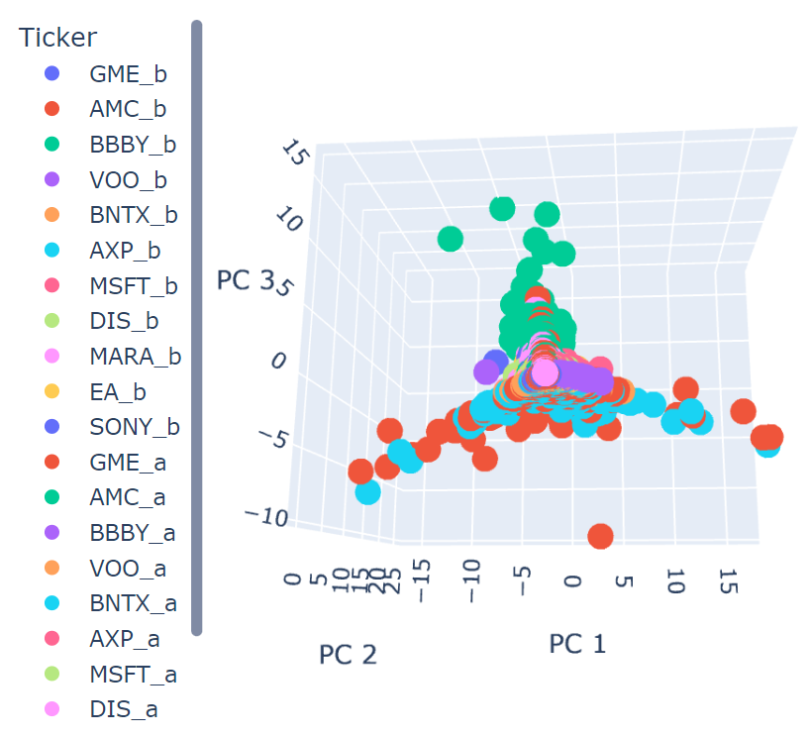
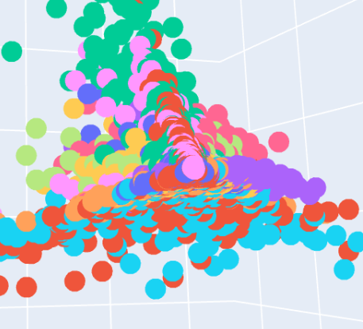
Results:
Date range: 4/28/2020 – 1/21/2021, and 2/04/2021 – 10/28/2021
Expained_variance_ratio
PC1 | PC2 | PC3
0.4177 | 0.3275 | 0.2329
Class | Value counts | Stocks
1 | 3616 | all
0 | 357 | GME_a, VOO_b&a, MSFT_b, MARA_a
2 | 60 | BNTX_a, GME_a
4 | 45 | AMC_a
3 | 14 | GME_a, BNTX_a
k = 5
Fig.1
Fig.2
Fig.3

Slide 9
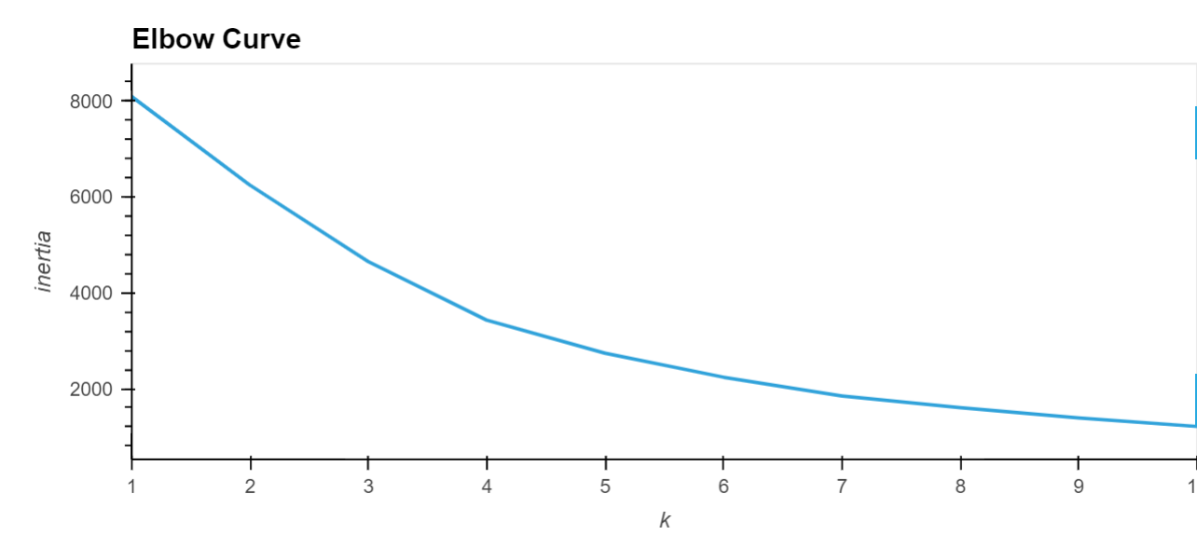
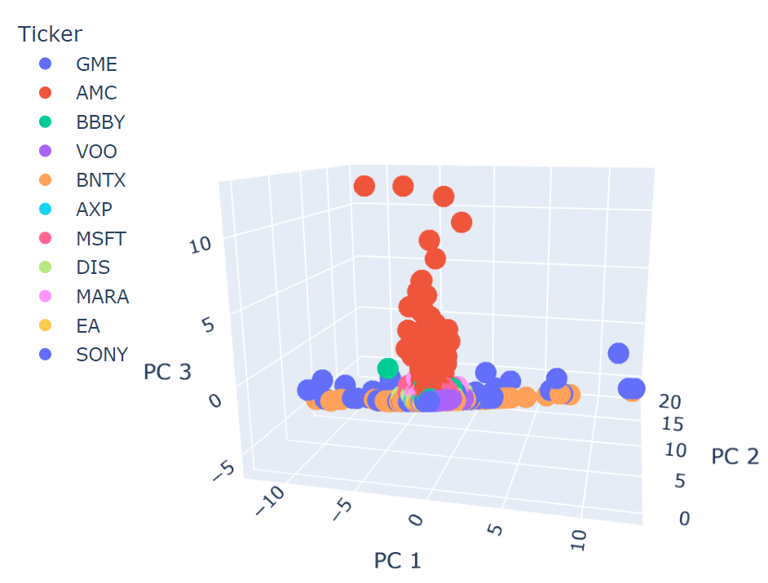
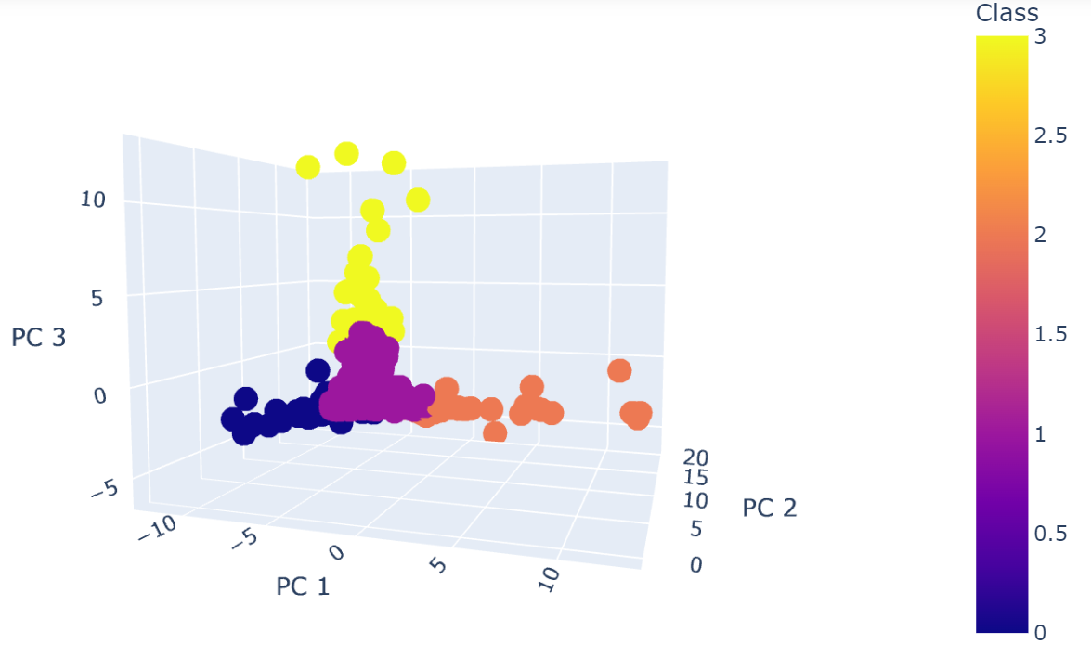
Results:
“After” Date range: 2/04/2021 – 10/28/2021
Expained_variance_ratio
PC1 | PC2 | PC3
0.4242 | 0.3216 | 0.2381
Class | Value counts | Stocks
1 | 1928 | all
0 | 57 | GME, BNTX, BBBY
2 | 42 | GME, BNTX
3 | 14 | AMC
k = 4
Fig.1
Fig.2

Slide 10
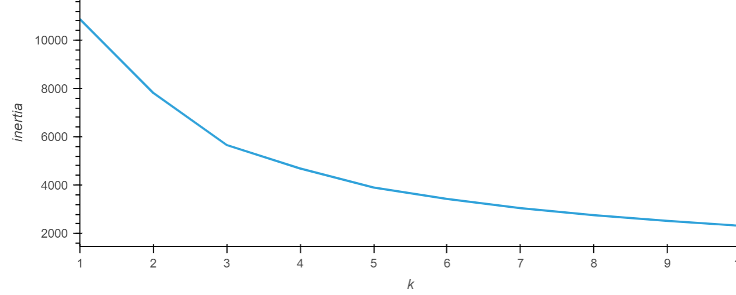
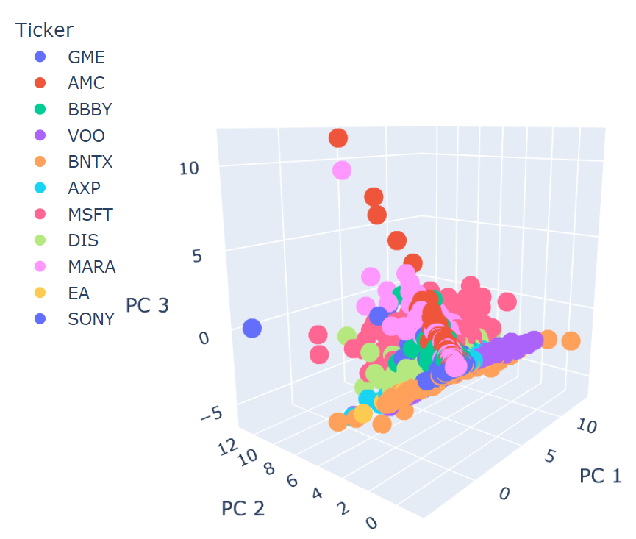
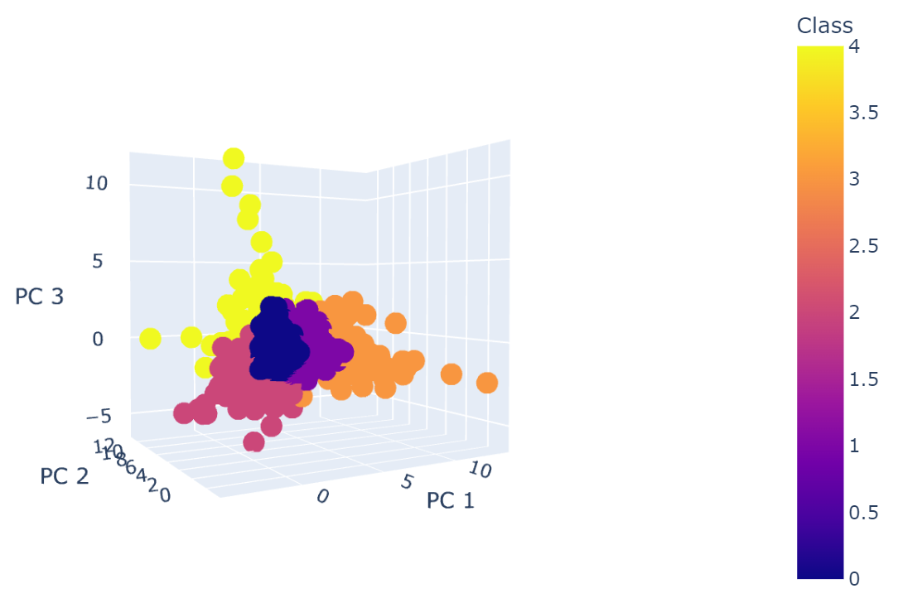
Results:
“Before” Date range: 1/01/2020 – 1/21/2021
Class | Value counts | Stocks
1 | 1789 | All
0 | 597 | AXP, EA, DIS, SONY, VOO
2 | 327 | AXP, DIS, EA, MSFT, BNTX
3 | 125 | AXP, BNTX, VOO, MSFT
4 | 77 | AMC, GME, MSFT, MARA
Expained_variance_ratio
PC1 | PC2 | PC3
0.4170 | 0.3336 | 0.1815
k = 5
Fig.1
Fig.2

