Slide 1
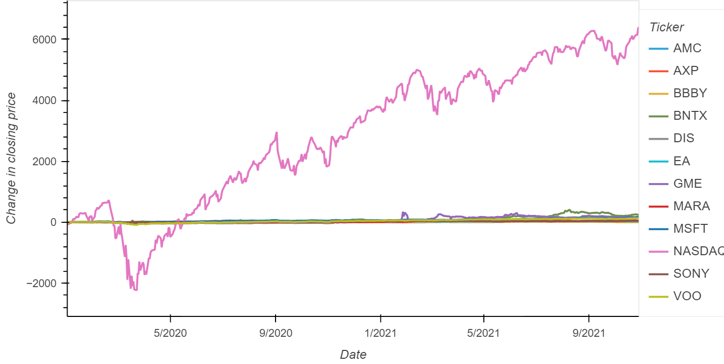
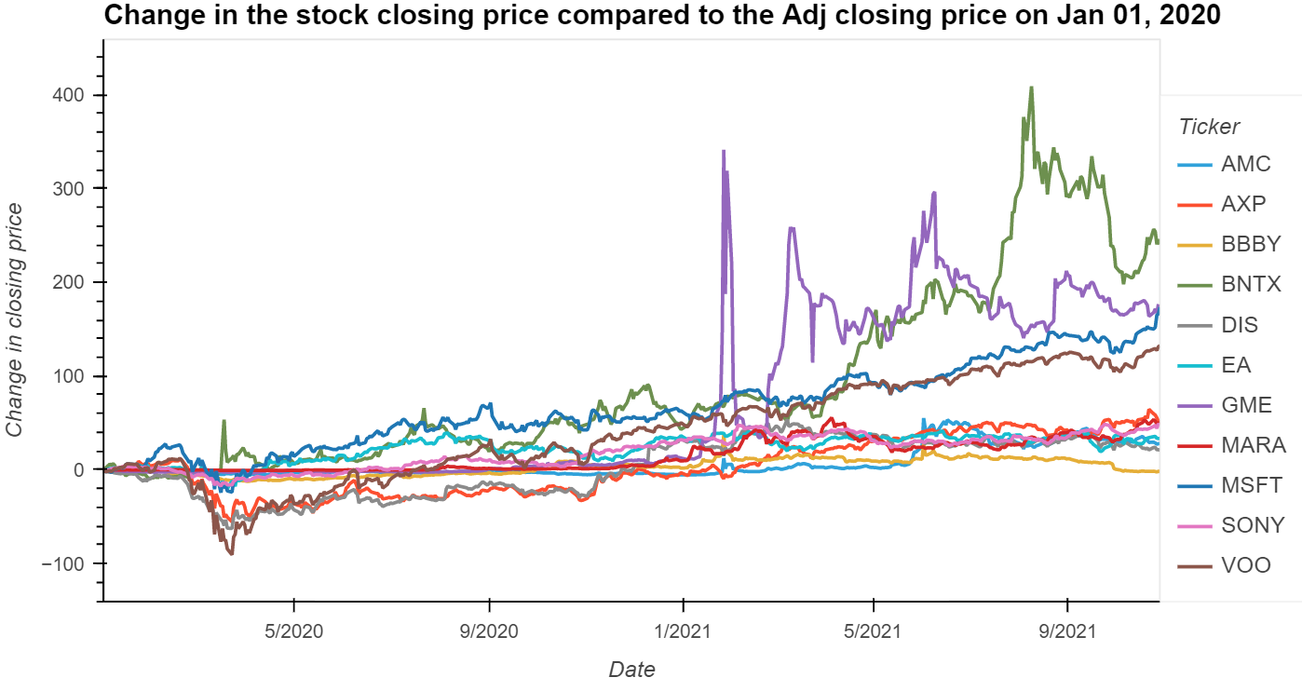
All stocks trends from Jan 01, 2020, until Oct 20, 2021
The graph showing all the stocks studied for this presentation

Slide 2
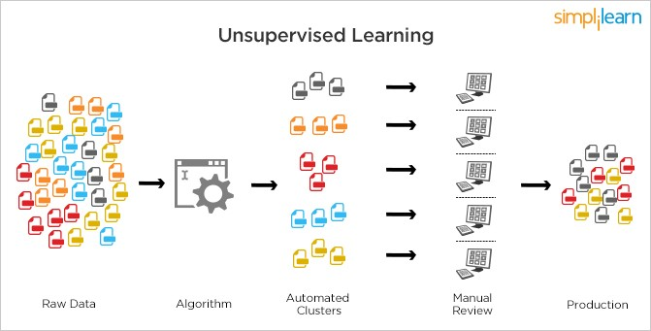
Unsupervised Machine Learning Algorithm
What is Unsupervised Machine Learning (un-ml)?
An uml is an unsupervised machine learning algorithm that is used to analyze and cluster unlabeled datasets.
It looks for hidden patterns or data grouping without any human intervention.
uml is a good algorithm to use for exploratory data analysis.

Slide 3
Why did we use the uml for this stock analysis project?
The scope of the project changed from the initial objective of correlating social media sentiment to stock prices.
We wanted to study the effects of social media sentiment to the change in stock price before and after the GME “explosion”.
Unfortunately, there was insufficient paired outcome of data to train and test on. We then decided to look for patterns in the stock's behavior before and after the explosion, rather than predict a classification.
In addition to comparing stock prices, we used PCA combined with K-means clustering to identify patterns in a small set of stocks before and after the explosion in stock price that occurred for game stop.

Slide 4
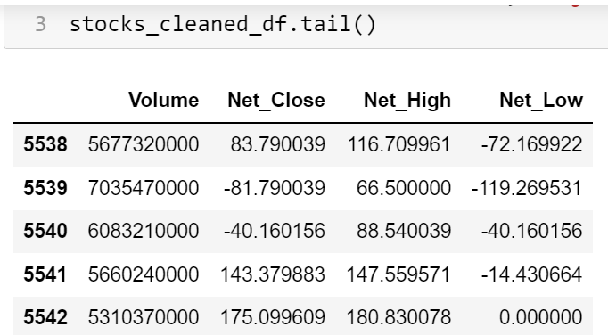
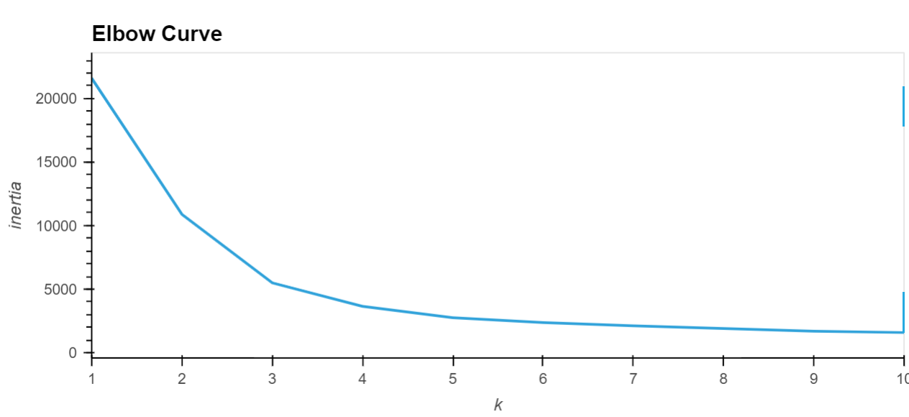
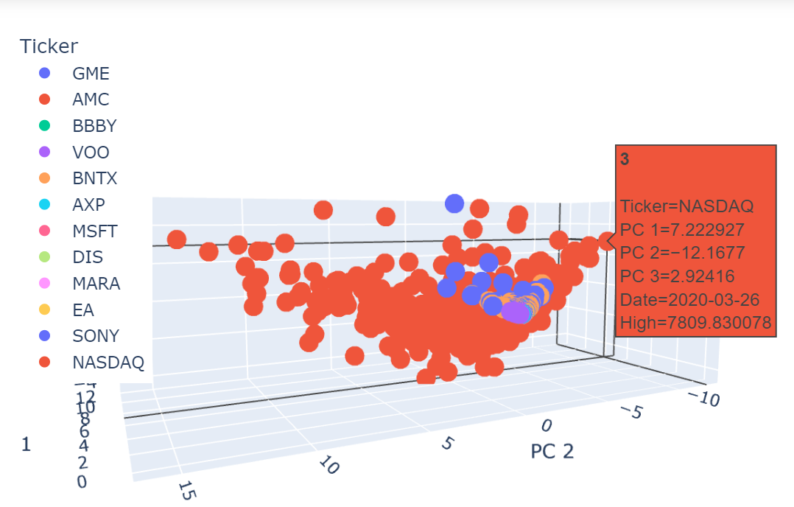
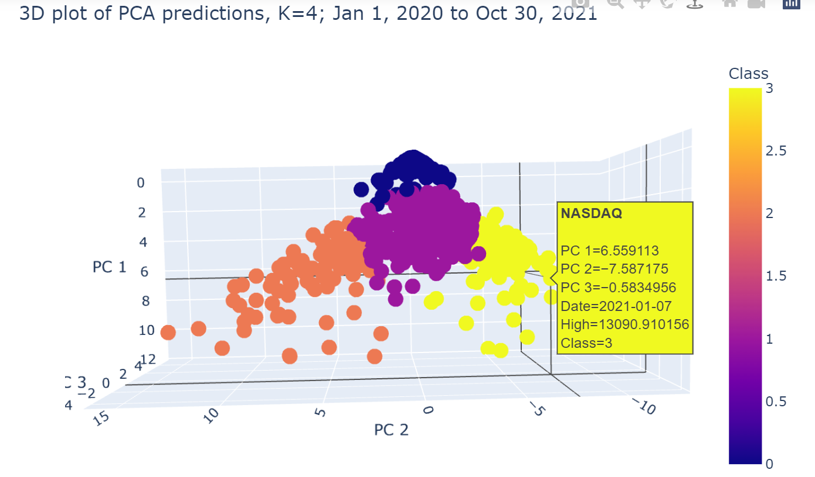
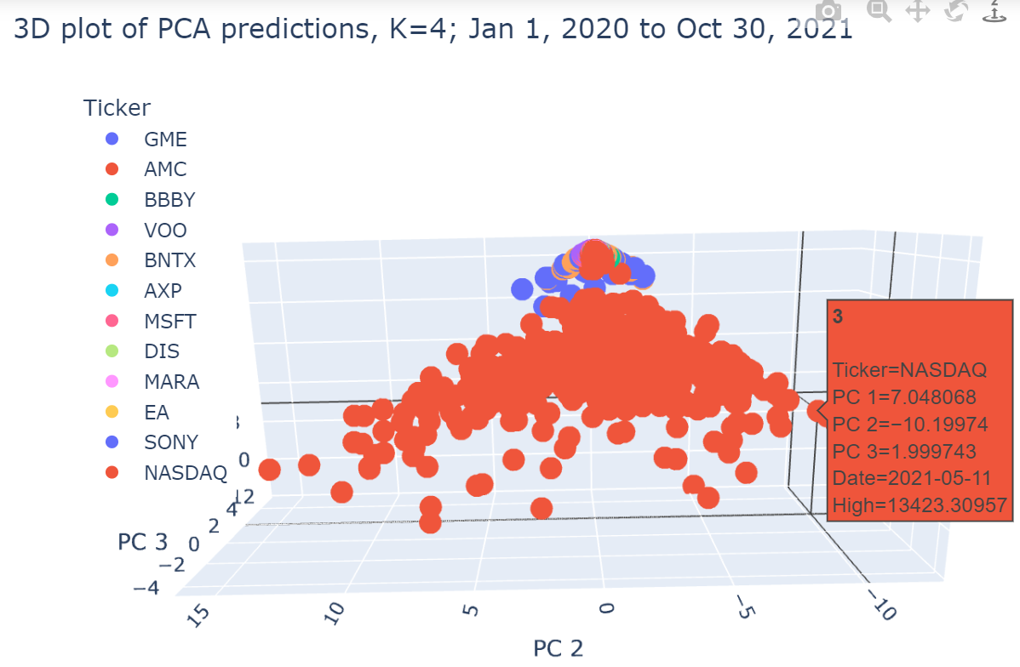
Results: All stocks

Slide 5
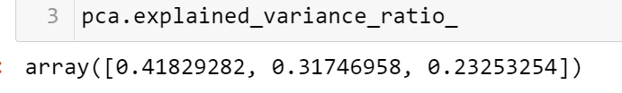
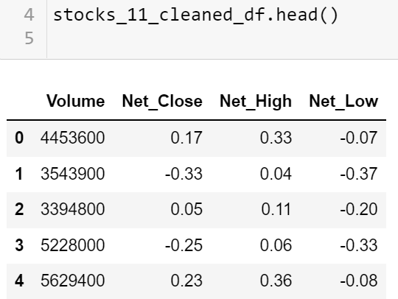
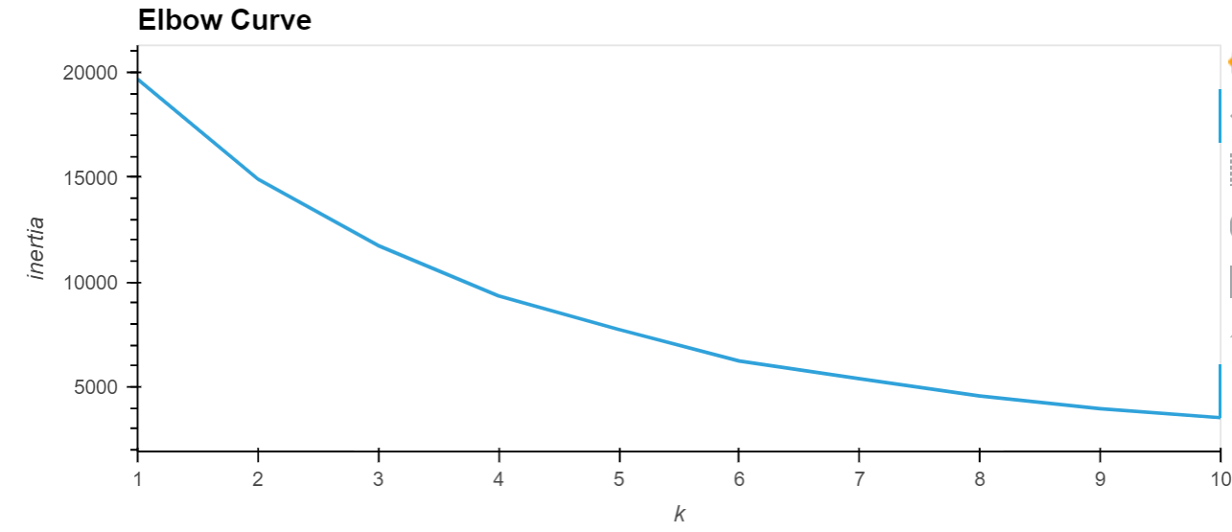
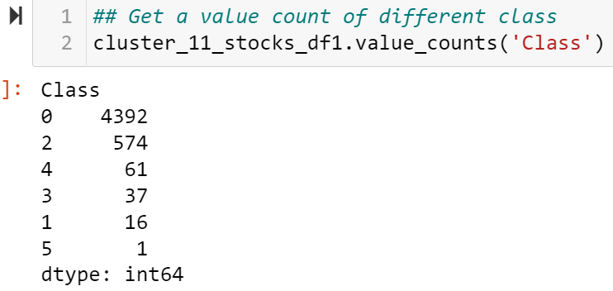
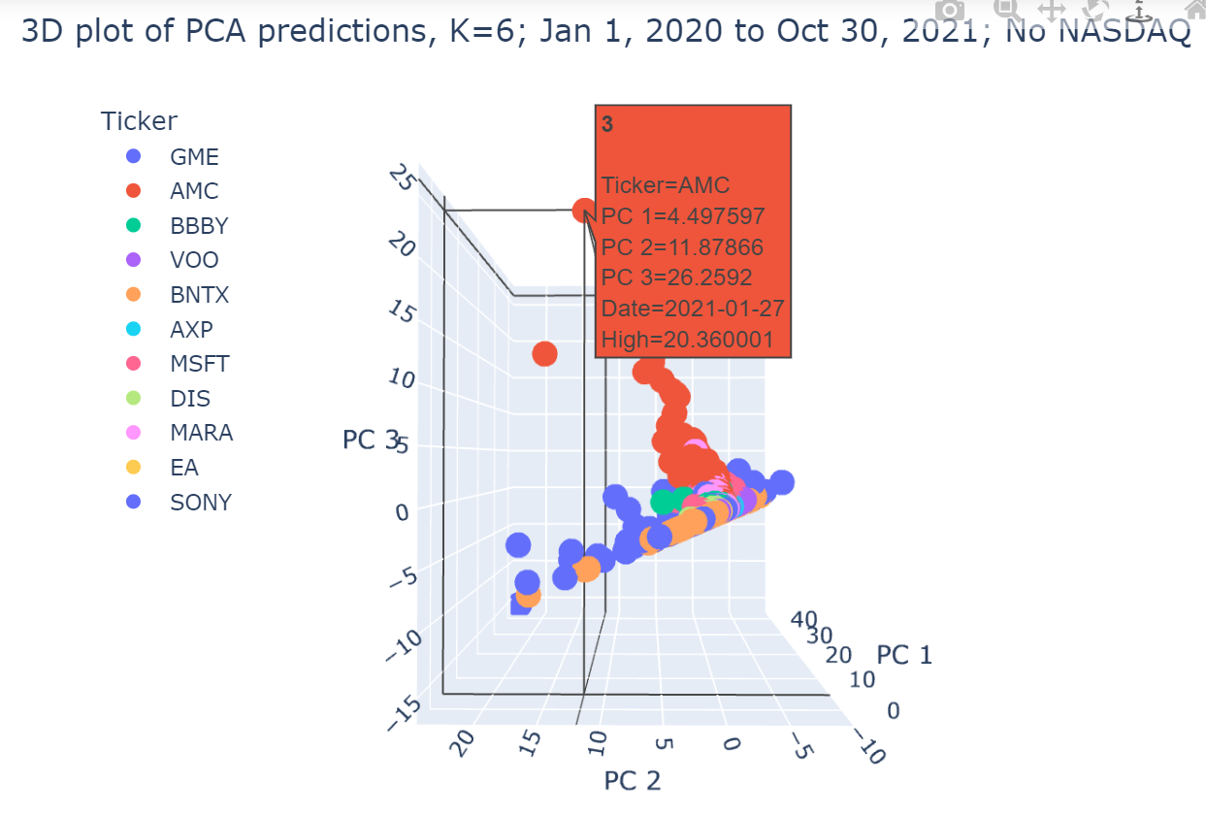
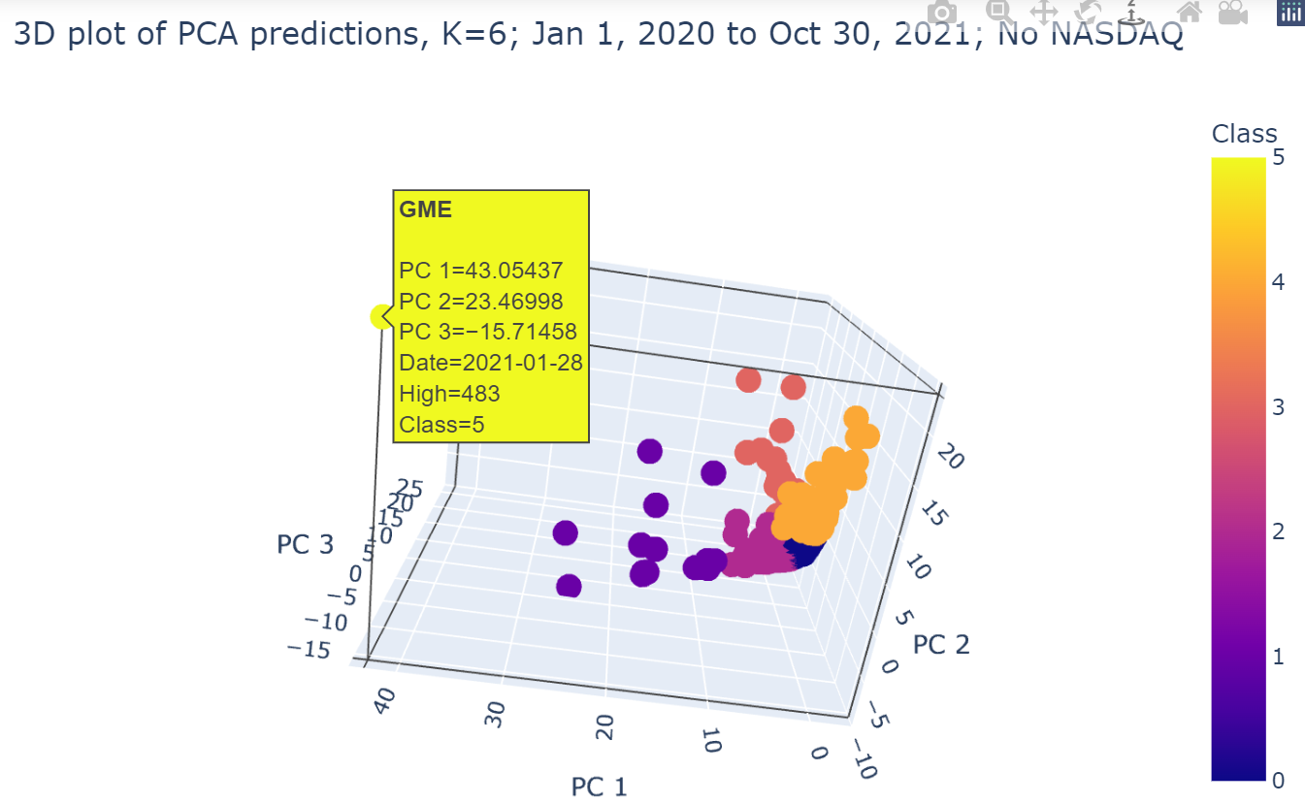
Results:11 stocks

