Slide 1
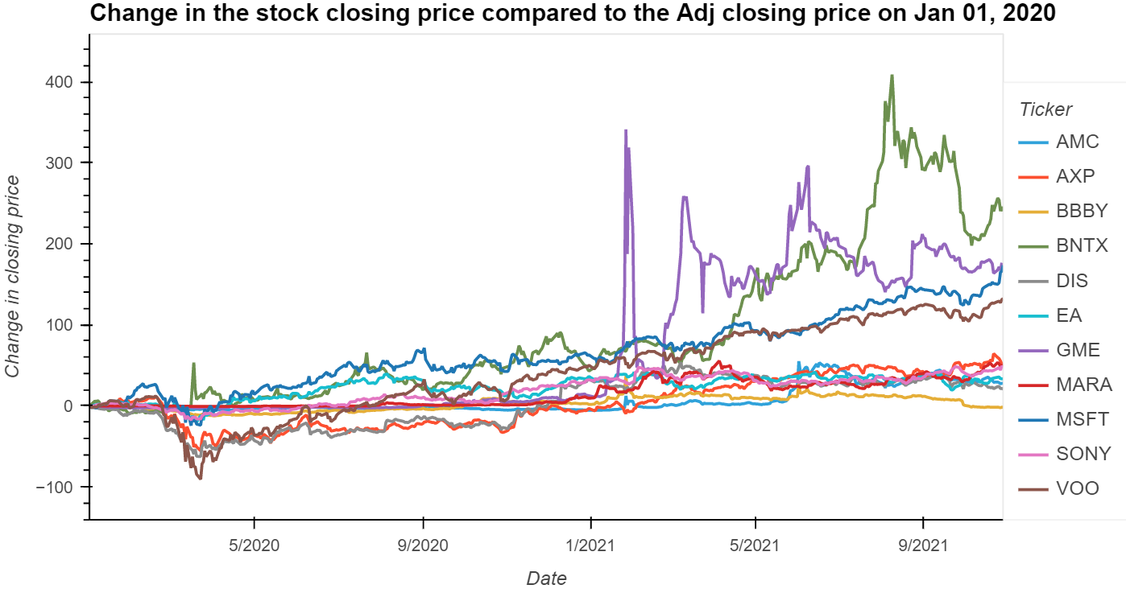
All stocks trends from Jan 01, 2020, until Oct 20, 2021
The graph showing all the stocks studied for this presentation

Slide 2
Why did we use the uml for this stock analysis project?
The scope of the project changed from the initial objective of correlating social media sentiment to stock prices.
We wanted to study the effects of social media sentiment to the change in stock price before and after the GME “explosion”.
Unfortunately, there was insufficient paired outcome of data to train and test on. We then decided to look for patterns in the stock's behavior before and after the explosion, rather than predict a classification.
In addition to comparing stock prices, we used PCA combined with K-means clustering to identify patterns in a small set of stocks before and after the explosion in stock price that occurred for game stop.

Slide 3
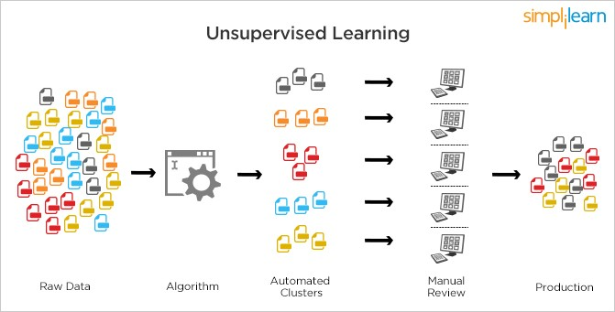
Unsupervised Machine Learning Algorithm
What is Unsupervised Machine Learning (uml)?
An uml is an unsupervised machine learning algorithm that is used to analyze and cluster unlabeled datasets.
It looks for hidden patterns or data grouping without any human intervention.
uml is a good algorithm to use for exploratory data analysis.
Image credit: Wikipedia

Slide 4
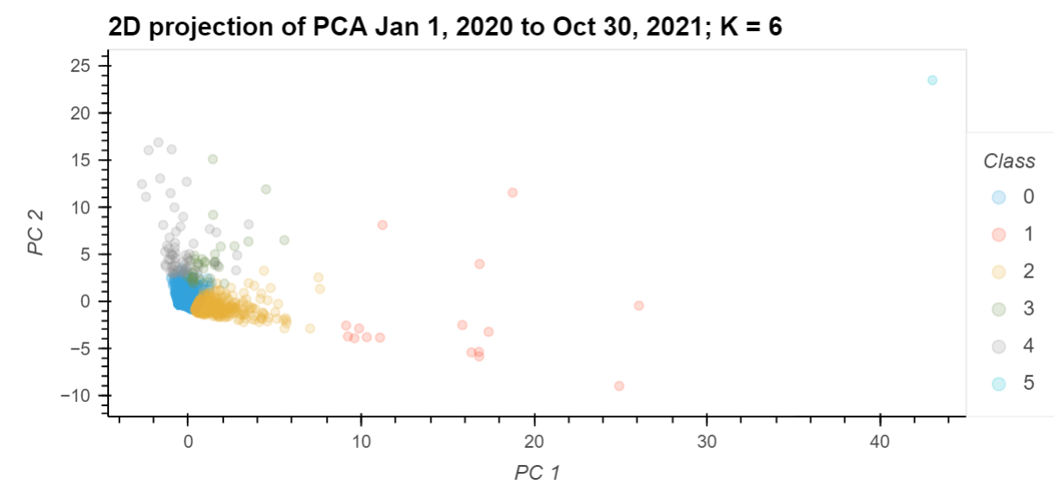
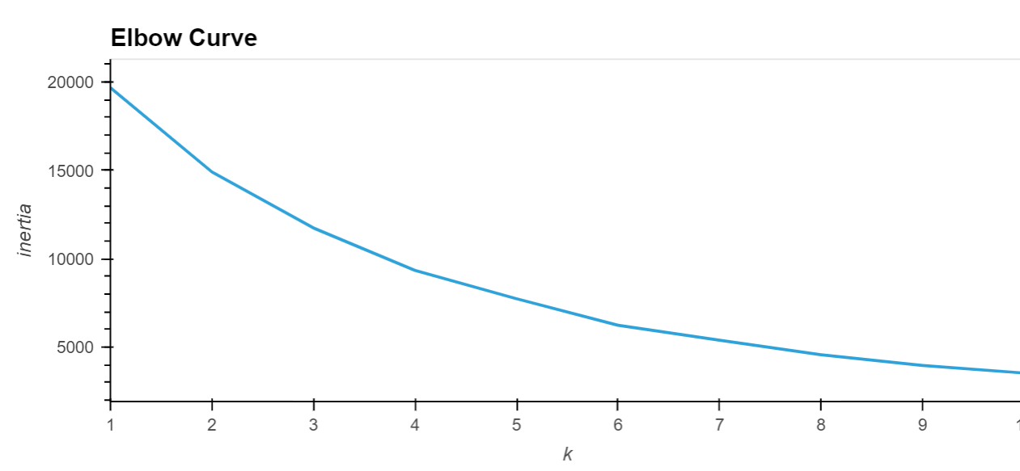
What is PCA (Principal Component Analysis?
PCA is a type of machine learning used to do exploratory data analysis and make predictive models.
It is used for dimensionality reduction of a dataset by projecting each data point onto the first few components to obtain a lower dimensional data while preserving as much of the data’s variation as possible.
What is K-Means Algorithm
K-means is a simple uml that identifies and groups similar datapoints by looking at the underlying patterns.
K-means looks for a fixed number (k) of clusters in a dataset.
The algorithm identifies k-number of centroids and allocates each data point to the nearest cluster.
Inertia: Sum of squared distance of samples to their closest cluster center.

Slide 5
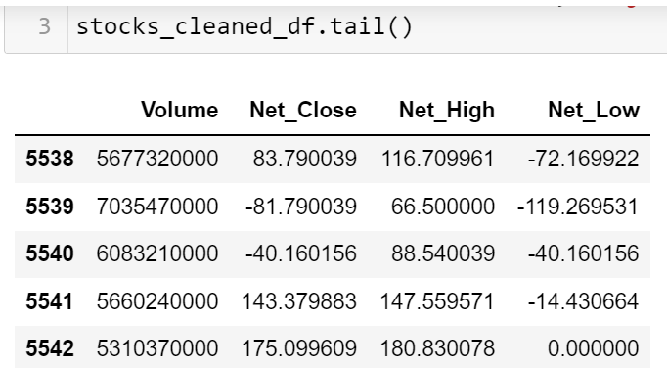
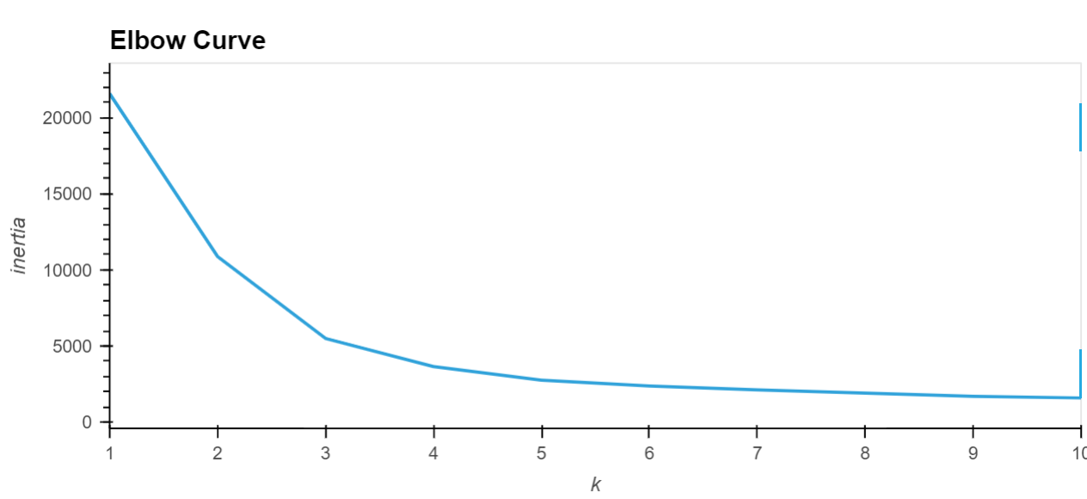
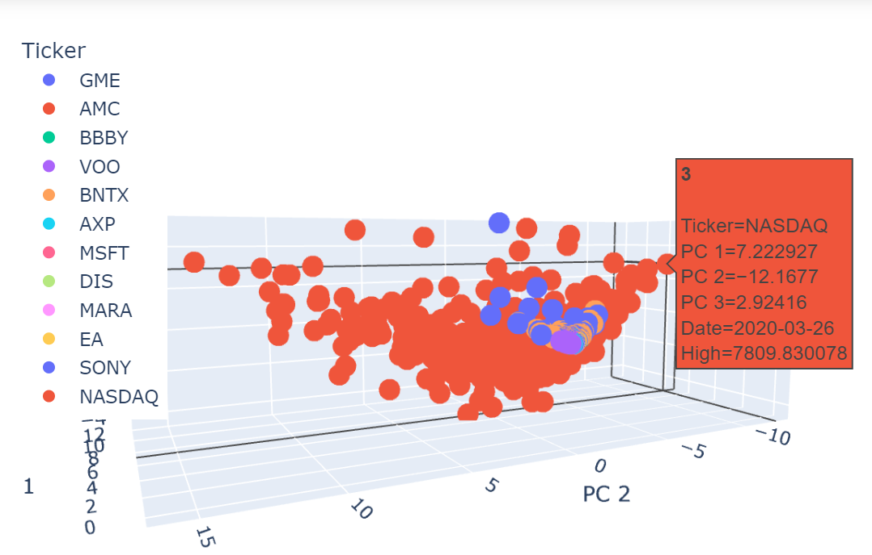
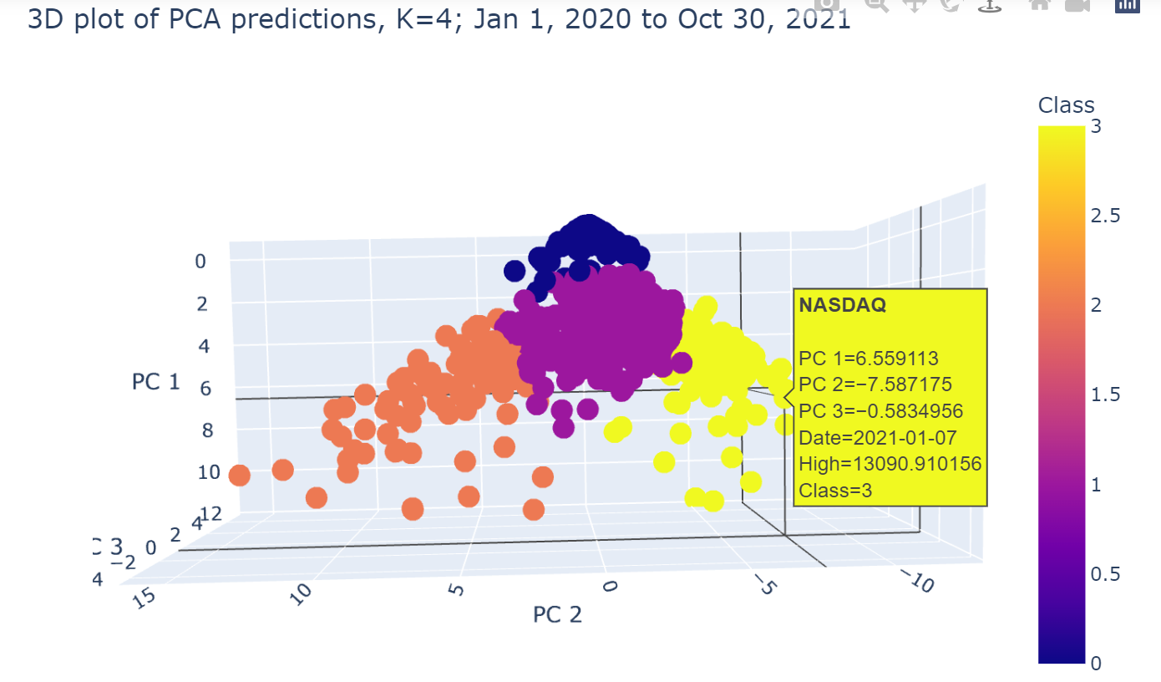
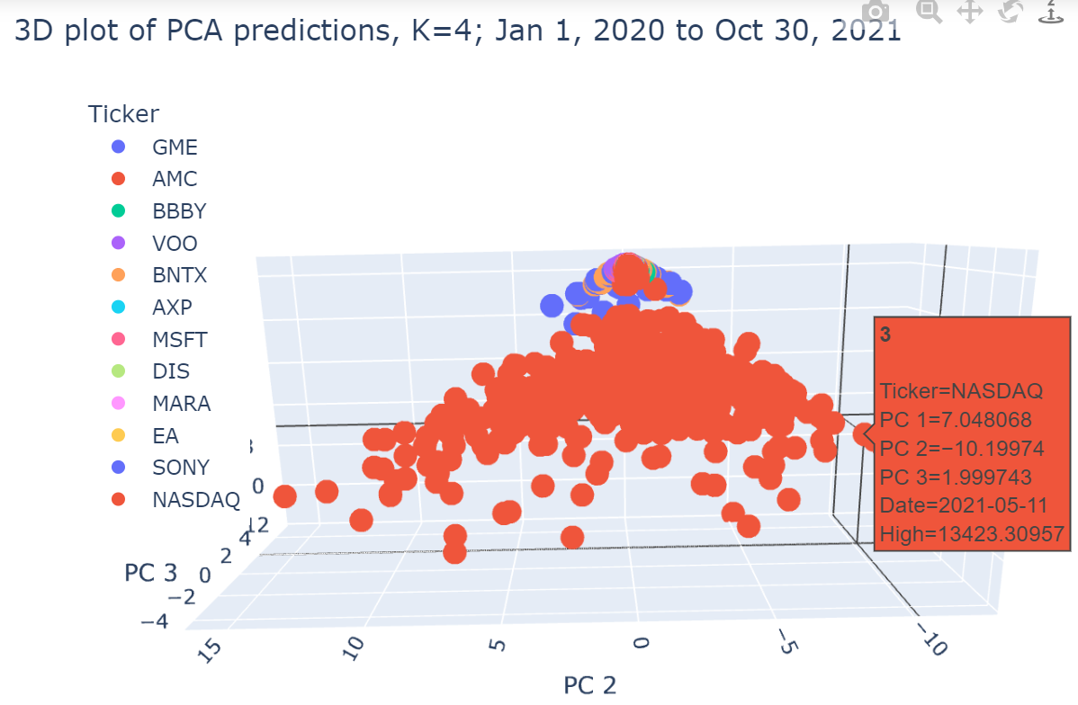
Results: All stocks

Slide 6
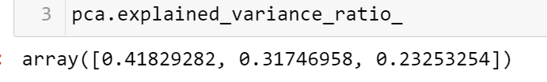
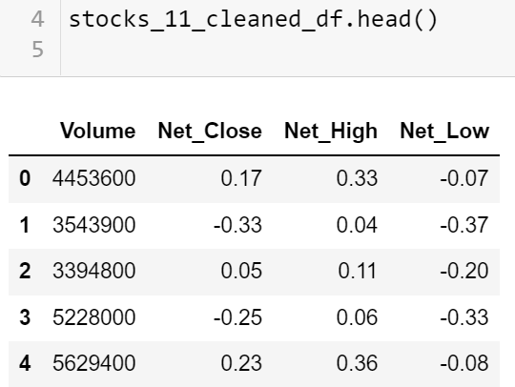
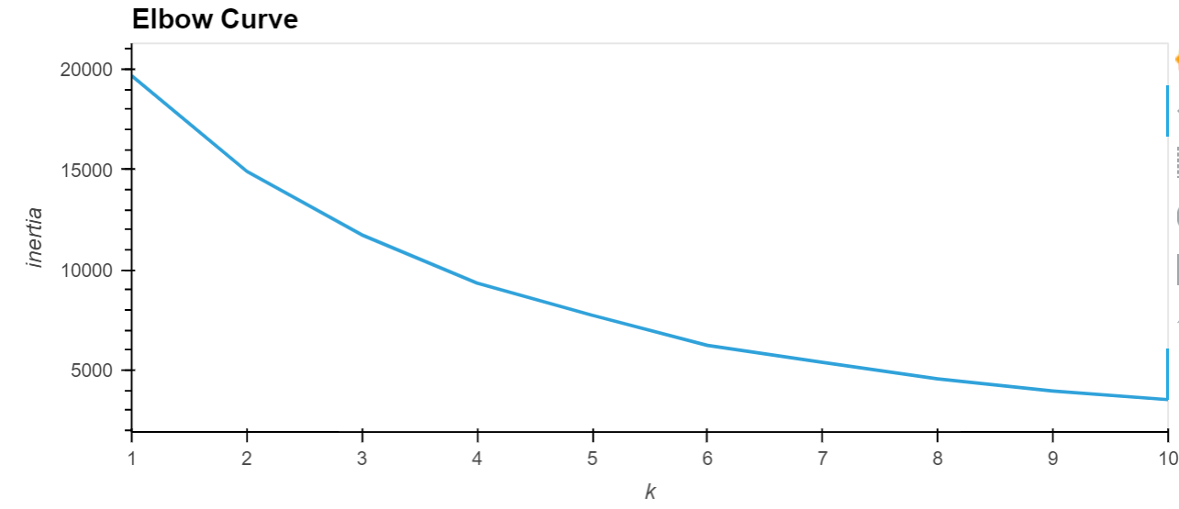
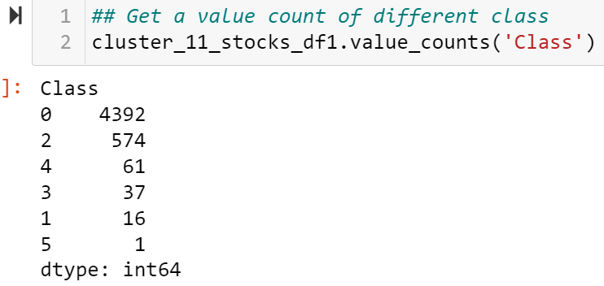
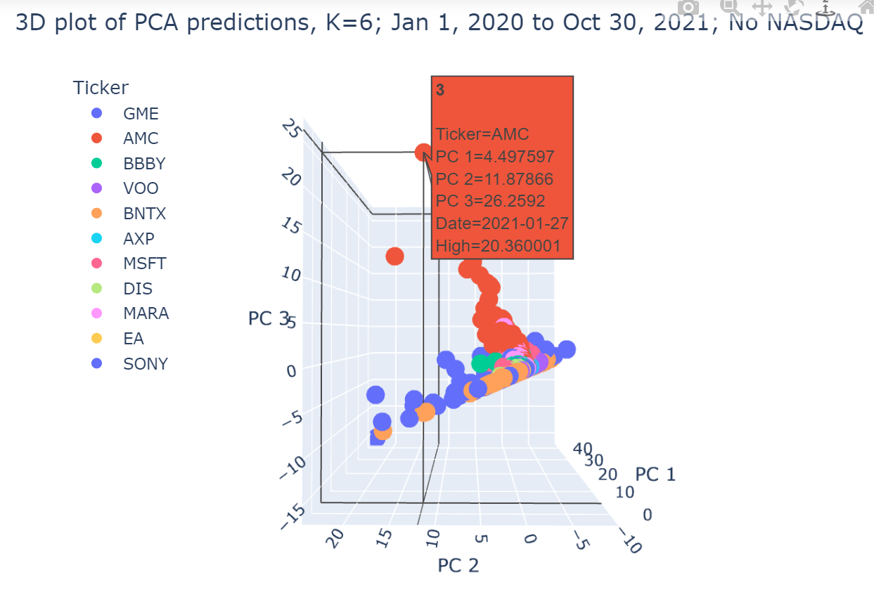
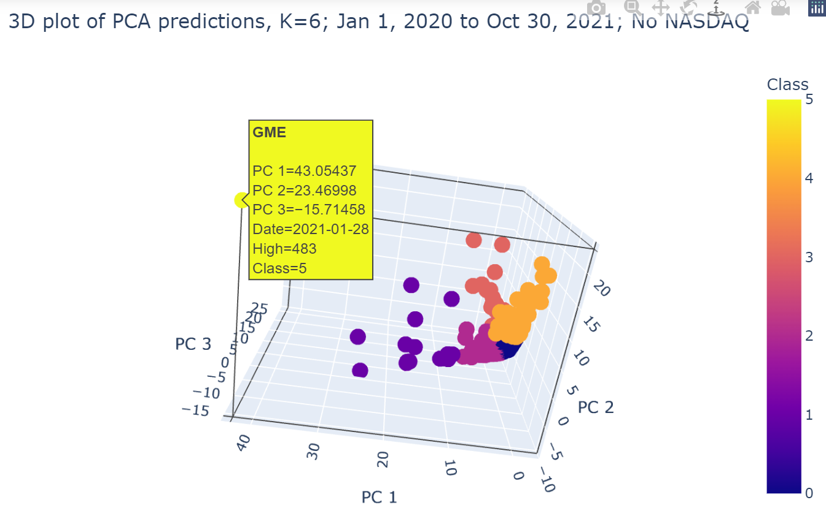
Results:11 stocks

Slide 7
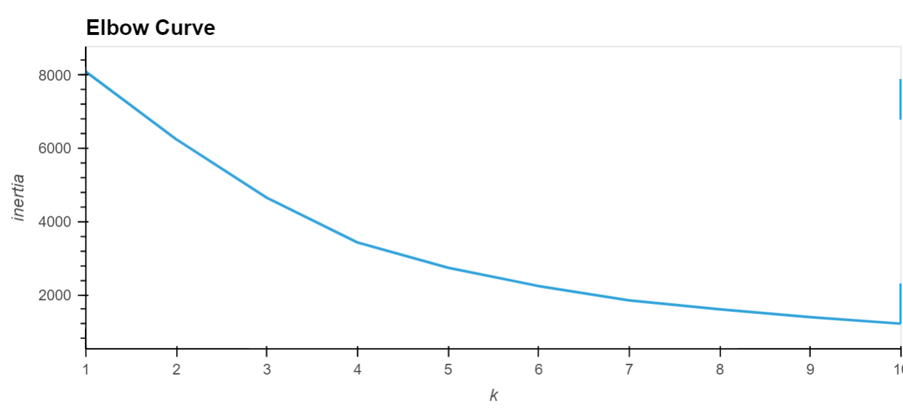
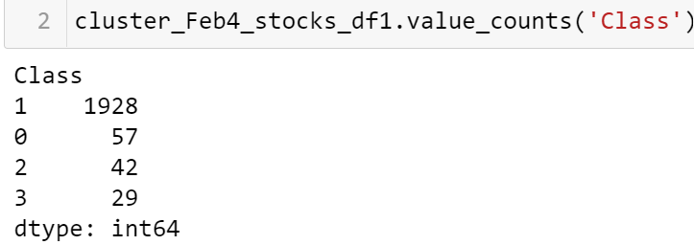
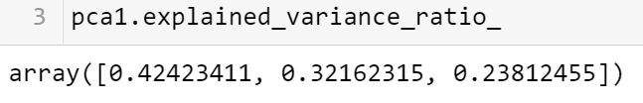
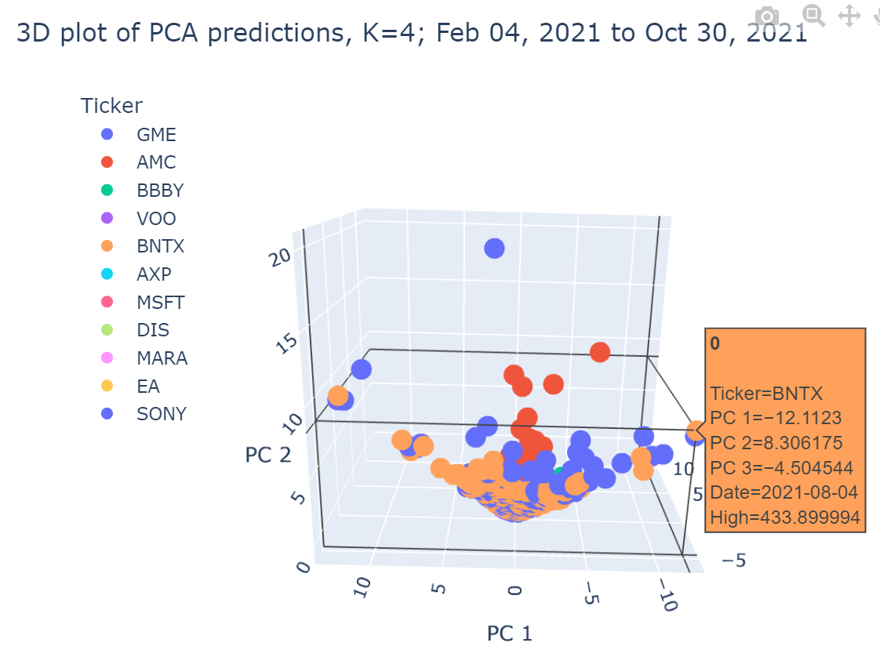
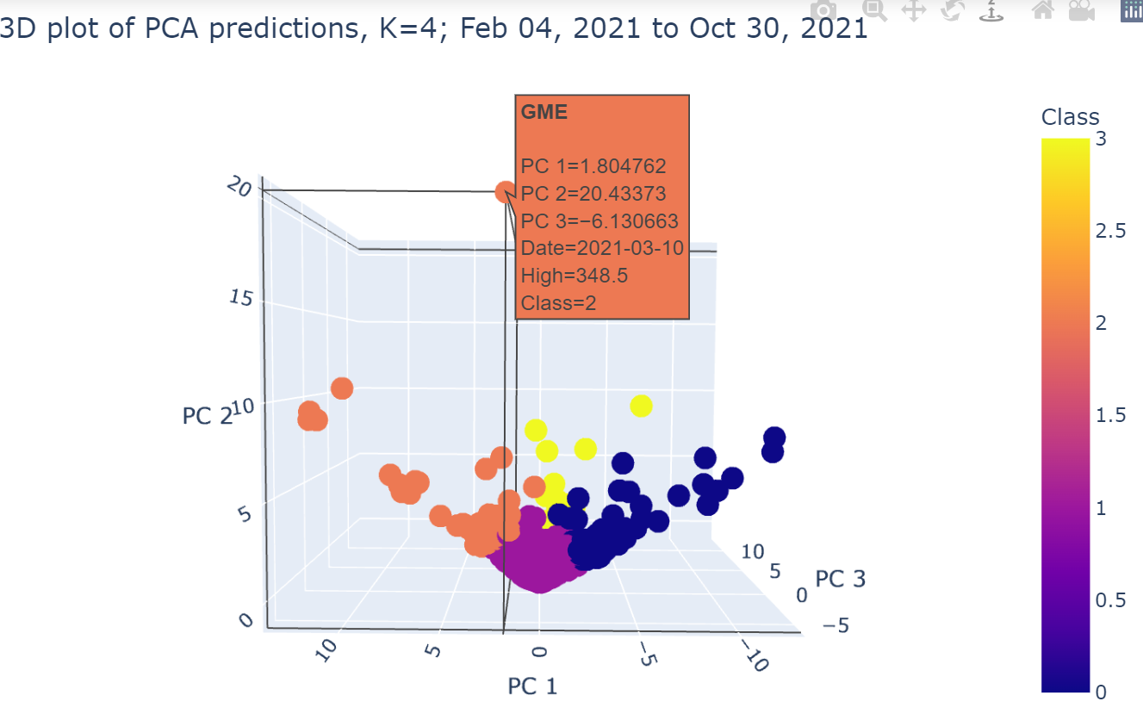
Repeat same calculation (No NASDAQ) with a shorter date range (Feb 4, 2021 until Oct 30, 2021)

Slide 8
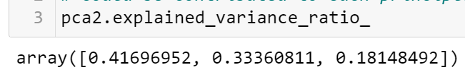
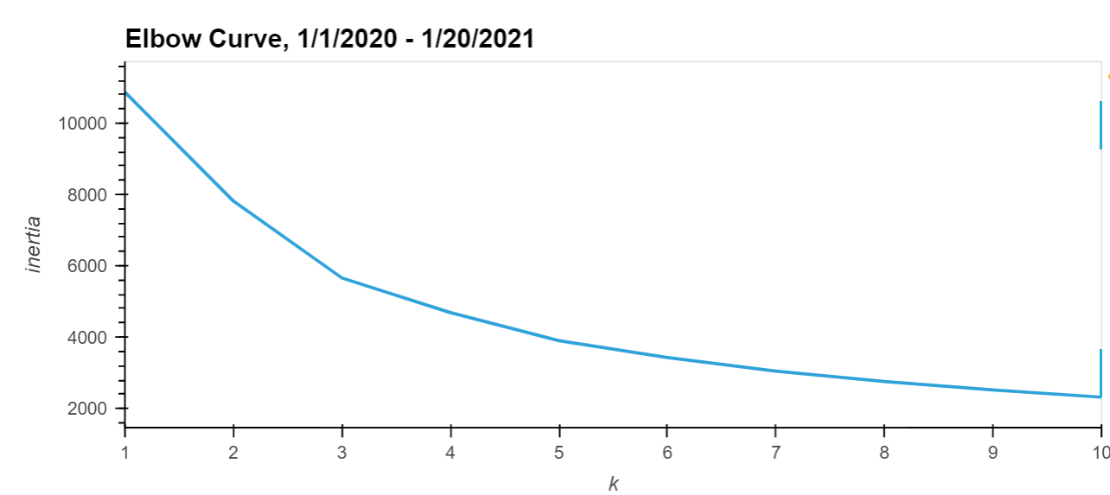
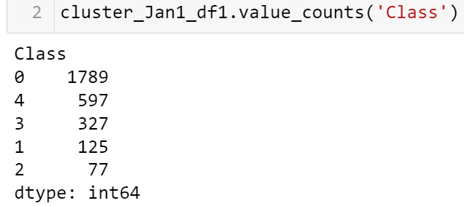
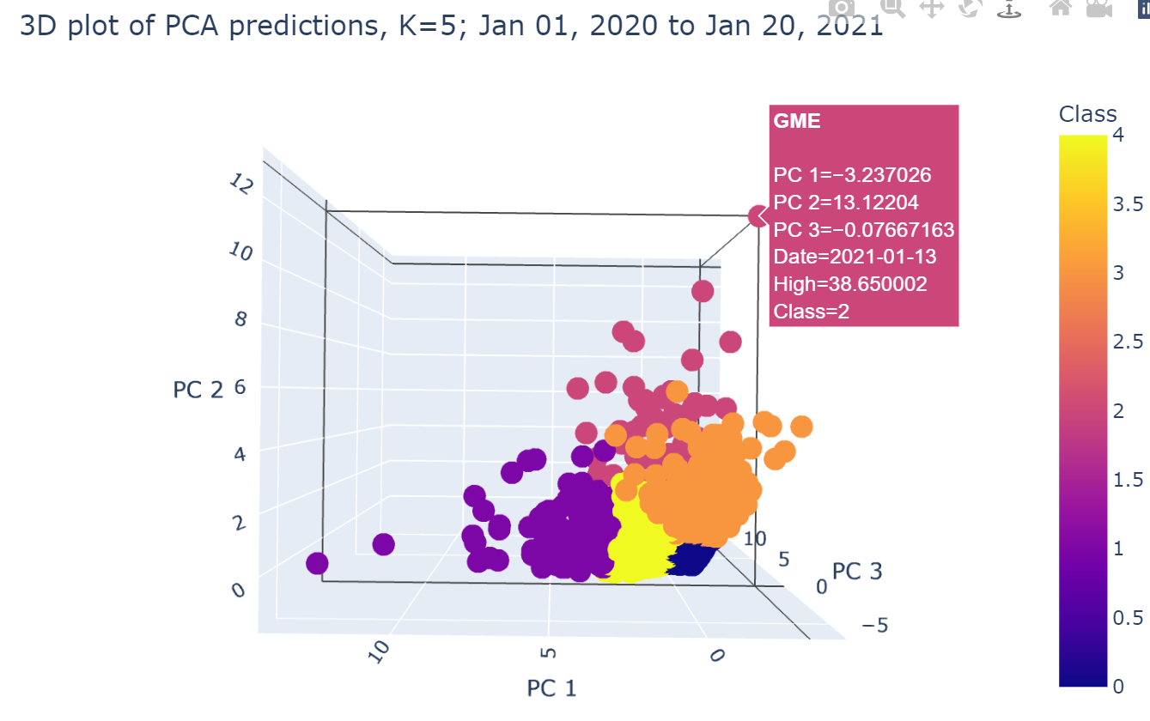
Repeat the analysis for time between Jan 1, 2020 until Jan 20, 2021. No NASDAQ

Slide 9
Repeat the analysis for time between Jan 1, 2020 until Jan 20, 2021. No NASDAQ

Slide 10
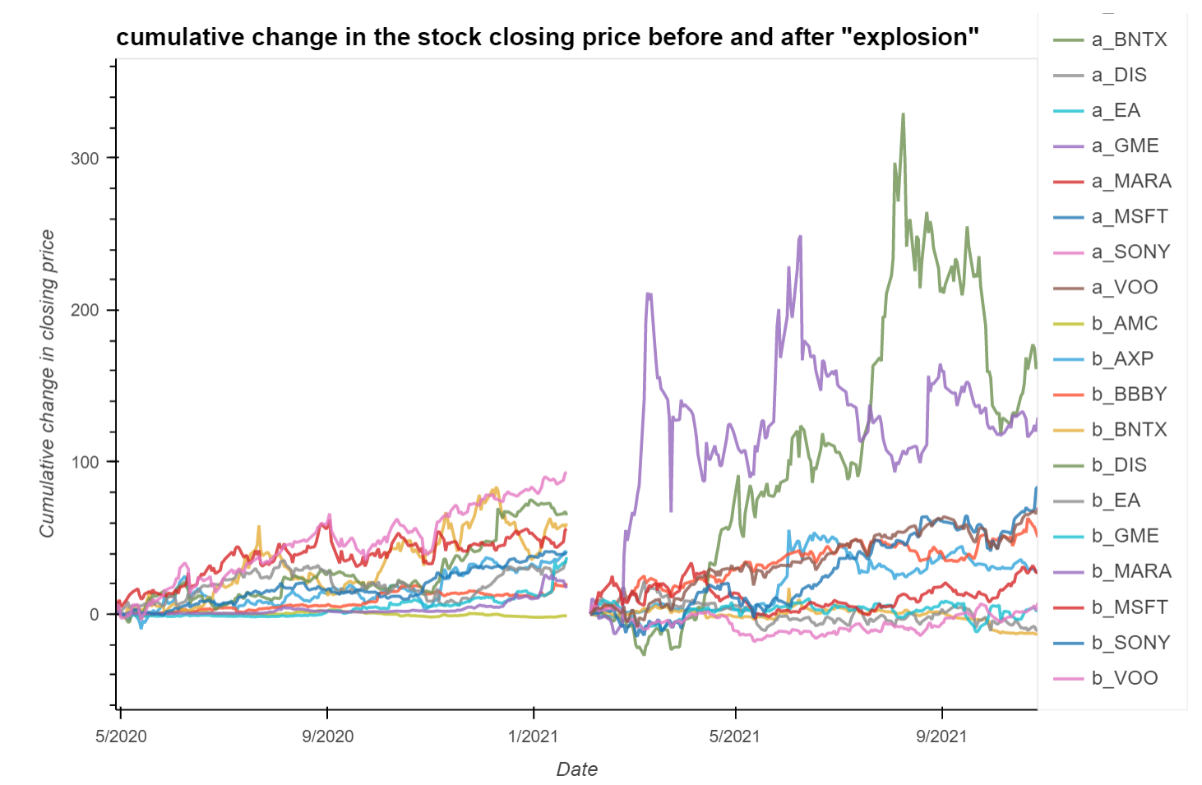
Look at Before and After

Slide 11
Before-After Fitting with K=5 clusters
Stocks before and Stock after cluster distribution
Stock Ticker | Cluster Before | Cluster After
EA | 1 | 1

