Slide 1
APOLOGETICS
IN ONE LESSON
almost
Ai1L.net
Lesson 17
Early Skeptics Became Believers; the Tomb was Empty

Slide 2
New Testament Timeline
+3 years
+30 years
Jerusalem meeting ²
Galatians, Thessalonians
Corinthians
Revelation
Paul becomes a Christian ¹
Jesus’ Life
Gospels recorded
0 AD
+2 years
50 AD
100 AD
Gospels as oral
history
¹ | Acts 9:18
² | Galatians 1:8; 2:2

Slide 3
New Testament Timeline
Jerusalem meeting ²
Galatians, 1 Thessalonians, Romans
Philemon, 1-2 Corinthians
+3 years
+30 years
Revelation
Undisputed Epistles
Jesus’ Life
Gospels recorded
Paul becomes a Christian ¹
0 AD
+2 years
50 AD
100 AD
Gospels as oral history
¹ | Acts 9:18
² | Galatians 1:8; 2:2

Slide 4
Start
Start

Slide 5
Paul in the New Testament
Jesus’ death
2nd visit (famine, Acts 11)
Paul converted
(Acts 9)
Barnabas gets Paul (Acts 11)
Galatians written
Paul dies*
4th visit (Acts 18)?
In Arabia
5th visit (Acts 21)
1st Jerusalem visit (Acts 9)
3rd Jerusalem visit
(Acts 15)
* Not recorded in
New Testament
30 AD
50 AD
70 AD

Slide 6
Paul in the New Testament
Jesus’
death
Barnabas gets Paul ⁴
Paul delivers famine relief ⁵
Paul in Arabia
1
To Damascus and back
2
Paul introduced to the apostles ³
30 AD
40 AD
50 AD
Paul becomes a Christian ¹
Paul returns to Damascus ²
¹ | Acts 9:18
² | Acts 9:23
³ | Acts 9:26-38
⁴ | Acts 11:25
⁵ | Acts 11:27-30
1
1
2

Slide 7
Paul in the New Testament
Jesus’ death
2nd visit (famine, Acts 11)
Paul converted
(Acts 9)
Barnabas gets Paul (Acts 11)
Galatians written
Paul dies*
4th visit (Acts 18)?
5th visit (Acts 21)
1st Jerusalem visit (Acts 9)
3rd Jerusalem visit
(Acts 15)
* Not recorded in
New Testament
30 AD
50 AD
70 AD

Slide 8
Paul in the New Testament
Jesus dies
2nd visit (famine, Acts 11)
Paul converted
(Acts 9)
Barnabas gets Paul (Acts 11)
Galatians written
Paul dies*
4th visit (Acts 18)?
5th visit (Acts 21)
1st Jerusalem visit (Acts 9)
3rd Jerusalem visit
(Acts 15)
* Not recorded in
New Testament
30 AD
50 AD
70 AD

Slide 9
Rome
Paul
Aristarchus
Luke
Acts implies Luke and Aristarchus traveled with Paul to Rome
Philemon
Written by Paul
Mentions Aristarchus & Luke
Colossians
Written by Paul
Mentions Aristarchus & Luke

Slide 10
✓
Abraham
✓
✕
Isaac
Ishmael
✓
✕
Jacob
Esau
✓
Jesus

Slide 11
Noah | Built an ark for a future flood
Abraham | Left his homeland to a location he didn’t even know yet
Sarah | Believed the promise of a child (though she was old and barren)
Joseph | Spoke about the exodus of the Israelites and gave instructions about his bones
Moses | “valued disgrace for Christ above the treasures of Egypt, for he was looking ahead to his reward”
Rahab | Welcomed the spies so that she could be later saved

Slide 12
Noah | Built an ark for a future flood
Abraham | Left his homeland to a location he didn’t even know yet
Sarah | Believed the promise of a child (though she was old and barren)
Joseph | Spoke about the exodus of the Israelites and gave instructions about his bones.
Moses | “valued disgrace for Christ above the treasures of Egypt, for he was looking ahead to his reward.”
Rahab | Welcomed the spies so that she could be later saved

Slide 13
Chart Title
This is the chart sub-title

Slide 14
Chart Title
This is the chart sub-title

Slide 15
Athenians | Paul
A special day | Mankind’s seasons are set by God (17:25)
Temple | You dwell in him (17:28)
Introducing a new God | Not a new God, and you need to be introduced to him (17:30)
They are the judge | God judges you (17:31)

Slide 16
Hebrew | Aleph | Bet | Gimel
Greek | Alpha | Beta | Gamma
English | A | B | C
Latin | A | B | C
LEVEL 1
LEVEL 2
LEVEL 3

Slide 17
Chart Title
This is the chart sub-title

Slide 18
Church Attendance
1972-2014 (General Social Surveys)

Slide 19
Chart Title
This is the chart sub-title

Slide 20
Architecture
This is the sub-title
Alpha
Beta
Primary
Delta
Gamma
Epsilon
Zeta
Secondary
Eta
Theta
Tertiary

Slide 21
Architecture
This is the sub-title
Alpha
Beta
Primary
Gamma
Delta
Epsilon
Secondary
Zeta
Eta
Theta
Tertiary

Slide 22
Options
This is the sub-title
Option 1
Alpha
Option 2
✓
Beta
Option 3
Gamma
Option 4
Delta

Slide 23
List
This is the sub-title
Alpha
Beta
Gamma
Delta

Slide 24
List
This is the sub-title
1
Alpha is the first letter in the Greek language and aleph is the first in Hebrew
2
Beta is the second letter in the Greek language
3
Gamma is the third letter in the Greek language
4
Delta is the fourth letter in the Greek language

Slide 25
List
1
Alpha is the first letter in the Greek language and aleph is the first in Hebrew
2
Beta is the second letter in the Greek language
3
Gamma is the third letter in the Greek language
4
Delta is the fourth letter in the Greek language

Slide 26
Key Takeaways
1
We can have confidence in the text despite some questions
2
Textual Criticism is a little complicated; know that people sometimes use this to their advantage
3
The New Testament has an “embarrassment of riches” compared to other ancient works
4
Don’t hold ancient manuscript culture to modern print culture standards

Slide 27
IDEA IN BRIEF
What?
Use questions to engage others (not just statements)
Why?
Makes your job easier
Is more effective
How?
By asking:
What do you mean by that?
How did you come to that conclusion?
Could you help me with ___?

Slide 28
Some question goes here
1

Slide 29
“This is the sort of truth that is hard to explain because it is a fact; but it is a fact to which we can call witnesses”
G.K. Chesterton The Everlasting Man

Slide 30
“This is the sort of truth that is hard to explain because it is a fact; but it is a fact to which we can call witnesses”
G.K. Chesterton The Everlasting Man

Slide 31
Timeline
This is the sub-title
Galatians, Thessalonians
Corinthians
Revelation
Jesus’ Life
Gospels recorded
0 AD
50 AD
100 AD

Slide 32
Timeline
This is the sub-title
Jesus
dies
Galatians written
Gospels recorded
Revelation written
30 AD
52 AD
60-70 AD
90 AD

Slide 33
100%
0%
0%
0%
NT books written in 1st century
Apocryphal “gospels” written in 1st century
Apocryphal “gospels” written in 1st century
Apocryphal “gospels” written in 1st century

Slide 34
5,500+
Greek NT Manuscripts

Slide 35
5,500+
Greek NT Manuscripts

Slide 36
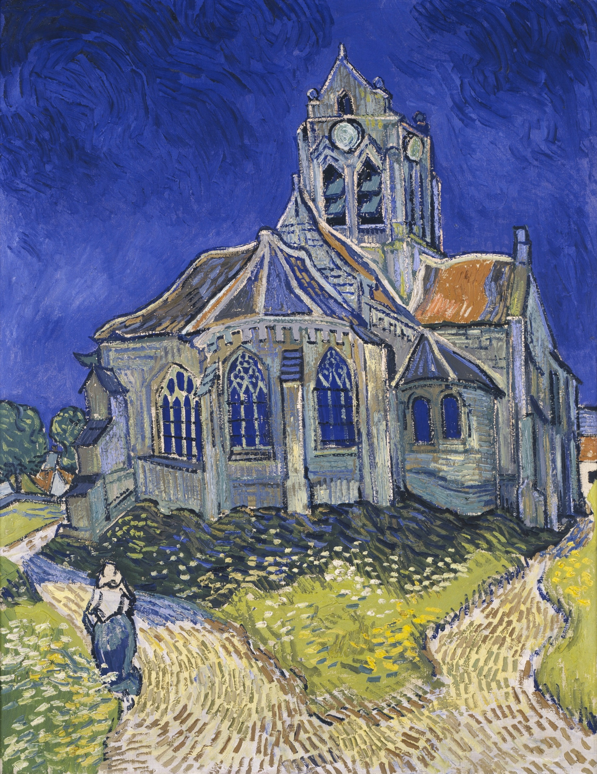
The Church at Auvers
Vincent van Gogh (June 1890)

Slide 37
The Church at Auvers
Vincent van Gogh (June 1890)

Slide 38
The Church at Auvers
Vincent van Gogh (June 1890)

Slide 39
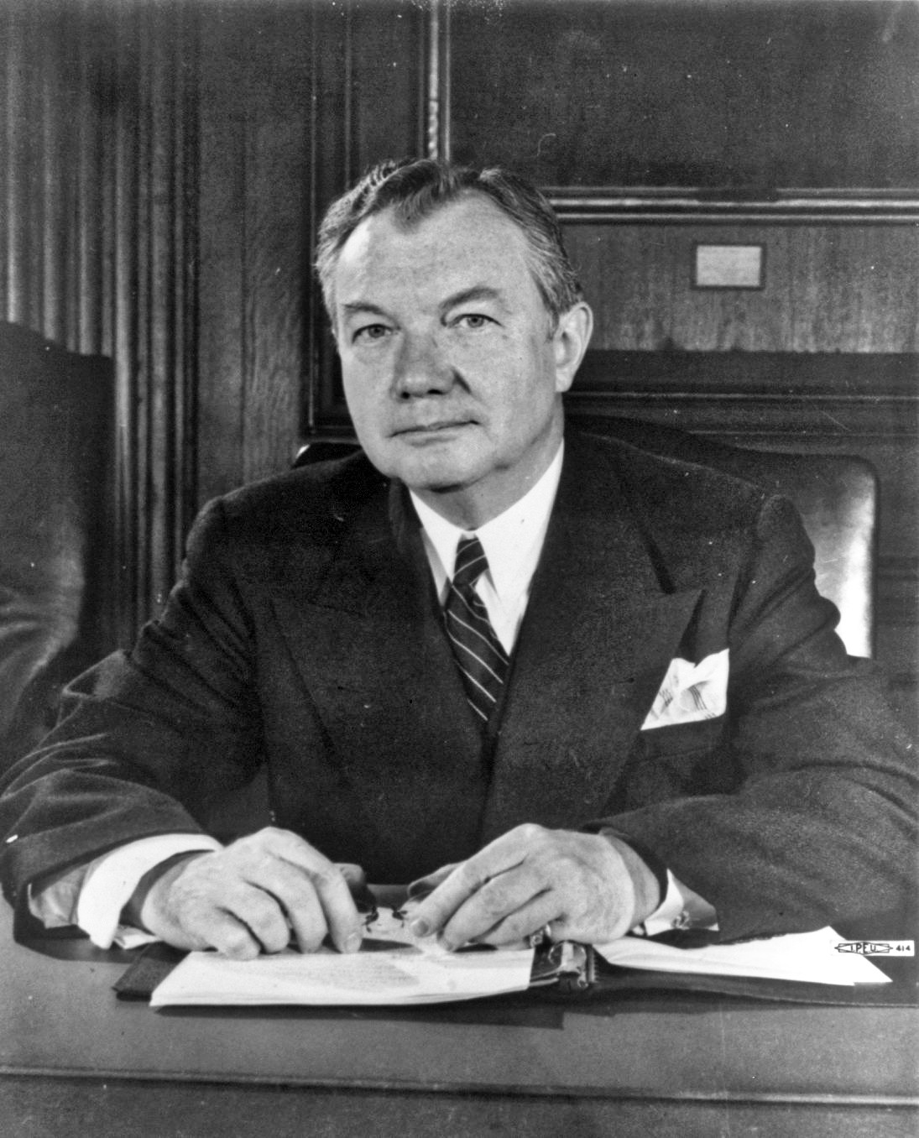
“there is in the tradition and experience which we include under the name of ‘the law’, a wisdom higher than that of any legislature or its statutes and more sure than that of any court or its decisions.”
Justice Robert H. Jackson

Slide 40
“there is in the tradition and experience which we include under the name of ‘the law’, a wisdom higher than that of any legislature or its statutes and more sure than that of any court or its decisions.”
JUSTICE ROBERT H. JACKSON

Slide 41
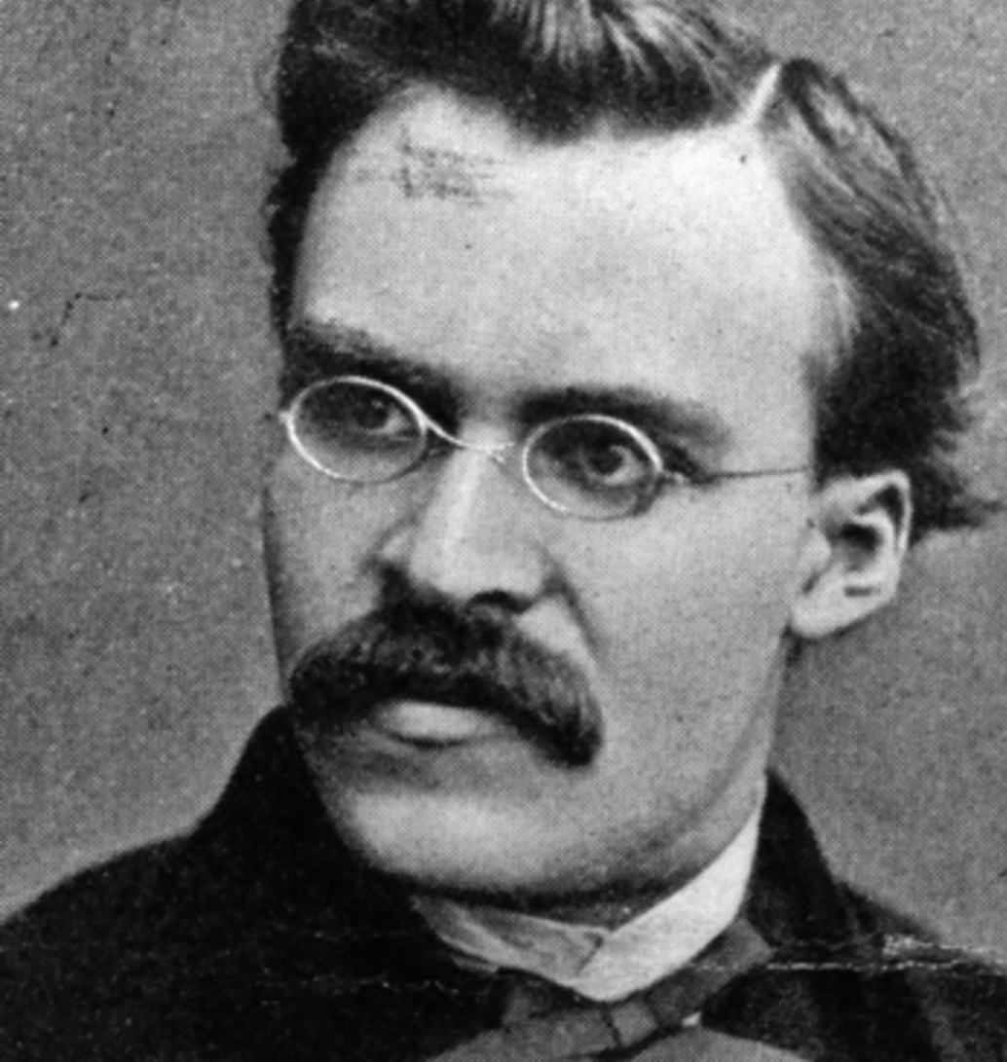
“God is dead. God remains dead. And we have killed him. How shall we comfort ourselves, the murderers of all murderers? What was holiest and mightiest of all that the world has yet owned has bled to death under our knives: who will wipe this blood off us? What water is there for us to clean ourselves?”
FRIEDRICH NIETZSCHE Thus Spoke Zarathustra

Slide 42

But we are a colony of heaven on earth as we cling tightly to our life-giver, the Lord Jesus Christ, …
using his matchless power, he continually subdues everything to himself.
Philippians 3:20-21

