Slide 1
Domain Adaptation
Hung-yi Lee 李宏毅
Notes:
TBA: label confusion
TBA: Universal domain adaptation
TBA: Style transfer
=====
Ref: https://dl.acm.org/doi/pdf/10.1145/3400066
?t=180
Domain Separation Network (DSN) (NIPS 2016) 除了domain adversarial training 的另一種domain adaptation方法，主要是用有一點點feature disentanglement的方式，透過一個share encoder將兩個不同domain的相同資訊學起來、而兩個不同domain相異的資訊則是使用private source encoder & private target encoder學起來

Slide 2



You have learned a lot about ML. Training a classifier is not a big deal for you. ☺
Training
Data
Testing
Data
99.5%
57.5%
The results are from: http://proceedings.mlr.press/v37/ganin15.pdf
Domain shift: Training and testing data have different distributions.
Domain adaptation
Transfer learning: https://youtu.be/qD6iD4TFsdQ

Slide 3

Domain Shift
Training Data
Testing Data
Source
Domain
Target Domain
1
2
3
4
5
1
2
3
4
5
This is “0”.
This is “1”.

Slide 4
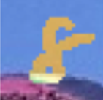
Domain Adaptation
Source Domain (with labeled data)
“4”
“0”
“1”
Knowledge of target domain
Idea: training a model by source data, then fine-tune the model by target data
Challenge: only limited target data, so be careful about overfitting
“8”
Little but
labeled

Slide 5
Domain Adaptation
Source Domain (with labeled data)
“4”
“0”
“1”
Knowledge of target domain
“8”
Large amount of unlabeled data
Little but
labeled

Slide 6
Basic Idea
Learn to ignore colors
Feature Extractor
(network)
feature
Source
The same distribution
Different
Target
Feature Extractor
(network)
feature

Slide 7




Domain Adversarial Training
image
class distribution
Feature Extractor
Label
Predictor
“4”
Source
(labeled)
blue points
Target
(unlabeled)
red points

Slide 8


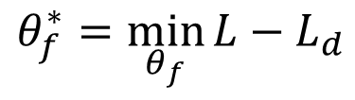



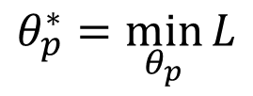


Domain Adversarial Training
$$θ_{f}^{∗}=\min_{θ_{f}}{L−L_{d}}$$
?
always zero?
$$θ_{f}$$
$$θ_{p}$$
Feature Extractor
Label
Predictor
“4”
$$L$$
Generator
$$θ_{p}^{∗}=\min_{θ_{p}}{L}$$
Feature extractor: Learn to “fool” domain classifier
$$θ_{d}^{∗}=\min_{θ_{d}}{L_{d} }$$
$$L_{d}$$
$$θ_{d}$$
Domain
Classifier
Source?
Target?
Also need to support label predictor
Discriminator
Notes:
Simultaneous Deep Transfer Across Domains and Tasks
Eric Tzeng, Judy Hoffman, Trevor Darrell, Kate Saenko

Slide 9
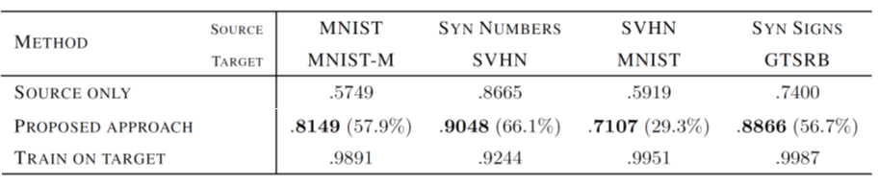
Domain Adversarial Training
Yaroslav Ganin, Victor Lempitsky, Unsupervised Domain Adaptation by Backpropagation, ICML, 2015
Hana Ajakan, Pascal Germain, Hugo Larochelle, François Laviolette, Mario Marchand, Domain-Adversarial Training of Neural Networks, JMLR, 2016

Slide 10
Limitation
class 1 (source)
Target data
(class unknown)
class 2 (source)
Decision boundaries learned from source domain
Source and target data are aligned, but ……
Target data (unlabeled far from boundary)

Slide 11

Considering Decision Boundary
unlabeled
Small entropy
Feature Extractor
Label
Predictor
1
2
3
4
5
unlabeled
Large entropy
Feature Extractor
Label
Predictor
1
2
3
4
5
Used in Decision-boundary Iterative Refinement Training with a Teacher (DIRT-T)
https://arxiv.org/abs/1802.08735
Maximum Classifier Discrepancy
https://arxiv.org/abs/1712.02560
Notes:
經過實驗過後，我們最後決定用Maximum Classifier Discrepancy (2019)的MCD來當作boss baseline。一樣是針對boundary的部分進行改善
https://arxiv.org/pdf/1908.04951.pdf

Slide 12
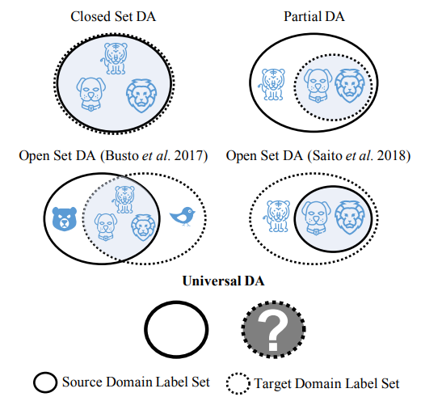
Outlook
Universal domain adaptation
https://openaccess.thecvf.com/content_CVPR_2019/html/You_Universal_Domain_Adaptation_CVPR_2019_paper.html

Slide 13
Domain Adaptation
Source Domain (with labeled data)
“4”
“0”
“1”
Knowledge of target domain
Testing Time Training (TTT)
“8”
https://arxiv.org/abs/1909.13231
little &
unlabeled
Large amount of unlabeled data
Little but
labeled
Notes:
Source of image: https://yueatsprograms.github.io/ttt/home.html
https://www.youtube.com/watch?v=NbuWxmMco30

Slide 14

Domain Adaptation
Source Domain (with labeled data)
“4”
“0”
“1”
Knowledge of target domain
“8”
little &
unlabeled
Large amount of unlabeled data
Little but
labeled

Slide 15
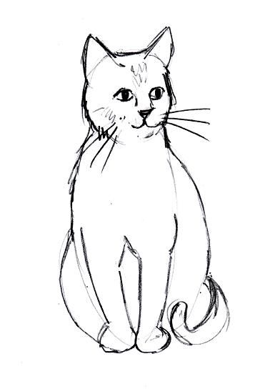
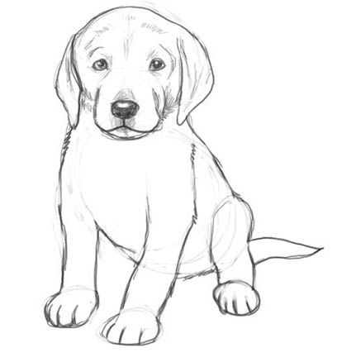
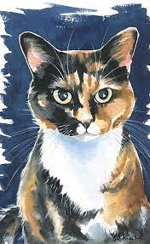
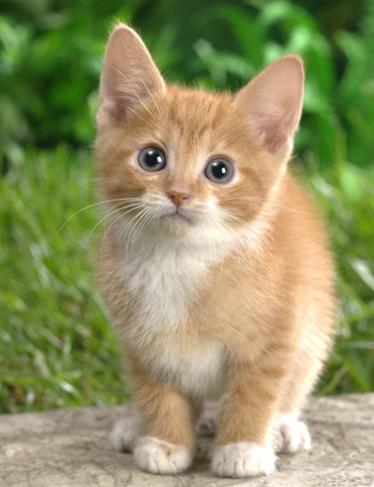

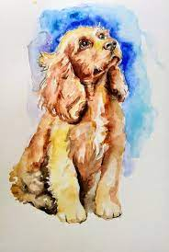


Domain Generalization
https://ieeexplore.ieee.org/document/8578664
cat
dog
cat
dog
cat
dog
cat
dog
Training
Testing
cat
dog
cat
dog
cat
dog
cat
dog
Training
Testing
https://arxiv.org/abs/2003.13216
Notes:
Domain Generalization With Adversarial Feature Learning

Slide 16
Concluding Remarks
Source Domain (with labeled data)
“4”
“0”
“1”
Knowledge of target domain
“8”
little &
unlabeled
Large amount of unlabeled data
Little but
labeled

