Slide 1

Life Long Learning
Hung-yi Lee
李宏毅
https://www.pearsonlearned.com/lifelong-learning-will-help-workers-navigate-future-work/
Notes:
題目: https://docs.google.com/document/d/1UuerFJkA6ihiyYDvXvPw-u51XTQVNHgVBmSJqf_ZkOg/edit
===
題外話：使用weight pruning的訓練技巧做在lifelong learning上的方法就有幾篇如packnet和中研院的CPG。
====
Three scenarios for continual learning
=====
In general, LLL approaches can be categorized into three types. Regularization-based methods aim to consolidate essential parameters in a model by adding regularization terms in the loss function [3–7]. Architecture-based methods try to assign some model capacity for each task or expand the model size to handle additional tasks [8–10]. Data-based methods then try to save or generate some samples from the past tasks to prevent catastrophic forgetting [11–15]. Studies of LLL have been reported more on computer vision [3, 5–7, 9–12, 14–19] and reinforcement learning [3, 4, 8, 9, 20], yet much less on automatic speech recognition (ASR) tasks [21–24].
========
作業裡,會請同學跑過baseline, EWC, Synaptic Intelligence(SI) 的 easy part (不用改任何一行code只要run), medium是實做MAS, Riemann Walk( EWC + SI ) 的方法(挖空格實做)，strong的規劃是和去年一樣的 SCP(ICLR 2020 的spotlight) (挖空格實做),
希望老師上課可以提到 MAS, Riemann Walk, Synaptic Intelligence的作法細節
可以的話，交待部份的 SCP(ICLR 2020 的spotlight) 背景
(全部做完便會完成6種作法)
https://vimeo.com/238242232 https://fzenke.net/wp-content/uploads/2018/03/icml_15min_v1.0_web.pdf

Slide 2

Life Long Learning (終身學習)
https://world.edu/lifelong-learning-part-time-undergraduate-provision-crisis/

Slide 3

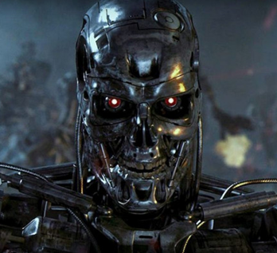
What people think about AI …
I can solve task 1.
I can solve tasks 1&2.
I can solve tasks 1&2&3.
…
Learning Task 1
Learning Task 2
Learning Task 3
Life Long Learning (LLL), Continuous Learning, Never Ending Learning, Incremental Learning
Notes:
https://vlomonaco.github.io/core50/benchmarks.html

Slide 4
Life Long Learning in real-world applications
“New task”
Feedback
“Old task”
Labelled Data
Model
Online
Notes:
In real-world applications, the input distribution of the data (e.g., sensory inputs) is prone
to constant changes due to environmental variations (e.g., seasonal changes), exposure to new situations
(e.g., change in the surface friction), sensory malfunction (e.g., water droplets on a camera),
among others.

Slide 5
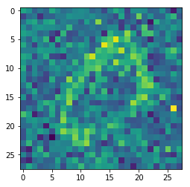
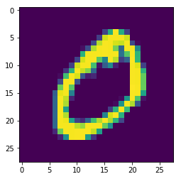
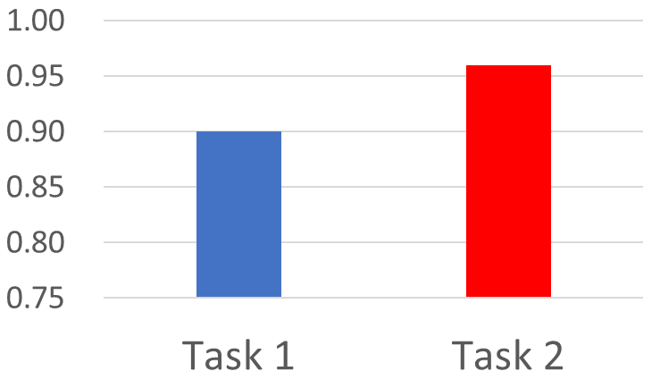
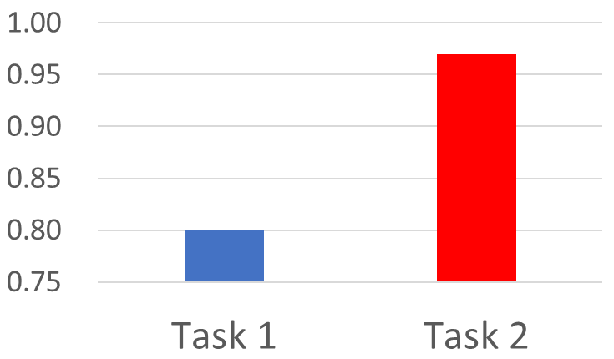
Example
=
3 layers, 50 neurons each
Task 1
Task 2
This is “0”.
This is “0”.
96%
97%
90%
Forget!!!
80%

Slide 6
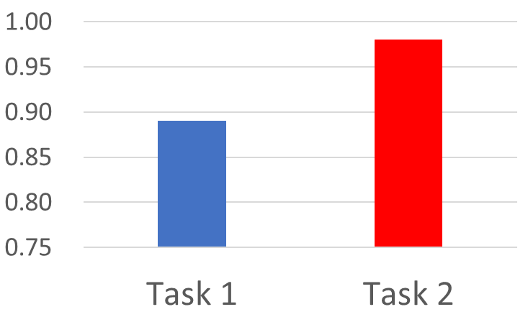
Learning Task 1
Learning Task 2
96%
97%
90%
Forget!!!
80%
98%
Learning Task 1
89%
Learning Task 2
The network has enough capacity to learn both tasks.

Slide 7
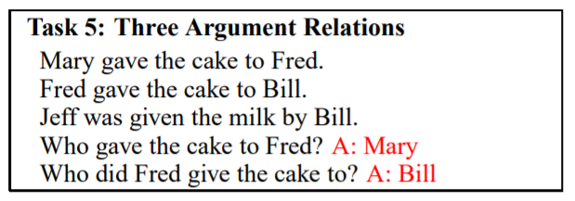
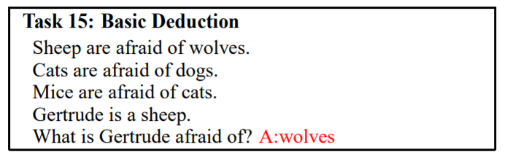
Example
QA: Given a document, answer the question based on the document.
There are 20 QA tasks in bAbi corpus.
Train a QA model through the 20 tasks
Notes:
This is hw 7

Slide 8
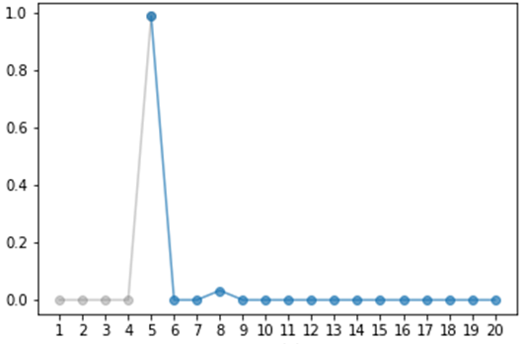
Example
Accuracy
Task 5
Machine forget what it has learned?!
Machine learns 20 tasks sequentially

Slide 9
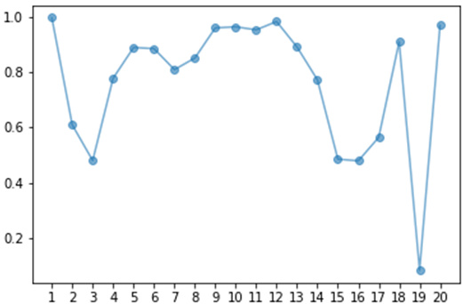
Example
感謝何振豪同學提供實驗結果
Task 5 Accuracy
Accuracy of all 20 tasks
Learning 20 tasks sequentially
Learning 20 tasks simultaneously
Not because machine are not able to do it, but it just didn't do it.
是不為也
非不能也

Slide 10
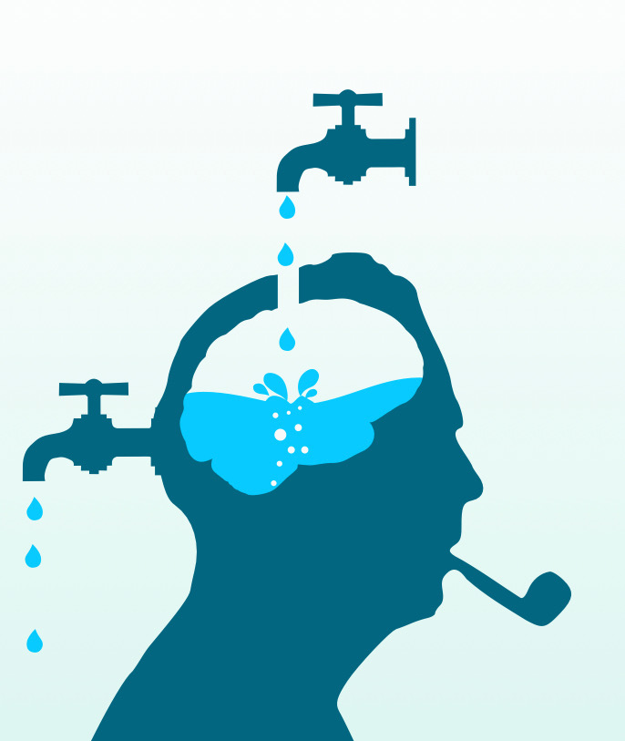
Catastrophic Forgetting
Notes:
Intransigence: ɪnˋtrænsədʒəns n.
不妥協；不讓步

Slide 11
Wait a minute ……
Learning Task 1
Learning Task 2
Multi-task training can solve the problem!
Multi-task training can be considered as the upper bound of LLL.
Using all the data for training
Computation issue
Training Data
for Task 1
Training Data
for Task 999
Training Data
for Task 1000
……
Always keep the data
Storage issue

Slide 12

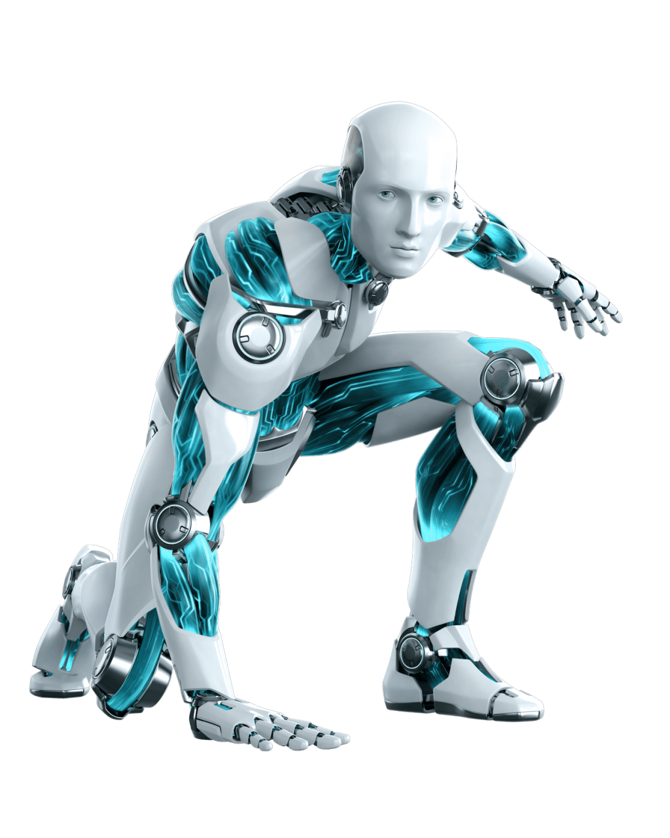
Wait a minute ……
Train a model for each task
Learning Task 1
Learning Task 2
Learning Task 3
Eventually we cannot store all the models …
Knowledge cannot transfer across different tasks

Slide 13
Life-Long v.s. Transfer
I can do task 2 because I have learned task 1.
Transfer Learning:
fine-tune
(We don’t care whether machine can still do task 1.)
Learning Task 1
Learning Task 2
Even though I have learned task 2, I do not forget task 1.
Life-long Learning:

Slide 14
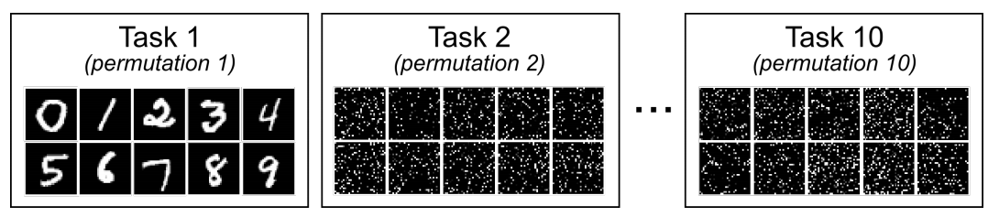
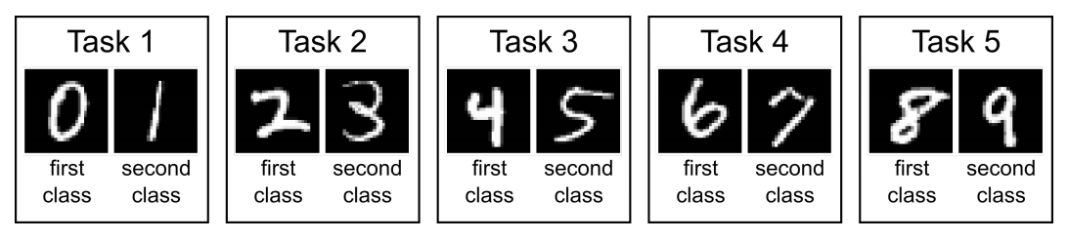
Evaluation
https://arxiv.org/pdf/1904.07734.pdf
First of all, we need a sequence of tasks.

Slide 15
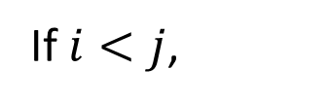
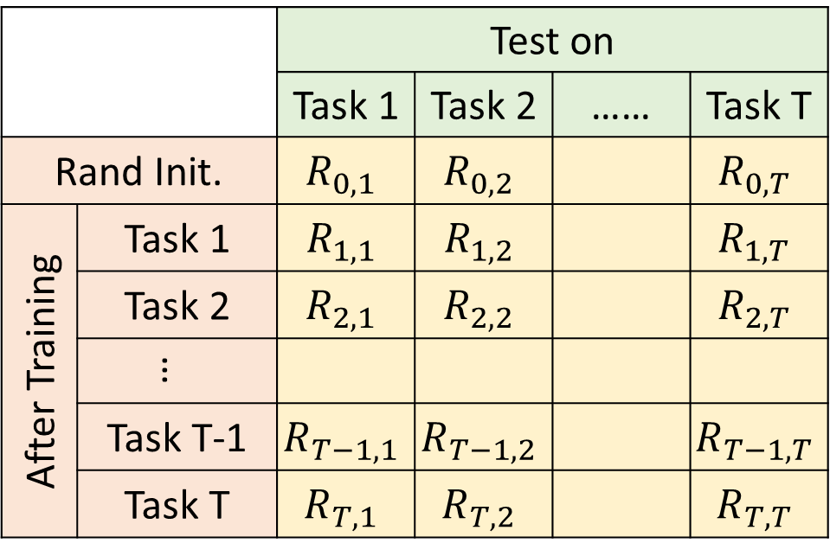
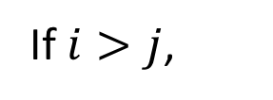
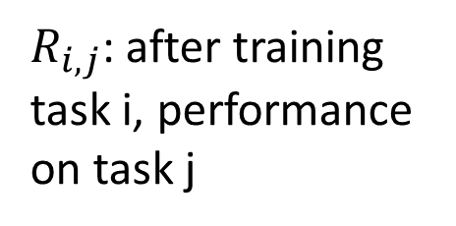
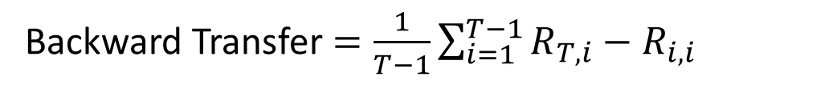
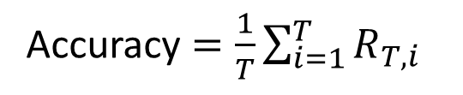
 |  | Test on
 |  | Task 1 | Task 2 | …… | Task T
Rand Init. |  | $$R_{0,1}$$ | $$R_{0,2}$$ |  | $$R_{0,T}$$
After Training | Task 1 | $$R_{1,1}$$ | $$R_{1,2}$$ |  | $$R_{1,T}$$
 | Task 2 | $$R_{2,1}$$ | $$R_{2,2}$$ |  | $$R_{2,T}$$
 | …
 | Task T-1 | $$R_{T−1,1}$$ | $$R_{T−1,2}$$ |  | $$R_{T−1,T}$$
 | Task T | $$R_{T,1}$$ | $$R_{T,2}$$ |  | $$R_{T,T}$$
Evaluation
$R_{i,j}$: after training task i, performance on task j
If $i>j$,
After training task i, does task j be forgot
If $i<j$,
Accuracy $=\frac{1}{T}\sum_{i=1}^{T}{R_{T,i}}$
Can we transfer the skill of task i to task j
Backward Transfer $=\frac{1}{T−1}\sum_{i=1}^{T−1}{R_{T,i}−R_{i,i}}$
(It is usually negative.)
Notes:
GEM

Slide 16
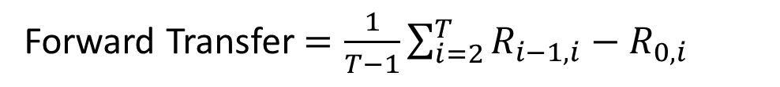
 |  | Test on
 |  | Task 1 | Task 2 | …… | Task T
Rand Init. |  | $$R_{0,1}$$ | $$R_{0,2}$$ |  | $$R_{0,T}$$
After Training | Task 1 | $$R_{1,1}$$ | $$R_{1,2}$$ |  | $$R_{1,T}$$
 | Task 2 | $$R_{2,1}$$ | $$R_{2,2}$$ |  | $$R_{2,T}$$
 | …
 | Task T-1 | $$R_{T−1,1}$$ | $$R_{T−1,2}$$ |  | $$R_{T−1,T}$$
 | Task T | $$R_{T,1}$$ | $$R_{T,2}$$ |  | $$R_{T,T}$$
Evaluation
$R_{i,j}$: after training task i, performance on task j
If $i>j$,
After training task i, does task j be forgot
If $i<j$,
Accuracy $=\frac{1}{T}\sum_{i=1}^{T}{R_{T,i}}$
Can we transfer the skill of task i to task j
Backward Transfer $=\frac{1}{T−1}\sum_{i=1}^{T−1}{R_{T,i}−R_{i,i}}$
Forward Transfer $=\frac{1}{T−1}\sum_{i=2}^{T}{R_{i−1,i}−R_{0,i}}$
Notes:
GEM

Slide 17
Research Directions
Selective Synaptic Plasticity
Additional Neural Resource Allocation
Memory Reply
突觸的
可塑性
Regularization-based Approach

Slide 18









Why Catastrophic Forgetting?
Task 1
Task 2
$$θ^{0}$$
$$θ^{∗}$$
$$θ^{∗}$$
$$θ_{2}$$
$$θ_{2}$$
Forget!
?
$$θ^{b}$$
$$θ^{b}$$
$$θ_{1}$$
$$θ_{1}$$
The error surfaces of tasks 1 & 2.
(darker = smaller loss)

Slide 19
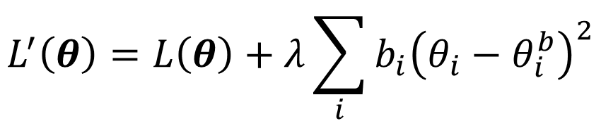
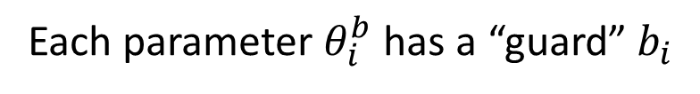
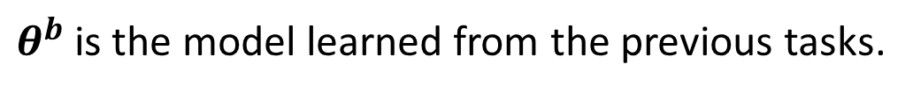
Selective Synaptic Plasticity
Basic Idea: Some parameters in the model are important to the previous tasks. Only change the unimportant parameters.
$θ^{b}$ is the model learned from the previous tasks.
Each parameter $θ_{i}^{b}$ has a “guard” $b_{i}$
How important this parameter is
Loss for current task
$$L^{′}\left(θ\right)=L\left(θ\right)+λ\sum_{i}{b_{i}{\left(θ_{i}−θ_{i}^{b}\right)}^{2}}$$
Loss to be optimized
Parameters to be learning
Parameters learned from previous task
Notes:
Elastic adj.
有彈性的
Consolidation鞏固，加強，強化

Slide 20
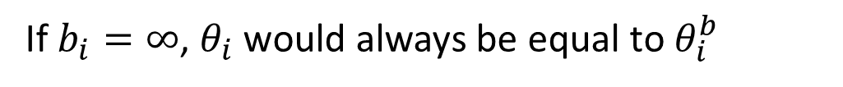
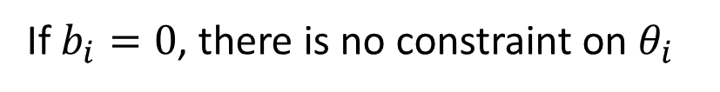
Selective Synaptic Plasticity
Basic Idea: Some parameters in the model are important to the previous tasks. Only change the unimportant parameters.
$θ^{b}$ is the model learned from the previous tasks.
Each parameter $θ_{i}^{b}$ has a “guard” $b_{i}$
$θ$ should be close to $θ^{b}$ in certain directions.
$$L^{′}\left(θ\right)=L\left(θ\right)+λ\sum_{i}{b_{i}{\left(θ_{i}−θ_{i}^{b}\right)}^{2}}$$
If $b_{i}=0$, there is no constraint on $θ_{i}$
Catastrophic Forgetting
If $b_{i}=∞$, $θ_{i}$ would always be equal to $θ_{i}^{b}$
Intransigence
Notes:
Intransigence
不妥協；不讓步

Slide 21


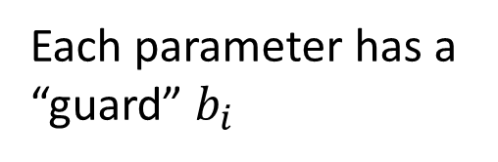

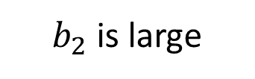

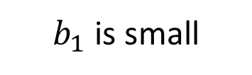
Selective Synaptic Plasticity
Task 1
$$θ_{1}^{b}$$
$$θ^{0}$$
$$θ_{1}$$
can be changed ☺
$b_{1}$ is small
$$θ_{2}$$
$$θ_{2}^{b}$$
$$θ^{b}$$
$$θ_{1}$$
$$θ_{2}$$
don’t touch it!
Each parameter has a “guard” $b_{i}$
$b_{2}$ is large

Slide 22


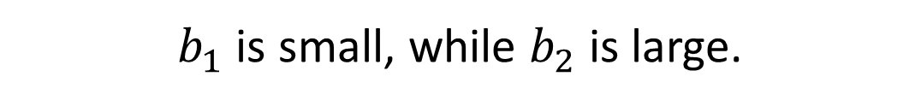

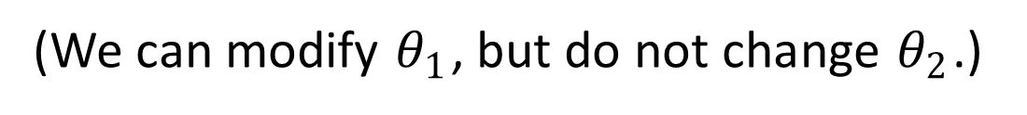
Selective Synaptic Plasticity
Task 1
Task 2
$$θ^{0}$$
Do not forget!
$$θ^{∗}$$
$$θ_{2}$$
$$θ_{2}$$
$$θ^{∗}$$
$$θ^{∗}$$
$$θ^{b}$$
$$θ^{b}$$
$$θ_{1}$$
$$θ_{1}$$
$b_{1}$ is small, while $b_{2}$ is large.
(We can modify $θ_{1}$, but do not change $θ_{2}$.)

Slide 23
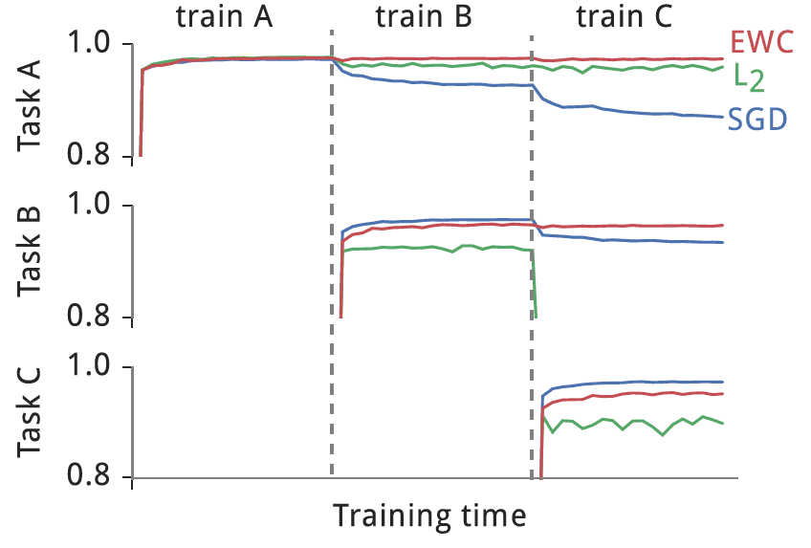

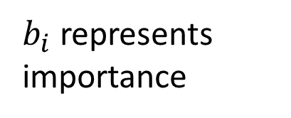

Selective Synaptic Plasticity
$b_{i}$ represents importance
$$b_{i}=1$$
$$b_{i}=0$$
Intransigence
MNIST permutation, from the original EWC paper

Slide 24
Selective Synaptic Plasticity
Elastic Weight Consolidation (EWC)
https://arxiv.org/abs/1612.00796
Synaptic Intelligence (SI)
https://arxiv.org/abs/1703.04200
Memory Aware Synapses (MAS)
https://arxiv.org/abs/1711.09601
RWalk
https://arxiv.org/abs/1801.10112
Sliced Cramer Preservation (SCP)
https://openreview.net/forum?id=BJge3TNKwH
Notes:
We then propose a fundamentally different class of preservation methods that aim at preserving the distribution of internal neural representations for previous tasks while learning a new one. We propose the sliced Cram\'{e}r distance as a suitable choice for such preservation and evaluate our Sliced Cramer Preservation (SCP) algorithm through extensive empirical investigations on various network architectures in both supervised and unsupervised learning settings. We show that SCP consistently utilizes the learning capacity of the network better than online-EWC and MAS methods on various incremental learning tasks.
==
Synaptic: 突觸的
Synapsis: 突觸
EWC: pdf
https://pdfs.semanticscholar.org/ee89/738fcc69212b36fb990389d817b5fb7e486b.pdf
https://github.com/moskomule/ewc.pytorch/blob/master/demo.ipynb

Slide 25








Gradient Episodic Memory (GEM)
https://arxiv.org/abs/1706.08840
Task 1
Task 2
$$θ^{0}$$
$$g$$
as close as possible
$$θ^{b}$$
$$g′$$
$$θ^{b}$$
$$g^{b}$$
$$g^{b}$$
$$g′∙g^{b}≥0$$
: negative gradient of current task
: negative gradient of previous task
Need the data from the previous tasks
: update direction
Notes:
Episodic （戲劇、小說等）插曲多的；情節不連貫的；插曲式的

Slide 26
Research Directions
Selective Synaptic Plasticity
Additional Neural Resource Allocation
Memory Reply

Slide 27
Progressive Neural Networks
Task 1
Task 2
Task 3
input
input
input
https://arxiv.org/abs/1606.04671
Notes:
https://arxiv.org/pdf/1606.04671v3.pdf

Slide 28
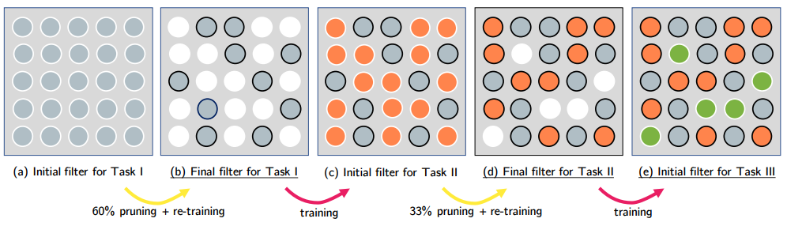
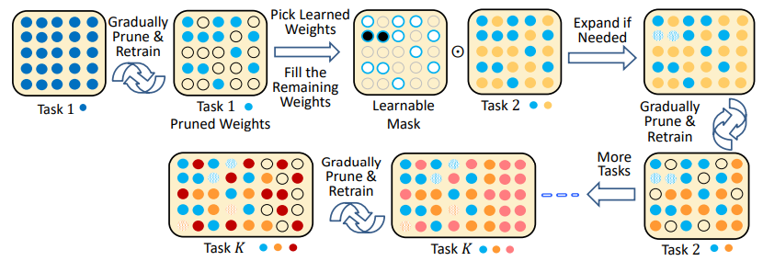
PackNet
https://arxiv.org/abs/1711.05769
Compacting, Picking, and Growing (CPG)
https://arxiv.org/abs/1910.06562
Notes:
I need to check these approaches !

Slide 29
Research Directions
Selective Synaptic Plasticity
Additional Neural Resource Allocation
Memory Reply

Slide 30
https://arxiv.org/abs/1705.08690
https://arxiv.org/abs/1711.10563
https://arxiv.org/abs/1909.03329
Generating Data
Generating pseudo-data using generative model for previous tasks
Generate task 1 data
Generate
task 1&2 data
Training Data
for Task 1
Training Data
for Task 2
Multi-task
Learning
Solve task 1
Solve task 2
Notes:
Shin, H., Lee, J. K., Kim, J. & Kim, J. (2017), Continual learning with deep generative replay,
NIPS’17, Long Beach, CA
Kemker, R. & Kanan, C. (2018), Fearnet: Brain-inspired model for incremental learning, ICLR’18,
Vancouver, Canada.

Slide 31
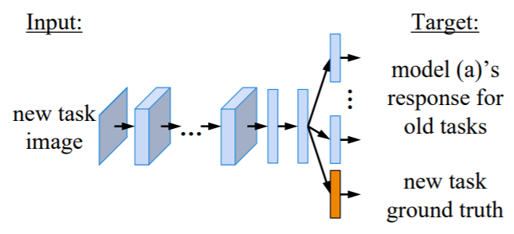
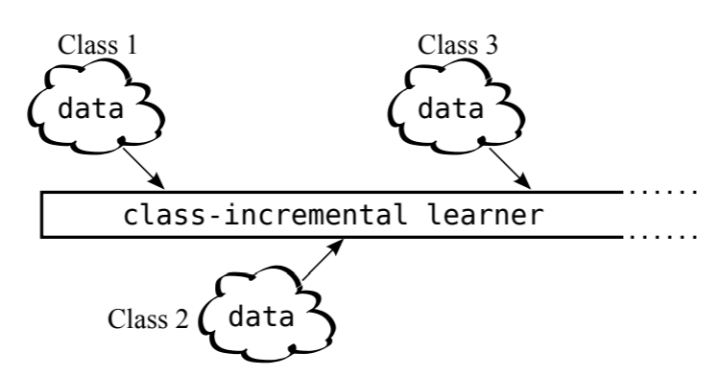
Adding new classes
Learning without forgetting (LwF)
https://arxiv.org/abs/1606.09282
iCaRL: Incremental Classifier and Representation Learning
https://arxiv.org/abs/1611.07725
Three scenarios for continual learning
https://arxiv.org/abs/1904.07734

Slide 32
Concluding Remarks
Memory Reply
Additional Neural Resource Allocation
Selective Synaptic Plasticity

Slide 33
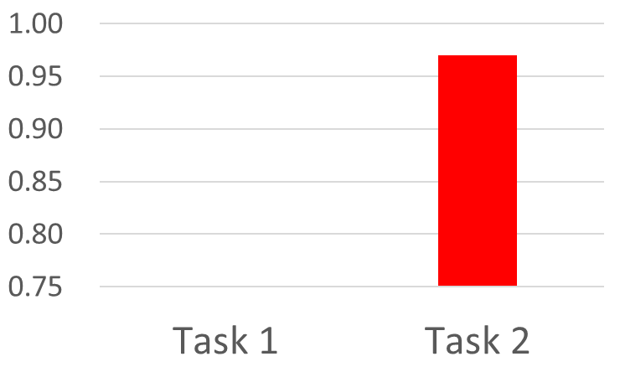

Curriculum Learning
: what is the proper learning order?
Task 1
Task 2
96%
97%
90%
Forget!!!
80%
Task 2
Task 1
97%
97%
90%
62%

Slide 34
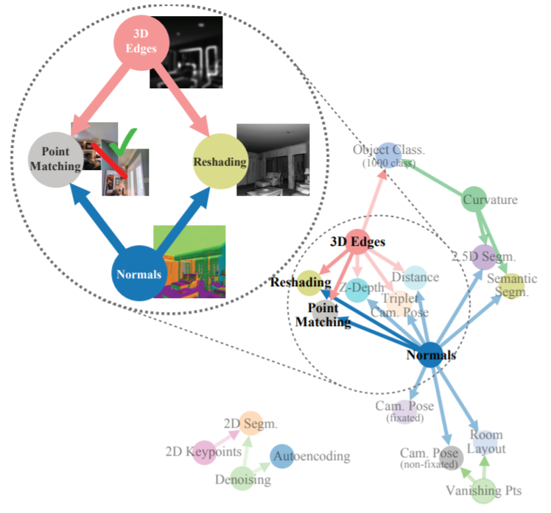
taskonomy
= task + taxonomy
(分類學)
http://taskonomy.stanford.edu/#abstract

